Slide 1
Weeks 1 and 2 APRIL 20TH to May 3rd 2020
Week 1. Termly 3 hour drawing assessment of young homeless woman. This drawing should be improved from your last two.
Week 2. You will create an artists research page on the Artist; AUGUSTUS JOHN
Many of you have created very small drawings of his college friend. You need to draw this portrait A5 size, looking at the way the artist uses light on the young man’s face.

Slide 2
Termly Drawing assessment
You are to draw from the same photograph of the young woman, this is for you to see your progress from September, January then now April.
You must add shape carefully, looking 70% and drawing 30%.
Think about shapes of features being objects so you draw objectively not being overwhelmed by the subject matter of young women being homeless, draw her face the shape of a fruit bowl, her eyes; almonds, her nose a small pear and her lips; a slice of lemon.

Slide 3
Your test is for 3 hours so take your time, use a pencil, draw on A4 paper
You can use the warming up exercises on the next slide if you have not drawn for a while.
Then add your shapes, markmaking, texture, look for detail then build up tones, adding the strong use of light to the left side of the woman’s face. This will give the face 3D effect like Augustus John’s drawing we looked at in September and you will be relooking at next week.
https://www.bbc.com/bitesize/guides/zyv397h/revision/1

Slide 4
Starter warm up exercises 2 minutes each
Arrow of Progress
Discovering
Developing
Securing
Mastering
Continual line
Opposite hand
Not looking at the page
Tone only

Slide 5
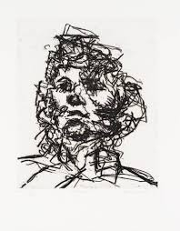
Markmaking skills
Arrow of Progress
Discovering
Developing
Securing
Mastering

Slide 7
Arrow of Progress
Discovering
Developing
Securing
Mastering
50 Mins to concentrate on observation and shape.
50 mins to focus on detail and texture.
50 mins to apply tone and shadow.
20 Mins to self assess your work.

Slide 8
How many of the markmaking techniques on the next slide can you use building up the textures and tones on the young woman’s face, hair and hands?

Slide 9
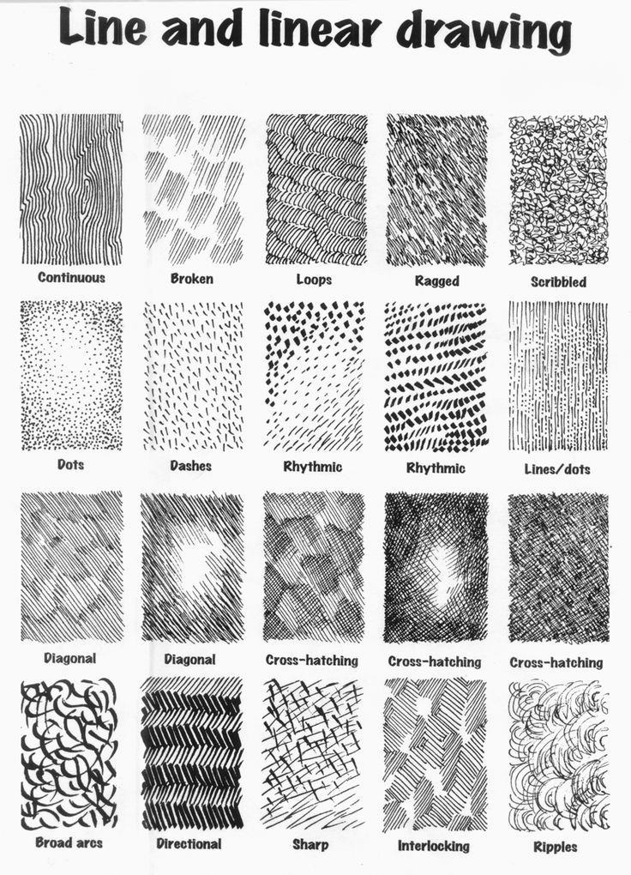

Slide 10
Arrow of Progress
Discovering
Developing
Securing
Mastering
Learning objective:
Observational drawing skills focussing on the formal elements.
GCSE KEYWORDS
OBSERVATION, SHAPE, DETAIL, TONE, SHADOW, TEXTURE, MARK MAKING.
Learning outcome: Drawing baseline test
Must: Demonstrate skills in observation and shape. Grade C/4
Challenge: Explore the application of detail through the use of Mark Making.
Grade B/6
Stretch: Analyse where tone could be added to your work. Grade A/8
Extension: Evaluate your composition and refine your work by adding detail through mark-making Grade A*/9

Slide 11
Arrow of Progress
Discovering
Developing
Securing
Mastering
Self Assessment
Assess your art work from today’s lesson. Write your WWW’s and EBI’s for drawing.

Slide 12
Arrow of Progress
Discovering
Developing
Securing
Mastering
Blooms Questions
Is my drawing detailed?
What makes a drawing tonal?
Why should a drawing have detail?
Should a drawing always be tonal?
Describe why tone should be added densely?
What stands out as being effective in this drawing? Why?
Do you think you have added tonal range? Why?
How did you use detail?
Why did you use expressive marks?
How could this drawing reach a higher level?

Slide 13
Week 2 studying an artist’s drawing
Compare your drawing from last week to Augustus John’s drawing of his college friend in 1903.
How has he used light on the young man’s face? Does this make the portrait look 3D?
How has he drawn the hair? Has he used lines to show each strand of hair then horizontal lines to show each section so it looks like layers of hair on a human head not straw? Does the hair have light hitting it? Where? How has he drawn the clothes?

Slide 14
Your 3 hour assessment drawing from last week of a young woman
Compare your drawing of hair on the woman portrait compared to how Augustus John draws hair?
Have you left light on your portrait of the woman? How has the artist added light on his friend’s face?
Describe sections of yours and the artist’s portrait of detail, markmaking, 5 ranges of tone and loose quick texture?

Slide 15
Draw an A5 portrait of the following slide of Augustus John’s friend
The last 2 slides of questions should have taken you 15 minutes to answer.
Now you need to look at the drawing by Augustus John for 70% and drawing for 30 % of the next one hour.
You have 45 minutes to fill an A5 page copying the artist’s techniques thinking about the questions you answered for the first 15 minutes.

Slide 17
When you have finished your 45 minute Augustus John’s portrait, answer the following questions.
Did your recent drawing of AUGUSTUS JOHN’S friend improve after answering the questions in the first 15 minutes?
Is this portrait improved from the drawing you did in September of the college friend?
What improvements are you happy with over the last 2 weeks relooking at an artist and on your assessment portrait?

Slide 18
For the next 30 minutes Answer the following blooms questions in full sentences on the next slide on spare paper. An example; ‘I would describe Augustus John’s portrait of his friend as a well expressively drawn portrait with three different ways of drawing skills. Hair is realistic, face looks 3D as has light hitting it on the sitter’s left side and the clothes are drawn quickly with mark making’. You will create a finished art research page in the last hour, follow the slides until the end. You will need to bring all art work to Art when we are back in school.

Slide 19
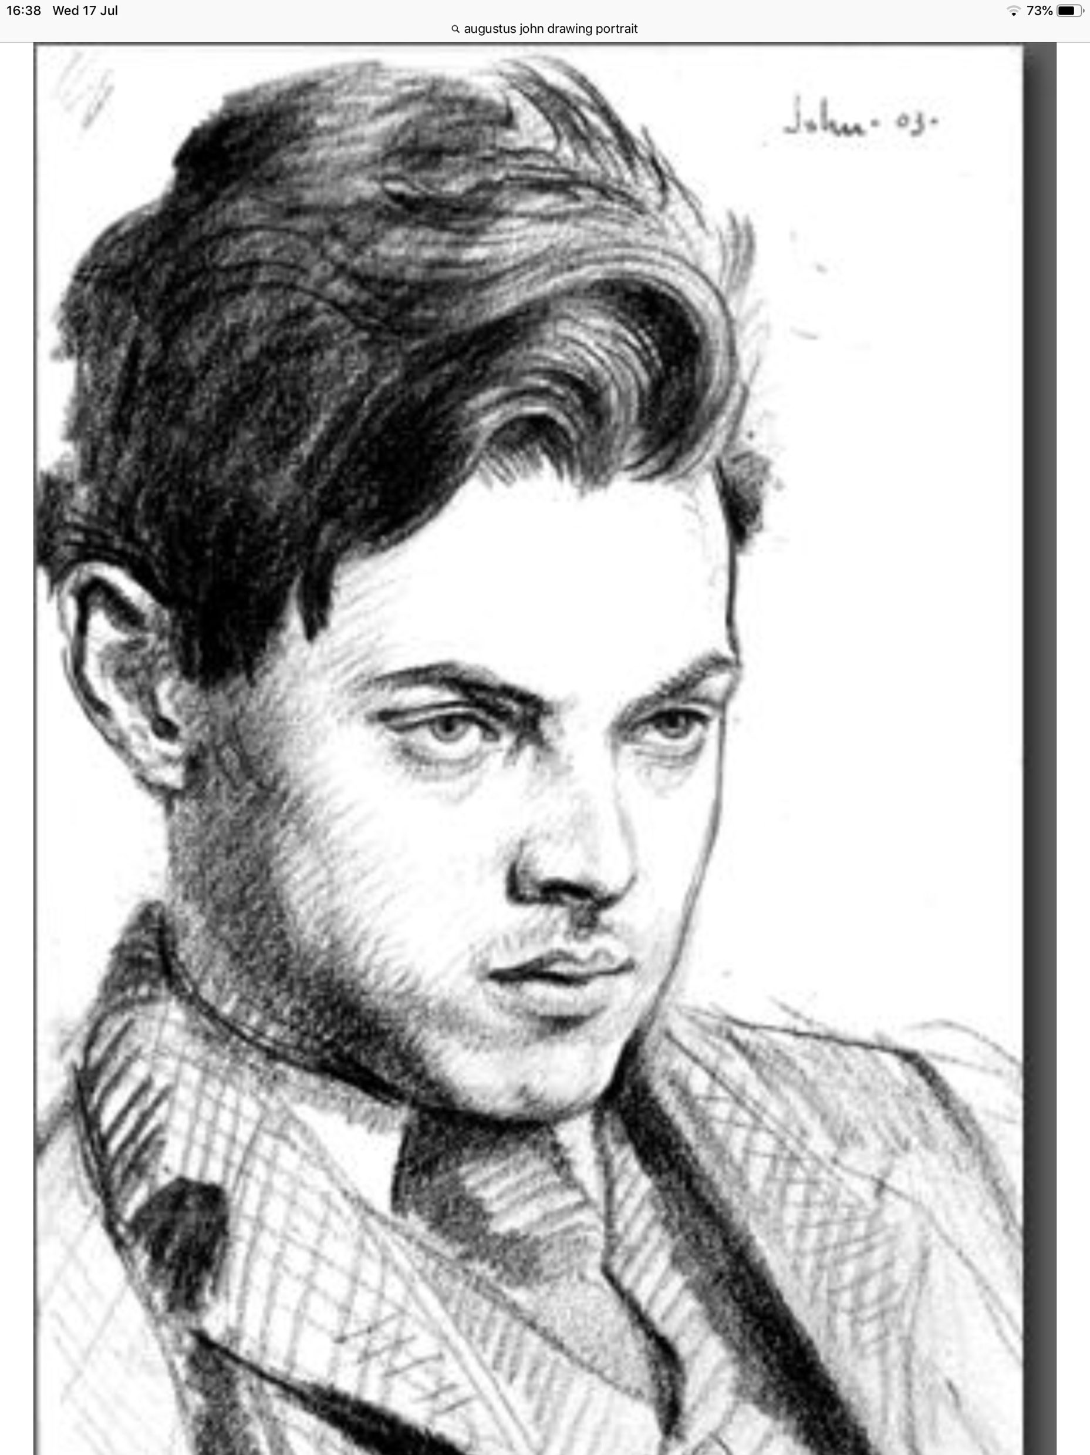
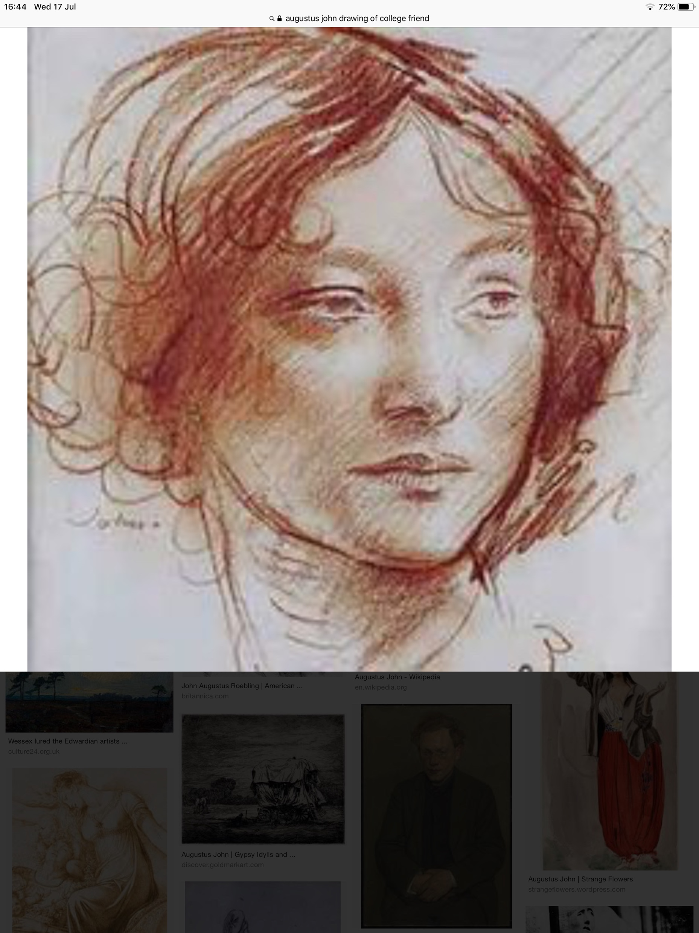
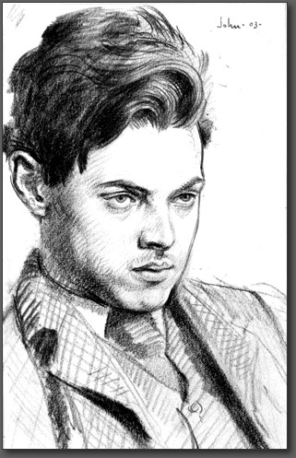
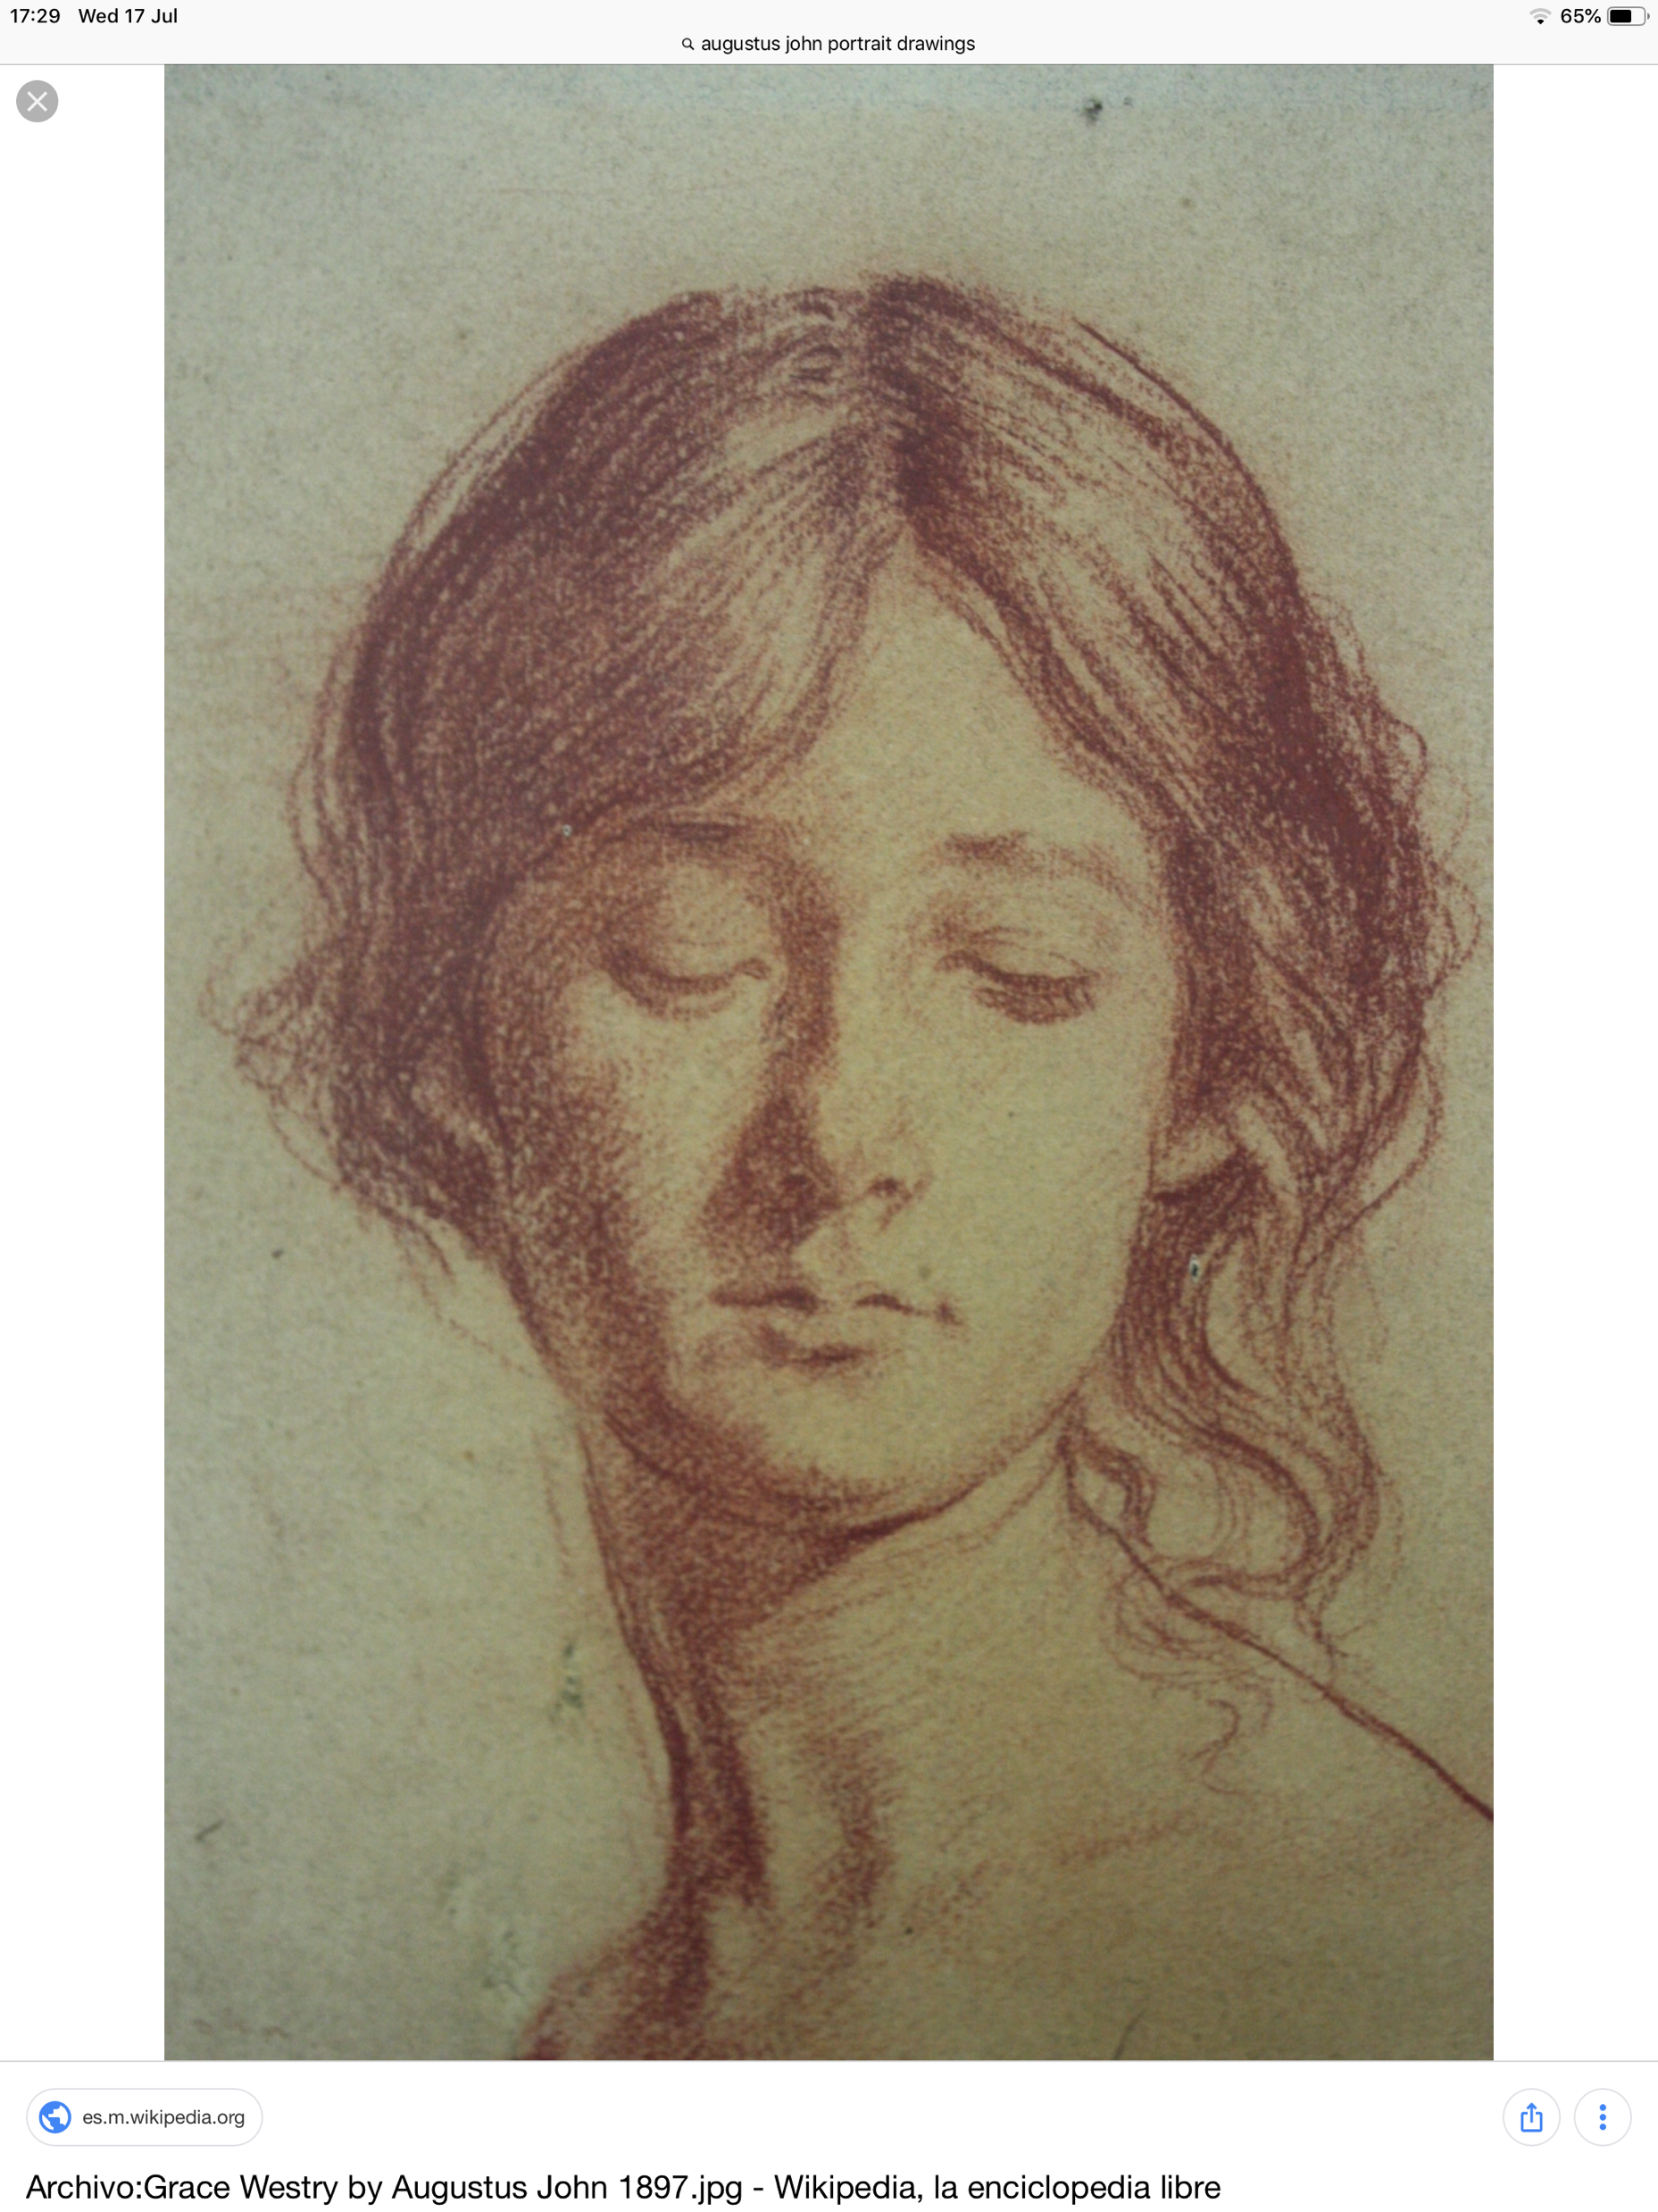
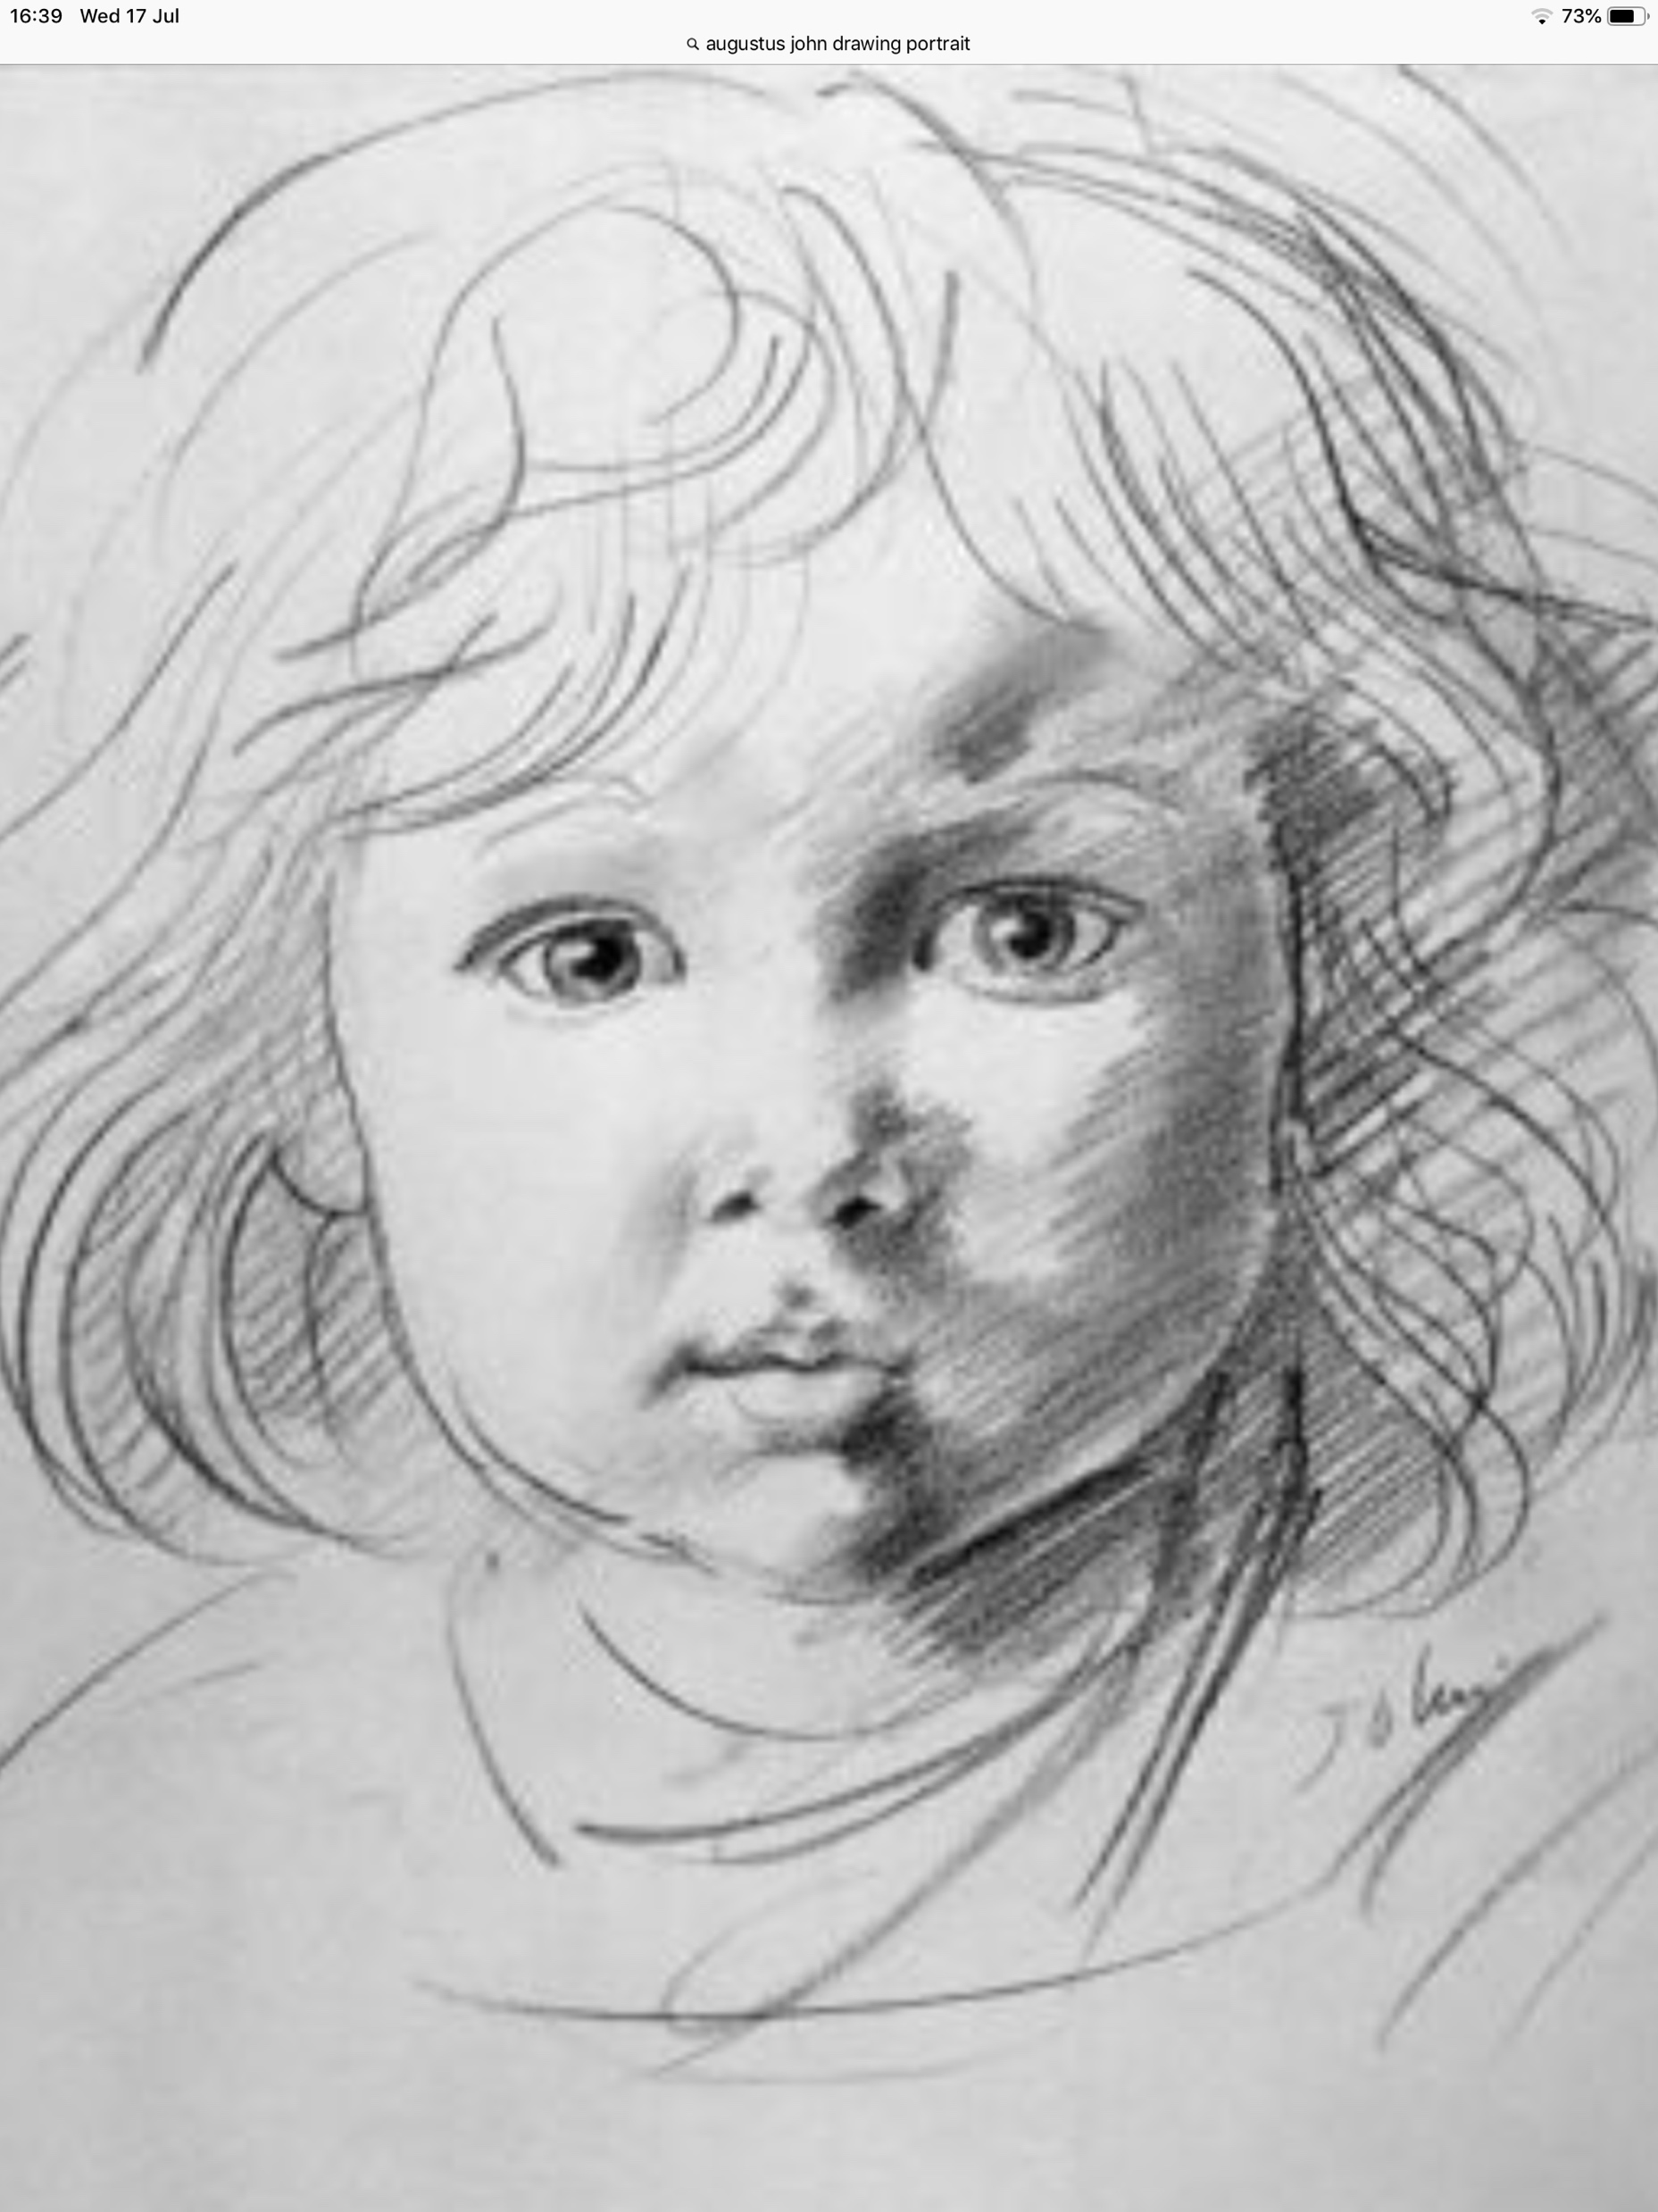
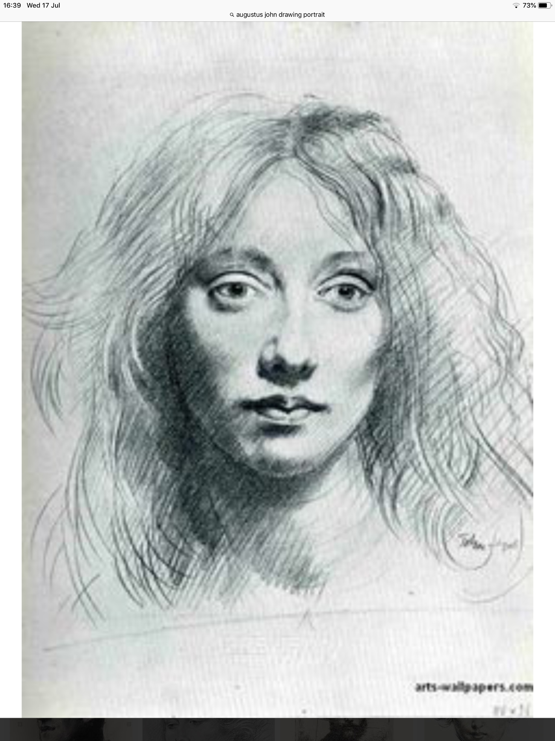
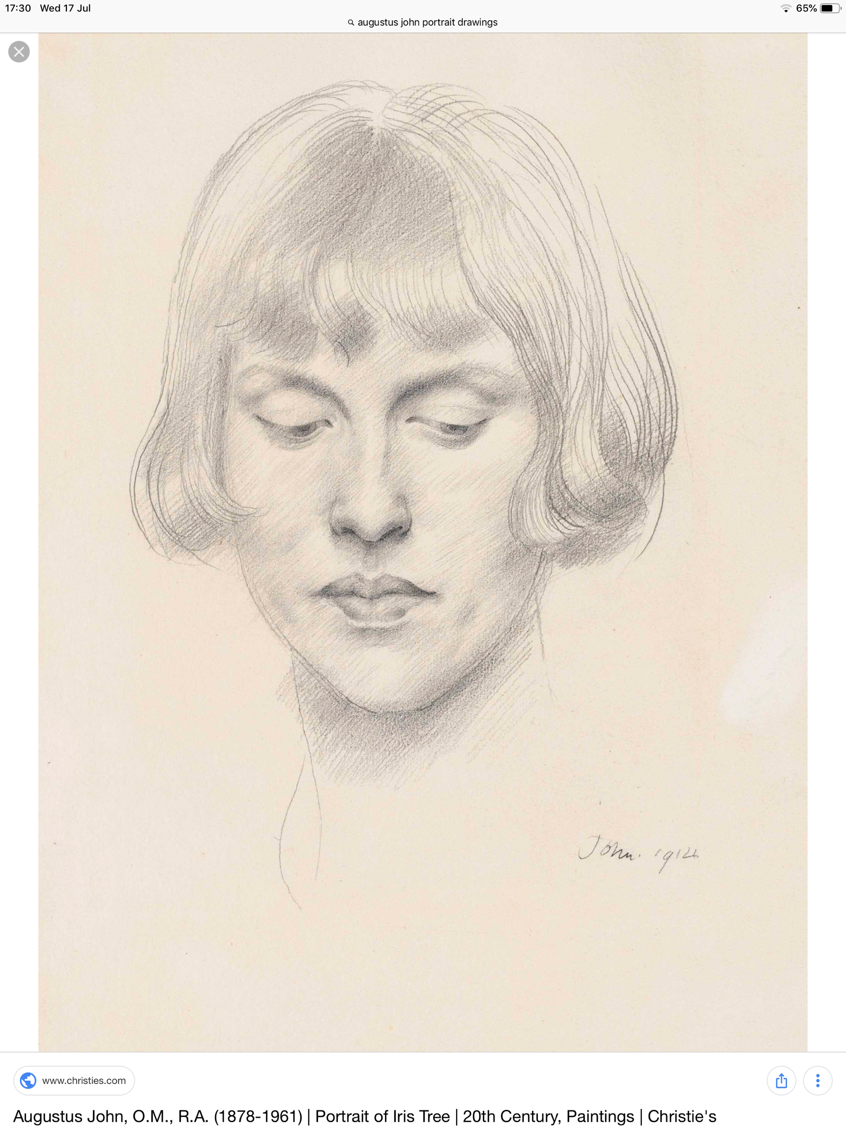
Augustus John
Augustus John
1. DESCRIBE, What words would you use to describe this work?
2. RELATE, What things do you recognise in this work? What things seem new to you?
3. ANALYSE, What colour is used the most in his work? Look at colour examples.
4. INTERPRET, What title would you give to this work? What made you decide on that title?
5. EVALUATE, What do you think is good about this work? What is not so good?

Slide 20
For the next 30 mins you must research AUGUSTUS JOHN
Online
Answering ten questions on the next slide
Using the word bank to support your writing, writing at this level will help you achieve a higher grade.
You will add this information to your artist page.
Look at the last slide for inspiration how to create an interesting GCSE artist research page.
https://www.bbc.com/bitesize/guides/zwk82nb/revision/1

Slide 22
Adding the two lots of information you have researched and your drawing of AUGUSTUS JOHN’S friend you should create an artist research page like the one on the next slide.
You can use collage, tea stain (NO MILK) and add keywords.
Be as creative as you want for your last 1 hour.

Slide 23
All the art work you create for the next 14 weeks is part of your GCSE Art course.
You must spend the time allocated as these are the lessons when at school.
You must follow each task to your best ability.
All the art work achieved over the 14 weeks is to be brought in to your next art lesson when we are back at school.

Slide 24
An Example of GCSE art student’s grade 6 artist’s research pages
Newspaper
collage
Artist’s name
Information about artist
Information about artist
Brown
Paper
Tea stain
Tracing paper
Drawings of artists artwork

