Slide 1
Year 8 weeks 1 and 2 (April 20th to 3rd May)
You drew cans or shoes in September and January and now you need to complete your test in 1 hour for summer term’s assessment.
Draw on A4 paper with a pencil and bring to art when we are back at school.

Slide 2
You can complete the warm up exercises on the next slide if you have not drawn for a while before you start your 1 hour drawing of a drinks can.

Slide 3
Starter warm up exercises 2 minutes each
Arrow of Progress
Discovering
Developing
Securing
Mastering
Continual line
Opposite hand
Not looking at the page
Tone only

Slide 4
Set up your drinks can or cans, you can place on a spare piece of paper so you can see shadows easily.
Are you setting up a composition of more than one drinks can to achieve a higher level?
You can shine light on to the drinks can so you can see tones carefully and shadow on the opposite side
Use the next slide to help you divide your 1 hour drawing test
Divide your hour into 15 minute sections; shape, detail, markmaking, tones and shadows
https://www.bbc.com/bitesize/guides/zyv397h/revision/1

Slide 5
Arrow of Progress
Discovering
Developing
Securing
Mastering
15 mins to concentrate on observation and shape.
15 mins to focus on detail and texture.
15 mins to apply tone and shadow.
5 mins to self assess your work.

Slide 6
The following slides show you what each level the drawing of cans are. Compare your finished drawing to see which level you think your drawing is.
When you have completed your observational drawing you must assess it using 2 WWWs and 1 EBI on your paper
Examples; WWW: I have added realistic shape. WWW: my use of tone makes the can look three dimensional
EBI: I need to practise my detail of text/writing on the can.

Slide 7
Arrow of Progress
Discovering
Developing
Securing
Mastering
Learning objective:
Observational drawing skills focussing on the formal elements.
GCSE KEYWORDS
OBSERVATION, SHAPE, DETAIL, TONE, SHADOW, TEXTURE, MARK MAKING.
Learning outcome: Drawing baseline test
Must: Demonstrate skills in observation and shape. Grade C/4
Challenge: Explore the application of detail through the use of Mark Making.
Grade B/6
Stretch: Analyse where tone could be added to your work. Grade A/8
Extension: Evaluate your composition and refine your work by adding detail through mark-making Grade A*/9

Slide 8
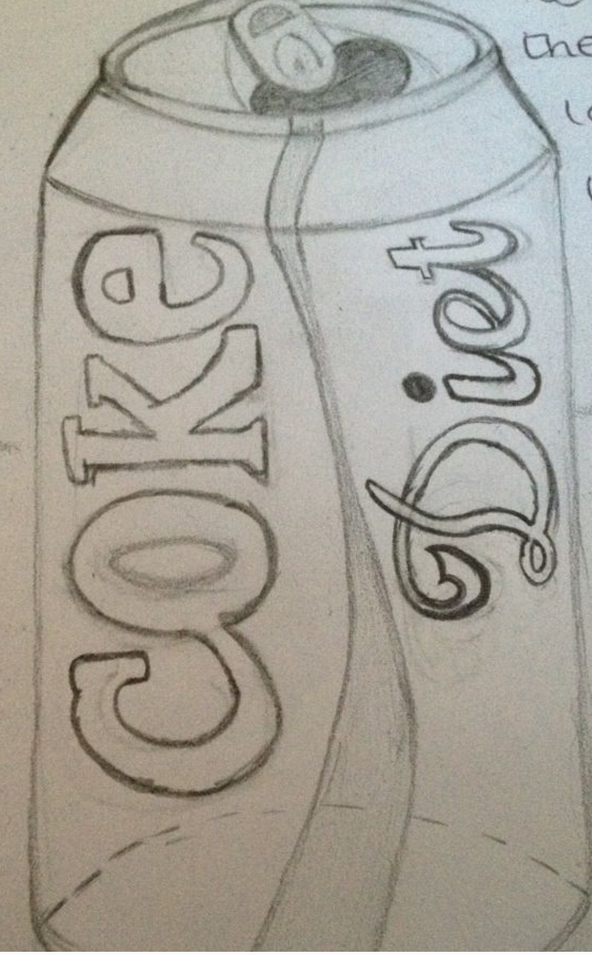
Arrow of Progress
Discovering
Developing
Securing
Mastering
Can Drawing Level 4 DISCOVERING

Slide 9
Arrow of Progress
Discovering
Developing
Securing
Mastering
Can Drawing Level 5 DEVELOPING

Slide 10
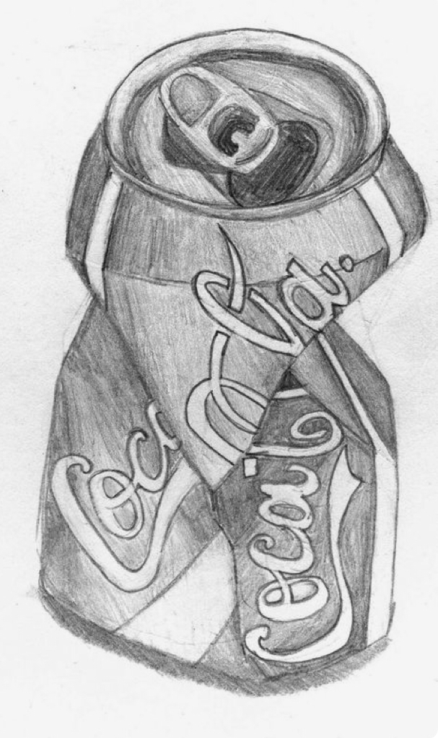
Arrow of Progress
Discovering
Developing
Securing
Mastering
Can Drawing Level 6 SECURING

Slide 11
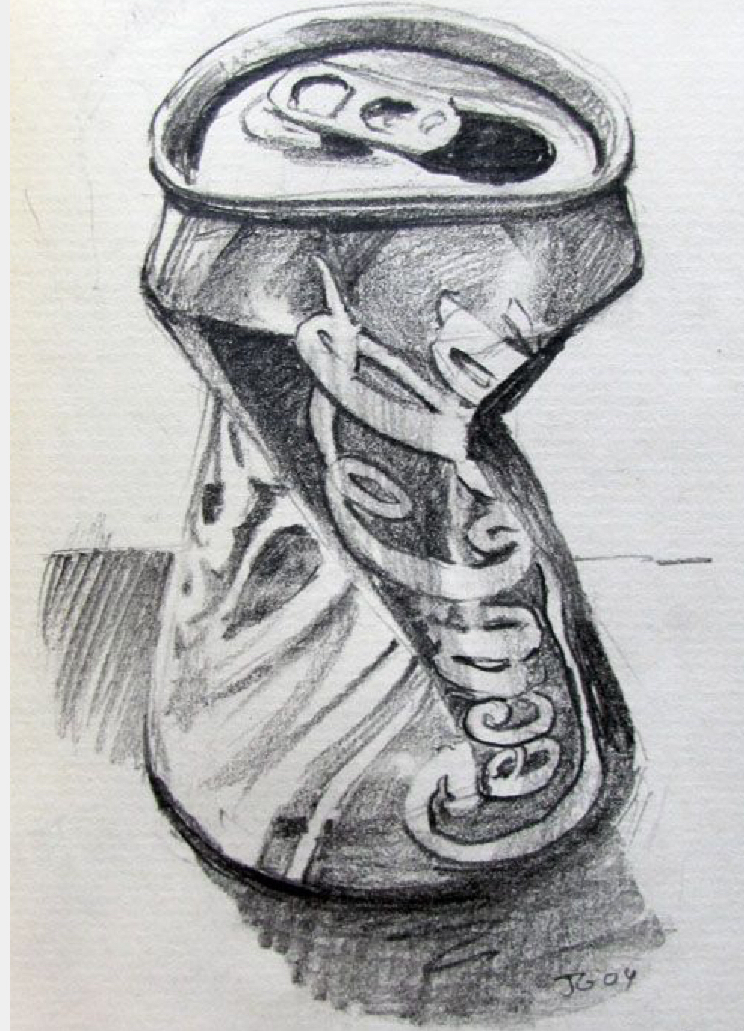
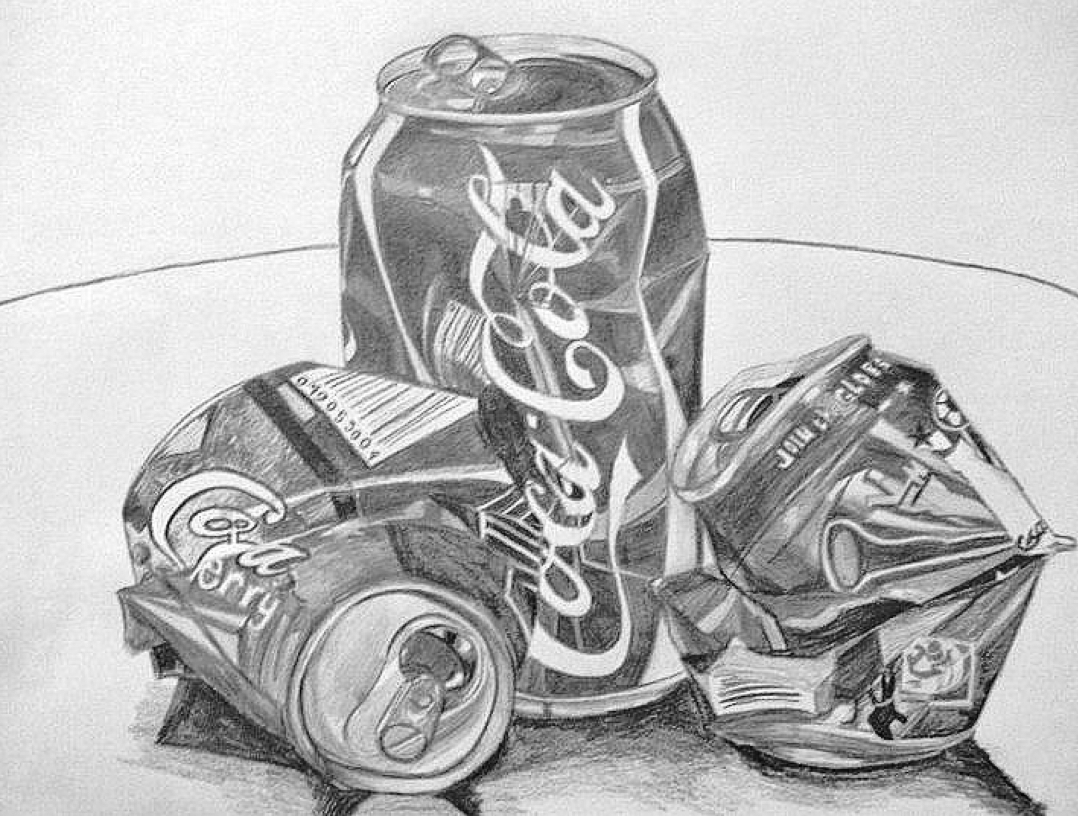
Arrow of Progress
Discovering
Developing
Securing
Mastering
Can Drawing Level 7 MASTERING

Slide 12
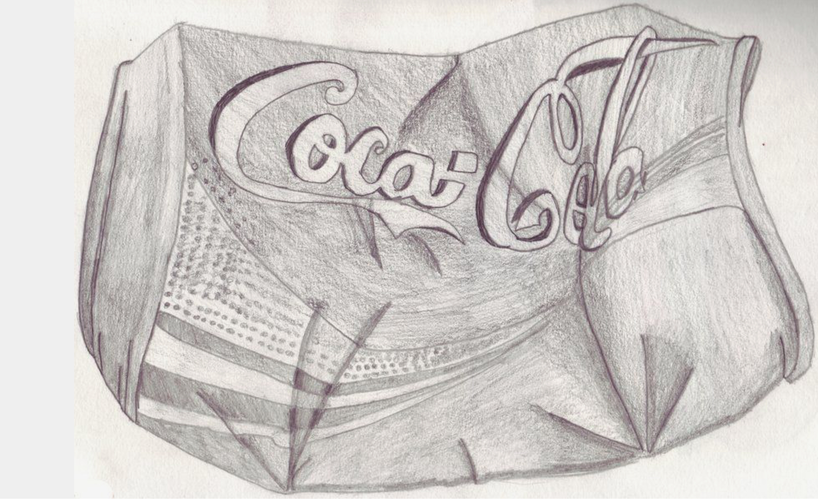
Arrow of Progress
Discovering
Developing
Securing
Mastering

Slide 13
How much mark making on the next slide can you use on your drawing of drinking can/cans?

Slide 15
Arrow of Progress
Discovering
Developing
Securing
Mastering
Assess your art work from today’s 1 hour lesson using WWW’s and EBI’s on your can drawing.

Slide 16
Arrow of Progress
Discovering
Developing
Securing
Mastering
Blooms Questions
Is this drawing detailed?
What makes a drawing tonal?
Why should a drawing have detail?
Should a drawing always be tonal?
Describe why tone should be added densely?
What stands out as being effective in this drawing? Why?
What do you think about your tonal range?
How did you use detail?
Why did you use expressive marks?
How could this drawing reach a higher level?

Slide 17
Year 8 week 2 (one hour)
You are to complete an artist research page on A4 or A3 PAPER . Look at end slide for inspiration.
The GCSE student added tea stain (no milk), newspaper, brown paper, tracing paper to decorate her artist’s research page.
Draw with pencil, pen and use collage or paint. Bring to Art when we are back at school.
The artist you will research is DAVID PAYTON
who draws cans with pens on brown paper.

Slide 18
You are to add the artist’s name at the top of the paper and then answer the blooms questions see the next slide. Then add drawings copying David Payton’s cans adding them around the writing.When answering the questions write more than one word e.g ‘I would describe the artists work as realistic, three dimensional and colourful’.
https://www.bbc.com/bitesize/guides/zwk82nb/revision/1

Slide 19
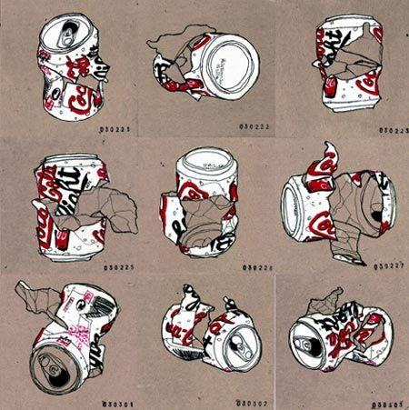
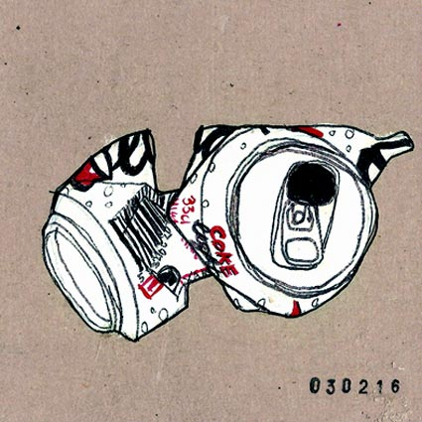
David Payton
1. DESCRIBE, What words would you use to describe this work?
2. RELATE, What things do you recognise in this work? What things seem new to you?
3. ANALYSE, What colour is used the most in his work? Look at colour examples.
4. INTERPRET, What title would you give to this work? What made you decide on that title?
5. EVALUATE, What do you think is good about this work? What is not so good?

Slide 20
An Example of GCSE art student’s grade 6 artist’s research pages
Newspaper
collage
Artist’s name
Information about artist
Information about artist
Brown
Paper
Tea stain
Tracing paper
Drawings of artists artwork

