Slide 1
Unit 3 - Training for Personal Fitness
Learning objectives
Design a personal fitness training programme
Know about the musculoskeletal system and cardiorespiratory system and the effects on the body during fitness training
Implement a self-designed personal fitness training programme to achieve own goals and objectives
Review a personal fitness training programme.

Slide 2
Scenario
Your local sports centre has launched a ‘Get Fit’ initiative for schools and colleges in the area. You can participate in this initiative to improve your chosen activity/sport from Unit 2: Practical Performance in Sport.
You should safely incorporate any training method you like into your programme but it needs to relate to your chosen activity/sport from Unit 2. This is your chance to make sure your training is as exciting and fun as possible! Make sure you include everything you need to make your training programme effective.

Slide 3
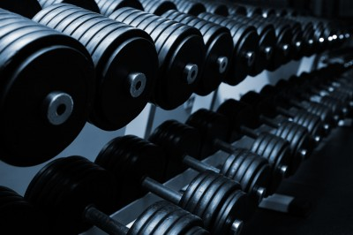
Section A
Design a personal fitness training programme
Notes:
Photo: © 123RF Limited

Slide 4
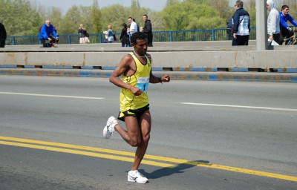
Personal information to aid training programme design
When a coach or trainer produce a training plan they will consider a number of guidelines to maximum the benefit for the athlete. If the training suits the performer the desired result will be achieved.
Notes:
Photo: © 123RF Limited

Slide 5
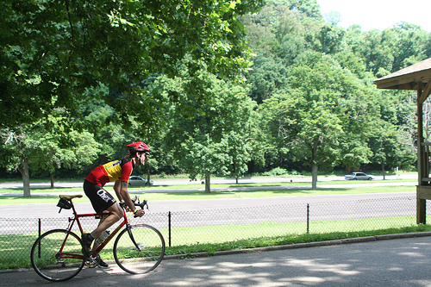
Setting personal goals
Watch me
How might setting goals help an athlete improve?
Notes:
Photo by: © ndanger on Flickr. This image is reproduced under the terms of the Creative Commons License 2.0. http://www.flickr.com/photos/ndanger/778074359/

Slide 6
Setting personal goals
Goal setting is the first step in designing a training programme. These should be agreed with your coach and should follow the SMARTER principle:
Notes:
Photo: © London 2012

Slide 7
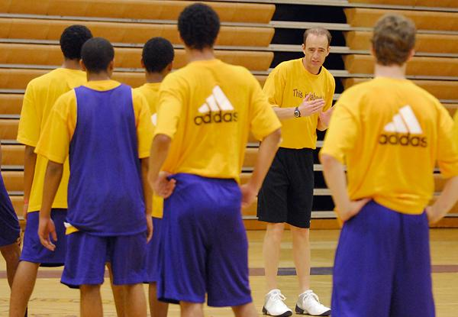
Specific – targets must to the point.
Measureable – can it be measured and compared.
Achievable – the target must be challenging but yet reachable.
Realistic – matched to the performers skill level.
Time related – Set for a particular time to be completed.
Evaluated – After completion or time frame has expired reflection is vital.
Rewarded – Athletes should feel praised for successfully achieved goals.
Setting personal goals
When setting goals athletes should apply the SMARTER principle.

Slide 8
Setting personal goals
Bobby is a 100m sprinter and has set the following targets below using the SMARTER principle in order to optimise his performance on the track.
Specific – “To take a 0.5 second off my time personal best time”
Measureable – “I will time my runs every training session for the next five weeks of training”
Achievable – “My coach and I devised the training programme around improving leg strength and power, and reactions for my start”
Realistic – “We agreed that a 0.5 seconds off my personal best is realistic for my current ability and status“
Time related – “We agreed to do the training programme four times per week for the next five weeks”
Evaluated – “I met my target set for a PB in the 100m by the end of the season”
Rewarded – “I am so happy to have achieved a personal best time. My coach and I have finally seen all the hard work pay off”

Slide 9
Setting personal goals
Goal setting is an effective method of progressing, managing demanded of sport and as part of injury rehabilitation.
Timescales for goals:
Goals set should be set and followed up with timely reviews. Individuals and teams will use short, medium and long term goals to allow for incremental success.
Think. Pair. Share – What sort of goals might an injured athlete set?

Slide 10
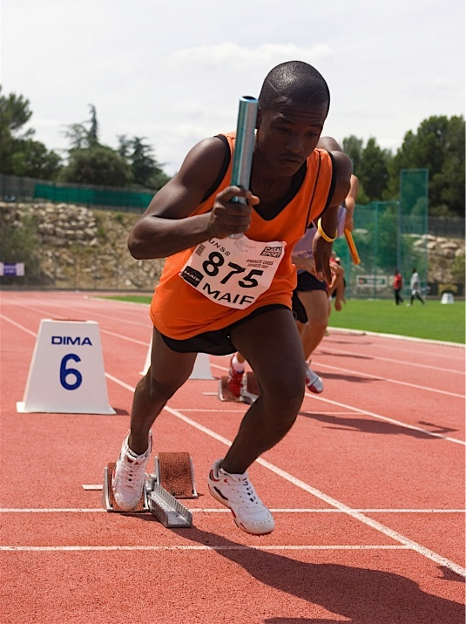
Setting personal goals
Short term goals:
These are over a small period of time usually covering anything from one day to a month.
i.e. today I aim to run under 25 seconds for the 200m.
Medium term goals:
These are progressive goals that support the achievement of longer term goals.
i.e. my aim is to improve my tumble turn timing to help improve my overall time and hopefully position.
Notes:
Photo (Chelsea): © deshow.net
Photo (Sprinter): © FocusMedia

Slide 11
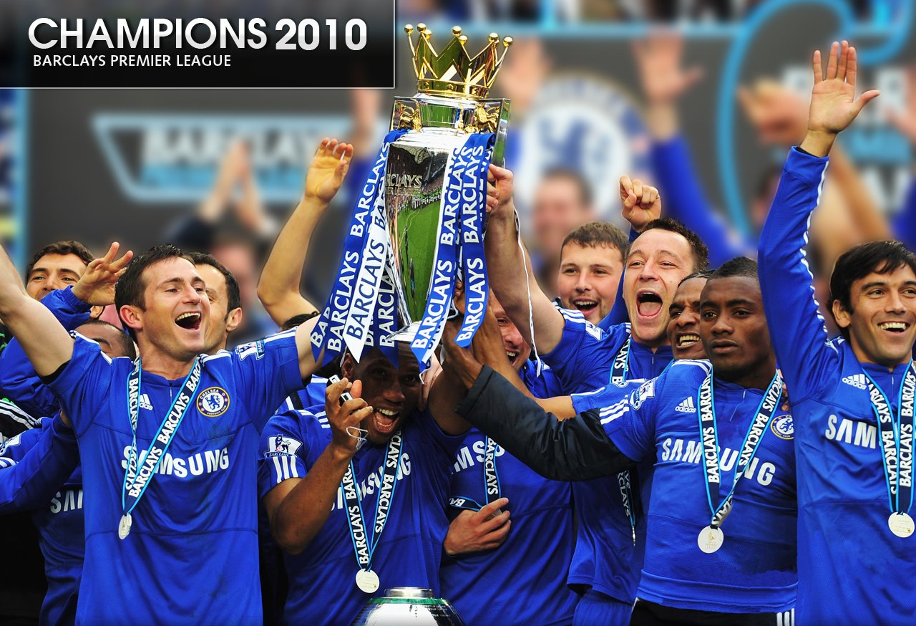
Setting personal goals
Long term goals:
This is the targets set over a sustained period of time. i.e. winning a league.
Notes:
Photo: © deshow.net

Slide 12
Training Programme Design
The combination of activities should meet the needs, goals, aims and objectives of the subject.
Aims: This is the details of what the performer would like to achieve in their activity of choice.
Objectives: How performers intend to meet their aims addressing the right components of fitness.
Notes:
Photos: © deshow.net

Slide 13
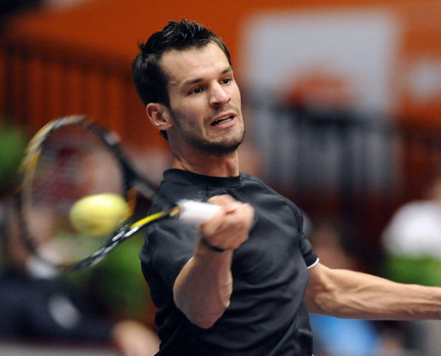
Training Programme Design
Select appropriate training methods for your activities for improving/maintaining fitness.
Notes:
Photos: © deshow.net

Slide 14
Training Programme Design
A coach should also consider the following when planning a training programme:
Duration – Length of the training programme i.e. 6 weeks.
Adaptability – venues available to use. i.e. inside or outside and weather conditions.
Progress – How will improvements be achieved (FITTA principle) and measured (fitness tests)
Notes:
Photos: © deshow.net

Slide 15
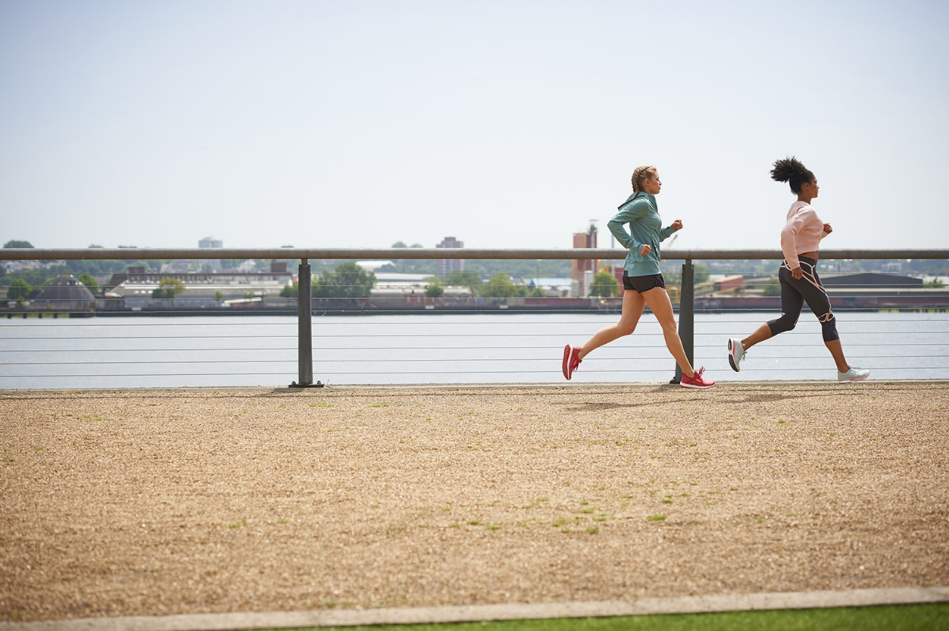
Training Programme Design
When setting a training programme coaches should consider the type of activities they implement based on:
Subject requirements
Sport/physical activity undertaken
Age of athletes
Gender
Physical activity levels
Access to facilities
Injuries/health issues

Slide 16
Medical History and Screening
A commonly used medical screening test is the Physical Activity Readiness Questionnaire (PAR-Q)
If an athlete answers yes to any of the medical conditions experienced they should be checked over by a GP prior to starting an exercise programme.
Think. Pair. Share – What type of questions might be included in a PAR-Q?
Notes:
Photo: © PE Resources Bank
Photo: © Focusmedia

Slide 17
Medical History and Screening
Look at the difference between the lifestyle questionnaire and a PAR-Q.
Lifestyle Questionnaire
HERE
PAR-Q
HERE
Think. Pair. Share – What questions may raise concerns? What would be your action plan if a client answered yes to one or more questions?

Slide 18
Medical History and Screening
If the training suits the performer’s needs, results will be achieved. Attitude and motivation towards training is vital in order to succeed.
i.e. a marathon runner who wants to improve cardiovascular fitness to better their run time by 3 minutes in 4 months will training every day using continuous training.
Notes:
Photo: © 123RF Limited

Slide 19
Programme design
Using personal information about the client is important for an effective training programme but also for health and safety reasons.
Data received is confidential and is subject to the data protection act. This is a law that controls how personal information is used by companies. A consent form is also necessary to ensure the individual is suitably informed of the process.

Slide 20
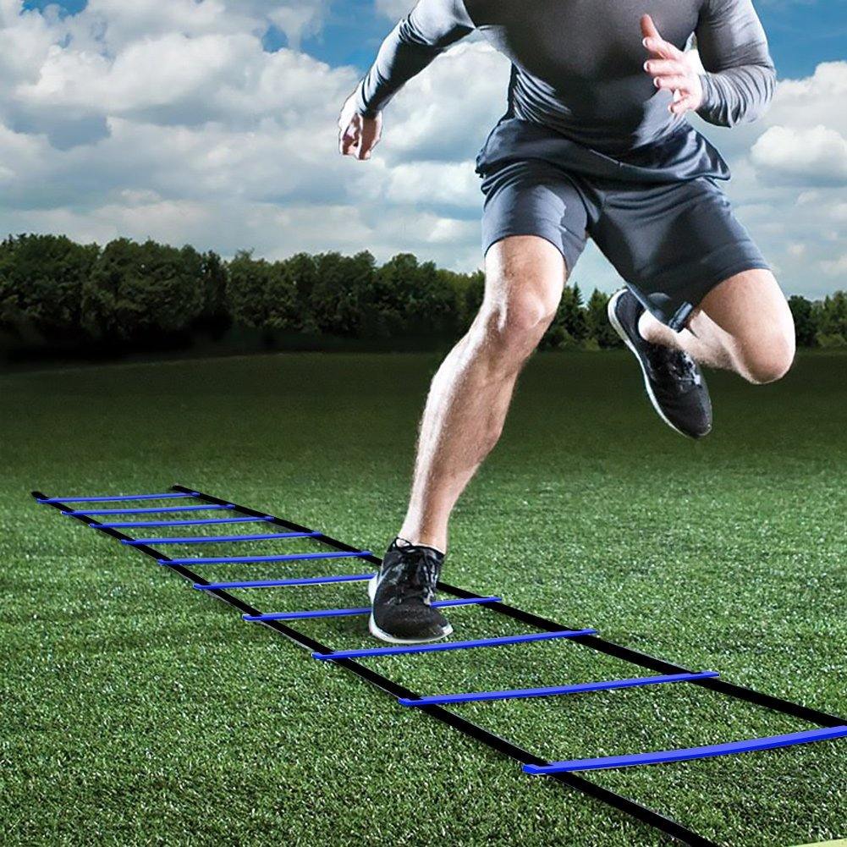
Programme design – Methods of training
Consider the appropriate method of training for the component of fitness selected to improve.
Think. Pair. Share – What method/s of training mainly improve which components of fitness?

Slide 21
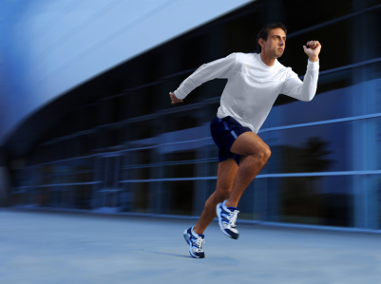
Programme design – Methods of training
The most common cardiovascular training methods used to improve aerobic endurance are:
Continuous training
Fartlek training
Interval training
Notes:
Photo by: LOCOG

Slide 22
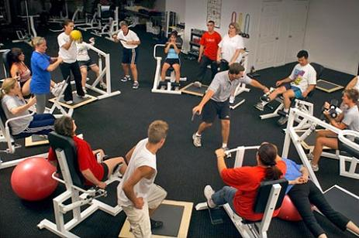
Programme design – Methods of training
There are a number of method of training aimed at improving muscular strength:
Circuit training
Weight/Resistance training
Notes:
Photo: © Klearchos Kapoutsis on Wikimedia Commons. This image is reproduced under the terms of the Creative Commons License 2.5.

Slide 23
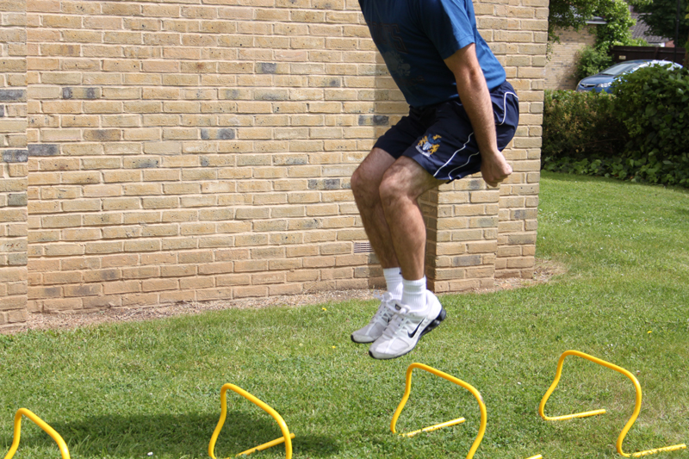
Programme design – Methods of training
Speed and power training works largely in the anaerobic training zone and includes:
Plyometric training
Short interval training
Notes:
Photo: © istock photo

Slide 24
Programme design – Principles of training
There are certain principles of training which should be followed to improve performance
Think. Pair. Share - Why should athletes follow a set of principles when planning and carrying out training?
Notes:
Photo by: deshow.net

Slide 25
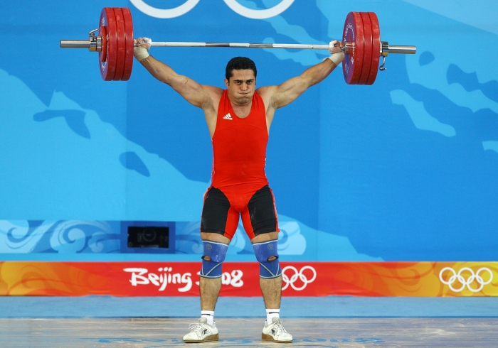
Programme design – Principles of training
Specificity: Your training should be geared towards your chosen sport or activity.
You need to train specifically to develop the right:
1. Muscle groups
2. Type of fitness
3. Related skills to the activity
For example, if you are training for a weightlifting competition, it’s no use going swimming every day. You need to concentrate on strength training for your arms and legs.
Notes:
Photo: © London 2012

Slide 26
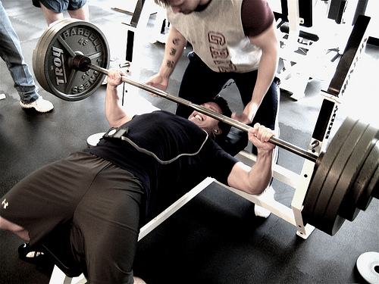
Programme design – Principles of training
Progressive Overload: Exercising at the same intensity will only maintain current fitness levels. An athletes body needs to be gradually pushed each session.
Progression overload can be achieved by using the FITT principle.
Notes:
Photo: © Russell Garner on Flickr. This image is reproduced under the terms of the Creative Commons License 2.0. http://www.flickr.com/photos/28686289@N05/2677720863/

Slide 27
Programme design – Principles of training
For training to improve an individuals fitness they must following the F.I.T.T. basic principle of training.
Notes:
Photo by: © ndanger on Flickr. This image is reproduced under the terms of the Creative Commons License 2.0. http://www.flickr.com/photos/ndanger/778074359/

Slide 28
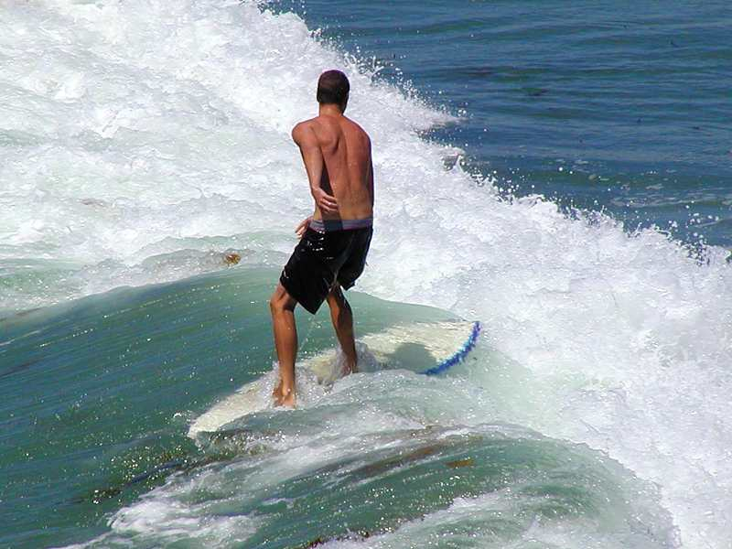
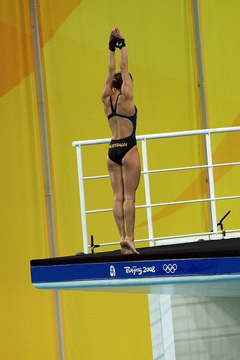
FITT Principle
1. Frequency - How often we train
The body needs time to recover from each training session. Training should be spread over the week and varied.
Notes:
Photo (Surfer): © www.public-domain-image.com
Photo (Diver): © bleublogger on Flickr. This image is reproduced under the terms of the Creative Commons License 2.0.

Slide 29
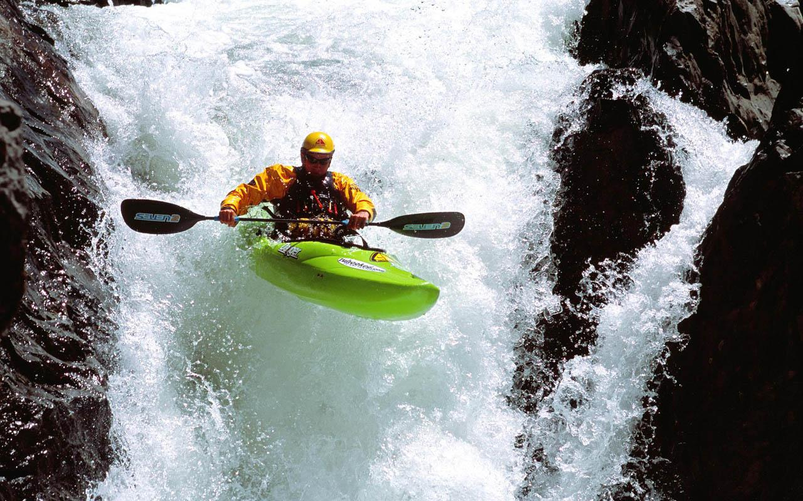
FITT Principle
2. Intensity - How hard we train
Fitness gains are only achieved if the body systems work hard enough.
Athletes must start at the right intensity, depending on our current fitness. An understanding of training thresholds also help.
Notes:
Photo: © deshow.net

Slide 30
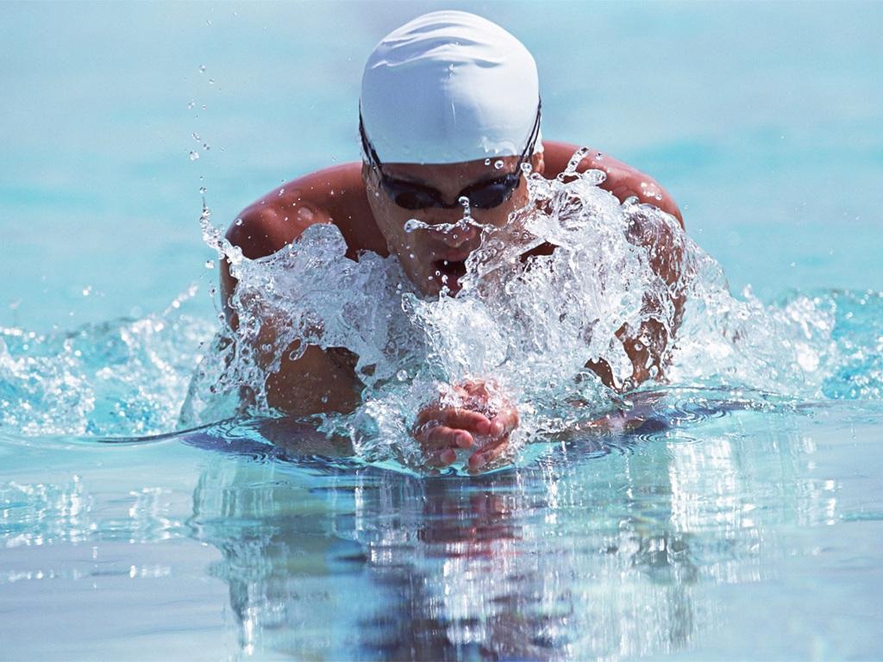
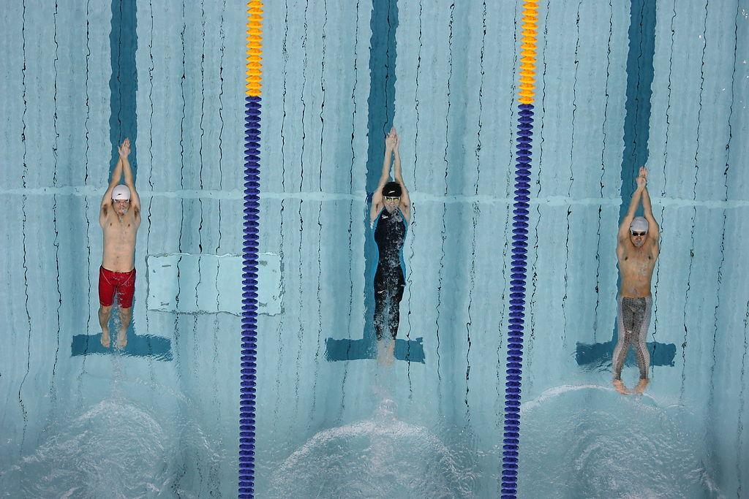
FITT Principle
3. Time - How long we train
Each session must last at least 20 minutes to get any benefits.
To improve aerobic fitness training sessions should last longer and working HR should rise between 60-80% of maximum.
Notes:
Photos: © deshow.net

Slide 31
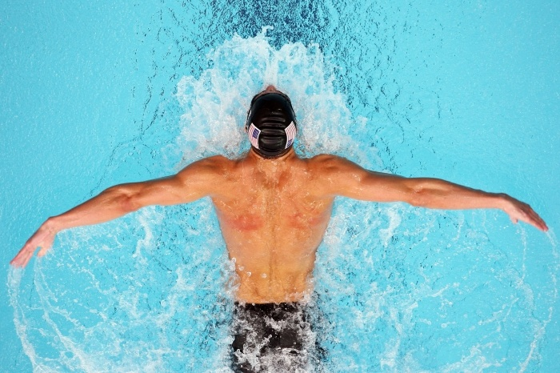
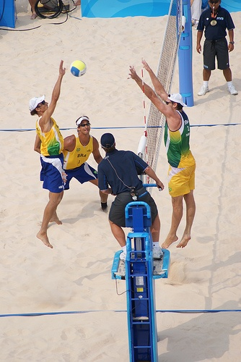
FITT Principle
4. Type - What type of training used
Athletes should analyse our particular sport to know the fitness and skills they need. The training programme should include types of activity to develop these skills and fitness.
Notes:
Photo (Swimmer): © London 2012
Photo: © bleublogger on Flickr. This image is reproduced under the terms of the Creative Commons License 2.0.

Slide 32
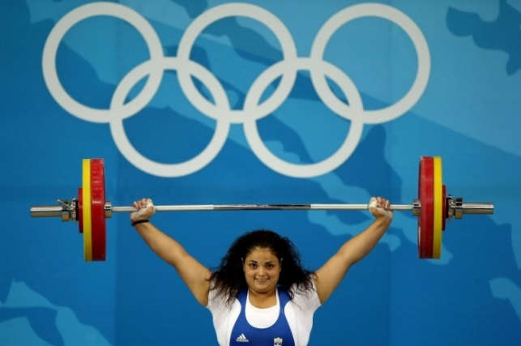
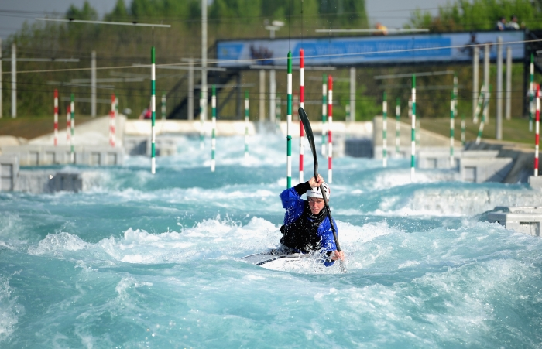
Individual difference/needs
Everybody's fitness level differ and should therefore tailor training to their specific needs.
Understanding an individuals needs will mean training is set at their level and accounts for their strengths and weaknesses.
Elite performers may adjust their training in the run up to a competition.
Notes:
Photos: © London 2012

Slide 33
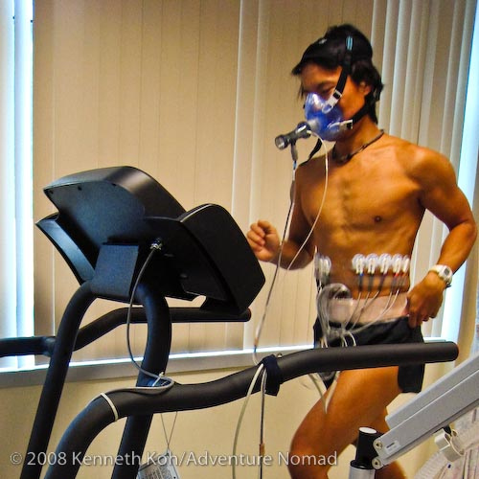
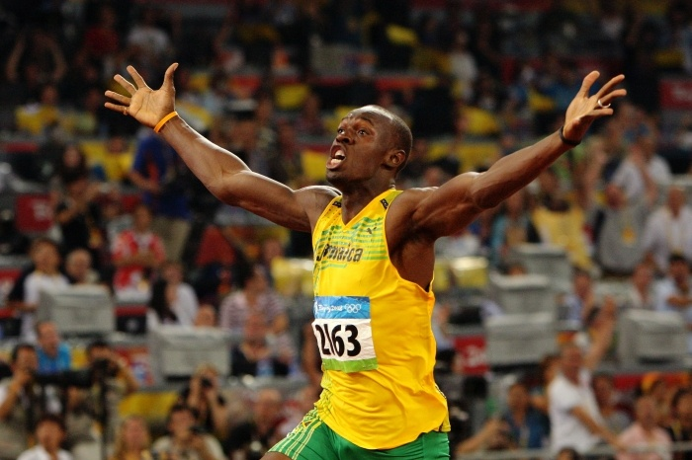
Adaptation
This is how the body reacts to training loads placed on it. The more the body is pushed the better its ability to cope.
Adaptations occur during recover periods between training sessions.
Notes:
Photos: © London 2012

Slide 34
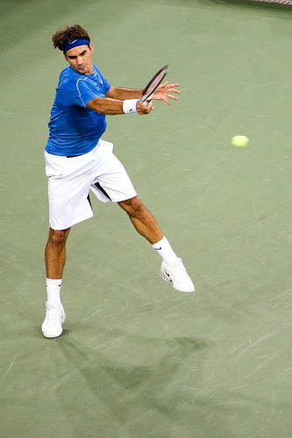
Reversibility
Reversibility is process of an athletes body losing fitness levels. It the opposite of progressive overload and can occur if training has stopped due to illness or injury.
This simply means that unless you keep training, any fitness gains will be lost.
Athletes say.....
“If you don’t use it, you lose it!”
Notes:
Photo by: © toga on Flickr. This image is reproduced under the terms of the Creative Commons License 3.0. http://www.flickr.com/photos/14622025@N00/511921542

Slide 35
Reversibility
This means that instead of progressing or remaining at the same level, the athlete loses fitness. It only takes 3 or 4 weeks to get out of condition.
This has implications does for an elite performer who’s season has just finished and may become out of shape.
Reversibility may also take place after an injury or illness as normal training can become difficult.

Slide 36
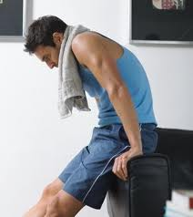
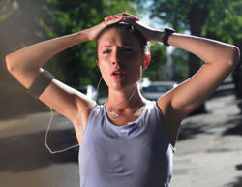
Rest and Recovery
This is required so that the body can recover from the training and to allow adaption to occur.
A coach should consider the following factors in order to safe improve fitness levels:
Age
Gender
Environment
Experience
Notes:
Photo: © Focus Media

Slide 37
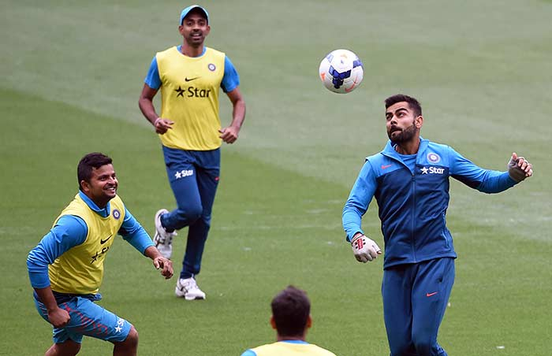
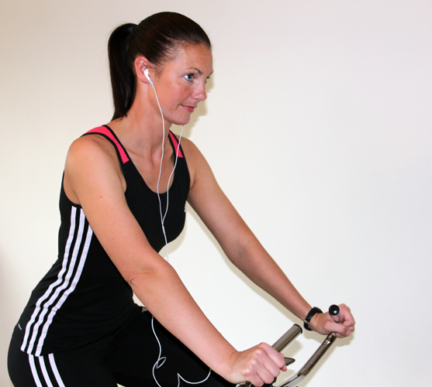
Variance/Tedium
A training programme needs to have variety in order to maintain interest and motivation. Boredom can lead to people to give up training. To avoid this individuals may:
Use different challenges
Mix fitness training with skill
Notes:
Photo: © PE Resources Bank

Slide 38
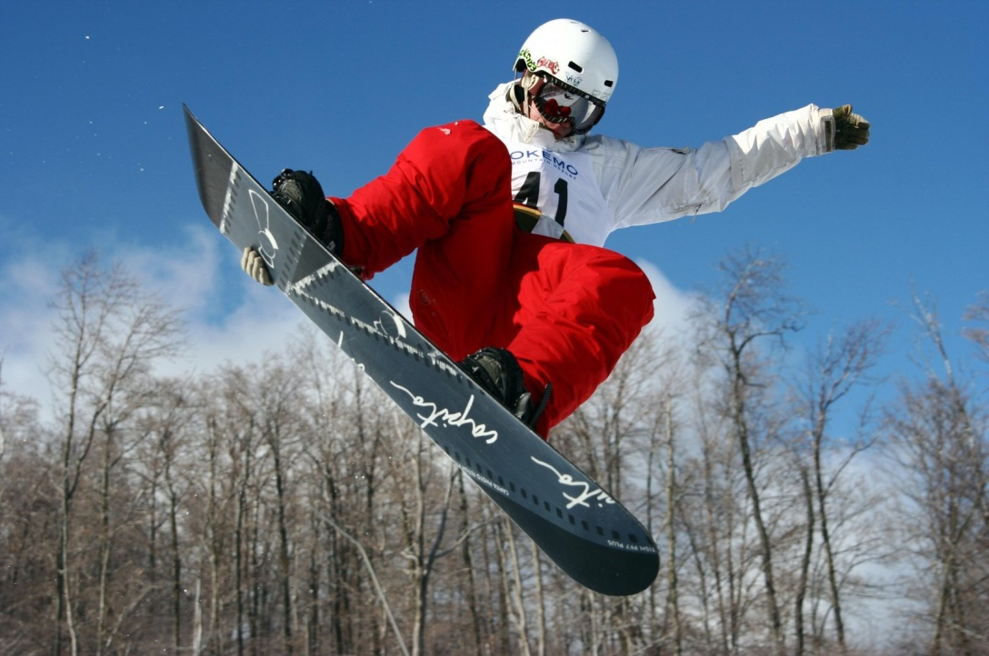
Warm up/Cool down
Every training method requires a full warm up and cool down to ensure the performer’s safety.
Warm up: This should consist of light, continuous physical activity to prepare the body for exercise. A thorough warm up is vital to prepare the mind and body.
Notes:
Photo: © pincusvt on Flickr. This image is reproduced under the terms of the Creative Commons License 3.0. http://www.fotopedia.com/items/flickr-2266019996

Slide 39
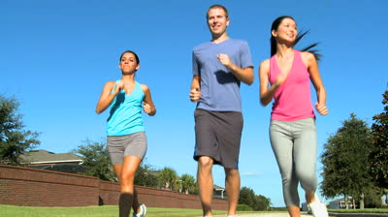
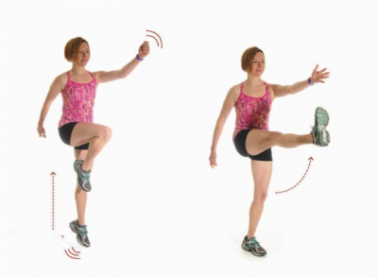
Warm up/Cool down
A typical warm up routine is stated below:
Stage 1: Pulse raiser
Involves gentle jogging, skipping, side stepping and gentle sprints x3.
Stage 2: Stretches
From head to toe the body needs to be stretched including all major muscle groups. These may be static (still) stretches or dynamic (movement based)
Notes:
Photo by: © deshow.net

Slide 40
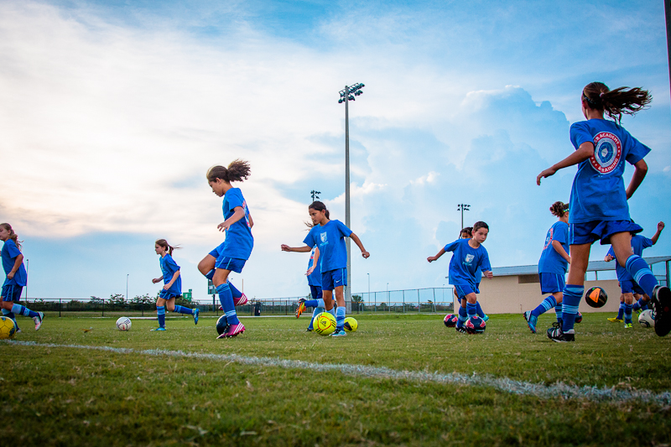
Warm up/Cool down
Stage 3: Exercise Specific Drills
Players use a ball to dribble, pass and shoot in order to ready the body for a game.
Notes:
Photo by: © deshow.net
Photo by: © toga on Flickr. This image is reproduced under the terms of the Creative Commons License 3.0. http://www.flickr.com/photos/togasaki/29377913

Slide 41
Warm up/Cool down
A cool down will slowly reduce heart rate and return the body to a complete resting state. Light continuous movement will remove lactic acid and prevent blood pooling.
Notes:
Photo: © PE Resources Bank

Slide 42
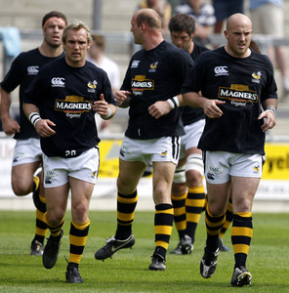
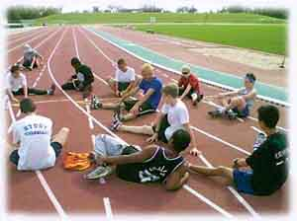
Warm up/Cool down
To begin with a cool down must start with a gentle jog reducing down to a walk.
The second part of a cool down involves static stretches lasting for a minimum of 30 seconds each. This helps improve flexibility.
Notes:
Photo by: deshow.net
Photo by: © Marcello Casal Jr/ABr. This image is reproduced under the terms of the Creative Commons License 2.5.

Slide 43
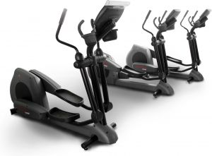
Creative design
You will have to give consideration to preventing barriers to training occurring, ensuring exercise is maintained and the programme is enjoyable.
Include interesting, different exercise activities to maintain motivation and commitment and to prevent boredom!
Notes:
Photo (Machines): © Stock.xchng. http://www.sxc.hu/photo/489121
Photo (Gloves): © Stock.xchng. http://www.sxc.hu/photo/279226

Slide 44
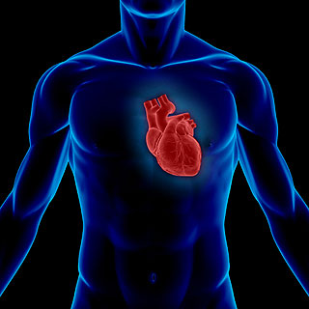
Consider working intensities
An estimate of maximum heart rate is calculated as:
Maximum Heart Rate (MHR) = 220 – age
Worked example:
A 25 year-old would have a maximum heart rate of:
220 – 25 = 195bpm
Notes:
Photo: © Velo Steve on Flickr. This image is reproduced under the terms of the Creative Commons License 2.0. http://www.flickr.com/photos/juniorvelo/4465946980/
Photo (Heart): © istock Photo

Slide 45
Consider working intensities
To improve fitness from regular exercise you must push your heart rate above a certain level, known as the training thresholds.
There are two training thresholds:
Aerobic Training Threshold (Cardiovascular fitness)
Anaerobic Training Threshold (Power)
= 60-85 % of the maximum heart rate
= 85% + of the maximum heart rate

Slide 46
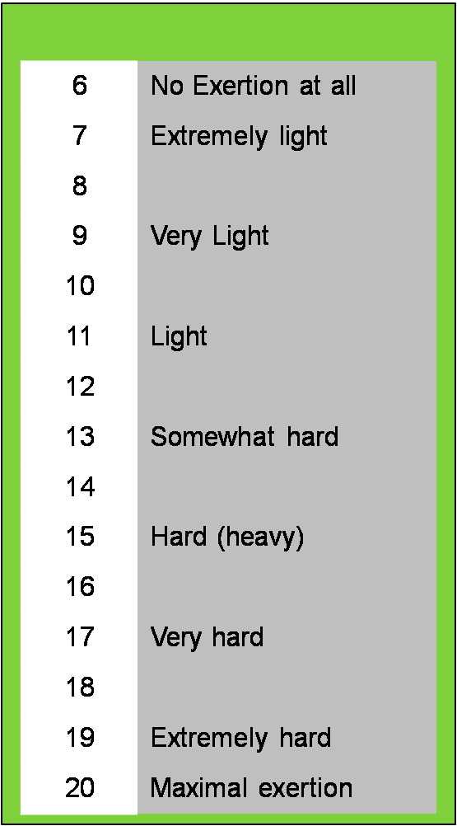
Rate of Perceived Exertion
Borg scale
The Borg scale is a simple method of rating perceived exertion (RPE) and is used to measure a performer's level of intensity during exercise.
During exercise, the Borg scale is used to assign numbers to how you feel about the exercise undertaken.
Notes:
Photo: © PE Resources Bank

Slide 47
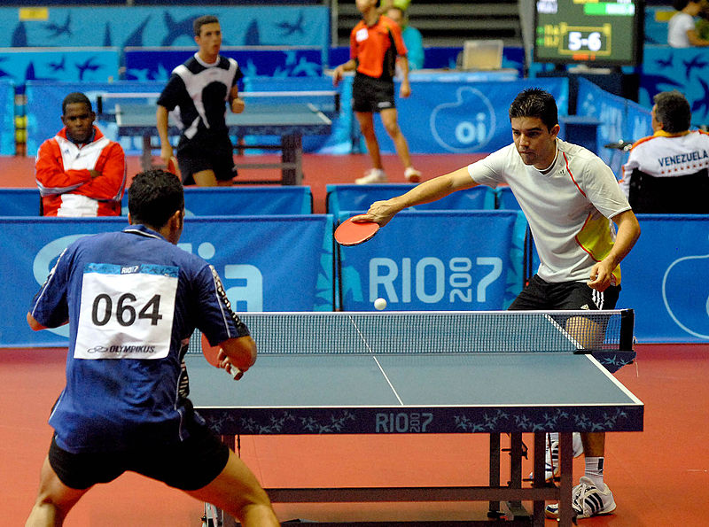
Rate of Perceived Exertion & Heart Rate
Rating of perceived exertion (RPE) can also be used to predict heart rate. The following equation is used:
RPE x 10 = Heart Rate (BPM)
Notes:
Photo by (Tennis): © Deshow.net
Photo (Table Tennis): © This photograph was produced by Agência Brasil. This image is reproduced under the terms of the Creative Commons License 2.5. Brazil.

Slide 48
Section A: Assignment Task
Task A:
Design and justify a safe six-week personal fitness training programme to meet an activity/sport goal which meets the needs of the individual, showing creativity in the design.
Check your Assignment Booklet for the Assessment Criteria

Slide 49
The evidence for learning aim A must include:
Personal information including a medical history questionnaire.
Goals which are set over a short, medium and long term for a chosen activity/sport in Unit 2.
An aim for the programme which links to one component of fitness.
Motivation and how this can be maintained through the fitness training programme.
A training programme that incorporates one method of training and appropriate principles of training.

Slide 50
Section B:
Know about the musculoskeletal system and cardiorespiratory system and the effects on the body during fitness training
Notes:
Photo: © deshow.net

Slide 51
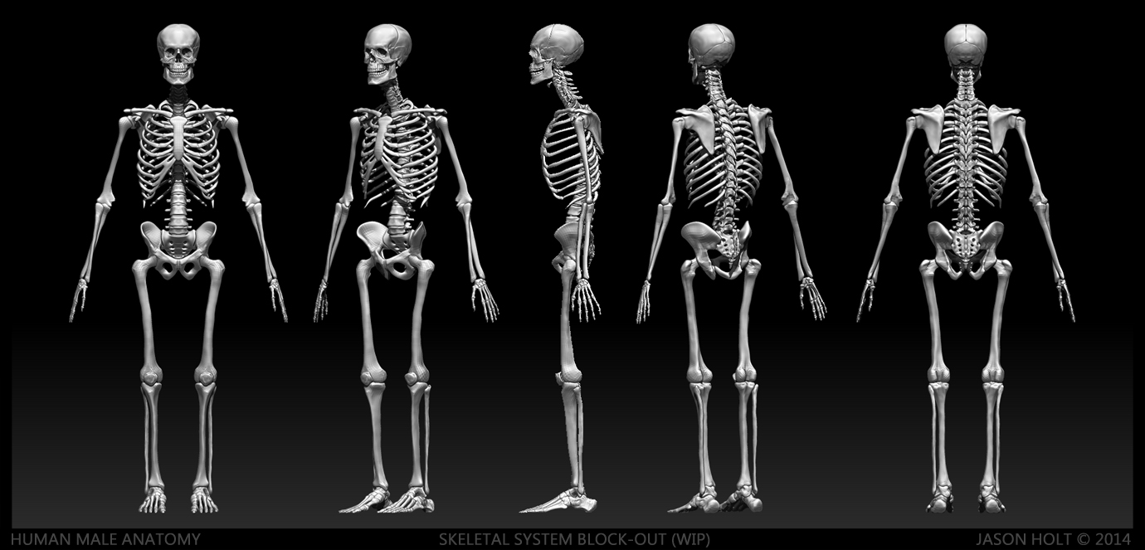
Musculoskeletal system
The skeleton is a framework for the body and provides many other functions. There are 206 bones in the body.
Watch me
How many bone names do you know already?
Notes:
Photo by: © istock Photo

Slide 52
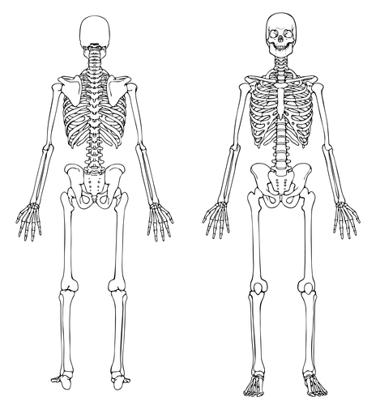
Musculoskeletal system
Head/Neck joint
Cranium
Notes:
Photo by: © istock Photo

Slide 53
Musculoskeletal system
Shoulder joint
Clavicle
Scapula
Humerus
Notes:
Photo by: © istock Photo

Slide 54
Musculoskeletal system
Chest region
Ribs
Sternum
Vertebrae
Notes:
Photo by: © istock Photo

Slide 55
Musculoskeletal system
Elbow region
Humerus
Radius
Ulna
Notes:
Photo by: © istock Photo

Slide 56
Musculoskeletal system
Wrist region
Carpals
Metacarpals
Phalanges
Notes:
Photo by: © istock Photo

Slide 57
Musculoskeletal system
Hip joint
Femur
Pelvic Girdle
Notes:
Photo by: © istock Photo

Slide 58
Musculoskeletal system
Femur
Patella
Knee joint
Tibia
Fibula
Notes:
Photo by: © istock Photo

Slide 59
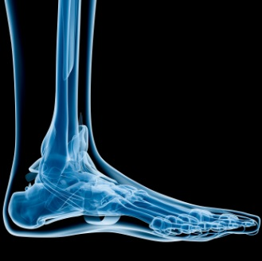
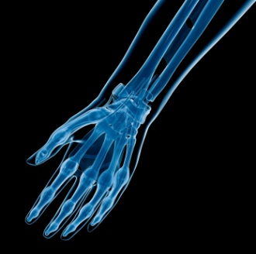
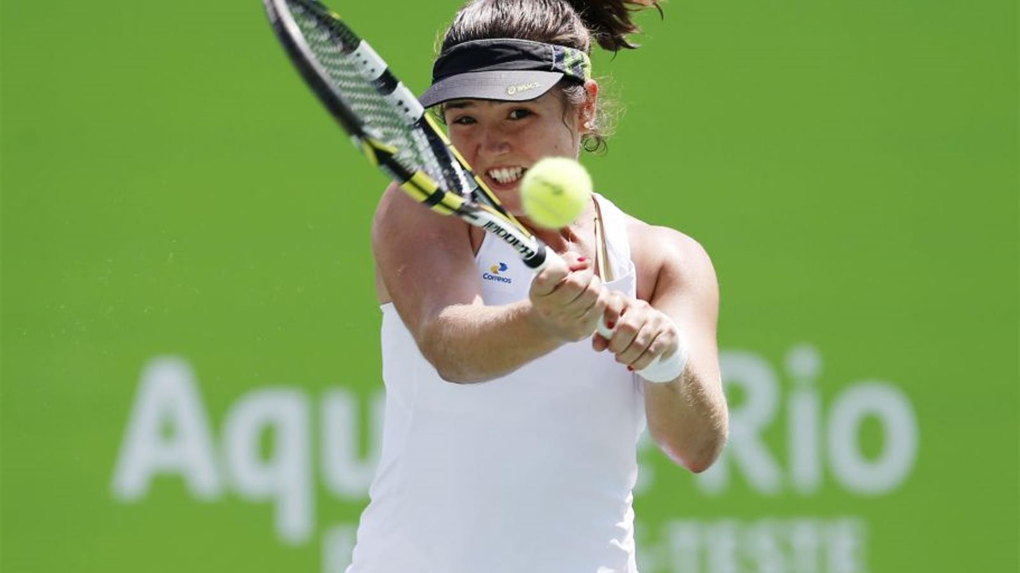
Musculoskeletal system
Foot
Hand
Tarsals
Carpals
Metatarsals
Metacarpals
Phalanges
Phalanges
Notes:
Photo by: © Rio Games 2016

Slide 60
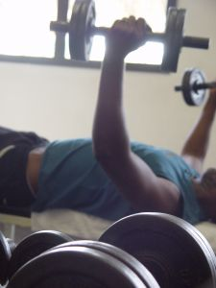
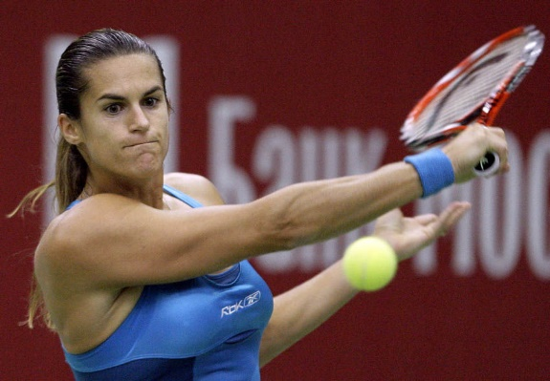
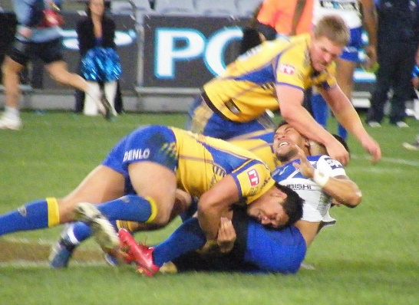
Musculoskeletal system
Muscles are used in everyday life all the time. Sportspeople are reliant on the power of skeletal muscles to compete.
Watch me
How many muscle names can you recall?
Notes:
Photo by: © paddynapper on Flickr. This image is reproduced under the terms of the Creative Commons License 2.0. http://www.flickr.com/photos/28990363@N05/2816462088/
Photo by: © deshow.net
Photo: © Stock.xchng. http://www.sxc.hu/photo/223838

Slide 61
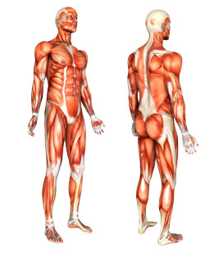
Muscles
External Obliques
Latissimus Dorsi
Trapezius
Posterior Deltoid
Pectolaris Major
Teres Major
Anterior Deltoid
Triceps Brachii
Biceps Brachii
Gluteus Medius
Wrist Flexors
Rectus Abdominals
Gluteus Maximus
Adductor Longus
Wrist Extensors
Biceps Femoris
Rectus Femoris
Gastrocnemius
Tibialis Anterior
Soleus
Notes:
Photo: © Stock.xchng.

Slide 62
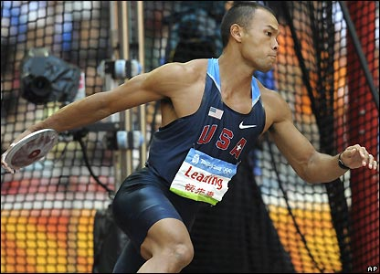
Synovial Joints
Definition:
‘A joint is a place where two or more bones meet’ This is known as articulation.
The skeleton is a framework connected by joints.
Joints are necessary for muscles to lever bones and create movement.
Notes:
Image © 2006 Jupiterimages Corporation

Slide 63
Synovial Joints
Synovial joint (freely moveable joint): These joints are the most moveable and are vital to sporting actions.
i.e. the knee joint
Notes:
Image © istock photo

Slide 64
Synovial Joints
1. Ball and socket joints allow movement in all directions and is the most mobile joint in the body.
Example: Shoulders and hips used in a tennis serve.
Think. Pair. Share – Using examples, how are these joints used in sport?
Notes:
Photo by: © deshow.net

Slide 65
Synovial Joints
2. Hinge joints - only allow forwards and backwards movement like the hinge on a door.
Examples found in the body: The knee and elbow.
Why are these joints important for sport?
These joint are extremely powerful and in conjunction with surrounding muscles can produce power and speed i.e. Knee drive during a 100m sprint
Notes:
Photo by: © LOCOG

Slide 66
Synovial Joints
3. Pivot joints have a ring of bone that fits over a bone sticking out. Pivot joints allow rotation only.
Examples found in the body: The joint between the atlas and axis in the neck which allows turning and nodding of head
Why are these joints important for sport?
This joint allows for small movements that assist a larger sporting action
i.e. breathing during a swimming stroke
Notes:
Photo by: © deshow.net

Slide 67
Short term effects of exercise
Watch me
How does the body react to the start of any exercise?
Notes:
Photo by: © LOCOG

Slide 68
Short term effects of fitness training
The musculo-skeletal system responds to exercise in the short term by:
Increasing production of synovial fluid: This lubricates the joints and protects the bones during the increased demand place on them. It also increases the range of movement at a joint.
Increasing muscle and ligament pliability: The onset of exercise helps to warm the muscle and surrounding ligaments. This allows for a greater degree of movement and are less likely to suffer strains.
Notes:
Photo: © Rio 2016

Slide 69
Short term effects of fitness training
Increasing muscle temperature: Working muscles produce heat and rely on the body systems to cool down.
Notes:
Photo by: © LOCOG

Slide 70
Short term effects of fitness training
In the hours and days after exercise, the body can experience the following:
Micro-tears – resistance training involving weights will place the muscle under stress and caused small tears in the muscle fibres. Training adaptions will take place once the body has sufficient rest and recovery. Protein is often used to aid muscle repair.
Notes:
Photos by: © deshow.net

Slide 71
Cardio-respiratory system
The cardiovascular system refers to the heart, blood vessels and the blood.
Watch me
The circulatory system and it’s components
Notes:
Photo by: © istock Photo

Slide 72
Cardio-respiratory system
The left side of the cardiac muscle has a thicker wall to allow the heart to contract with more force on the oxygenated side.
RIGHT ATRIUM - An upper chamber receiving de-oxygenated blood.
LEFT ATRIUM - An upper chamber receiving oxygenated blood from the lungs.
RIGHT VENTRICLE - A lower chamber containing de-oxygenated blood.
LEFT VENTRICLE - A lower chamber containing oxygenated blood.
Notes:
Photo by: © istock Photo

Slide 73
Cardio-respiratory system
The more the efficient the heart the greater the capacity to transport oxygen.
AORTA - Oxygenated blood is pumped at high pressure from the heart to the body.
VENA CAVA- Returns deoxygenated blood to the heart either via the superior or inferior vena cava.
PULMONARY ARTERY - Carries deoxygenated blood from the heart to the lungs.
PULMONARY VEIN - Returns oxygenated blood to the heart.
Notes:
Photo by: © istock Photo

Slide 74
Cardio-respiratory system
Other structures of the heart that enable a smooth functioning include:
SEMI-LUNAR VALUES - Prevent expelled blood flowing back into the heart.
BICUSPID - Prevent blood flowing back into the left atrium.
SEPTUM - The wall dividing the left and right sides of the heart.
TRICUSPID - Prevent blood flowing back into the right atrium from the ventricle.
Notes:
Photo by: © istock Photo

Slide 75
Cardio-respiratory system
Oxygen travels along the following pathway from the mouth/nose to the alveoli.
Nose
Bronchi
Mouth
Bronchioles
Trachea
Lungs
Alveoli
Notes:
Photo by: © deshow.net

Slide 76
Short term effects of exercise
The short term effects of exercise on the cardiorespiratory system:
Increase in heart rate
Increase in respiratory rate/depth of breathing

Slide 77
Short term effects of exercise
Depth and rate of breathing increases in direct proportion to the intensity of the exercise. The greater the exercise intensity the higher the concentration of carbon dioxide in the blood. The respiratory system reacts by:
Carbon dioxide production stimulates faster and deeper breathing.
Notes:
Photo by: © LOCOG

Slide 78
Short term effects of exercise
Lactic acid build up – This is the uncomfortable sensation in your muscles during high-intensity anaerobic exercise.
Notes:
Photo by: © LOCOG

Slide 79
Section B: Assignment Task
Task B:
Explain the short-term effects on the musculoskeletal and cardiorespiratory systems during the fitness training programme.
Check your Assignment Booklet for the Assessment Criteria

Slide 80
The evidence for learning aim B must include:
Diagrams to identify the correct location of the main structures in the musculoskeletal and cardiorespiratory systems.
An explanation of the main functions of the musculoskeletal system.
A summary of the short-term effects on the musculoskeletal and cardiorespiratory systems during the fitness training programme.

Slide 81
Section C:
Implement a self designed personal fitness training programme to achieve own goals and objectives
Notes:
Photo: © Ronette Vrey. Dreamstime

Slide 82
Safely implement a personal fitness training programme
You will need to take full responsibility for completing and recording details for each training session
Taking part in planned sessions which are using appropriate training methods.
Performing to the best of your ability
Gaining agreement from coach / trainer for any missed sessions
Understanding the importance of commitment.
Notes:
Photo: © Clipart 2012

Slide 83
Safely implement a personal fitness training programme
Participants must wear the correct training clothing and footwear.
Safe and correct use of equipment
Implementation of the correct technique
Awareness of safety issues i.e. Personal safety especially when outside.
Notes:
Photo (Treadmill): © Mr. T in DC on flickr. This image is reproduced under the terms of the Creative Commons License 2.0. http://www.flickr.com/photos/mr_t_in_dc/3292145208/
Photo (Baseball): © Stock.xchng. http://www.sxc.hu/photo/1139160

Slide 84
Training diary for each session
A training diary:
When keeping a training diary athletes should log details of:
Competitions and achievements.
Progressions and adaptations to training sessions.
Personal feelings and motivation for training.
Notes:
Photos: © Stock.xchng. http://www.sxc.hu/photo/1175999

Slide 85
Training diary for each session
Make sure you:
Use dates and times
Log session duration
Resources required (equipment)
Log personal performances/
achievements
Type of training
FITT programme details
Principles of training and intensity using % HR max and RPE
Include summary comments
Notes:
Photo (Diary): © Clipart 2012
Photo (Winner): © Stock.xchng. http://www.sxc.hu/photo/1389662

Slide 86
Measures for success
Success may be gauged by the level of intrinsic and extrinsic motivation.
Levels of self motivation and self-confidence towards completing the 4/6 week programme.
Notes:
Photos: © deshow.net

Slide 87
Measures for success
Motivation for training, including details in the diary of personal feelings before, during and after each training session.
Details of how the programme has been adapted to ensure continued commitment to training. i.e. Using a variety of activities/ training methods.
Notes:
Photos: © deshow.net

Slide 88
Measures for success
Achievement against personal aims, goals and objectives
i.e. How has performance or improvement in the component of fitness chosen been taken to a higher level?
Notes:
Photos: © deshow.net

Slide 89
Section C: Assignment Task
Task C:
Safely implement a successful six-week personal fitness training programme, maintaining a training diary to summarise outcomes and evaluate performance/progress.
Check your Assignment Booklet for the Assessment Criteria

Slide 90
The evidence for learning aim C must include:
Pictures or videos of the learner participating in the training programme (if pictures are used this should be supported by a record of practical activity that confirms which grading criterion the learner has provided evidence for).
A training diary which highlights measures for success:
Evidence of personal development.
Personal achievement against original programme goals, aims and objectives o personal enjoyment, dedication and commitment to training.
Amending their programme to avoid or overcome any barriers to training
Motivation for training: specifically what has maintained the levels of motivation throughout training?

Slide 91
Section D:
Review a personal fitness training programme
Notes:
Photo: © Stock.xchng. http://www.sxc.hu/photo/1390006

Slide 92
Review the programme
It is good practice to conduct a review after each session including objective assessment evidence from the short term physiological effects.
Consider using:
Heart rate
Breathing rate
RPE (Borg scale)
Feelings about muscle fatigue/soreness
Notes:
Photo: © PE Resources Bank

Slide 93
Review the programme
As a sports performer you need to develop the ability to:
Accurately observe and evaluate your own performance in a chosen sport.
Provide a detailed analysis of strengths and weaknesses and help structure ways to improve a performance.
Notes:
Photos: © London 2012

Slide 94
Review the programme
Reviewing training programmes should include:
Details about how the short term effects of exercise have changed or improved.
How these changes will have helped improve the chosen sport/activity?
Notes:
Photos: © London 2012

Slide 95
Review the programme
Evidence of modifications to the training programme should look like the performance cycle below:
Weekly performance
Analyse performance
Plan and justify changes
Notes:
Photos: © London 2012

Slide 96
Review the programme
When conducting a programme review think about:
Previous achievements
Strengths of the performer
Areas for development
The demands of the sport assessing
The components of fitness chosen
The suitability of the methods of training used

Slide 97
Review the programme
Following the analysis, the player/team should agree the development plan put forward by the observer/coach. Without this, agreed goals and targets for the future will have little effect.

Slide 98
Section D: Assignment Task
Task D:
Fully explain the results, strengths and improvements for the training programme, justifying recommendations for future training and performance.
These should be linked back to your chosen sport/activity.
Check your Assignment Booklet for the Assessment Criteria

Slide 99
The evidence for learning aim D must include:
A review after each training session, which includes an assessment of the evidence gathered including short term physiological effects.
A discussion of how the programme was modified during the training period.
Identification of clear strengths and areas for improvement.
Recommendations of how they could improve their training in the future.

