Slide 1

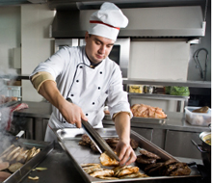
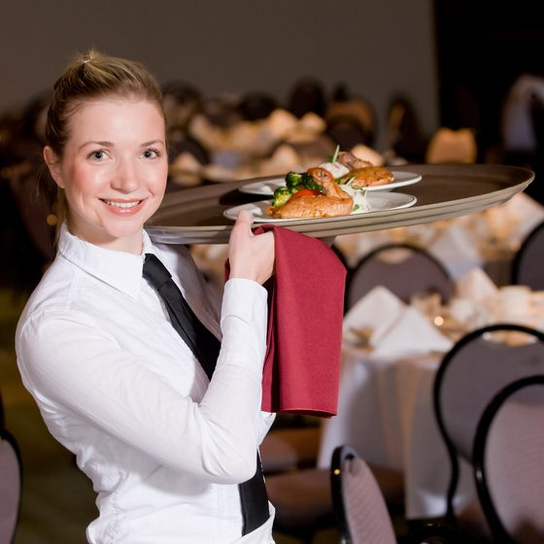
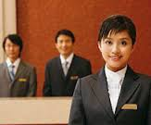
Y10 Hospitality and Catering
Unit 1 – The Hospitality and catering industry
LO1: AC1.1
Lesson 1 – The structure of the Hospitality and Catering industry

Slide 2
Lesson objectives
To understand what a service is and the 5 types in the hospitality industry
To gain knowledge of the different types of providers and how they fit into the services
Understand the difference between commercial and non commercial establishments and the services provided.
Begin exploring the accommodation industry

Slide 3
Lesson outcomes
All
Students will be able to describe the structure of the Hospitality and Catering industry within Lincolnshire.
Most
Students will be able to provide examples.
Some
Students will be able to fully analyse the need for different Hospitality and Catering provisions within a county.

Slide 4
Hospitality?
The friendly and generous reception and entertainment of guests, visitors or strangers

Slide 5
AC 1.1 Content
Hospitality and catering industry
- Types of provider
- Types of service
- Commercial establishments
- Non-commercial catering establishments
- Services provided
- Suppliers
- Where hospitality is provided at non-catering venues
- Standards and ratings
- Job roles within the industry (management, kitchen brigade, front of
house, housekeeping, administration)

Slide 6
AC 1.1 Content p.128
Types of service | Accommodation | Food and beverages | Meetings and events | Entertainment and leisure | Travel and tourism services
What it involves | Where you stay over Breakfast provided
Business example

Slide 7
Types of service
Accommodation
Some areas provide accommodation, shelter, food, drink, and sometimes entertainment to the customer i.e. holiday parks, hotels and resorts.
Food and Beverages
This sector prepares and serves food and drink to the customer Outlets include: fast food, food outlets, cafes, restaurants, public houses and contract catering.
Meetings and Events
Some establishments provide rooms to hold meetings and events they may also provide food and drink for the clients and some provide accommodation, these are known as conference facilities: Clients specify what kind of service they require i.e. boardroom-style meeting room with lunch and refreshments served at given times.

Slide 8
Types of service
Entertainment and Leisure
This sector includes leisure facilities, golf clubs, race tracks, cinemas and bowling alleys. People often want food and drink when they attend these establishments and this sector meets those needs.
Travel and Tourism Services
There is a strong link between the hospitality industry and travel and tourism. Customers who are travelling by plane, boat, coach or car all require food and drink on the journey.

Slide 9
Types of Hospitality Providers
Establishment?
Somewhere that provides food and drink

Slide 10
Types of Hospitality Providers
Commercial and Non-Commercial establishments
One has an aim to make a profit the other does not make a profit
Which is which?

Slide 11
Types of Hospitality Providers
Commercial Establishments
These establishments charge the customer for the services they provide and therefore make a profit.

Slide 12
Types of Hospitality Providers
Non-Commercial establishments:
All need food and drink although Hospitality is not the main focus
These establishments often run on a limited budget and do not make a profit. They supply a service to support the communities

Slide 13
Types of Hospitality Providers
Pubs
Schools
Bistros
Cafes
The Armed Forces
Restaurants
Bed and Breakfast
Caravan parks
Hospitals
Separate the providers into commercial and non-commercial
Hostels
Colleges
Prisons
And Care Homes
Fast Food Outlets
Holiday resorts

Slide 14
Types of Hospitality Providers
Commercial establishments include:
Pubs
Bistros
Cafes
Restaurants
Fast Food Outlets
Hostels
Bed and Breakfast
Caravan parks
Holiday resorts
These establishments charge the customer for the services they provide and therefore make a profit. (Commercial)

Slide 15
Types of Hospitality Providers
Non Commercial establishments include:
Hospitals
Schools
Colleges
Prisons
The Armed Forces
And Care Homes
All need food and drink although Hospitality is not the main focus
These establishments often run on a limited budget and do not make a profit. They supply a service to support the communities

Slide 16
Types of Hospitality Providers
Residential and non- residential:
Residential- you stay over, they offer accommodation
Non-residential-you don’t stay over
A business can be non-commercial residential or commercial residential or non-commercial non residential or commercial non- residential

Slide 17
Types of Hospitality Providers
Pubs
Bistros
Cafes
Restaurants
Fast Food Outlets
Hostels
Bed and Breakfast
Caravan parks
Holiday resorts
Hospitals
Can you identify which ones are residential and non-residential
Schools
Colleges
Prisons
The Armed Forces
And Care Homes

Slide 18
Activity (15 mins)
Complete the answers in the back of your book, trying not to use your lesson notes
Either write in full sentences or write both the question and the answer.
Name 2 food and beverage outlets (2marks)
What type of food would you get on an aeroplane? (1marks)
What is a catering Establishment? (1marks)
What does commercial mean? (1marks)
What does non-residential mean? (1marks)
6. Explain why Hospital food will always be of a lower quality than restaurant food (3marks)
7. How is food provided in the entertainment industry, different to food provided in travel and tourism services (3marks)

Slide 19
Suppliers
Suppliers are companies that supply hospitality businesses with the products they need in order to provide a good level of service.

Slide 20

Hospitality: non-catering venues
For example stately homes which are hired by clients for wedding or business.
Outside company then provide the
food and drinks for the event.
Both are hired separately

