Slide 1
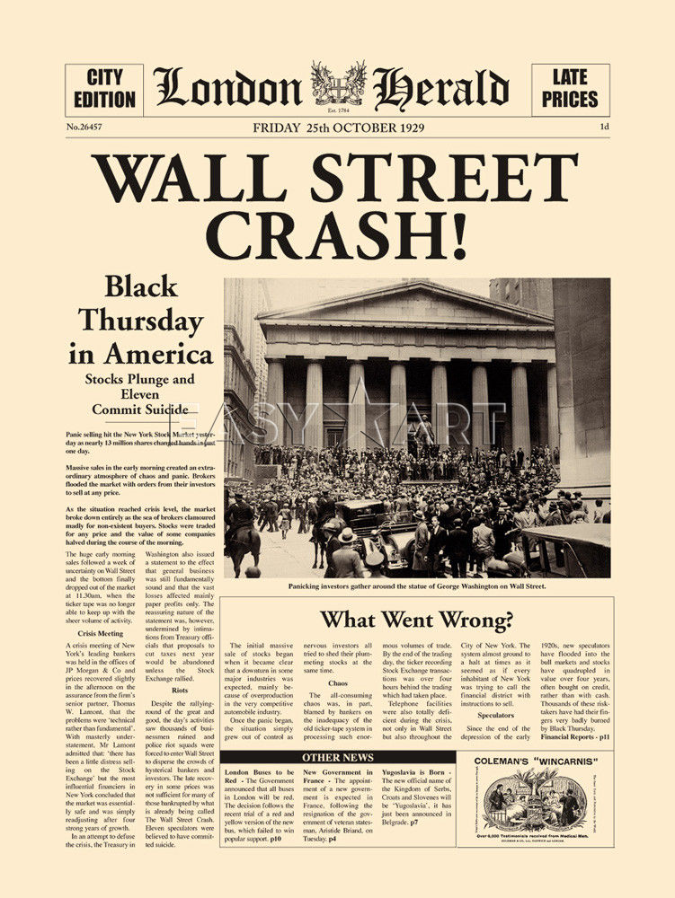
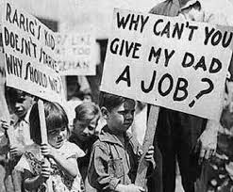
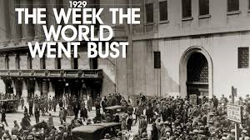
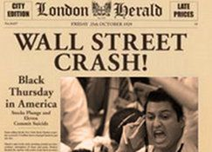
Topic 1 – Wall Street Crash
What do you think happened as a result of the Wall Street Crash?
Use the pictures to help you.

Slide 2
Why did the USA go bust in 1929?
Lesson/Topic Objectives
Know what the Wall Street Crash was.
Understand how the Wall Street Crash impacted the American people.
Evaluate the impact of the Wall Street Crash on the wider world.

Slide 3
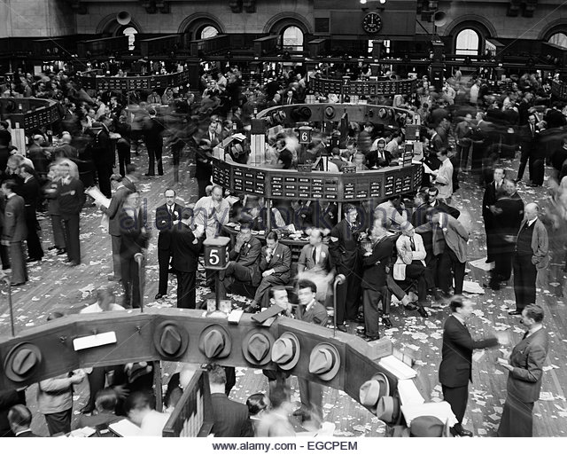
The trading floor at the New York stock exchange, 1920s
What is going on in this photograph?
What function might the room have?
Why do people look concerned?
Notes:
Ask students to infer what is going on in the photograph. What function might the room have / why do people look concerned

Slide 4
What is the stock market?
The stock market allows you to buy a share in a company.
You buy your share by investing (putting) money into the company.
The company can then use money to expand. The person who had invested their money will gain more money in return.
Imagine it like a pizza:
What happens to your slice is the pizza gets bigger?
Imagine this pizza is a company and you own a slice of the pizza. (The slice of pizza is your share of a company)
If the pizza gets bigger, your slice gets bigger.
If a company grew (made more money) your share would be worth more money!

Slide 5
Your task
In your own words, summarise what the stock market is.
Lay it out in the following way:
What is the stock market? (write as a sub heading)
Aim to include the following words:
Share
Company
Invest
money

Slide 6
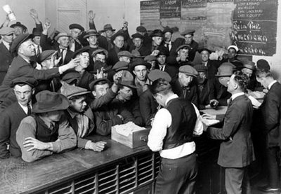
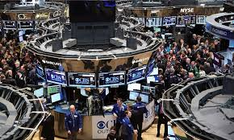
The Stock Exchange in 1920s
Throughout the 1920s, most people in the USA had more money to spend due to the economic boom.
Banks also introduced credit (money they lend people).
Americans bought cars (Ford Model Ts), radios and other consumer goods.
Around 4 million Americans owned shares in companies.
Many bought and sold their shares to make more money.
(This would be like selling your slice of pizza if you think you can get more money for it!)
What might happen if a company starts to lose money (got smaller)?
What might people who own shares want to do if their share gets smaller?
Americans waiting in line to buy shares on the stock market.
The New York Stock Exchange (on Wall St) today. Most deals are made over the phone or bought online.

Slide 7
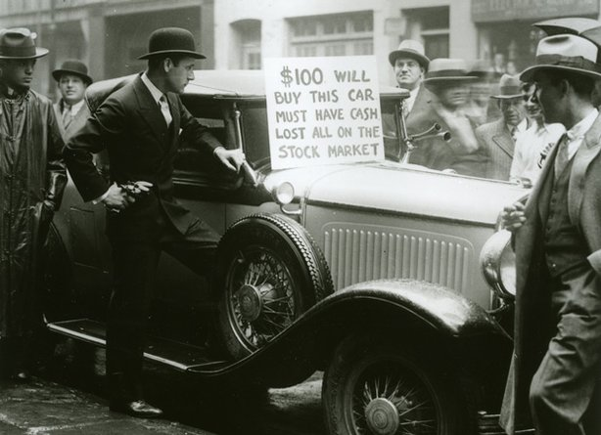
29th October 1929
How did the Wall Street Crash cause the American people to go bust?
Task 1: Watch the video and write down what you learn about the Wall Street Crash – as a mindmap - http://www.ovovideo.com/en/wall-street-crash-1929/
Task 2: Complete the paragraphs, using the missing words, on the next two slides.

Slide 8
Gap Fill 1
A number of financial experts warned that the American economy was __________ and in September 1929 some investors started ________ shares in large numbers. Many people started feeling nervous and investors went into _________ and rushed to sell their shares.
On__________, now referred to as Black Thursday 12.8 million shares were sold. Thousands of people saw their fortune, or any money they had in the bank, _________. On 29 October 1929, 16 million shares were sold at very low prices. The Stock Market in __________ had collapsed.
The ____________ came to a sudden end. Investors lost their money in the Crash and could not pay their________. Many banks closed, ordinary people lost their savings and people lost all hope for the _______.
panic / 24 October / New York / Roaring Twenties / debts / selling / disappear / future / warned

Slide 9
Gap Fill 2
People could no longer buy consumer goods like _______ and clothes. As a result, workers were made ________, other workers' wages was cut and unemployment rose to very high levels. This was the start of __________________ of the 1930s.
The Great Depression had consequences for the world. Many countries had borrowed money from the USA after the end of_______. Germany especially suffered as they had borrowed huge sums of money as a result of _________.
Germany was not the only country affected by the Wall St Crash. In_______, millions lost their jobs as production in factories slowed.
cars / redundant / The Great Depression / reparations / Britain / World War 1

Slide 10
Topic 2 – Communism in Russia
Lesson/Topic Objectives
You will be able to describe Communism and War Communism.
You will be able to make connections between a historical source, and your wider knowledge on the topic.
You will assess how useful a source is for an historian.

Slide 11
Context: Watch the clip. What did Communists promise? https://www.youtube.com/watch?v=KOK1TMSyKcM
Russia left the First World War in 1917 after signing the Treaty of Brest-Litovsk.
They left because at home in Russia, there was a Communist revolution taking place. This led to getting rid of the Tsar (Russian king/emperor).
This resulted in a civil war which was to tear Russia apart.
Communism → The idea that everyone is equal, and everything is owned by the state (government).
The Reds: known as the Bolsheviks or Communists (red is the colour of Communism). They wanted to stay in power and build a new Communist society.
The Whites: all the enemies of the Bolsheviks (the tsarists, nobles, middle-class democrats and others. Some wanted the Tsar back, some wanted a new type of government, others wanted a dictator. They all agreed they wanted to defeat the Bolsheviks. Supported by Britain, France, Japan and America.
What is a revolution?
Notes:
Watch clip so it links between WWI and Russian revolution. Then talk through info. Table shows two sides in the civil war.

Slide 12
The Reds (Bolsheviks) were surrounded…

Slide 13
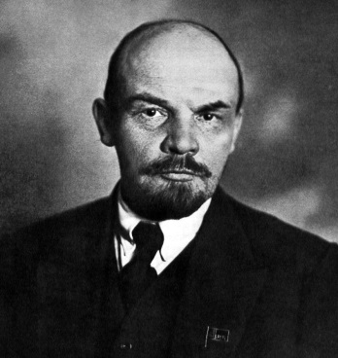
Lenin: The Bolshevik Leader
Lenin’s job during the Civil War was to run the government and organise food and factories in the Red-held area.
But food riots in spring 1918 and starving workers led to industries collapsing – this was no easy job!
To keep the Red Army (the Bolshevik Army) supplied, Lenin introduced a new policy: War Communism.
TASK: Using the information on war communism, on the following slides, answer these questions:
What were the key features of War Communism in towns?
What were the key features of War Communism in the countryside?
How did the Cheka (secret police) make the situation worse?
Why do you think people found it so hard to find food?
Why did the struggle between peasants and those collecting food become so bitter?
What did the Worker’s Opposition want?
Why did the sailors revolt?

Slide 14
War Communism Info – No.1
War Communism in Towns
The government took control of industry and told factories what to produce (make).
The factories were controlled by worker’s committees in 1917, but the committees didn’t run them very well.
So Lenin now put his own managers in charge and strict discipline was used. Some even suggested they were not factories but force labour (work) prisons!
Trade unions, which supported works rights, were not allowed. Workers were not allowed to leave the city they lived in.
Food was rationed but people could only get a ration card if they worked. The bread ration was sometimes as low as 200g per day. Larger rations were given to factory workers and soldiers. The only other way of getting food was on the Black Market.
Money became nearly worthless. In 1920, the rouble (Russian currency) was worth 1% of its 1917 value.
By 1920, wages were often paid in food or other goods, and many people bartered goods instead of using money.
War Communism in the countryside
Lenin desperately needed food to feed the workers. Since the peasants did not want to sell their grain for money which had no value, Lenin sent out units of Cheka (secret police) to take the surplus food by force.
Any peasants found hiding supplies were punished harshly.
Many peasants resisted and there was a bitter struggle. Many peasants decided to produce less grain because they thought it would just get taken away!

Slide 15
War Communism Info – No.2
The Red Terror
As a result of all of this, the Cheka (secret police) became more brutal! This time period was known as the Red Terror. People who opposed (went against) the government were arrested, and shot without a trial. Some were even sent to labour (work) camps.
Many peasants and workers began to think that the workers’ position was worse than when the Tsar (king) had been in charge of the government!
The results of War Communism
By 1921, the economy of Russia was ruined. Industrial production had fallen under War Communism.
The cities were in chaos: gangs of orphaned children roamed the streets, robbery and burglary were common, stolen goods appeared on the Black Market.
‘Bagmen’ rode the trains, bringing supplies into cities to sell and make illegal profit (money) on.
Agriculture (farming) also collapse. The disruption of war and taking extra grain, had led to low amounts of grain being harvested by peasants. They saw little point in growing food.
In 1921, even less grain was grown because of a drought. This led to famine, which killed up to 5 million people.
A huge international aid operation was launched, which was supported by the USA.

Slide 16
War Communism Info – No.3
Resource | 1913 | 1921
Coal | 29 | 9
Oil | 9.2 | 3.8
Iron | 4.2 | 0.1
Steel | 4.3 | 0.2
Sugar | 1.3 | 0.05
Electricity (in million kWh) | 2039 | 520
Opposition to War Communism
As a result of the poor economic situation, many people starting opposing the brutal way Lenin and his Communists were ruling Russia.
The Worker’s Opposition demanded higher wages, better conditions, more food, and workers’ control of industry. Many Bolsheviks were against the Cheka’s use of mass arrests to scare people into submission.
In March 1921, sailors at the Kronstadt naval base led an uprising because they said ‘life under the yoke of the Communist dictatorship has become more terrible than death’. These sailors had originally supported the Bolsheviks! Troops were sent to stop the uprising and 20,000 men were killed and wounded. The sailors were executed or sent to labour (work camps).

Slide 17
Source A: An eye-witness account of the Black Market.
What does this suggest about life in Russia?
What own knowledge supports this?
How is this useful for an historian studying life in Russia after WWI?
Provenance
The Black Market sells everything. There the former rich are selling their last items. The best grand piano sells for half the price of an ordinary record player…The formerly richest and most spoiled are now satisfied if they get some black bread and potatoes each day. An acquaintance of mine, formerly owner of a palace in Moscow, was given as his place of residence, the bathroom of his former [old] home.’
Content
Challenge: Can you use the provenance in your explanation of how useful the source is?
Notes:
Working towards the question: How useful is Source A to an historian studying life in Russia after WWI?
Students to infer from the source (Q1 – linking to basic inference skills to answer the question), add supporting own knowledge (Q2 – linking to supporting with OK in questions), and then explain in relation to the question (Q3 – needed for L3). Challenge includes provenance for L4.

