Slide 1
Capturing images using a camera

Slide 2
Parts of the camera
Objectives :
Plan for a project
Build skills for multimedia
Produce a media product
Body
Lens
Memory Card
Tripod set up

Slide 3
Task 1
Objectives :
Plan for a project
Build skills for multimedia
Produce a media product
Divide into 2 teams
  Your teacher will now divide into :
    Blue Car Team
    Red car Team (7-8 team members )
    This means there will be 2 Red Car teams per class and 2 Blue Car Teams per class )
  Your teacher will tell which team will be able to use the camera at each time.
    Timer will be set
  Plan and story board the pictures you need before you take any pictures
    make sure you complete all of the pictures on you story board

Slide 4
Task 2 Set up and take some pictures
Objectives :
Plan for a project
Build skills for multimedia
Produce a media product
Make use of the shot guide
Think about any special angles you can use
  This will be completed as a team your teacher will let you know haw long you have.
You will also be given an operations sheet

Slide 5
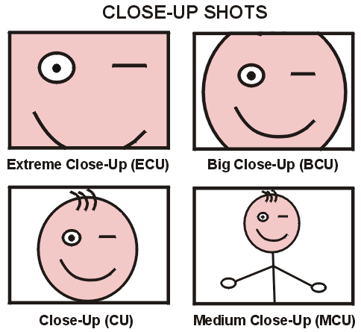
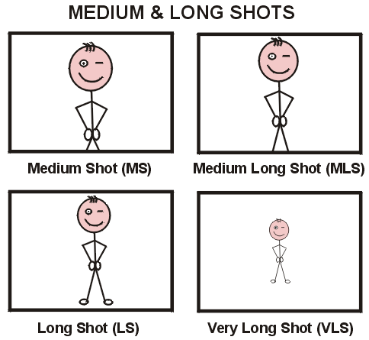
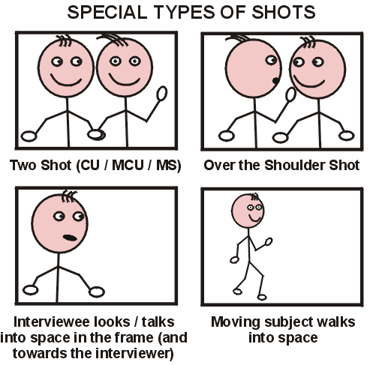
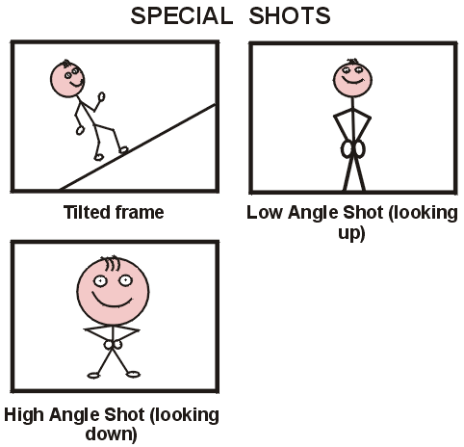
Objectives :
Plan for a project
Build skills for multimedia
Produce a media product

Slide 6
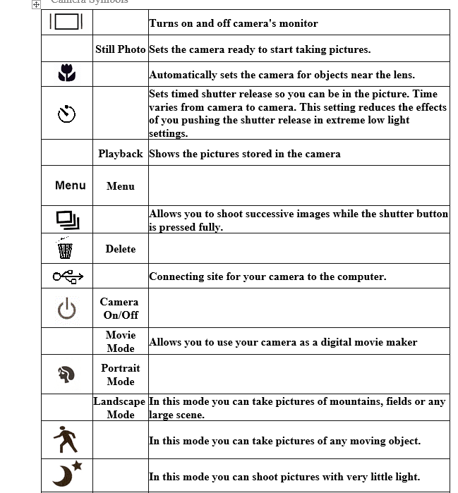
Objectives :
Plan for a project
Build skills for multimedia
Produce a media product

Slide 7
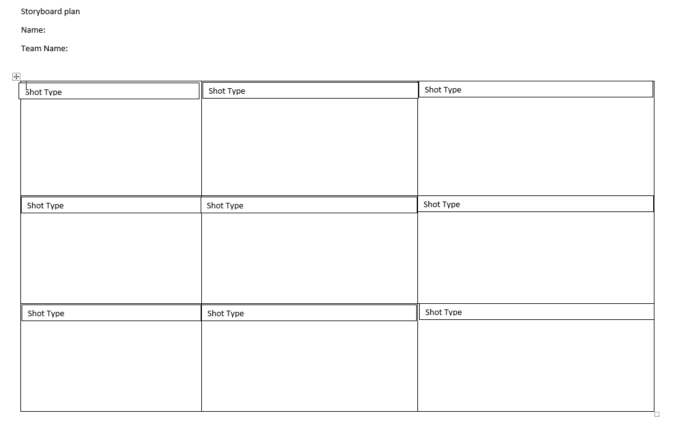
Objectives :
Plan for a project
Build skills for multimedia
Produce a media product

Slide 8

Photo Quality
Objectives :
Plan for a project
Build skills for multimedia
Produce a media product
What makes a photo good or bad quality?
How can we take a
good quality photograph?

Slide 9

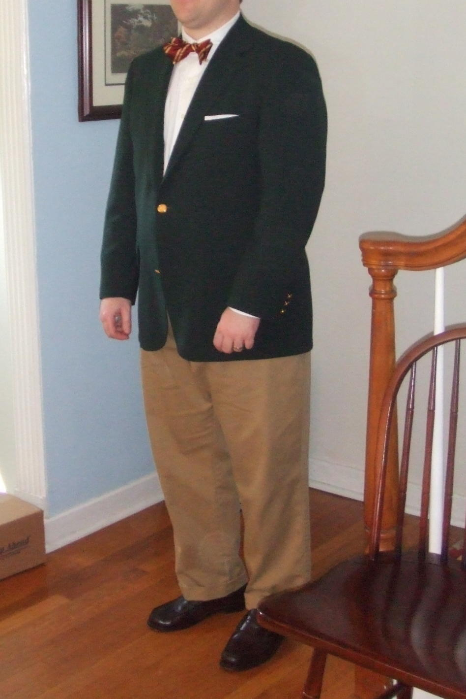
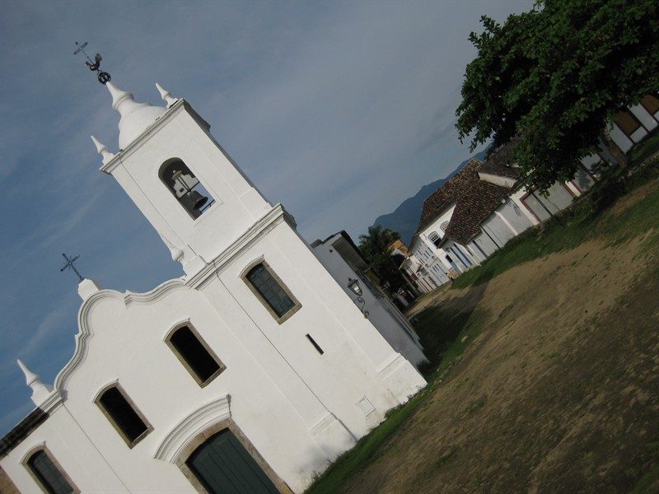
Good or Bad quality?
Objectives :
Plan for a project
Build skills for multimedia
Produce a media product

Slide 10


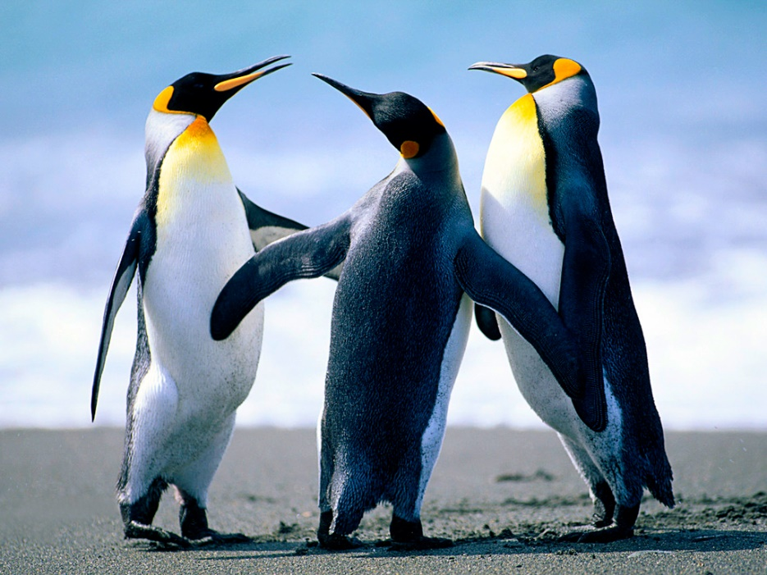
Good or bad quality?
Objectives :
Plan for a project
Build skills for multimedia
Produce a media product

Slide 11
Photos from different perspectives
Objectives :
Plan for a project
Build skills for multimedia
Produce a media product

Slide 12
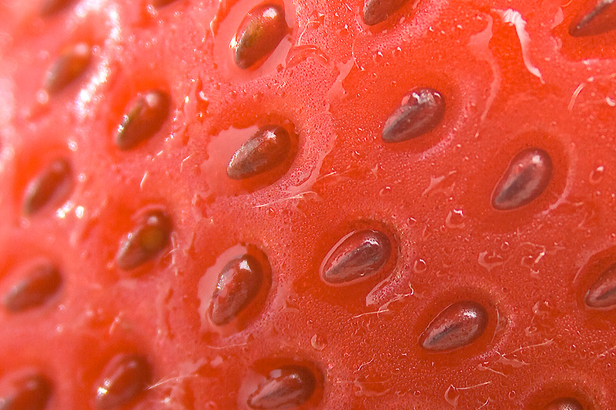
Extreme Close up
Objectives :
Plan for a project
Build skills for multimedia
Produce a media product
Gives effect of high drama

Slide 13

Close up
Objectives :
Plan for a project
Build skills for multimedia
Produce a media product
Gives greater detail

Slide 14

Medium Shot
Objectives :
Plan for a project
Build skills for multimedia
Produce a media product
Gives more general information whilst still providing some detail.

Slide 15

Long Shot
Gives an overview of a ‘subject’ and is able to provide contexts.
Objectives :
Plan for a project
Build skills for multimedia
Produce a media product

Slide 16
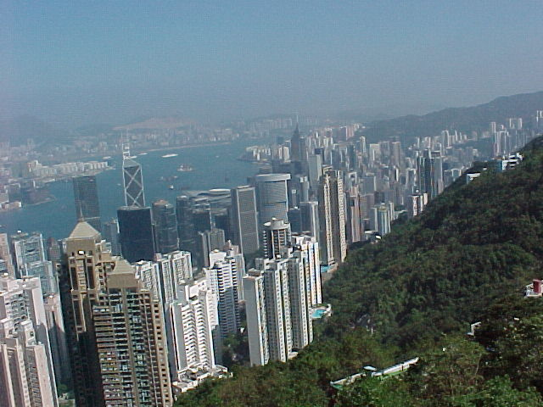
High point of view
Looking down or from above.
To create an effect or a different perspective.
Objectives :
Plan for a project
Build skills for multimedia
Produce a media product

Slide 17
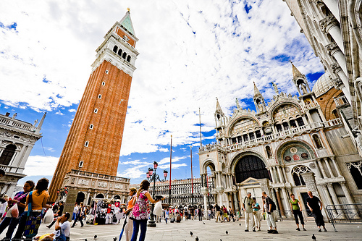
Low point of view
Objectives :
Plan for a project
Build skills for multimedia
Produce a media product
Looking up or from below.
To create an effect or a different perspective.

Slide 18
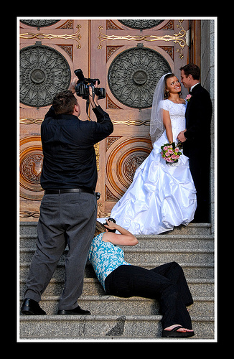
Taking a photo from different perspectives
From a high point of view
From a low point of view
Objectives :
Plan for a project
Build skills for multimedia
Produce a media product

