Slide 1
Photoshop Tasks
Insert Name Here
Notes:
For every Photoshop task you complete, you should explain the steps you took in the speakers notes section of your Google Slides document

Slide 2
The Brief
Link to CM website: tutorials
Are you the next new talented media producer?
TeenScene Media are running a competition to discover the next generation of talented teenage media producers.
You will need to prove you are able to experiment with a wide range of media skills and techniques, and to apply these to ‘re- imagine’ an existing media product for a new teenage audience.
You must build a portfolio showing your development of media production skills and techniques in the publishing sector.
To begin your portfolio, you should show that you have the knowledge to skilfully and creatively experiment with production skills to refine and edit content. This could include editing, adding effects, creating graphics, scaling etc.

Slide 3
How to use this booklet
For every task you do in Photoshop, take a screenshot of your image before you begin, and place it in the area labelled “Original”
Once you have edited your image, save it and upload it to the assignment on Google Classroom you downloaded it from.
Then place the edited image in the area labelled “Edited”
See the example on the next slide.

Slide 4
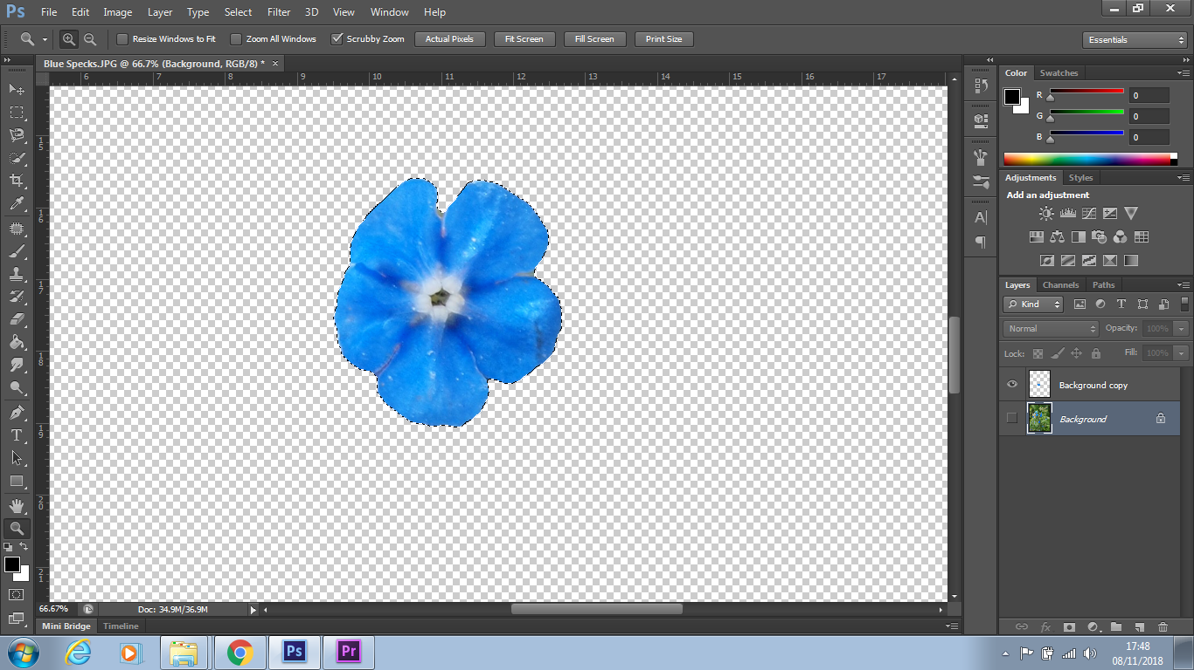
Selecting and Refining Edge
EXAMPLE
Original
Edited
Notes:
Describe your editing process, using the correct terminology.
When might you use this technique in a professional working practice?
How successful were you when completing this task? How do you know?
To select and refine the edge of this object, I used the “Quick Select Tool”, and then went to Select / Refine Edge. I then used “Shift Edge” and “Feather” toolbars to create a smoother, less rough outline around my object. I then made sure this outputted to a New Layer.
In a professional working practice, I might use this to remove an object from a background cleanly to put on a new image, or adjust the original shape, such as when editing a photo for a magazine or book cover.
I was successful in completing my task, and I know this as the edges of my object were not pixelated or rough, and were smooth and clean. The cut-out was also outputted to a brand new layer.

Slide 5
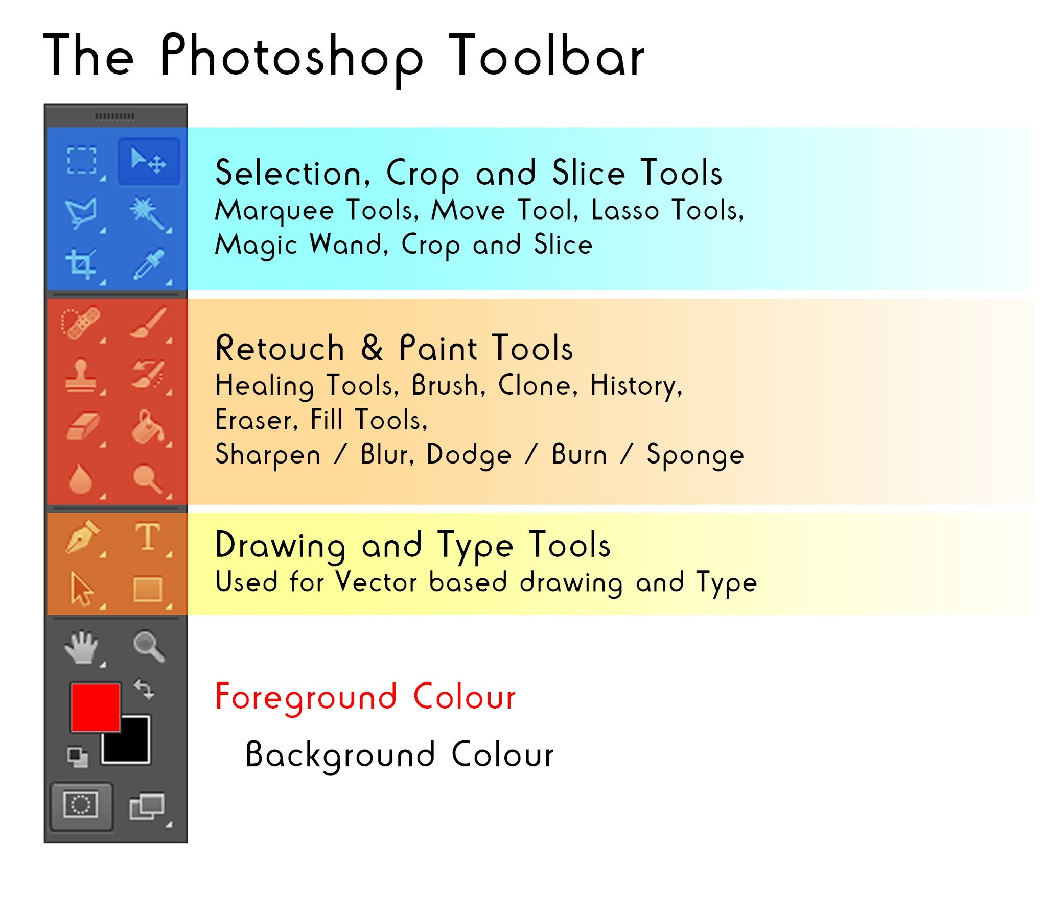

Slide 6
Scaling and cropping
Original
Edited

Slide 7
Selecting and Refining Edge
Challenge
Original
Edited

Slide 8
Colour Correction
Original
Edited

Slide 9
Adjustment Layers
Challenge
Original
Edited

Slide 10
Image Manipulation
Original
Edited

Slide 11
Image Manipulation (with colour correction)
Challenge
Original
Edited

Slide 12
Content Fill Aware
Original
Edited

Slide 13
Clone Brush Tool
Challenge
Original
Edited

Slide 14
Healing Brush tool
Original
Edited

Slide 15
Red Eye Removal
Original
Edited

Slide 16
Retouching with dodge and burn
Challenge
Original
Edited

Slide 17
Placement and editing of text
Original
Edited

Slide 18
Discuss your progress in each task
Write a paragraph into the speaker notes section of each media product answering the following questions
Describe your editing process, using the correct terminology.
When might you use this technique in a professional working practice?
How successful were you when completing this task? How do you know?
Use full sentences
Use software and media terminology accurately
Check your SPAG

