Slide 1
Narrative – what the specification says…
Narrative structures: linear, non-linear, circular, interactive, open/closed, single/multi-strand.

Slide 2
Objectives
Be able to describe linear, non-linear, circular, interactive, open/closed, single/multi-strand narrative structures and analyse how they are used to effectively create meaning and engage selected audiences.

Slide 3
Narrative and Story
Connect
Think of a well known story
Alice in Wonderland
Hansel and Gretel
Jack and the Beanstalk
Write down the start, middle and end of the story

Slide 4
Narrative and Story
Connect
What is the difference?
Story has a beginning, middle and end
Narrative is the order the story is told
All media texts have a narrative
Notes:
So therefore some products may follow different narratives, possibly with the end of the story first…

Slide 5
Narrative
2 main types of narrative (the order in which a story is told)
Linear
Non Linear

Slide 6
Linear Narrative
The story has a beginning, a middle and an end, told in that order.
This can be referred to as Classic Hollywood Narrative.
A B C D E
Can you think of any moving image
products that have a linear narrative?

Slide 7
Non-Linear Narrative
Story told in any order that is NOT
A B C D E
Can you think of some examples?
Why choose this style of story telling?

Slide 8
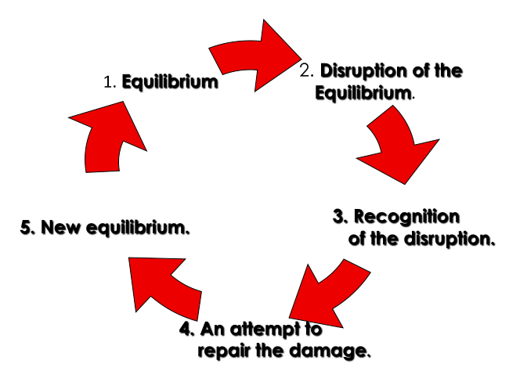
Todorov’s Narrative Theory
Notes:
Todorov is a theorist that argues that all narratives follow the same structure. An equilibrium where everything starts off fine, then something happens to distrupt that equilibrium with a journey to restore it, then ending with the equilibrium restored. The next slide gievs an example of how this works in the film the hangover.

Slide 9
Bob the Builder
https://www.youtube.com/watch?v=WaURWflzS-c
Notes:
Watch the episode above and ask pupils to write down when each stage of Todorov’s narrative structure is realised.

Slide 10
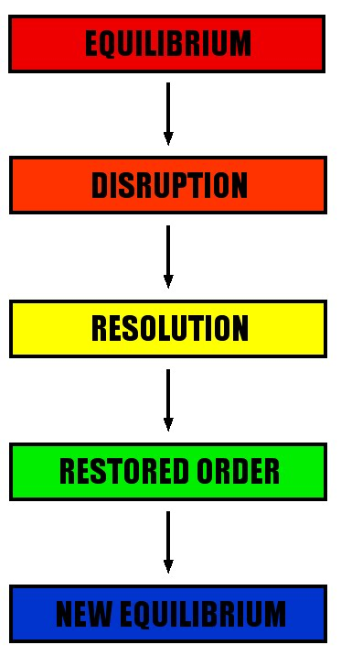
Todorov’s Narrative Theory
One of the main characters is
supposed to be getting married.
The group go on a ‘party’, losing the groom.
Group set about finding the groom.
Group finds the groom.
Main character gets married.
Notes:
Further example to discuss with the class

Slide 11
Apply this theory to 2-3 films you have watched
Film | Shooter | Bob the builder
Equilibrium | By himself. Calm. Chilling with his dog. | New boots – really happy.
Disruption | FBI want him to come out of retirement to do one last job. | They squeaked.
Recognition of the disruption | No choice. Been set up. Shot in the leg. | Other characters noticed. Mice started following him.
Attempt to repair the damage | Sets about trying to set up the FBI. | Walk off the squeak.
New Equilibrium | Succeeds – bad guys at FBI get what is coming to them. | Boots had stopped squeaking.
Notes:
Ask pupils to neatly copy this in their books. Or have it set up on Google classroom and have groups of pupils working collaboratively on it.

Slide 12
Open Narratives
A narrative which has no ending or is open to interpretation
e.g. Harry Potter
Maze Runner
Spiderman

Slide 13
Closed Narratives
A narrative with a definite, unquestionable ending.
e.g. The hangover

Slide 14
Single Strand Narratives
When a programme/film only has one narrative.
e.g. Finding Nemo

Slide 15
Multi strand Narratives
A number of different narratives within the same programme/film which finish by the end.
e.g. Coronation Street

Slide 16
Narrative Style (with an example) | Engages the audience by… (how does it make them feel) | Generates meaning by… (what does it make the audience think is happening/going to happen?)
Open Narrative
Closed Narrative
Single Strand Narrative
Multi Strand Narrative

Slide 17
Get the grade
Include lots and lots of examples from the product
Grade | What you HAVE to do…
Level 2 Pass | Identify the narrative structure. Describe the narrative structure with examples from the product. The product uses the narrative structure XXX in the product when…
Level 2 Merit/Distinction | The narrative structure XXX in the clip engages the audience by… because it… generates the meaning of… Therefore,… As a result… An example of this from the clip is …
Todorov
Linear
Non-linear
Single/multi strand
Open/closed

