Slide 1
Component 2 LA A
Vocational Brief

Slide 2

Spaced Retrieval Task: What can you remember?
Last term...
List as many photoshop tools as you can remember from last term...
Last term...
What is the file type suffix for a photoshop file?
Last term...
What does ‘conventions of the genre’ mean? Give an example...

Slide 3
Spaced Retrieval Task: What can you remember?
Last term...
When explaining a primary target audience, what three main things should be included?
Last term...
Who is the media producer?
Last week...
What is the suffix for a photoshop file? And what information does this format include that a .jpeg does not?

Slide 4

Spaced Retrieval Task: What can you remember?
Last term...
Describe this font. (3 points)
Last term...
How has the media producer used this design to communicate with the audience?
Last term...
What event might this be advertising? Where might you see this graphic? Who are the target audience?

Slide 5
Spaced Retrieval Task: What can you remember?
Last week
What is the opposite to a ‘light’ font….? What does ‘light’ mean?
Last week...
The brief you have been set requires certain technical details to be included what are they?
Last term...
What do all novel book covers have on them… the common characteristics?

Slide 6
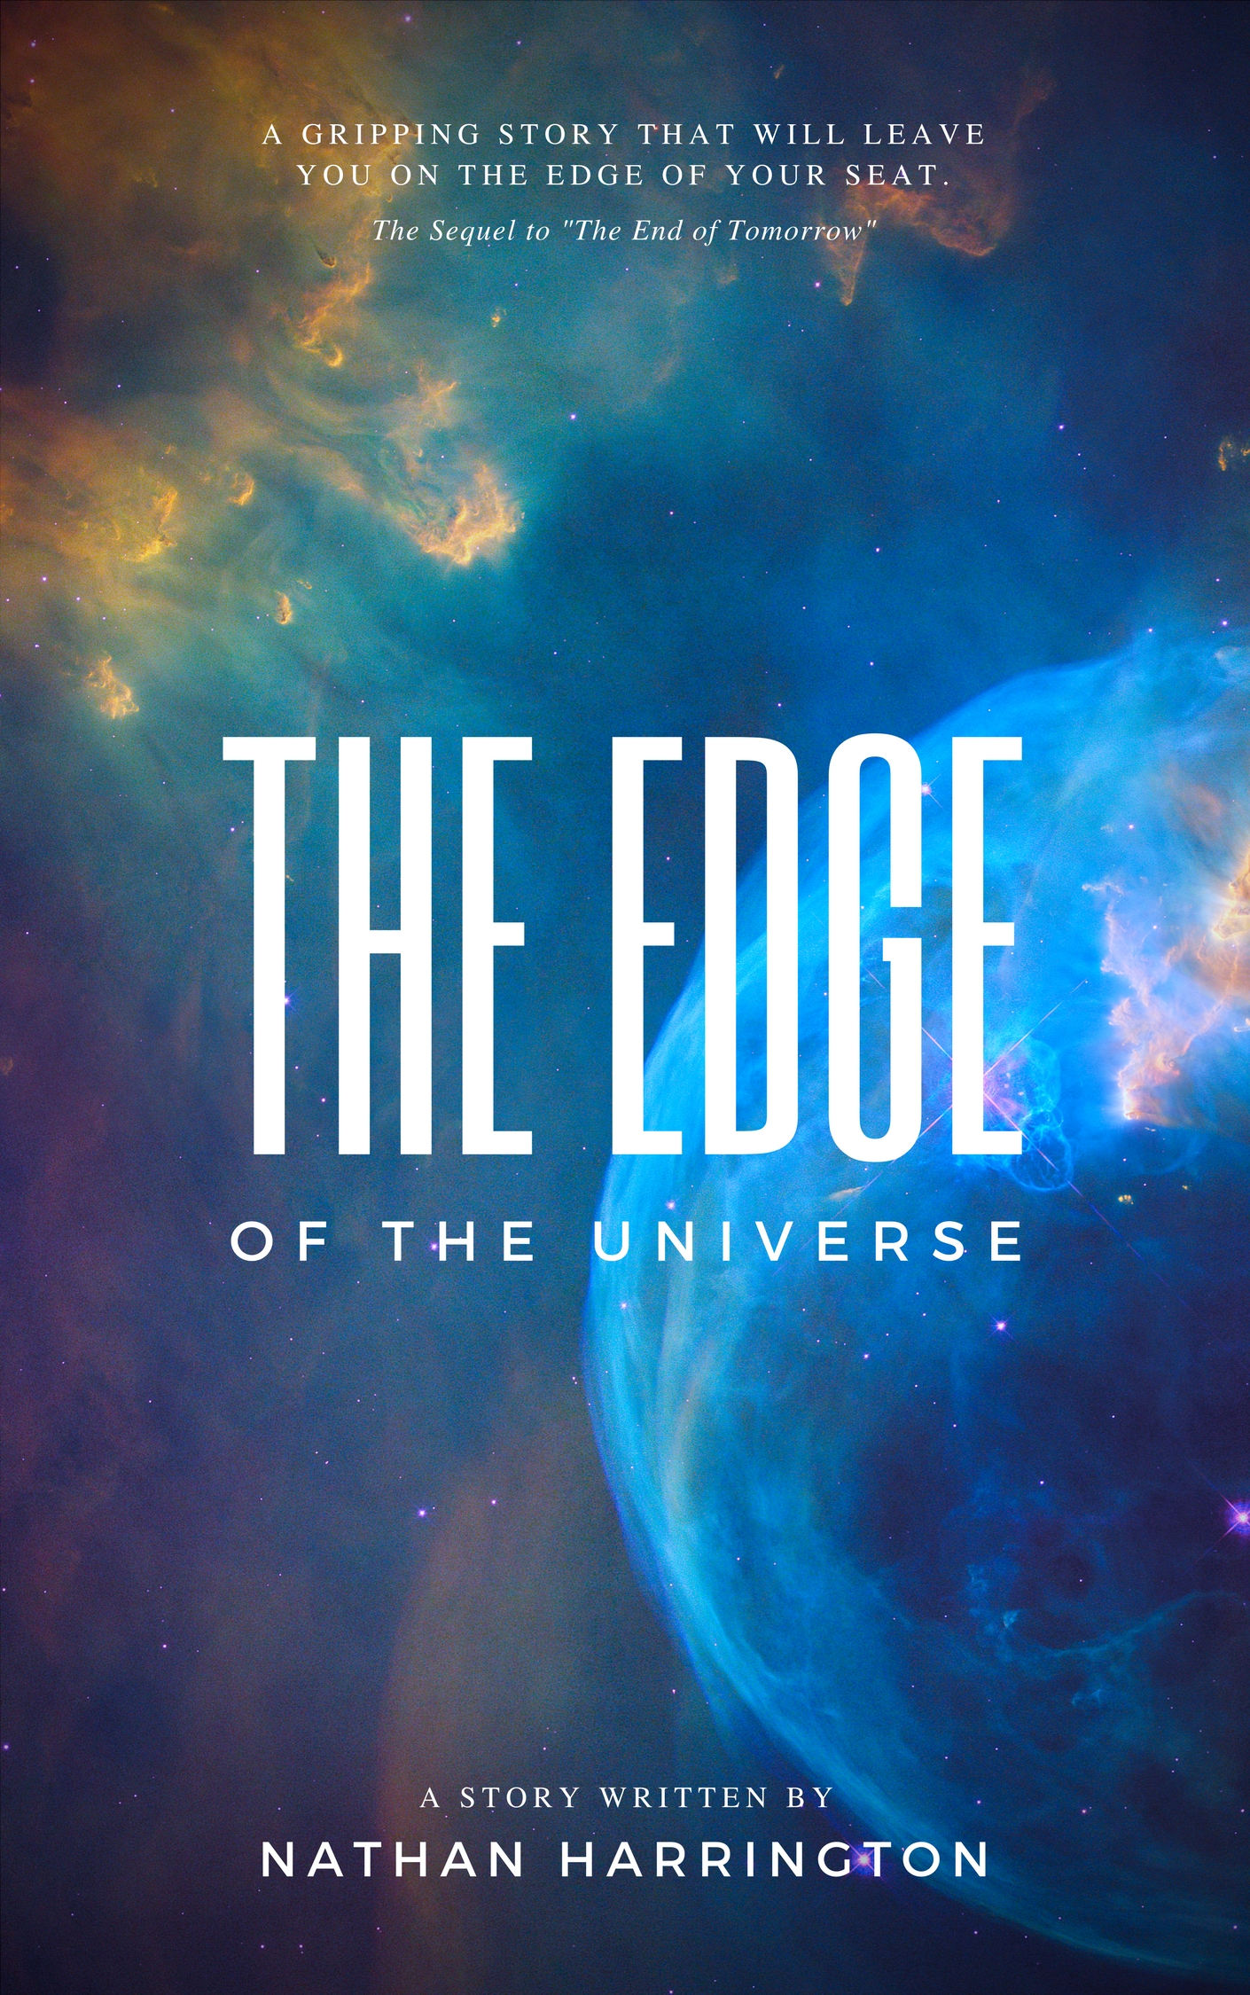
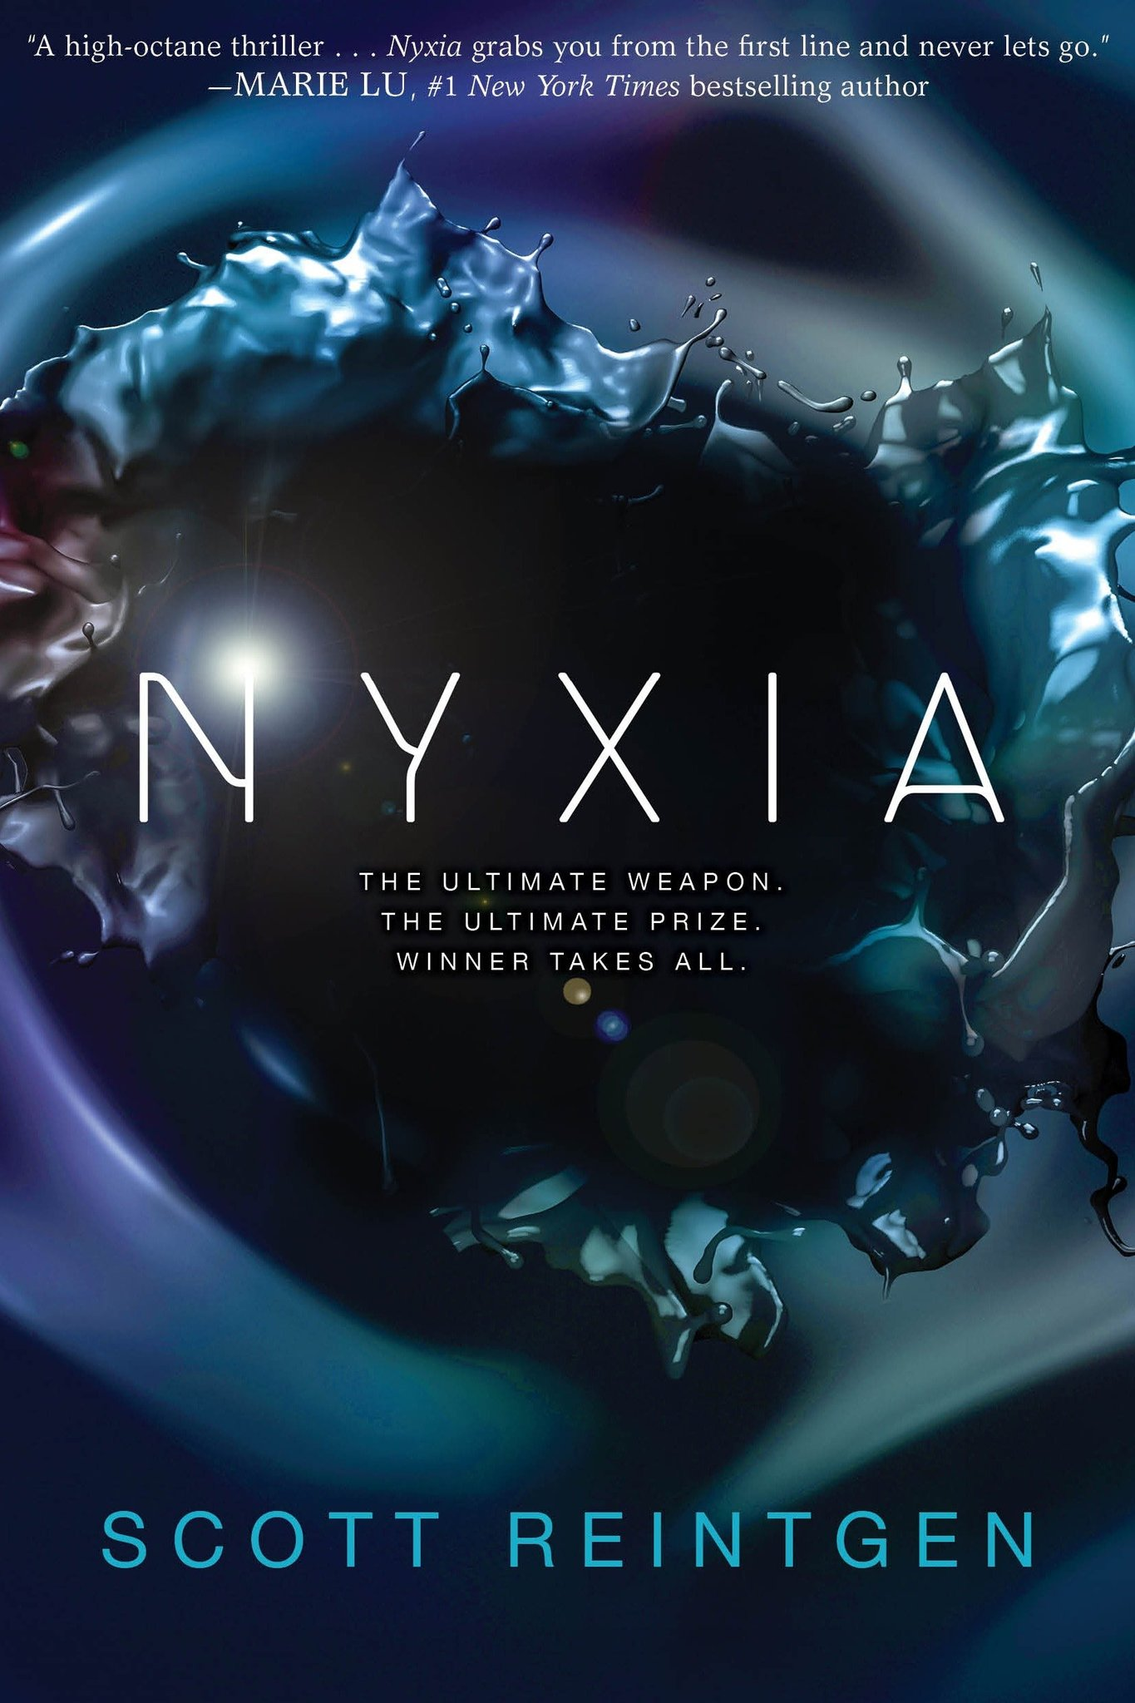
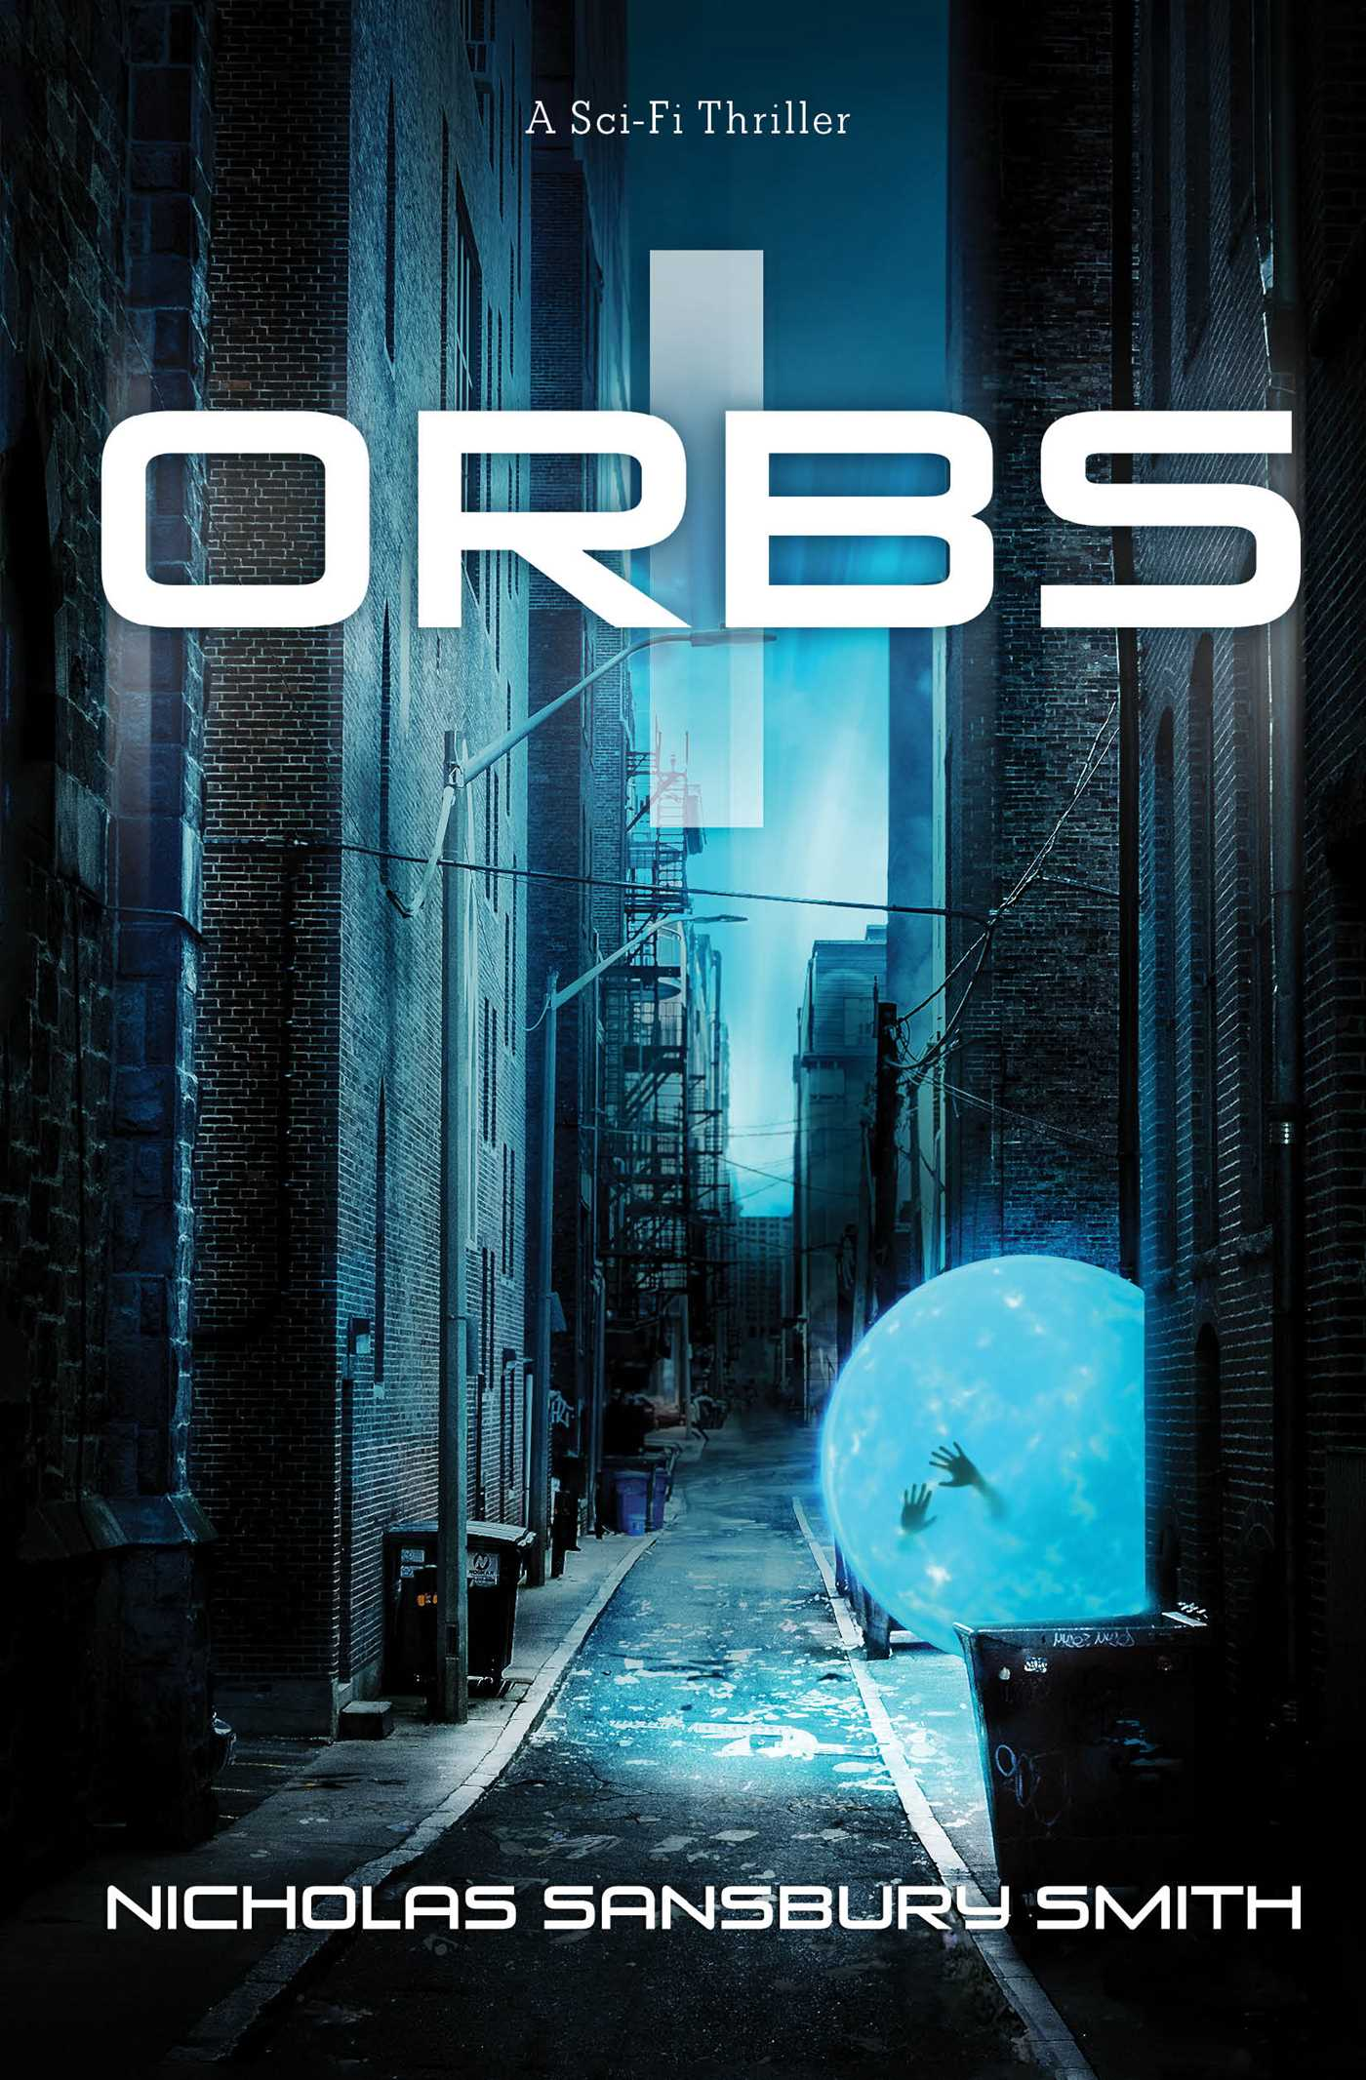
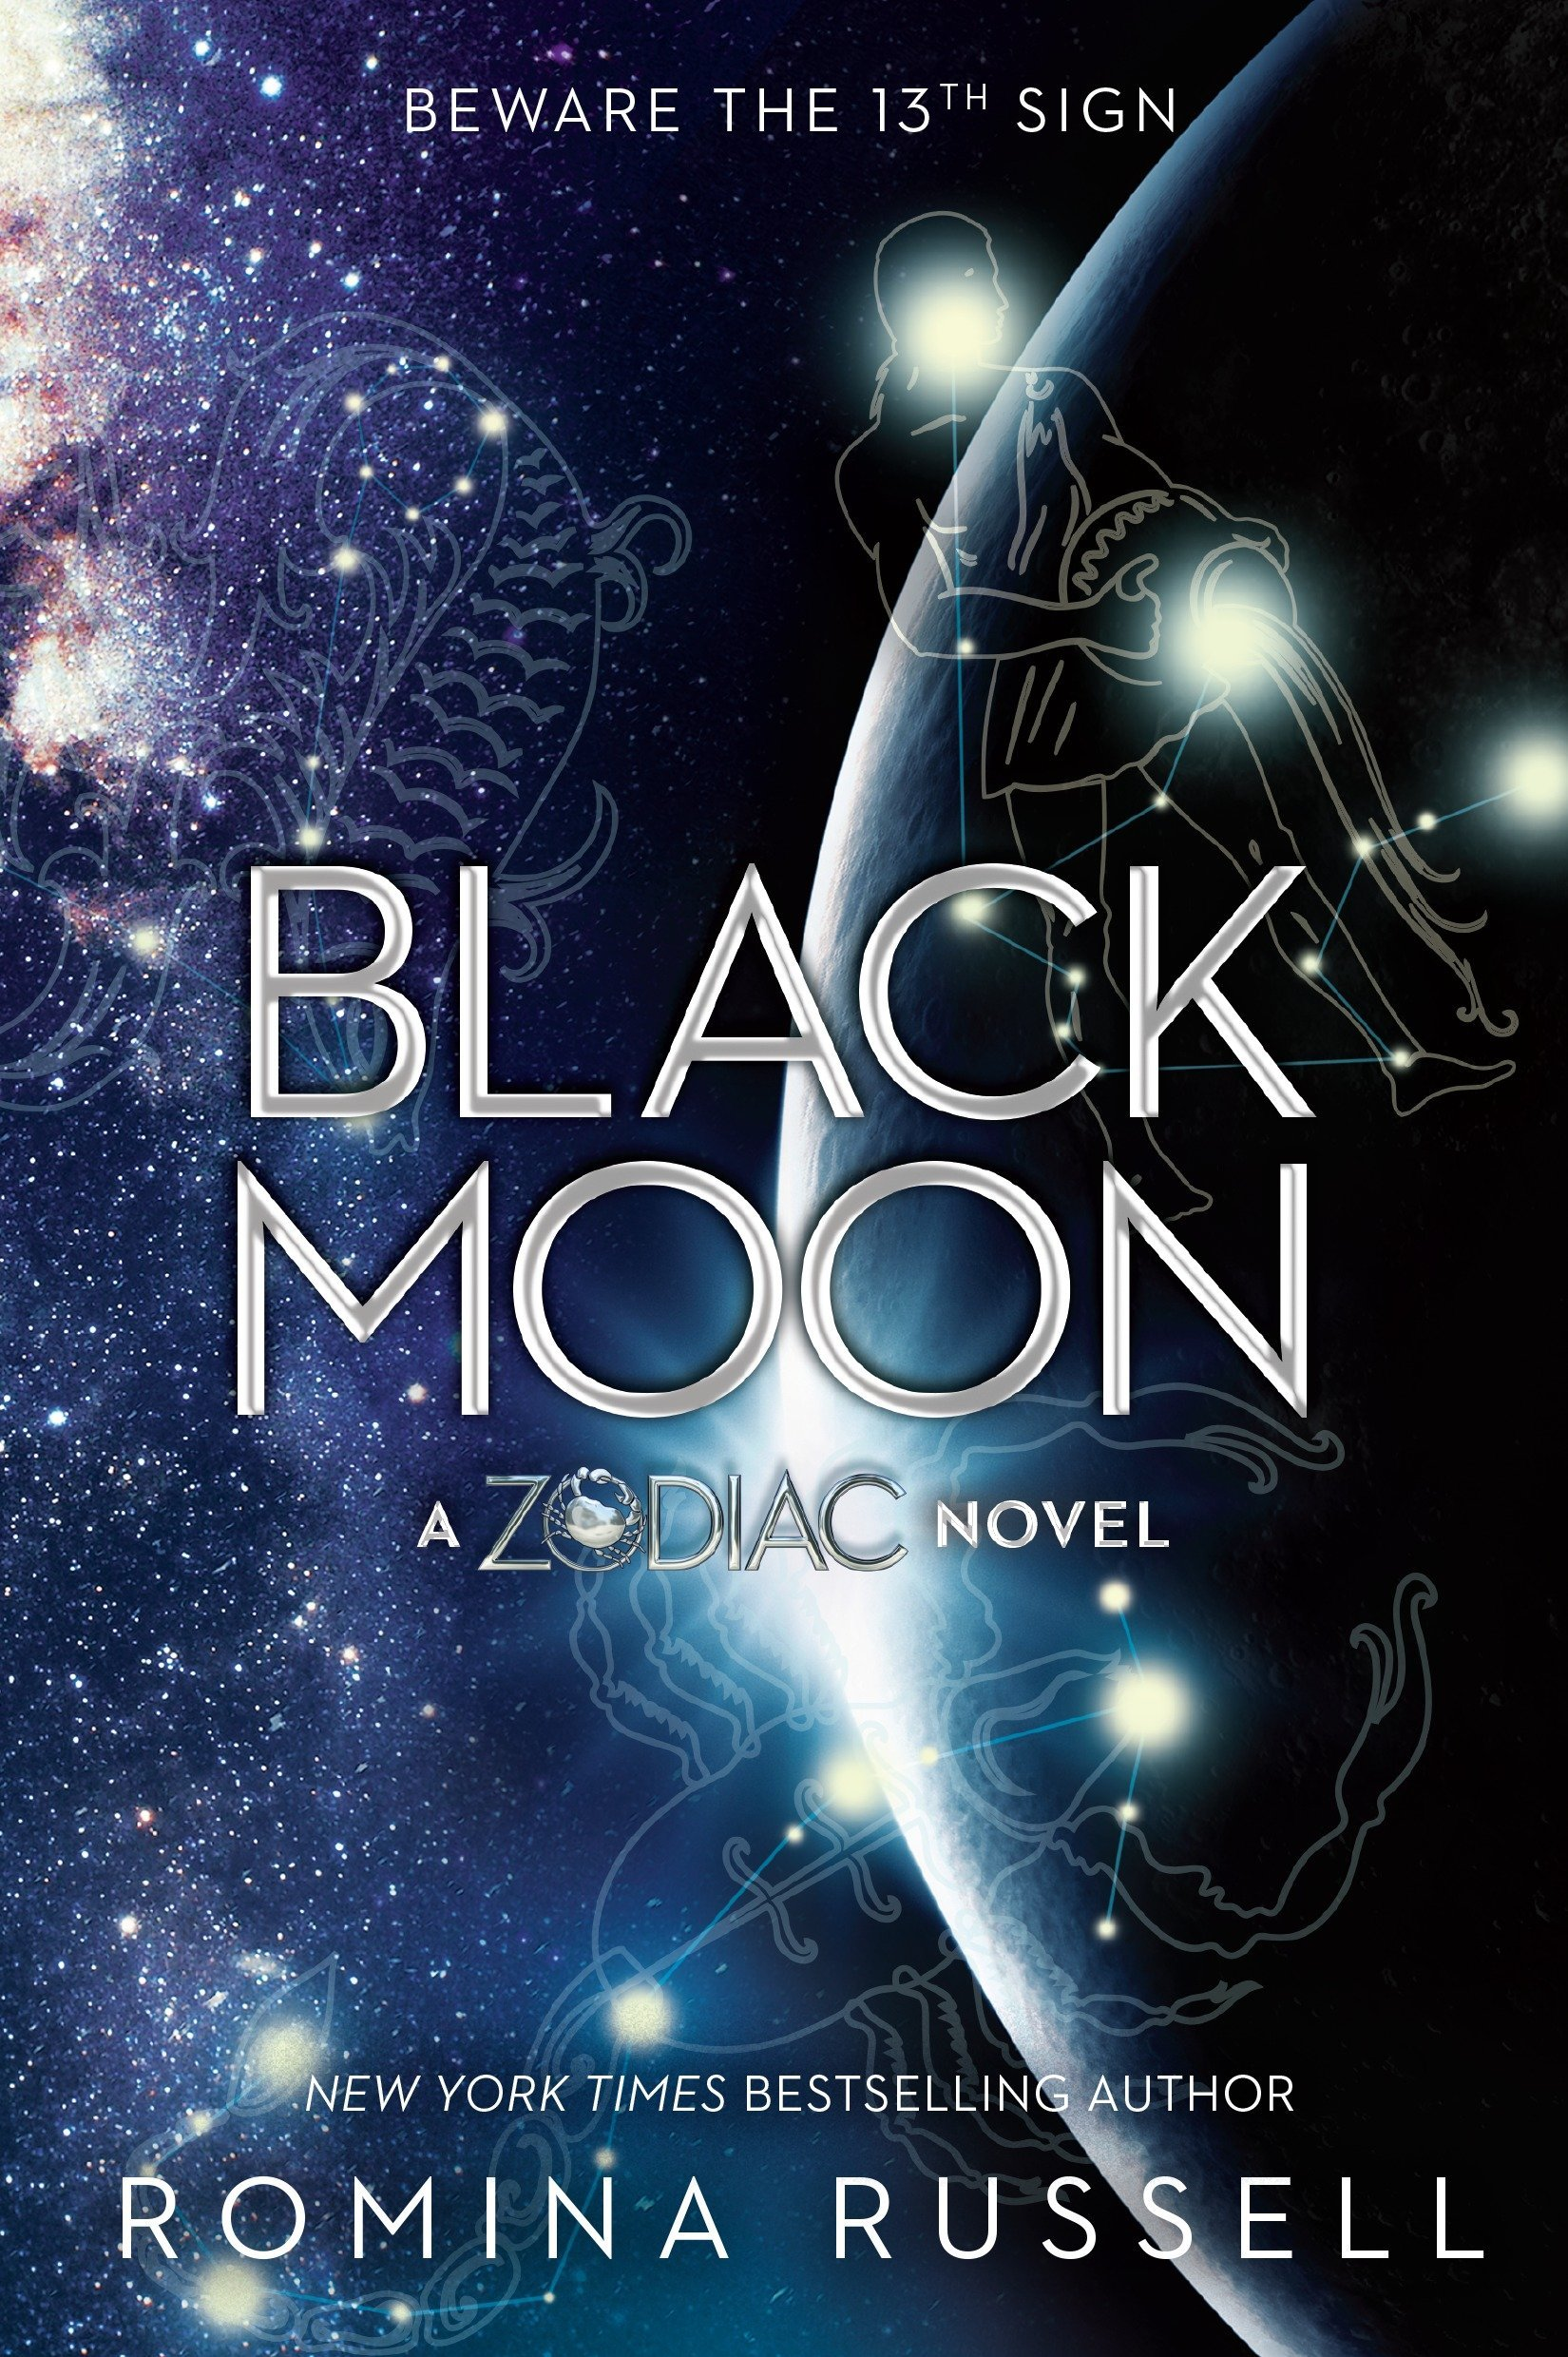
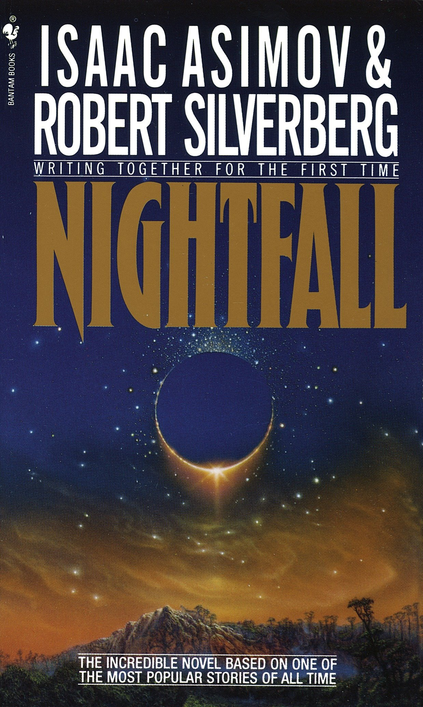
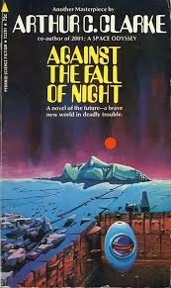
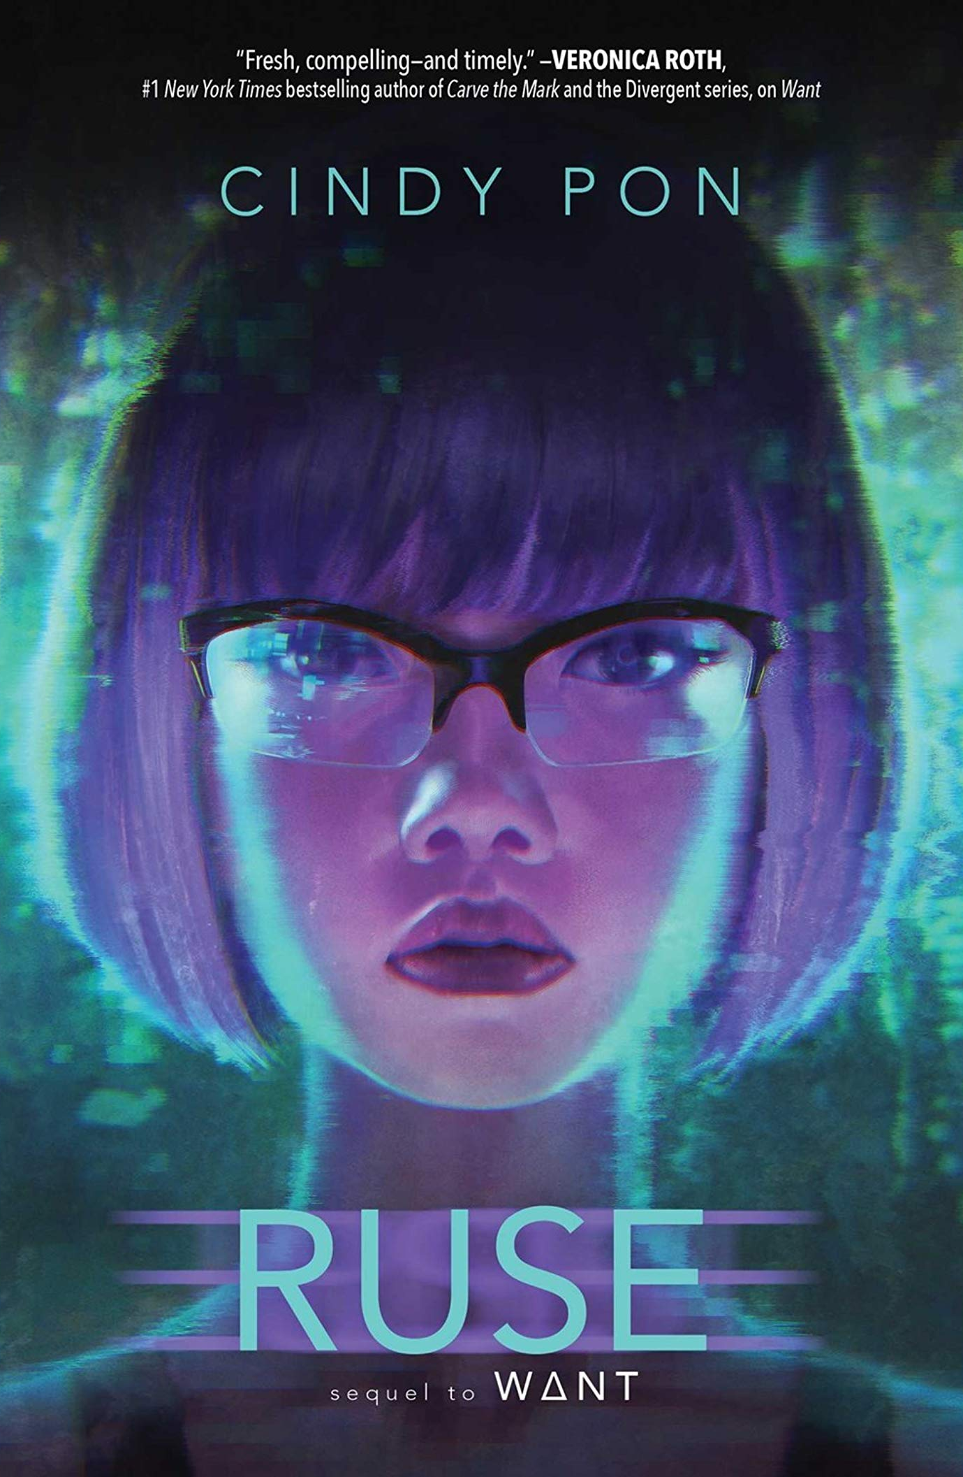
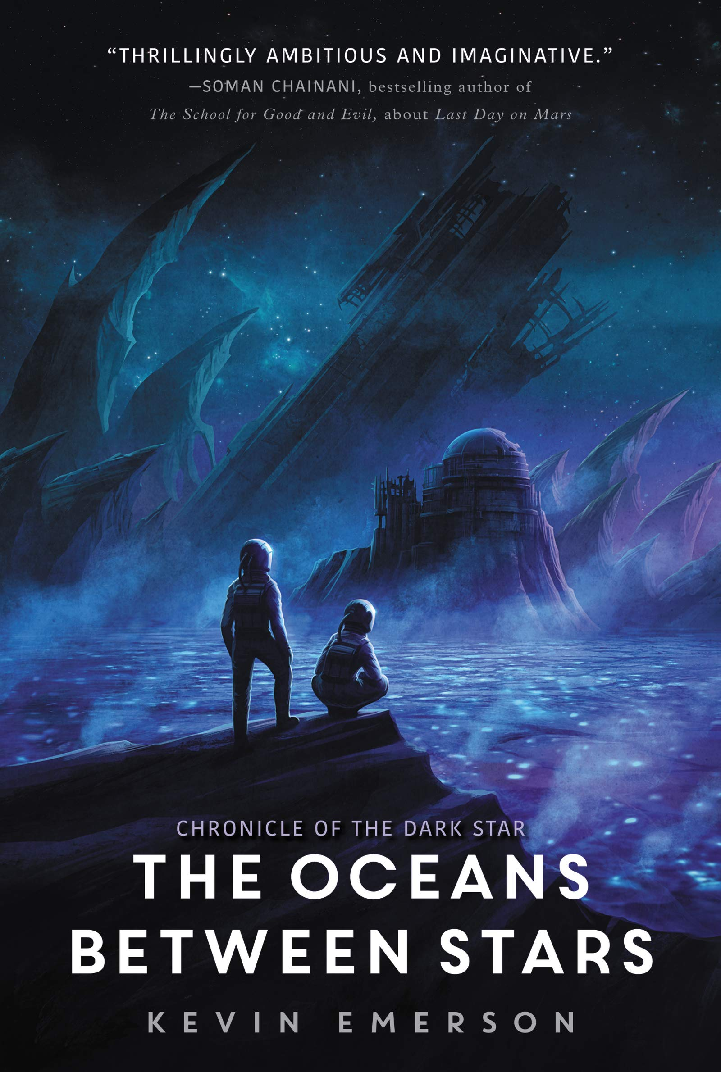
Analysis
Look at some of these science - fiction book covers. How do you know these belong to the science-fiction genre?
What do all of the covers include? Are there any covers here that don’t use what you’d expect to see?
Think about colours, fonts, images, etc...

Slide 7
Codes and conventions of the science-fiction genre - book cover
Colours
Darker colours such as blues, blacks and whites
Fonts
Extra bold or light condensed san serif fonts
Images
Space
Planets
Futuristic images
Challenge:
Can you explain why these codes and conventions are common in science fiction? How do they make the audience feel?

Slide 8
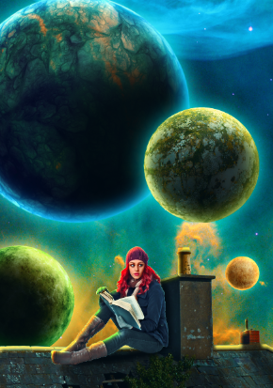
Recognising Assets
Look at the artwork for this science-fiction book cover. Identify the separate images used to create it.
What Photoshop tools would have been used to prepare the images for this book cover?
The image extraction?
The image layout?
The special effects?
The colours?
Key word:
Asset -Media assets are the graphics, videos, audio, animations maps, and other artistic data that go into media products

Slide 9
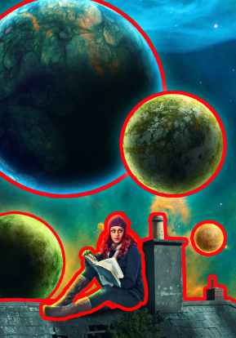
Image Extraction
Girl, Roof, Planets
Selected using Pen Tool / Polygon Tool
Background removed with Refine Edge Tool
Image Layout
Space background and composition
Copied and Pasted onto Layers and arranged in order
Special Effects
Planet Glow
Added using Blending Options
Shadows
Paintbrush with Gaussian Blur
Colour Changes
Added by using Layer Adjustments
Link to tutorial on CM website

Slide 10
What is a vocational brief?
A vocational brief contextualises a project by using a real-life or employment- based scenario. This typically draws on the broader attributes valued in the creative industry, such as planning, problem-solving and communicating, as well as the more general skills needed in work, like independent learning, following a brief, and working towards a deadline.
Contextualises - to place something in a particular setting

Slide 11
What will a vocational brief include?
A defined start date
A completion date
Clear requirements for the evidence that you need to provide.
The vocational brief will also give you an audience and a purpose.

Slide 12
Vocational Brief 1
Start Date:
Deadline for Submission:
Scholastic has approached you to produce the front cover for a new Young Adult Sci-Fi novel to be published later this year. The design you produce will also be used in advertisements to promote the book, and so it must show that the book is an entertaining read for teenages aged 13-15. The cover must target the audience consistently across all areas, including the main image, the use of colours, and the choice of fonts.
Scholastic has also requested that along with the cover itself, you also show evidence of your work in progress, as well as an explanation of the techniques you have used to create the cover.
The final cover must be submitted as an A5 300dpi document saved in an appropriate format, alongside the original PSD.

Slide 13
Technical Details
Title - “Jenny Starchild: Odyssey”
Author Name: Suzanne Lorde
Notes from the author:
For the cover, I would like to see the main character sitting on a rooftop, looking out into the night sky. The sky should contain several different alien planets, as her journey across the galaxy is one of the main plots of the novel. The theme of my story is exploration into other worlds, so I need the cover to be exciting and mysterious.
I want the cover to look like a classic sci-fi novel, so I would like the final cover to have blue and purple tones.

Slide 14
Key Information
Go through the vocational brief and the author notes, and highlight the essential information.
Can you tell me:
The start date?
The deadline submission?
What is the product you have been asked to design?
The audience?
The purpose?
What evidence is needed?
Challenge Task
How does the author want the cover to feel?
How could you use image manipulation techniques to show you this?

Slide 15
Vocational Brief 1
Start Date: 18-1-19
Deadline for Submission: 1-2-19
Scholastic has approached you to produce the front cover for a new Young Adult Sci-Fi novel to be published later this year. The design you produce will also be used in advertisements to promote the book, and so it must show that the book is an entertaining read for teenages aged 13-15. The cover must target the audience consistently across all areas, including the main image, the use of colours, and the choice of fonts.
Scholastic has also requested that along with the cover itself, you also show evidence of your work in progress, as well as an explanation of the techniques you have used to create the cover.
The final cover must be submitted as an A5 300dpi document saved in an appropriate format, alongside the original PSD.

Slide 16
Technical Details
Title - “Jenny Starchild: Odyssey”
Author Name: Suzanne Lorde
Notes from the author:
For the cover, I would like to see the main character sitting on a rooftop, looking out into the night sky. The sky should contain several different alien planets, as her journey across the galaxy is one of the main plots of the novel. The theme of my story is exploration into other worlds, so I need the cover to be exciting and mysterious.
I want the cover to look like a classic sci-fi novel, so I would like the final cover to have blue and purple tones.

Slide 17
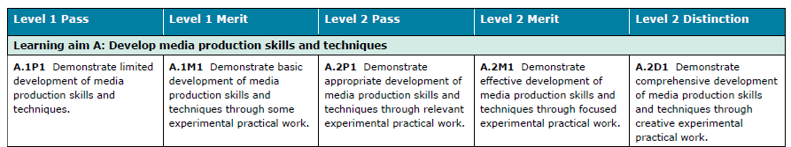
Assessment criteria

Slide 18

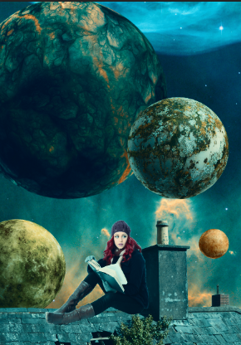
Skills used:
Copy and Paste
Selecting and Refining Edge
Working with layers
Colour Correction / Adjustment Layers

Slide 19
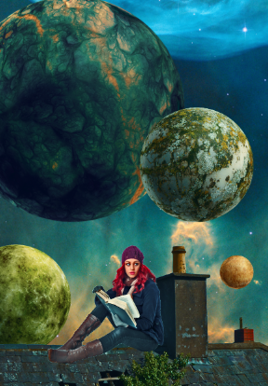
Skills used:
Copy and Paste
Selecting and Refining Edge
Working with layers
Colour Correction / Adjustment Layers
Eraser Tool
Levels
Curves

Slide 20
Skills used:
Copy and Paste
Selecting and Refining Edge
Working with layers
Colour Correction / Adjustment Layers
Layer Masks
Levels
Curves
Blending Options
Layer Modes

Slide 21
Your Task
Using the assets provided, create your own version of the science-fiction book cover requested in the brief.
As part of this task, you are expected to show your work in progress, and the tools you’ve used to create it. Screenshot frequently, and paste these screenshots into your Progress Log.
You will need to clearly evidence each and every tool used, before and after, and describe the impact each change has on the overall effect, in line with the original brief.
Save all assets in your Home area - CM folder - Vocational Brief folder

Slide 22
Plan your ideas
On the template provided, plan two different ideas for your response to the brief.
For each idea, explain your creative choices:
Layout
Colour palette
Special effects
Explain = describe what it will look like, which tools you plan to use to achieve this and what overall effect you are trying to achieve making explicit reference to the brief and indicating which science fiction book cover has influenced you.

Slide 23
Vocational brief planning sheet: Science Fiction book cover
Name:
Design Idea 1
Design Idea 2
Layout:
Layout:
Colour palette:
Colour palette:
Photoshop tools:
Photoshop tools:
Special effects:
Special effects:

Slide 24
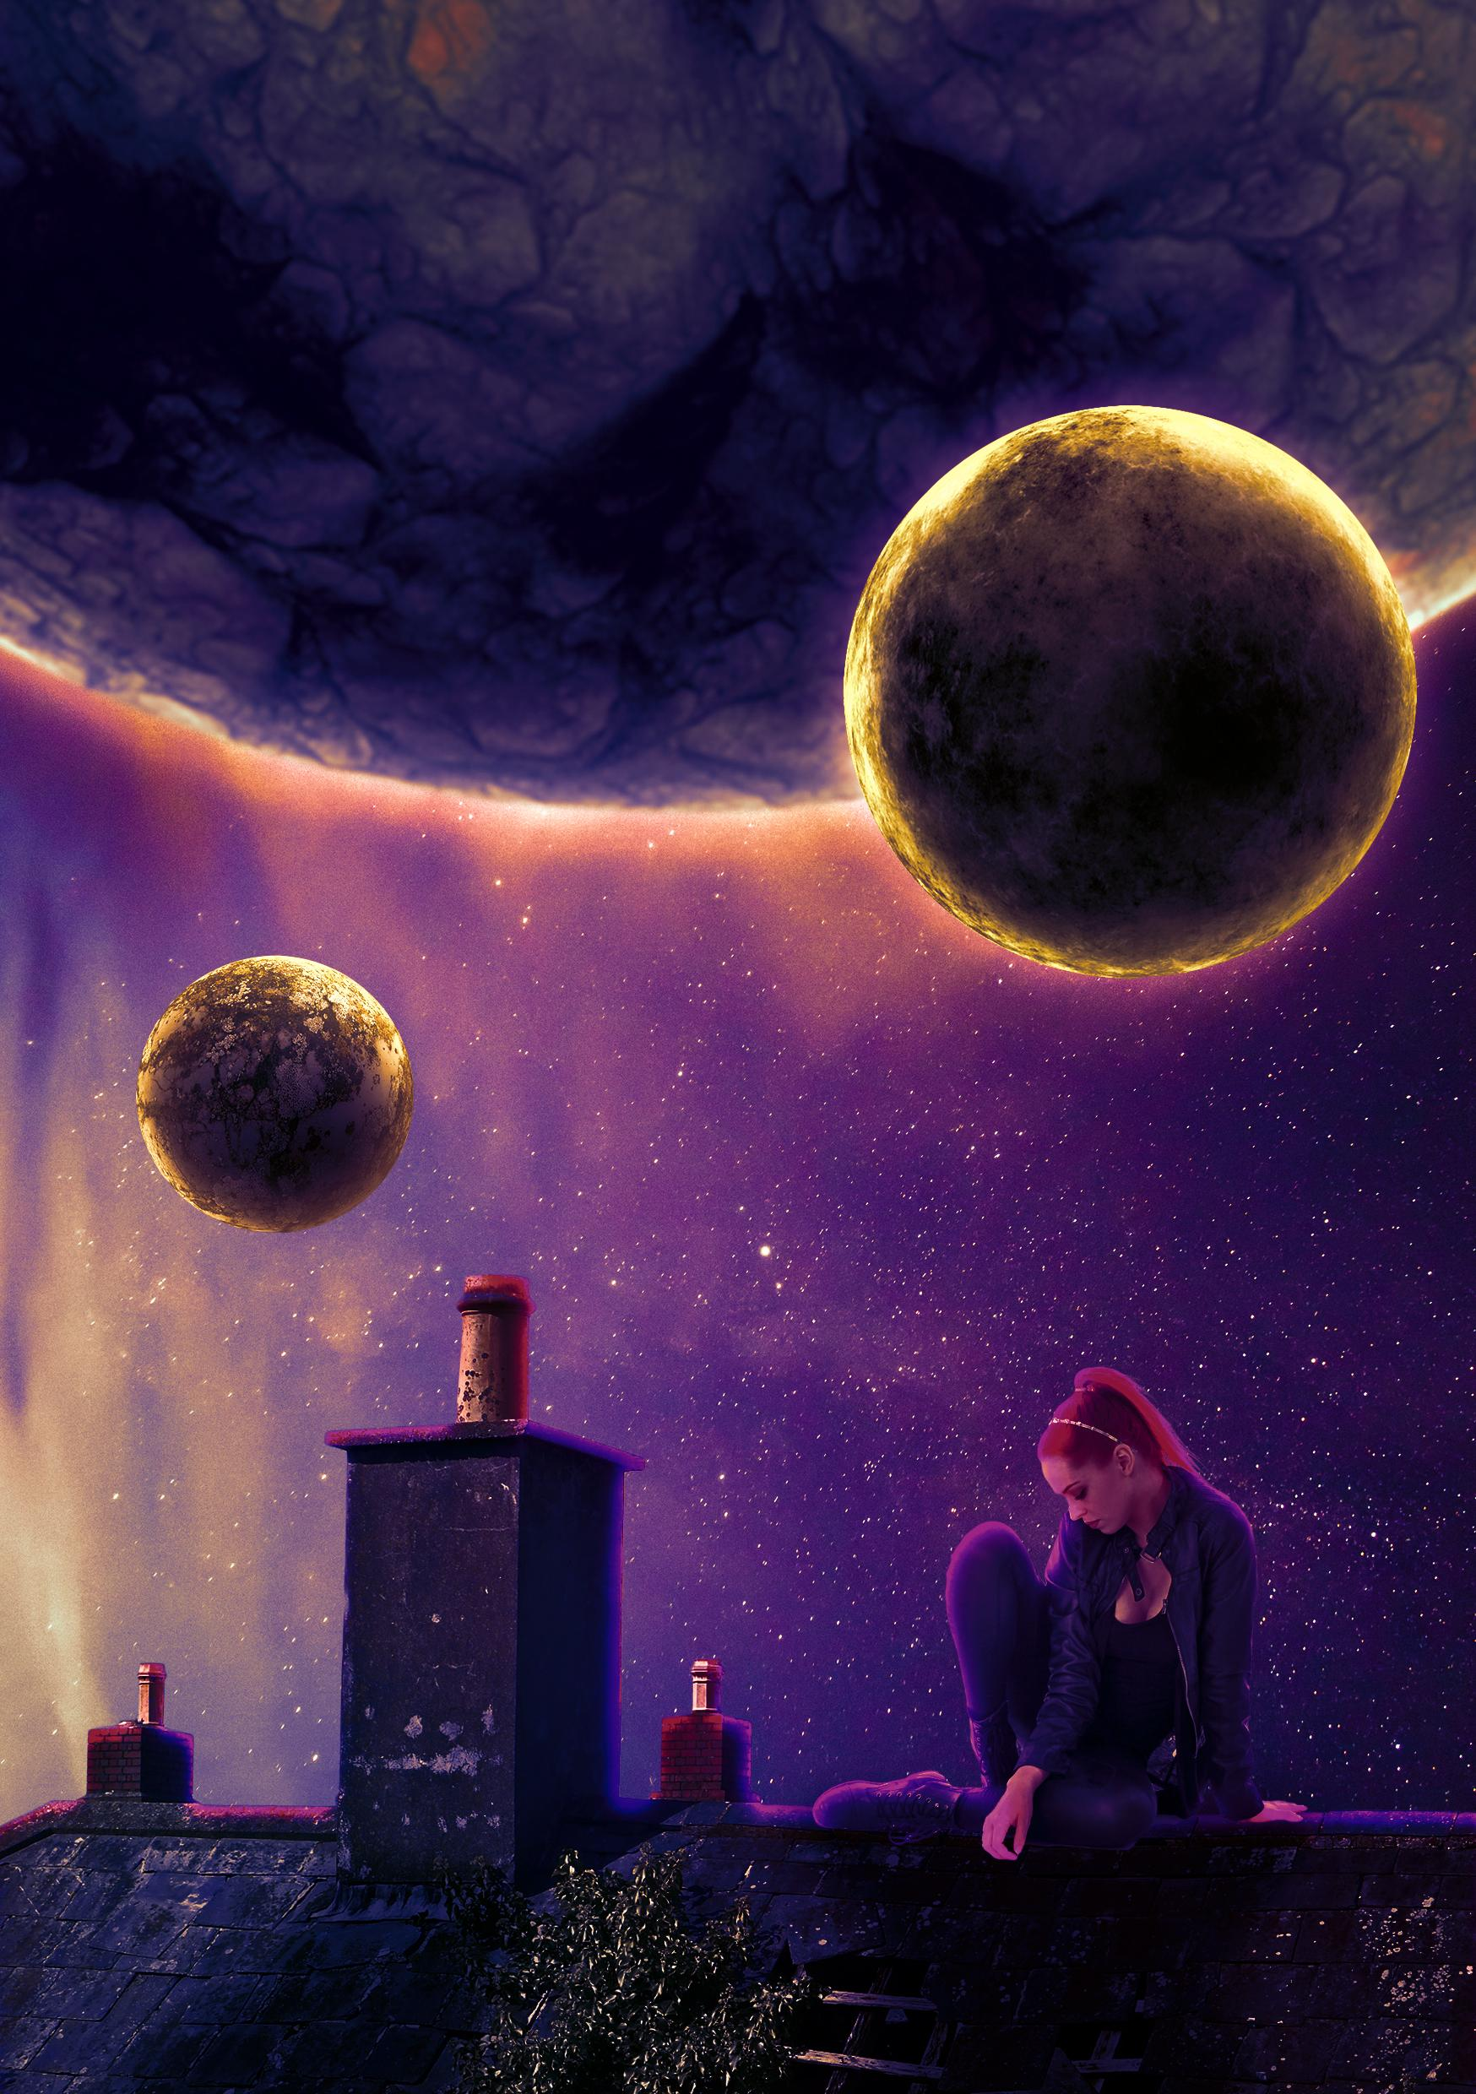
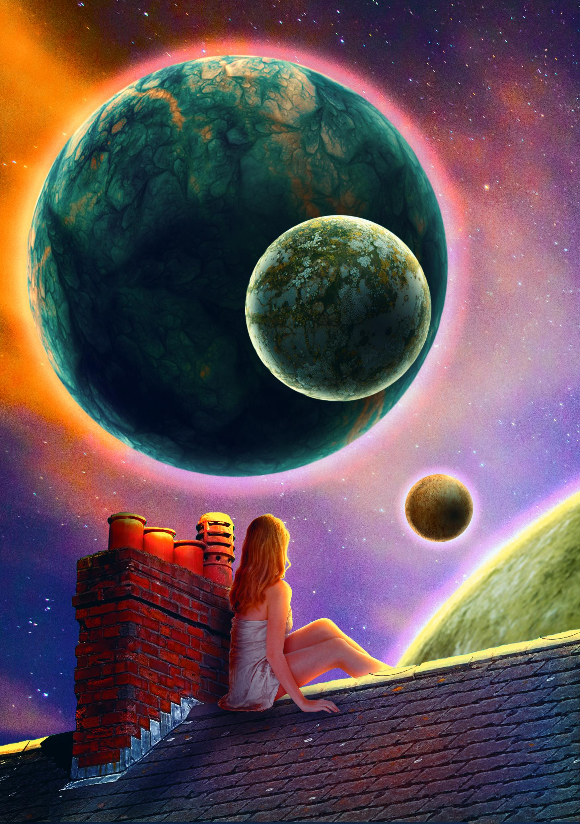
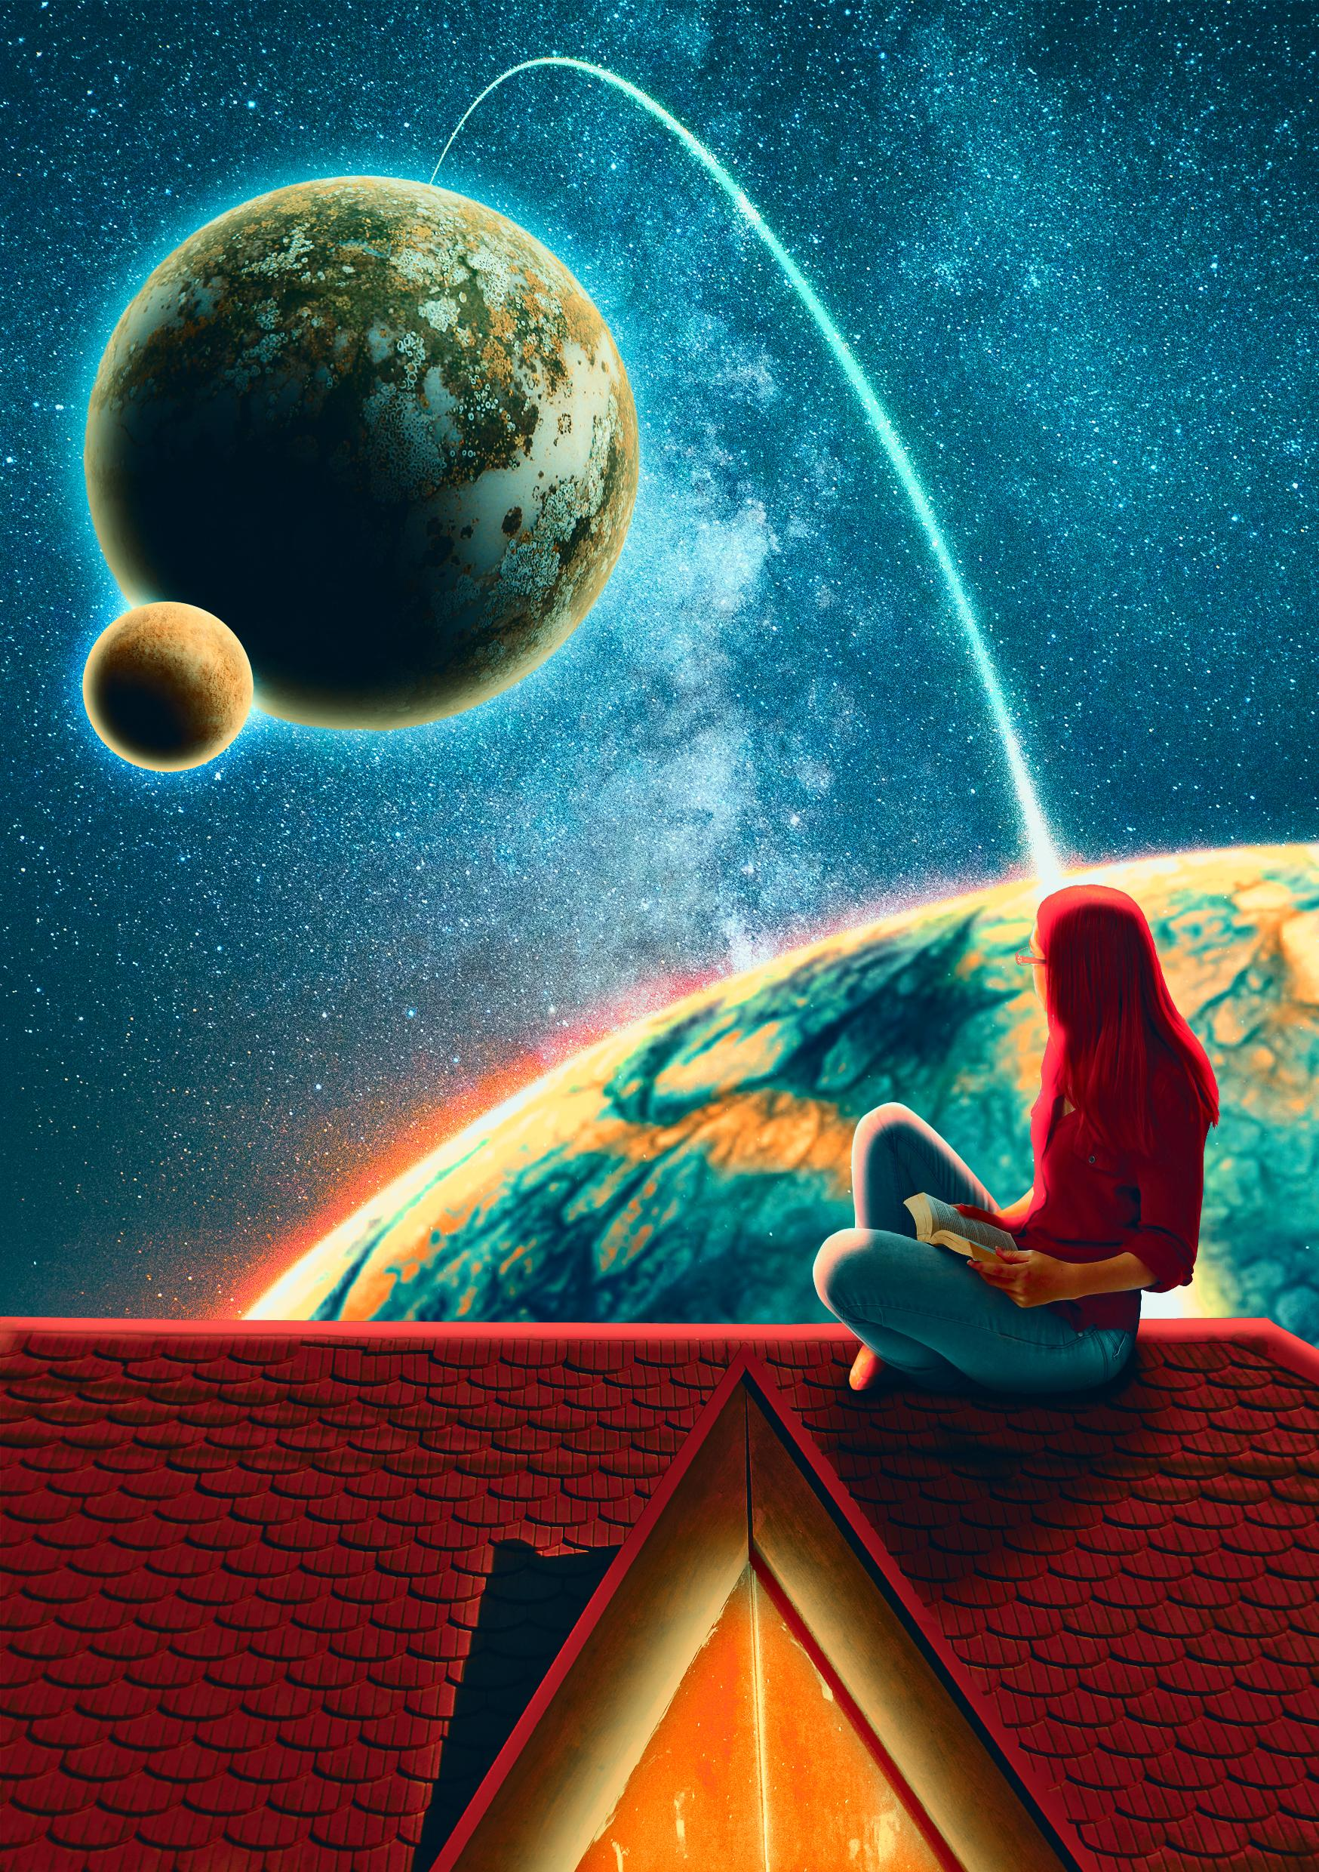
You have multiple images to choose from, and these can all be used to fulfill the brief. You have creative control over this project.

Slide 25
Inspiration
For each design choice you make and screenshot, you will need to say why you made that choice.
Use examples of other science fiction book covers as inspiration.
Include these in your Progress Log

Slide 26
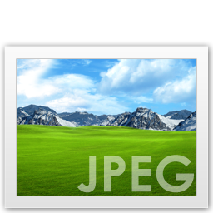
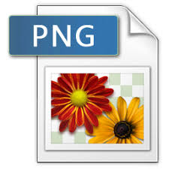
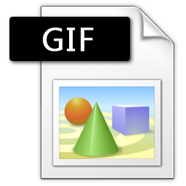
File formats in the Publishing Sector
There are many different file types used within the Publishing Sector. Each of them has a different purpose, and should be used at different times. Sometimes clients will ask for different file types specifically.

Slide 27
File Format Terms
Compression - Files are sometimes compressed to save space. Key information in the image is discarded to reduce file size.
Lossless compression - No image data is discarded to compress the file format. Only certain files are capable of this.
Bitmap File - A bitmap file is one that uses blocks of colour to make up it’s image content.
Vector File - A vector file is one that uses mathematical data to make up it’s image data. For this reason, they can be scaled infinitely and not lose image quality.

Slide 28
JPEG - Joint Photographic Expert Group
A JPEG is the most commonly used file format for images. It uses compression to reduce file size.
Advantages
JPEG files are portable and can be opened in most image softwares.
JPEG files can be reduced and compressed to 5% of their original size to save memory space and file size.
Disadvantages
As JPEG files are compressed, they lose image quality rapidly.

Slide 29
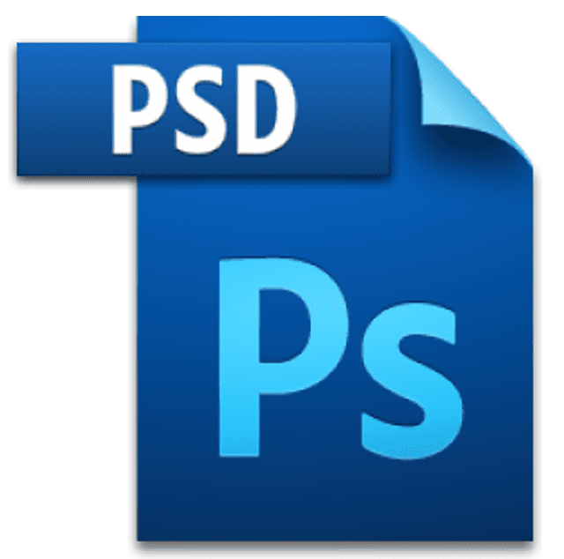
PSD - Photoshop Document
A PSD is the default file format that Photoshop saves it’s files into.
Advantages
PSD files can be opened and edited multiple times.
Disadvantages
PSD files can only be opened and edited in Photoshop

Slide 30
PNG - Portable Network Graphic
A PNG is a file format that uses lossless compression.
The memory size is smaller without losing quality.
Advantages
PNG files can have transparent backgrounds.
Can hold more colours than a GIF.
Disadvantages
Not good for large images.
Some websites won’t support them.

Slide 31
GIF - Graphics Interchange Format
A GIF is a file format that uses lossless compression. It is normally used for websites and animations.
Advantages
Supported by all websites
They can be animated.
Disadvantages
Only supports 256 colours.

Slide 32
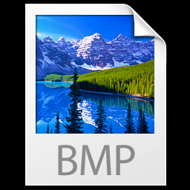
BMP - Bitmap Image
A bitmap is an image made up of lots of tiny squares of colour.
Advantages
BMP is a universal file format, and can be opened with most softwares.
Disadvantages
When enlarged, the blocks of colour are more visible and produce bad image quality.
To save the information on what colour goes where, a BMP can use lots of memory if the image is large.

Slide 33

TIFF - Tagged Image File Format
A TIFF is a file format that can be uncompressed, or that uses lossless compression. It is similar to a vector, and can be scaled infinitely.
Advantages
They won’t lose image quality if they are shrunk, rescaled, or moved to a different computer.
Disadvantages
Because the data is uncompressed, the file size can be very large.

Slide 34
Case Study 1
Case Study 2
Case Study 3
A client wants a new CD cover designed for their band. They want you to design the majority of the work, but they want to be able to edit the assets afterwards depending on what the other band-members want.
A client has asked for a book cover to be made for a new series of novels written by a famous author. Because this is a re-release of the author’s best works, the client wants the art for the book cover to be available to be used for posters and billboards.
You have been asked to photograph some students for a new school e-magazine. Before you add the photos to your design, the client wants to review the photographs to check whether they are suitable or not.
What file format should you use?
Answer: PSD
The client wants to be able to edit the assets later. This is only possible with a PSD.
What file format should you use?
Answer: TIFF
The art would need to be resized for posters and billboards, and would therefore have to be able to be scaled up without losing image quality.
What file format should you use?
Answer: JPEG
These are easy to send, easy to view, and wouldn’t take up too much file space.
Click here when you have the answer

Slide 35
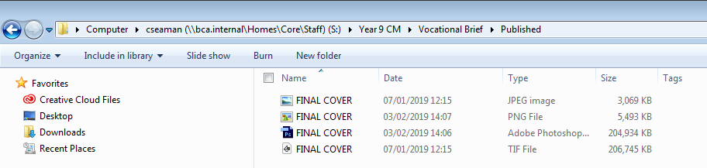
Your Task
Export your A5 Book Cover in the file formats: JPEG, TIFF and PNG.
Create a New Folder named “Published” in your Vocational Brief folder for these files. Once you’ve done this, screenshot this and add it to your Progress Log
Home Area- CM - Vocational Brief - Published

Slide 36
Fonts - Revisited
Fonts= the style of the font can change the message/feel of the text
Serif fonts have small serifs (flicks/tags) at the end of each letter and is often a font used in very formal situations eg news/information magazines
San-serif fonts do not have the flicks, they are plain and easy to read, often used in informal situations eg teen/fashion magazines

Slide 37
Fonts - Revisited
Describe the fonts used here on the Nightfall cover:
Challenge:
Anything else you notice?
What style is the text?
What effect does it have on the message communicated?
Serif | or | San-serif
Bold | or | Light
lower case | or | UPPERCASE
roman (non-italics) | or | Italics

Slide 38
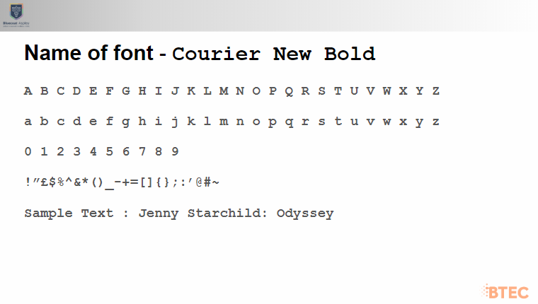
Looking at fonts
In your Progress Log, experiment with some different font styles.
Create a new slide underneath your screenshots and insert some different fonts.
You must explain why your font choice is suitable for your book cover. Use technical terminology where you can.
Challenge Task
Explore alternate versions of the same font, such as bold, italics, or with colours.

Slide 39
Fonts
There is no one font that is best suited for a purpose; you can use lots of options.
BUT
Fonts should be appropriate and match the audience.
“Good typography is invisible”
If you notice the font instead of what is being said, then you need to rethink your choice!

Slide 40
Name of font -
Example of how the slide should look:
A B C D E F G H I J K L M N O P Q R S T U V W X Y Z
a b c d e f g h i j k l m n o p q r s t u v w x y z
0 1 2 3 4 5 6 7 8 9
!”£$%^&*()_-+=[]{};:’@#~
Sample Text : Jenny Starchild: Odyssey

Slide 41
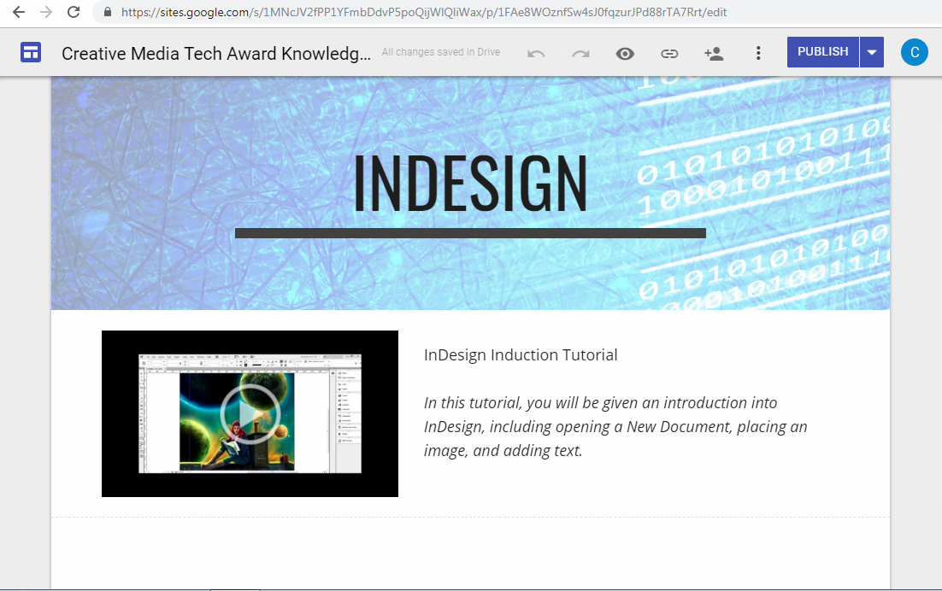
Adding Text to your Book Cover
Watch the tutorials on the Creative Media Knowledge Base for an induction into Adobe InDesign.
Set up your front cover in Indesign and add your chosen font to this, as well as the TeenScene Media Logo
Add Screenshots to your Progress Log as you go.

Slide 42
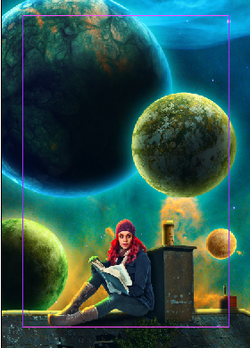
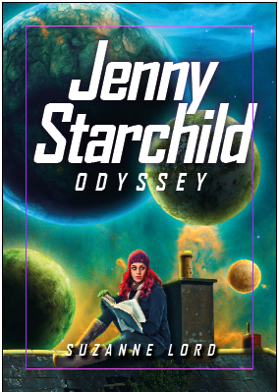
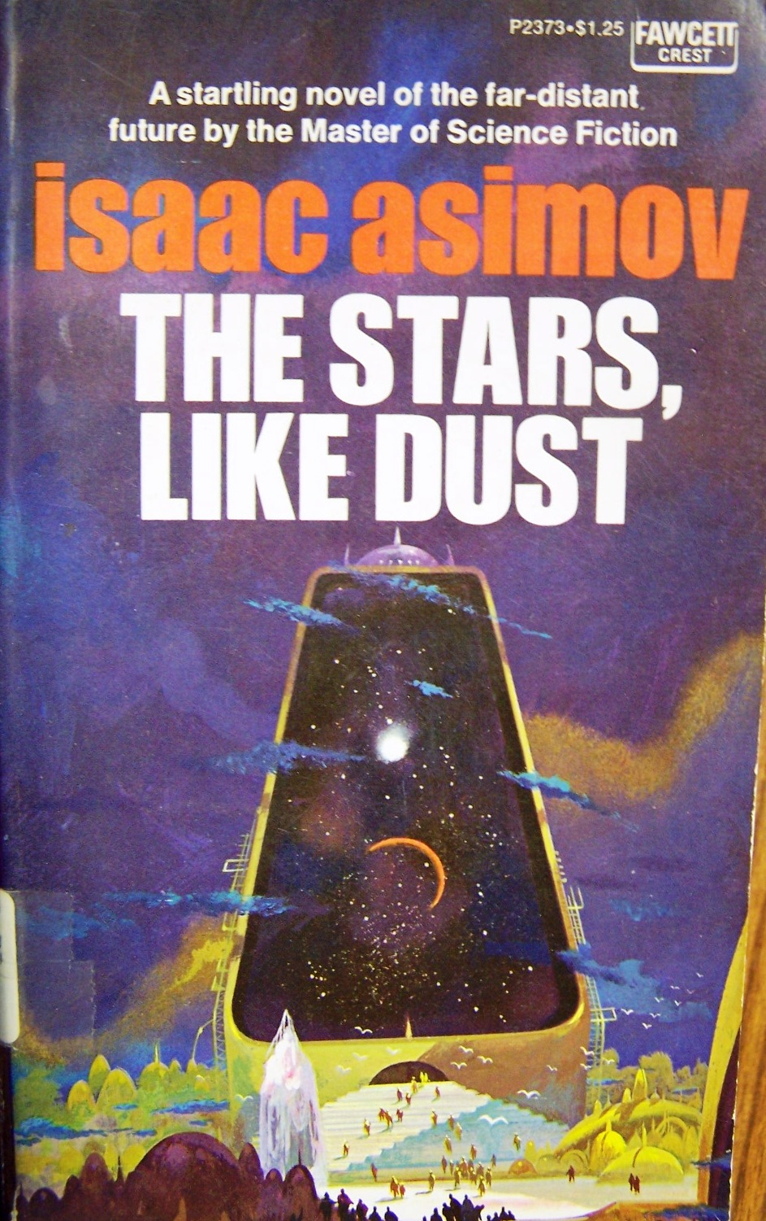
Progress Log
Date:
InDesign tool(s) used:
Type Tool
Guide Tool
Colour Picker
Font choice:
Arial Bold 400 kerning and 20% Italic
Before
After
Inspiration:
I wanted my front cover to have a simple, bold prominent text like the covers of older sci-fi novels. I then added an italic effect to make the font seem a bit more modern
Insert book cover
Design idea #1
Notes:
Why did you choose to use InDesign instead of Photoshop to add the text to your book cover design?
I chose to use Adobe InDesign because it is a vector based software. You can add text in Photoshop using the Type Tool, but because it is a bitmap, the text would be pixelated if we increased the size of the image. Because the final product is going to be used for promotional purposes, the text needs to be clear and legible even when it’s scale is increased.
Which InDesign tools did you use to add the text? Describe the process including the fonts, text size, colour and any other feature eg light/bold, uppercase/lowercase. Did you use the same fonts for all text or treat each element differently?
I added the title font using the Type tool to create a text box. For the title, I used the Arial Font, but used Arial Bold, and adjusted the kerning to make the letters spaced further apart. I made the title white, bold and uppercase. I used the same font for the author’s name, but made it smaller with a larger kerning. I did this because the title needed to be more prominent than the author’s name.
Where did you place your text on the page? Describe you choice of placement and the effect you intended to create? Make links to your inspiration.
Placement of the text is important because it is one of the main focus points of a book’s front cover. It needs to be easy to read and inviting to the audience. I chose to place my title in the centre of the cover in the top third of the cover. This is because a lot of science-fiction book covers from the seventies placed their text in this style, and the client wanted the book cover to look “classic”
Did you encounter any issues? How did you overcome these?
Whilst placing my text, I had to make sure everything was centred and equally placed. I used InDesign’s guide tools to make sure it was placed correctly.
When adding colour, I wanted the text to fit into the colour scheme of the image underneath. I didn’t want to guess, so I used the dropper tool to select exact an colour match from the image.

Slide 43
Progress Log
Date:
InDesign tool(s) used:
Font choice:
Before
After
Inspiration:
Insert book cover
Design idea #2
Notes:
Which InDesign tools did you use to add the text for your second design idea? Describe the process including the fonts, text size, colour and any other feature eg light/bold, uppercase/lowercase…
I added the title font using…
Where did you place your text on the page? Describe you choice of placement and the effect you intended to create? Make links to your inspiration.
Placement of the text is important because…. I chose to place my title…..
Did you encounter any issues? How did you overcome these?
Placement - using guides to make sure it is central/equally placed
Colour - use the dropper tool to select exact colour match from image
Which design idea do you prefer and why? Make links to the technical details in the brief to help you make your choice.

