Slide 1
Component 2 LA A
Vocational Brief: Progress Log
[EXAMPLE]
Issue date: Tuesday 15th January 2019
Submission date: Friday 1st February 2019

Slide 2
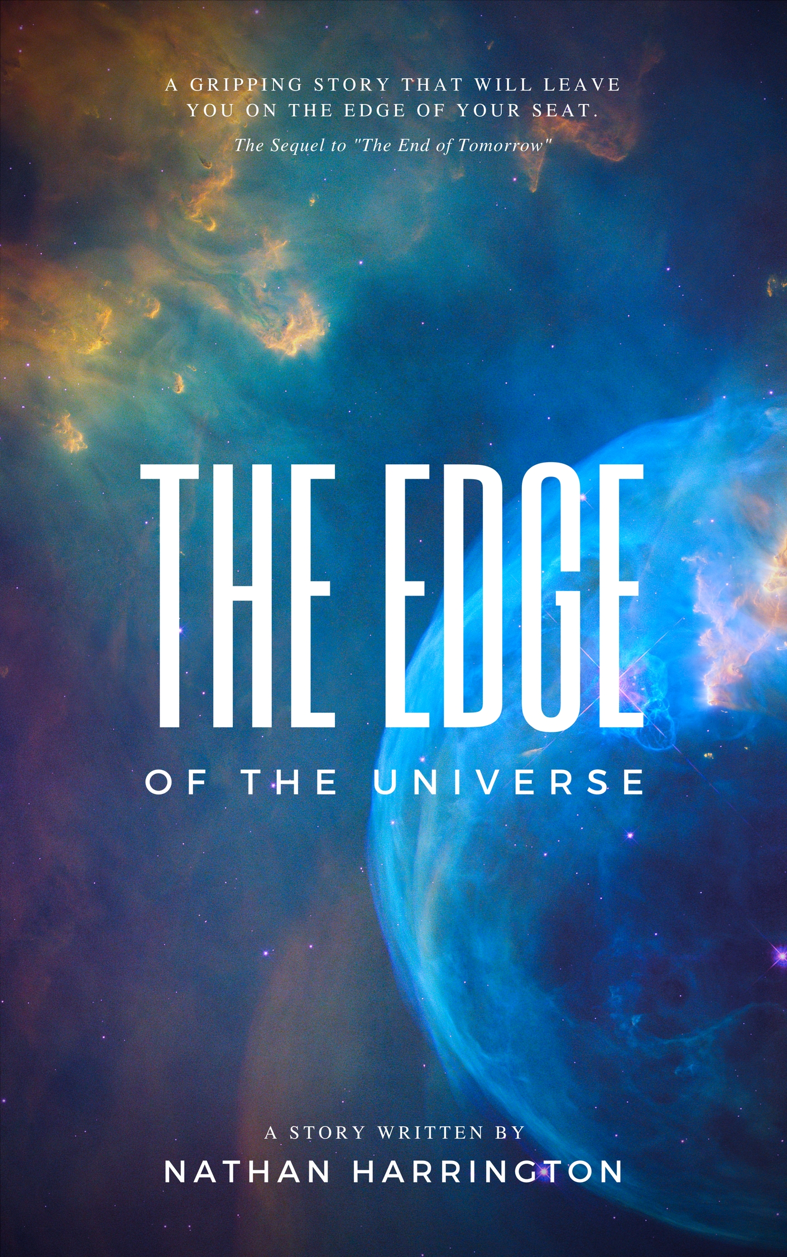
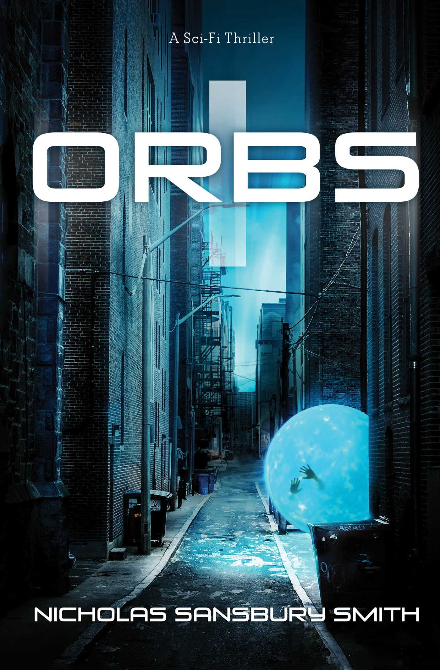
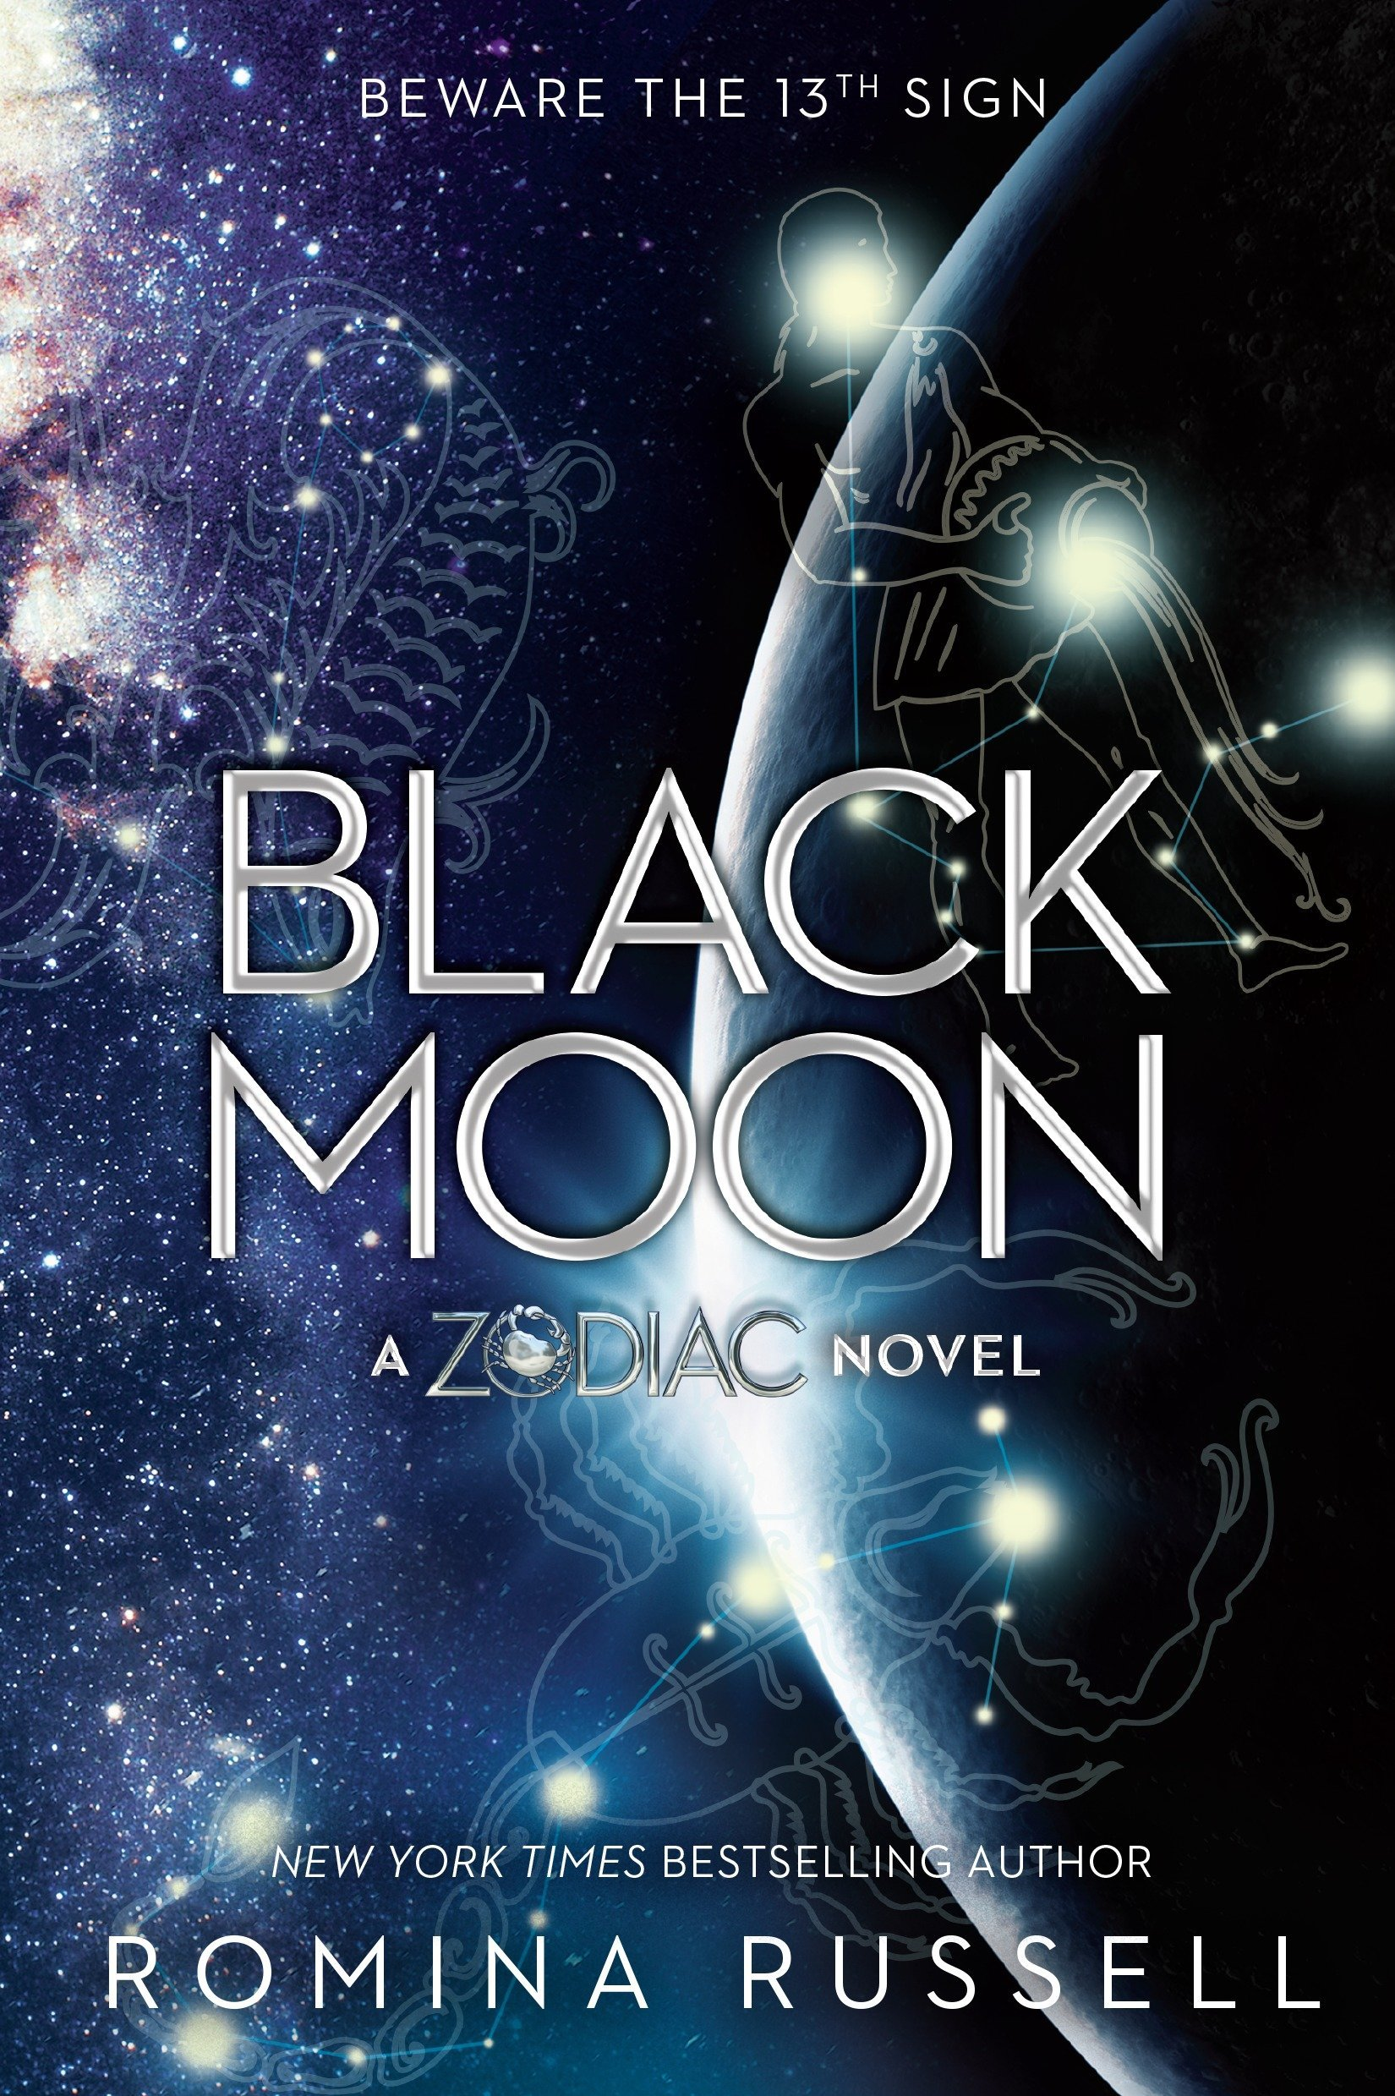
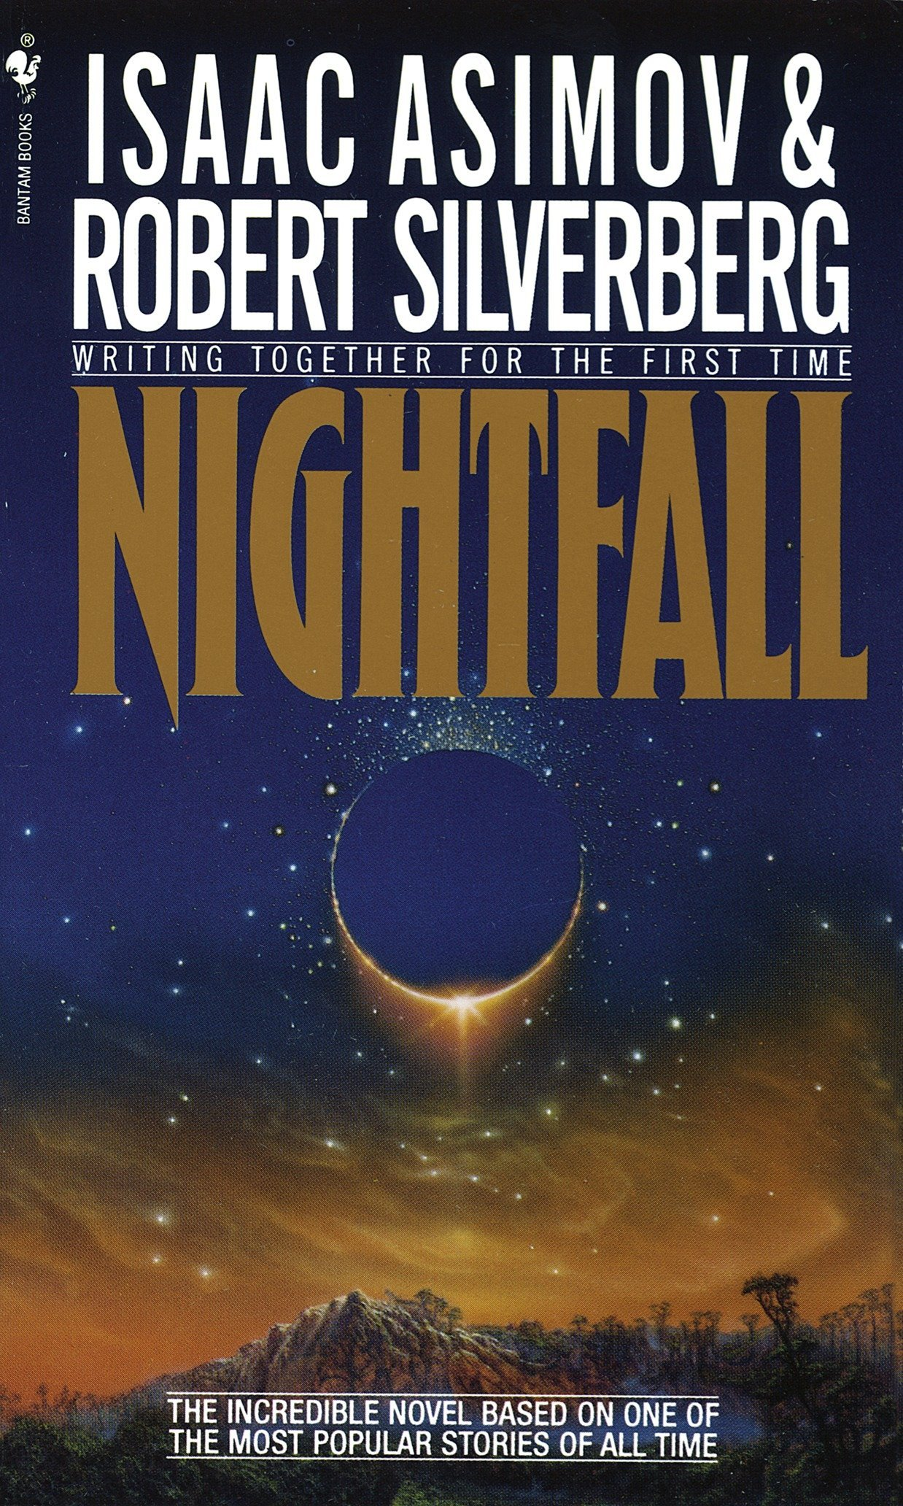
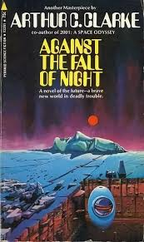
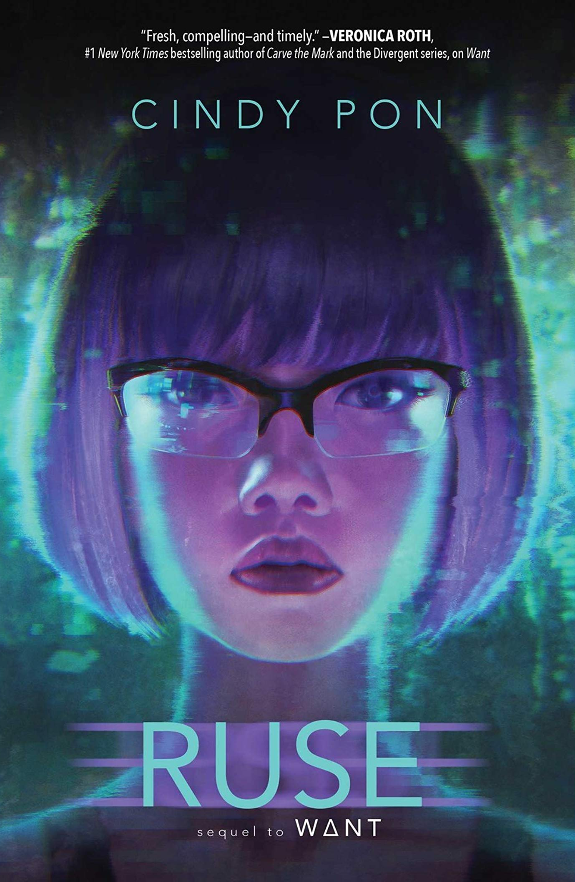
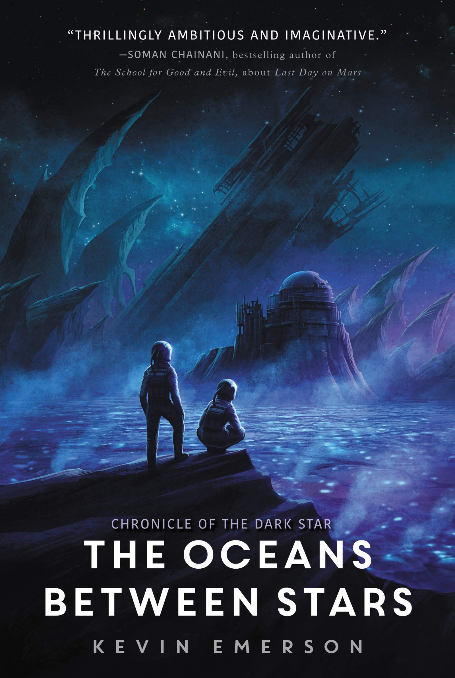
Codes and conventions of the science-fiction genre - book cover
Colours
Darker colours such as blues, blacks and whites
Fonts
Extra bold or light condensed san serif fonts
Images
Space
Planets
Futuristic images

Slide 3
Media assets are the graphics, videos, audio, animations maps, and other artistic data that go into media products
Image Extraction
Girl, Roof, Planets
Selected using Pen Tool / Polygon Tool
Background removed with Refine Edge Tool
Image Layout
Space background and composition
Copied and Pasted onto Layers and arranged in order
Special Effects
Planet Glow
Added using Blending Options
Shadows
Paintbrush with Gaussian Blur
Colour Changes
Added by using Layer Adjustments
Link to tutorial on CM website

Slide 4
Vocational Brief 1
Start Date: 18-1-19
Deadline for Submission: 1-2-19
Scholastic has approached you to produce the front cover for a new Young Adult Sci-Fi novel to be published later this year. The design you produce will also be used in advertisements to promote the book, and so it must show that the book is an entertaining read for teenages aged 13-15. The cover must target the audience consistently across all areas, including the main image, the use of colours, and the choice of fonts.
Scholastic has also requested that along with the cover itself, you also show evidence of your work in progress, as well as an explanation of the techniques you have used to create the cover.
The final cover must be submitted as an A5 300dpi document saved in an appropriate format, alongside the original PSD.

Slide 5
Technical Details
Title - “Jenny Starchild: Odyssey”
Author Name: Suzanne Lorde
Notes from the author:
For the cover, I would like to see the main character sitting on a rooftop, looking out into the night sky. The sky should contain several different alien planets, as her journey across the galaxy is one of the main plots of the novel. The theme of my story is exploration into other worlds, so I need the cover to be exciting and mysterious.
I want the cover to look like a classic sci-fi novel, so I would like the final cover to have blue and purple tones.

Slide 6
Your Task
Using the assets provided, create your own version of the science-fiction book cover requested in the brief.
As part of this task, you are expected to show your work in progress, and the tools you’ve used to create it. Screenshot frequently, and paste these screenshots into your Progress Log.
You will need to clearly evidence each and every tool used, before and after, and describe the impact each change has on the overall effect, in line with the original brief.
Save all assets in your Home area - CM folder - Vocational Brief folder

Slide 7
Appropriate, basic skills used which are relevant to the brief
Copy and Paste
Selecting and Refining Edge
Working with layers
Colour Correction / Adjustment Layers
Effective skills used to develop focussed work which considers the brief
Copy and Paste
Selecting and Refining Edge
Working with layers
Colour Correction / Adjustment Layers
Eraser Tool
Levels
Curves
Sophisticated skills used to show comprehensive and creative development of practical work, responding fully to the brief
Copy and Paste
Selecting and Refining Edge
Working with layers
Colour Correction / Adjustment Layers
Layer Masks
Levels
Curves
Blending Options
Layer Modes
Start off by using the basic tools - then progress to including more advanced tools and techniques.

Slide 8
Progress Log
Date:
Photoshop tool(s) used:
Quick Select
Select and Refine Edge
Intended effect:
Remove sky from behind the roof and add the roof to the A5 document.
Before
After
Inspiration:
The mountain in the foreground is positioned very low down on the cover. This gives the impression of the eclipse appearing further away and more eye-catching as it takes up a larger portion of the cover.
Insert book cover
Notes:
Which tools did you use to create this effect? Describe the process
To remove the roof from the background, I used the Quick Select. To begin, I created a selection around the sky, and then used “Inverse Selection” to select the roof instead. I then used the Select / Refine Edge Tool to make sure there were no white areas remaining. I outputted this to a new layer, and then duplicated the layer to my A5 document. Finally, I used Edit / Transform / Scale to adjust the size of the asset.
What effect did you intend to create?
The effect I wanted to create was add the roof to the background with none of the original sky present, so a space background could fit behind this seamlessly. Later I will use colour correction to blend this more effectively, which would only work if the roof has been extracted without any white areas from the original background.
Did you encounter any issues? How did you overcome these?
A problem I ran into was that the Quick Select Tool would sometimes pick up parts of the roof as well as the sky. To overcome this, I made the Quick Select Tool smaller, used the subtract option and removed the parts I didn’t need.

Slide 9
Progress Log
Date:
Photoshop tool(s) used:
Duplicate Layer
Transform Tool
Intended effect:
Place the space background behind the roof, and resize the background to leave no white spaces or gaps.
Before
After
Inspiration:
As the front cover needs to appeal to teenagers, I decided to choose a space background I thought would look more vibrant and exciting rather than just a plain night sky.
Insert book cover
Notes:
Which tools did you use to create this effect? Describe the process
To add the space background to the A5 document, I duplicated the layer to my A5 document after renaming the layer. Then, I used Edit / Transform / Scale to adjust the size of the asset. I then dragged my space layer underneath my roof layer.
What effect did you intend to create?
The effect I wanted to create was add the space background to the image so that it didn’t look stretched or distorted. Later I will use colour correction to enhance some of the duller colours.
Did you encounter any issues? How did you overcome these?
A problem I ran into was that the way in which I wanted my colours to face would have left white gaps on the bottom. To overcome this, I rotated the background using Edit / Transform, and then adjusted the scale to cover the white areas.

Slide 10
Progress Log
Date:
Photoshop tool(s) used:
Duplicate Layer
Edit and Transform
Intended effect:
Add planets into the space background and resize and reorganise these to be more visually interesting
Before
After
Inspiration:
Although this cover only has a single planet, I really how the use of size is used to convey the depth of space. I thought that having lots of different sized planets could make the space background seem more exotic.
Insert book cover
Notes:
Which tools did you use to create this effect? Describe the process
To add the planets to the A5 document, I duplicated the layers to my A5 document after renaming the layer. Then, I used Edit / Transform / Scale to adjust the size of the assets. I then positioned the planet layers above my roof and space layers.
What effect did you intend to create?
The effect I wanted to create was to give a sense of size to the planets, to make some look far away and bigger than others. Later I will use blending options to colour correct them to the space background, and add glows and shadows.
Did you encounter any issues? How did you overcome these?
A problem I ran into was that adding too many planets would have left the sky looking cramped. To overcome this, I didn’t use all of the planet assets, and arranged some using Edit / Transform / Scale to decrease the size to fit into the composition more effectively.

Slide 11
Progress Log
Date:
Photoshop tool(s) used:
Pen Tool
Select / Colour Range
Intended effect:
I wanted to extract the girl from the background so that her strands of hair would still be present. I used the Pen tool to get the main body, and then used Select / Colour Range to remove the white from around the hair.
Before
After
Inspiration:
The use of lighting in this cover makes this book fit into the conventions of sci-fi very clearly. I want to make the girl in my design stand out in a similar way; with light coming from the space background and the rest of her body silhouetted against the sky.
Insert book cover
Notes:
Which tools did you use to create this effect? Describe the process
To remove the figure from the background, I used the Pen Tool. To begin, I created an outline, and then turned this into a selection by right-clicking and choosing “make selection”. I then used the Select / Refine Edge Tool to make sure there were no white areas remaining. I outputted this to a new layer, and then duplicated the layer to my A5 document. Finally, I used Edit / Transform / Scale to adjust the size of the asset.
What effect did you intend to create?
The effect I wanted to create was to remove the girl from the background seamlessly so there were no white areas present, so she would be able to be placed onto the roof. Later I will use colour correction to blend this more effectively, which would only work if the figure was extracted without any white areas from the original background.
Did you encounter any issues? How did you overcome these?
A problem I ran into was that the Pen Tool was very precise and I couldn’t always see the outline I was creating accurately. To overcome this, I used the Magnifying Glass Tool to zoom in and see more accurately

Slide 12
Skills used:
Copy and Paste
Selecting and Refining Edge
Working with layers
Colour Correction / Adjustment Layers

Slide 13
Skills used:
Copy and Paste
Selecting and Refining Edge
Working with layers
Colour Correction / Adjustment Layers
Eraser Tool
Levels
Curves

Slide 14
Skills used:
Copy and Paste
Selecting and Refining Edge
Working with layers
Colour Correction / Adjustment Layers
Layer Masks
Levels
Curves
Blending Options
Layer Modes

Slide 15
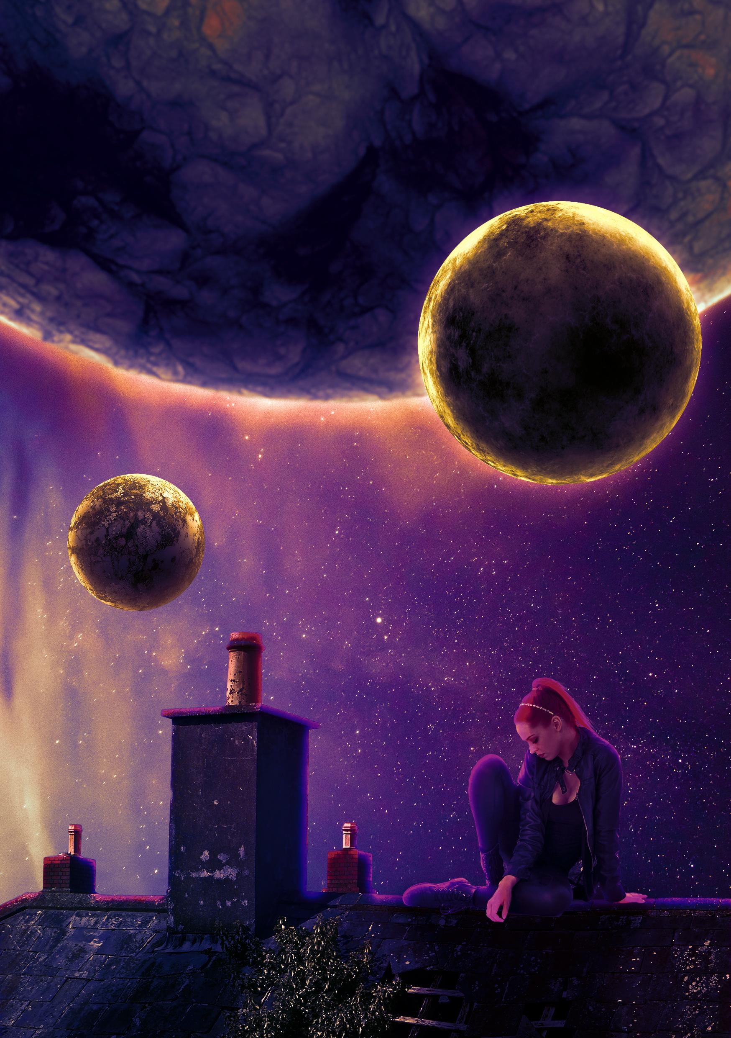
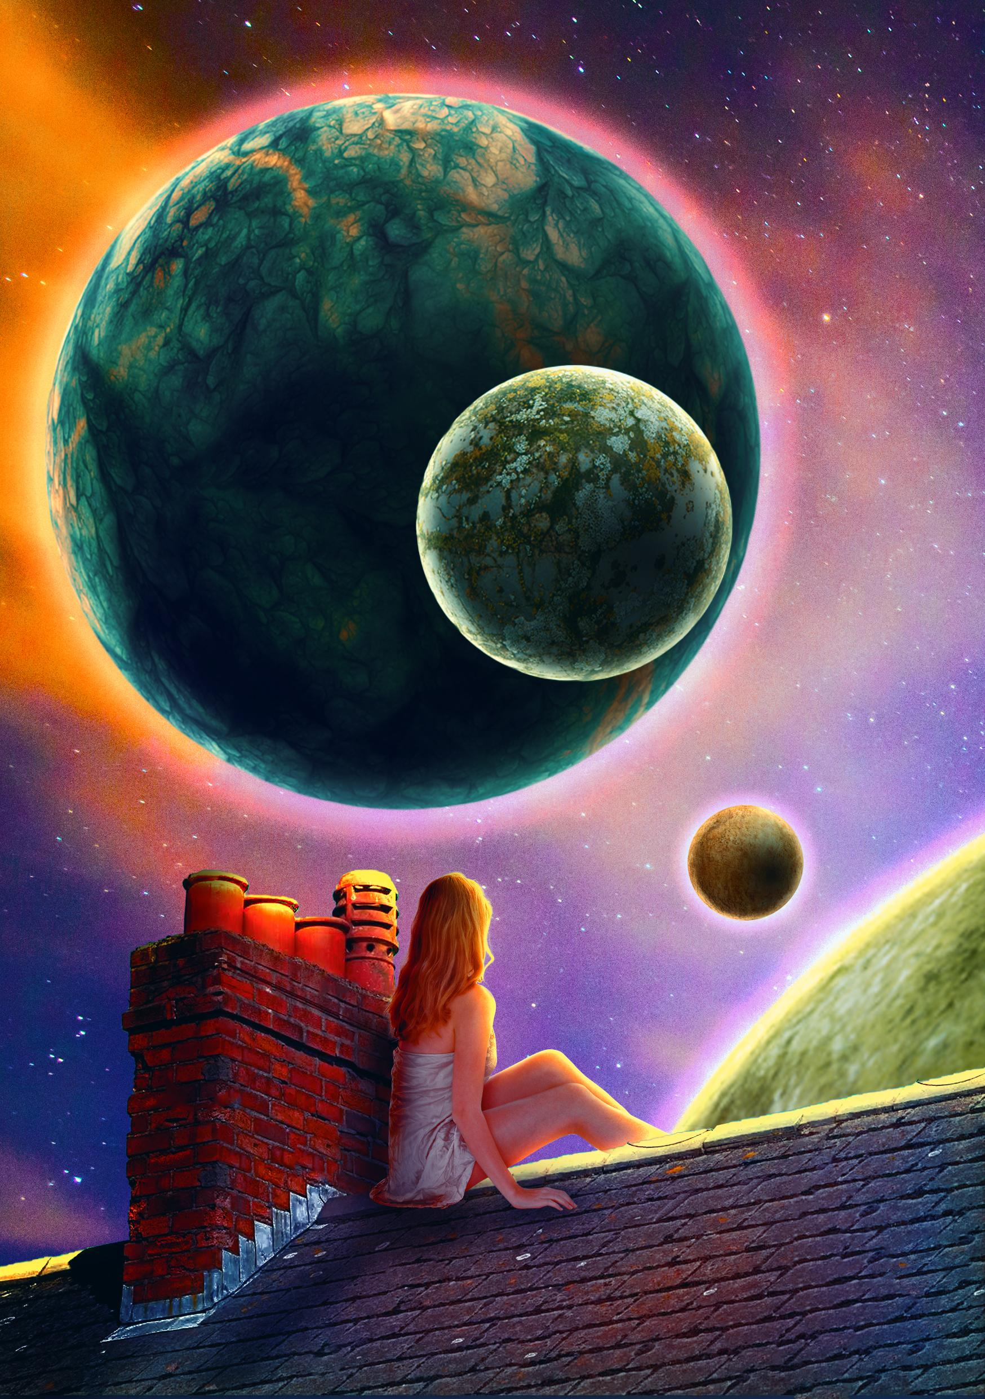
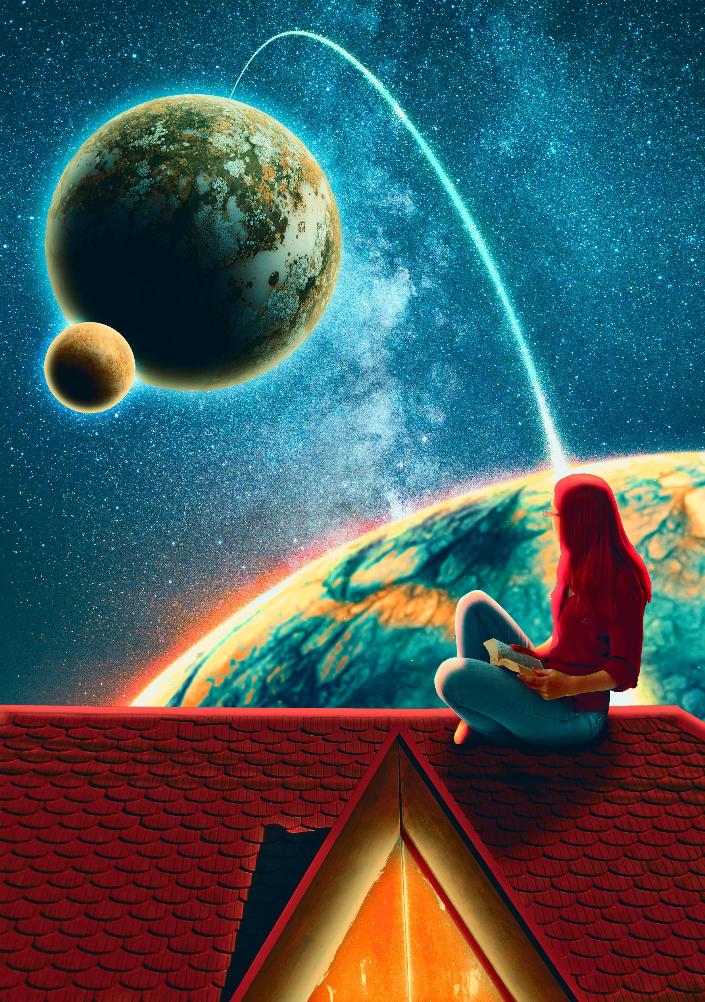
You have multiple images to choose from, and these can all be used to fulfill the brief. You have creative control over this project.

Slide 16
Speaker Notes Guidance
Write a paragraph into the speaker notes section of each media product answering the following questions
Which tools did you use to create this effect? Describe the process
What effect did you intend to create?
Did you encounter any issues? How did you overcome these?
Use full sentences
Use media terminology accurately
Check your SPAG

Slide 17
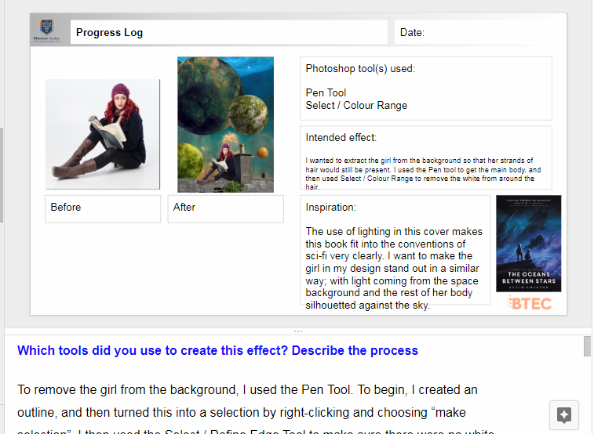
Exemplar Speaker Notes
These can be found in the examples above. Each exemplar example has been highlighted.
Sentence starters are in blue
Merit level writing is in green
Merit level will show effective use of skills
Distinction level writing is in yellow
Distinction level will show imaginative use of skills and problem solving
Key Vocab and Terminology is in red

Slide 18
Sentence Starters
Which tools did you use to create this effect? Describe the process
To create this effect, I used…
This tool is used for… and can be found in...
The effect I wanted to create was...and the best way to do this is to use…
To begin, I… after this, I then… to finish, I finally...
What effect did you intend to create?
The effect I wanted to create was…
I am attempting to…
Based on other sci-fi covers, I am trying to...
Did you encounter any issues? How did you overcome these?
The biggest problem I found was…
A problem I ran into was…
I used the .... tool to correct this
I ensured that…
To prevent the issue happening again, I will...

Slide 19
Key Vocab to mention
Which tools did you use to create this effect? Describe the process
To create this effect, I used…
This tool is used for… and can be found in...
The effect I wanted to create was...and the best way to do this is to use…
To begin, I… after this, I then… to finish, I finally...
Techniques
Select
Refine
Shadows
Highlights
Midtones
Layers
Transform
Inspiration
Colour scheme
Layout
Foreground / Background
Serif / San Serif
Bold / Light
Roman / Italicised
Composition
The Brief
Assets
Target Audience
Evidence
Layout
Genre
Codes and Conventions

Slide 20
GUIDANCE FOR DIGITAL TOOLS
Copy and Paste
Purpose:
To duplicate an image and add it to another location
Location in Photoshop:
Edit / Copy/Paste
Potential Problems:
Pasting your image into the wrong layer
Potential Solutions:
Making sure you have selected the correct layer first, or creating a new layer for the image before pasting.
Selecting and Refining Edge
Purpose:
To select an area of an asset to edit in more detail.
Location in Photoshop:
Selection Tools in Toolbar (Lasso, Polygon Tool, Pen Tool, Marquee Tool, Quick Select Tool…)
Select / Refine Edge
Potential Problems:
Selecting too much or too little of the desired asset
Potential Solutions:
Using the Refine Edge Tool to adjust the selection.
Working with layers
Purpose:
To separate different images to edit assets at different times
Location in Photoshop:
Layers Panel (bottom right of screen)
Layers (Top Toolbar)
Potential Problems:
Pasting your image into the wrong layer
Editing multiple images on the same layer
Potential Solutions:
Making sure you have selected the correct layer first, or creating a new layer for the image before pasting.

Slide 21
GUIDANCE FOR DIGITAL TOOLS
Eraser Tool
Purpose:
To erase part of an image
Location in Photoshop:
Left-hand Toolbar
Potential Problems:
Erasing too much by accident
Eraser not big enough
Potential Solutions:
Edit / Step Backward to undo
Using the square brackets ([ and]) to adjust the size
Levels
Purpose:
To adjust the amount of shadows / highlights and midtones in an image
Location in Photoshop:
Image / Adjustments / Levels
Adjustment Layers
Potential Problems:
Adding too much highlight or shadow
Potential Solutions:
Using the Adjustment Layer instead so any mistakes can be corrected.
Curves
Purpose:
To adjust the amount of shadows / highlights and midtones in an image
Location in Photoshop:
Image / Adjustments / Curves
Adjustment Layers
Potential Problems:
Adding too much highlight or shadow
Potential Solutions:
Using the Adjustment Layer instead so any mistakes can be corrected.
Notes:
Colour Correction / Adjustment
Purpose:
To adjust the colours of multiple images so that they fit together seamlessly
Location in Photoshop:
Adjustment Layers (beneath Layers Panel)
Image / Adjustments / Hue/Saturation
Potential Problems:
The colours looking unrealistic
Permanently adjusting the colours of a layer
Potential Solutions:
Small adjustments of Hue / Saturation instead of large ones
Using Adjustment Layers so the effect isn’t permanent

Slide 22
GUIDANCE FOR DIGITAL TOOLS
Layer Masks
Purpose:
To add and remove parts of a layer temporarily
Location in Photoshop:
Layers / Add Layer Mask
Potential Problems:
Erasing too much of a layer
Potential Solutions:
Changing your brush colour from black to white to paint erased areas back in
Blending Options
Purpose:
To add special effects to a layer
Location in Photoshop:
Right Click / Blending Options
Potential Problems:
Adding an unwanted effect
Potential Solutions:
Right Click / Clear Layer Style will remove effects
Layer Modes
Purpose:
To blend two layers together in different ways
Location in Photoshop:
Above the Layers Panel. The dialog box default is “Normal”
Potential Problems:
Changing the Layer Mode to something that doesn’t look correct
Potential Solutions:
Reset the dialog box to “Normal” from the drop-down menu

