Slide 1
Hello Year 7!
This PowerPoint covers the Atoms, Elements and Compounds topic. This is a new topic so the content will be new to you. Within the PowerPoint you will find information, practice questions, links to websites, and links to videos and online quizzes. Alongside the PowerPoint I have also provided a word document of all of the tasks you need to complete as you go along. You should write your answers on paper and mark them in green pen.
Normally, you would have 4 science lessons per week. This PowerPoint should last you for 2 weeks, and I think it should take you roughly 8 hours to work through the content. I have split the PowerPoint into 4 lessons – you should work through these lesson by lesson.
Try to complete all of your work to the best of your ability. When you are asked to answer questions, try the red ones first and work your way up to purple – these are the hardest! If you only manage to answer red or amber, that is fine. I look forward to seeing some of your hard work when we are back at school!
If you have any questions, then you can email me jravenscroft@bluecoatmeres.co.uk and I will try to get back to you as soon as possible.
Good luck!
Miss Ravenscroft ☺

Slide 2
Lesson 1: Elements, Compounds and Mixtures
Spaced Retrieval
Spiral
What are the independent, dependent and control variables?
A student wants to find out if eating breakfast in the morning makes you walk to school faster than if you don’t eat breakfast. What are the independent, dependent and control variables in this investigation?
Knowledge Organiser Recall
What is a cell?
What is an organelle?
Draw the particle models for a solid, a liquid and a gas.
Before starting lesson 1, try answering these questions without looking up the answers!

Slide 3
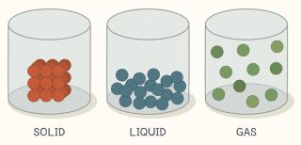
Lesson 1: Elements, Compounds and Mixtures
Spaced Retrieval – Answers
Spiral
What are the independent, dependent and control variables?
Independent variable – the thing you change.
Dependent variable – the thing you measure.
Control variable – the thing you keep the same.
A student wants to find out if eating breakfast in the morning makes you walk to school faster than if you don’t eat breakfast. What are the independent, dependent and control variables in this investigation?
Independent – eating breakfast or not.
Dependent – how fast you walk to school.
Control – the weather, the route you take to school, the shoes you wear on your walk, what time you leave…
Knowledge Organiser Recall
What is a cell?
The smallest unit of every living thing.
What is an organelle?
A structure found inside a cell that has a particular function.
Draw the particle models for a solid, a liquid and a gas.
Mark your work! How many did you get correct?

Slide 4
Lesson 1: Elements, Compounds and Mixtures
To understand the differences between elements, compounds and mixtures.
State the definitions of atoms, elements, compounds, mixtures and molecules.
Describe the differences between elements, compounds and mixtures.
Explain that chemical symbols are an international code used by scientists.

Slide 5
Atoms
An atom is the smallest unit of a substance.
Everything is made from atoms, including cells. Atoms are tiny particles that are far too small to see, even with a microscope.
If people were the same size as atoms, the entire population of the world would fit into a box about a thousandth of a millimetre across.

Slide 6
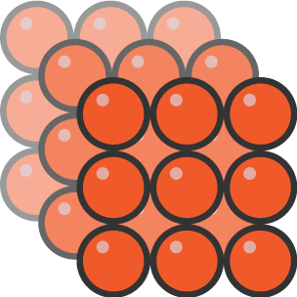
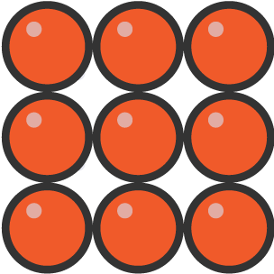
Atoms
We usually imagine atoms as being like tiny balls:
To make diagrams simpler, we usually just draw atoms as circles:

Slide 7
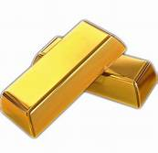
Elements
Atoms are found in elements. There are over 100 different elements.
The atoms in one element are the same as each other, but they are different from the atoms of all other elements.
For example, lead and gold are elements. A piece of pure gold contains only gold atoms. A piece of pure lead contains only lead atoms.

Slide 8
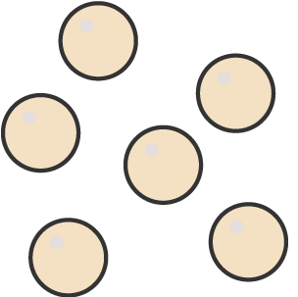
Elements
The atoms of some elements do not join together, but instead they stay as separate atoms.
Helium is like this:
Helium atom

Slide 9
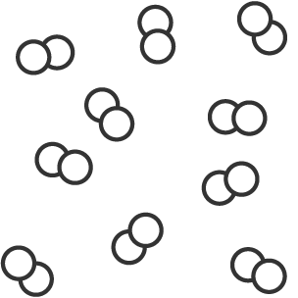
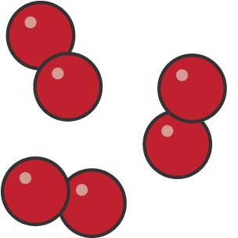
Molecules
The atoms of other elements join together to make molecules.
Oxygen and hydrogen are like this:
Oxygen and hydrogen are still elements though, as they are only made up of only one type of atom.
Oxygen atom
Hydrogen atom

Slide 10
Questions
Answer these questions about atoms, elements and molecules:
What is an atom?
What is an element?
Draw the particle models of:
An atom
An element
A molecule
Use the models you’ve drawn above to describe what a molecule is.

Slide 11
Answers
Mark your answers!
An atom is the smallest unit of a substance.
An element is a substance made up of one type of atom only.
Draw the particle models of:
An atom
An element
A molecule
A molecule is a substance that contains two or more atoms that are joined together.

Slide 12
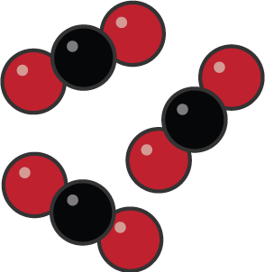
Compounds
A compound is a substance that contains atoms of two or more different elements, and these atoms are joined together.
The different elements are often drawn in different colours:

Slide 13
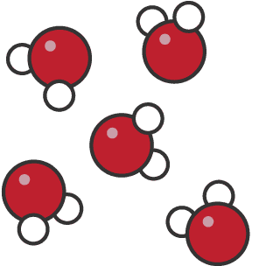
Compounds
For example, water is a compound of hydrogen and oxygen.
Oxygen atom (red)
Each water molecule contains two hydrogen atoms and one oxygen atom:
Hydrogen atom (white)

Slide 14
Mixtures
A mixture is also a substance that contains atoms of two or more different elements, but these atoms are not joined together.
For example, sea water is a mixture. The sand and the water are not joined together – they can be separated.

Slide 15
Questions
Answer these questions about compounds and mixtures:
What is a compound?
What is a mixture?
Draw the particle models of:
A compound
A mixture
Use the models you’ve drawn above to explain why water is an example of a compound and a molecule.

Slide 16
Questions
Mark your answers!
A compound is a substance that contains atoms of two or more different elements, which are joined together.
A mixture is a substance that contains atoms of two or more different elements, which are not joined together.
Draw the particle models of:
A compound
A mixture
Water is a compound because it contains atoms of two or more different elements (hydrogen and oxygen). It is also a molecule because a molecule is a substance that contains two or more atoms that are joined together.

Slide 17
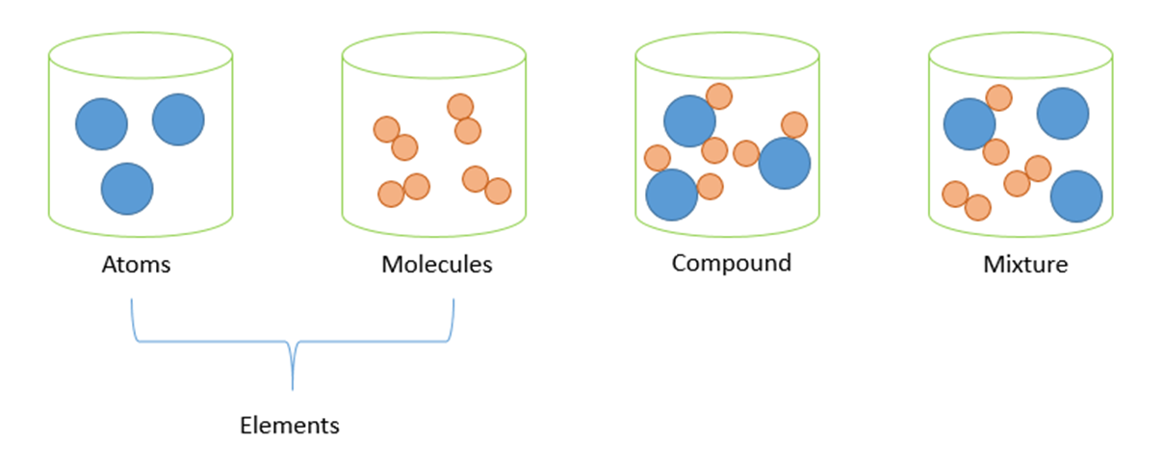
Summary
The difference between elements, compounds and mixtures is demonstrated below:

Slide 18
Elements compounds and mixtures
Watch this video to understand more about elements, mixtures and compounds!
https://www.youtube.com/watch?v=dXY6aQXAYPA

Slide 19
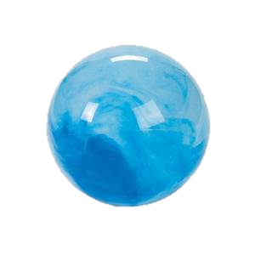
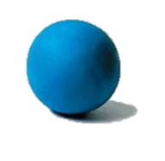
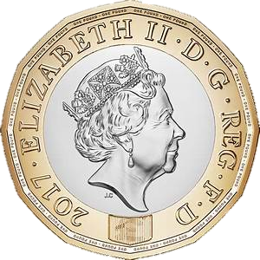
Modelling task
Have a look around your house for any round objects that could be used to represent atoms (such as marbles, bottle top lids, coins, M&Ms! etc…)
Task: Use these objects that you have found to make a model of an element, a compound and a mixture.
Be as creative as you can! You could make your model on paper so that you can draw labels.
When you have finished, take a picture and send it to me by email. I look forward to seeing your models!

Slide 20
Test yourself!
Task 1: Decide whether the following are elements, mixtures or compounds:
Lead
Water
Gold
Helium
Sea water
Oxygen
Hydrogen

Slide 21
Test yourself!
Green pen!
Lead – element
Water – compound (and molecule)
Gold – element
Helium – element
Sea water – mixture
Oxygen – element (and molecule)
Hydrogen – element (and molecule)

Slide 22
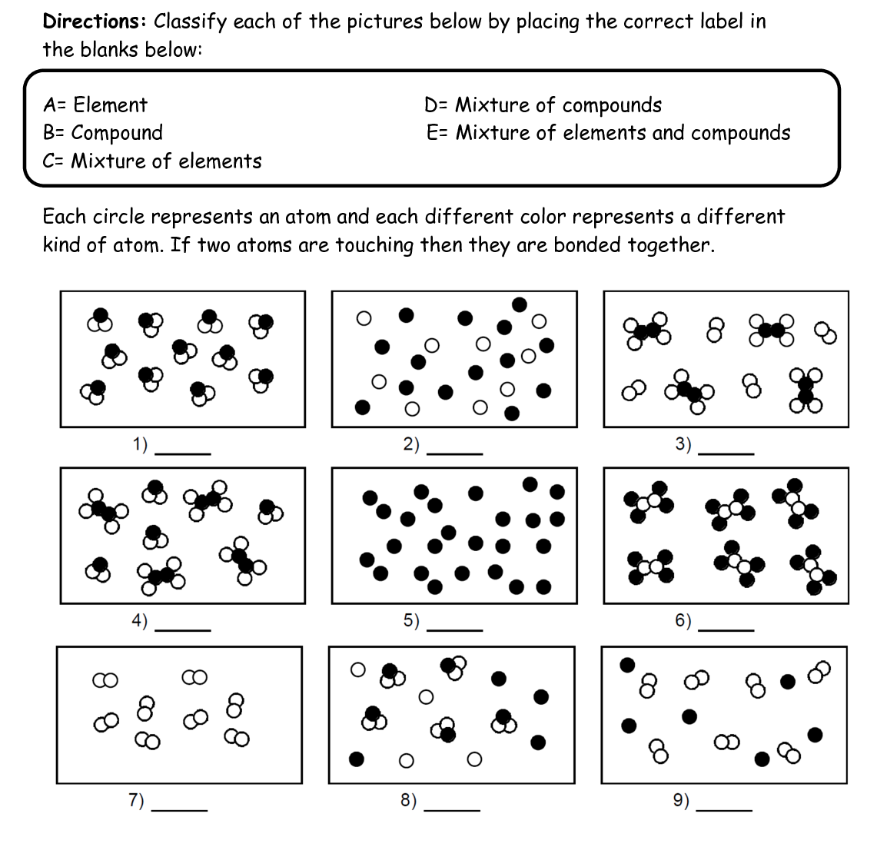
Challenge yourself!

Slide 23
Green pen!
B
C
E
D
A
B
A
E
C

Slide 24
End of lesson 1
Well done for completing lesson 1!
If you have any questions about the content, don’t hesitate to send me an email.

Slide 25
Lesson 2: Chemical Formulae
Spaced Retrieval
Spiral
Describe how you find the mean, median and mode from a set of data.
Find the mean, median and mode from the set of data below:
6, 12, 4, 8, 12, 3, 9, 10, 12
Knowledge Organiser Recall
What is an atom?
Give two examples of elements.
Explain why water is not an element.
Before starting lesson 2, try answering these questions without looking up the answers!

Slide 26
Lesson 2: Chemical Formulae
Spaced Retrieval – Answers
Spiral
Describe how you find the mean, median, mode and range from a set of data.
Mean – add the numbers together and divide by how many numbers there are.
Median – put the numbers in order and find the middle one.
Mode – find the most common number.
Find the mean, median, mode and range from the set of data below:
6, 12, 4, 8, 12, 3, 9, 10, 12
Mean = 8.44
Median = 9
Mode = 12
Knowledge Organiser Recall
What is an atom?
The smallest unit of a substance.
Give two examples of elements.
Lead, gold, helium, hydrogen, oxygen etc…
Explain why water is not an element.
Water is not an element because it is made up of atoms of more than one type of element.
Mark your work! How many did you get correct?

Slide 27
Lesson 2: Chemical Formulae
To understand what chemical formulae represent.
Relate chemical formulae to names of common compounds such as carbon dioxide, water, and methane.
Explain what a chemical formula shows.
Use names and chemical symbols to write the formulae of some simple compounds.

Slide 28
Last lesson recap
Watch this video to recall what we covered last lesson and to introduce this lesson’s content.
https://www.youtube.com/watch?v=CguFLlwZKoM

Slide 29
Chemical symbols
Each element is given its own chemical symbol, like H for hydrogen or O for oxygen.
Chemical symbols are usually one or two letters long.
Every chemical symbol starts with a capital letter, with the second letter written in lower case. For example, Mg is the correct symbol for magnesium, but mg, mG and MG are wrong.

Slide 30
Chemical symbols
Sometimes it is easy to tell which element a symbol stands for. For example, C stands for carbon and Li stands for lithium.
But sometimes the symbol comes from a name for the element that is not an English word. For example, W stands for tungsten (from the word wolfram) and Na stands for sodium (from the word natrium).
The same chemical symbols are used all over the world, no matter which language is spoken, which makes them very useful.

Slide 31
Chemical symbols
Element | Chemical symbol
Chlorine | Ca
Calcium | Au
Gold | He
Zinc | Mg
Copper | Zn
Helium | Cl
Magnesium | B
Boron | N
Nitrogen | K
Nickel | Fe
Iodine | Pb
Lead | Ni
Iron | Cu
Potassium | I
Task: See if you can match up these chemical symbols to the correct elements! Some are tricky – you may have to research the answers!

Slide 32
Chemical symbols
Element | Chemical symbol
Chlorine | Ca
Calcium | Au
Gold | He
Zinc | Mg
Copper | Zn
Helium | Cl
Magnesium | B
Boron | N
Nitrogen | K
Nickel | Fe
Iodine | Pb
Lead | Ni
Iron | Cu
Potassium | I
Mark your answers!

Slide 33
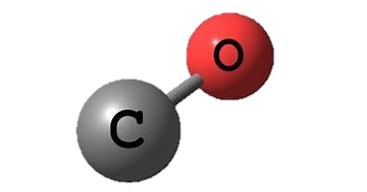
Chemical formulae
So single elements have a single chemical symbol (such as C for carbon and O for oxygen.
For a molecule, we use the chemical symbols of the elements it contains to write down its formula.
For example, the formula for carbon monoxide is CO. It tells you that each molecule of carbon monoxide consists of one carbon atom joined to one oxygen atom.
Handy hint! Every time you see a capital letter, this represents a new element.

Slide 34
Chemical formulae
Take care when writing your symbols and formulae. Be careful about when to use capital letters. For example, CO means a molecule of carbon monoxide but Co is the symbol for cobalt (an element).
The word 'formulae' is the plural of 'formula'. If we have more than one formula, we don't say formulas, we say formulae.

Slide 35
Chemical formulae
Task: Use the internet to find the chemical formulae of the following molecules:
Sodium chloride
Nitrogen monoxide
Potassium hydroxide
Cyanide

Slide 36
Chemical formulae
Mark your answers!
Sodium chloride – NaCl
Nitrogen monoxide – NO
Potassium hydroxide – KOH
Cyanide – CN

Slide 37
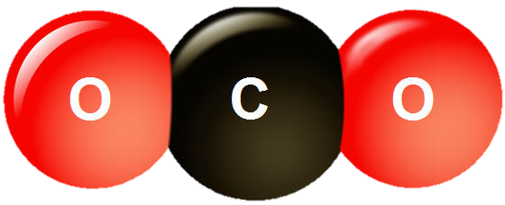
Numbers in chemical formulae
We use numbers to show when a molecule contains more than one atom of an element. The numbers are written below the element symbol.
For example, CO₂ is the formula for carbon dioxide. It tells you that each molecule has one carbon atom and two oxygen atoms.
Take care when writing these formulae. The small numbers go at the bottom. For example CO₂ is correct but CO² is wrong.

Slide 38
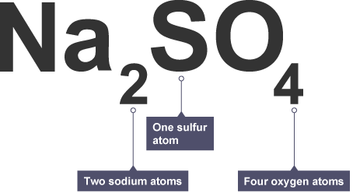
Numbers in chemical formulae
Some formulae are more complicated.
For example, the formula for sodium sulfate is Na₂SO₄. It tells you that sodium sulfate contains two sodium atoms (Na₂), one sulfur atom (S) and four oxygen atoms (O₄).

Slide 39
Chemical formulae
If you are still unsure, watch this video to help you understand!
https://www.youtube.com/watch?v=SRR-4BLzNus

Slide 40
Test yourself!
Task: Complete the table by putting the correct numbers in the correct columns. The first one has been for you.
Compound | Number of hydrogen (H) atoms | Number of oxygen (O) atoms | Number of carbon (C) atoms | Number of nitrogen (N) atoms | Number of chlorine (Cl) atoms
CO₂ | 0 | 2 | 1 | 0 | 0
H₂O
CO
CuCl
NH₄
HCl
CH₄

Slide 41
Test yourself!
Mark your answers!
Compound | Number of hydrogen (H) atoms | Number of oxygen (O) atoms | Number of carbon (C) atoms | Number of nitrogen (N) atoms | Number of chlorine (Cl) atoms
CO₂ | 0 | 2 | 1 | 0 | 0
H₂O | 2 | 1 | 0 | 0 | 0
CO | 0 | 1 | 1 | 0 | 0
CuCl | 0 | 0 | 1 | 0 | 1
NH₄ | 4 | 0 | 0 | 1 | 0
HCl | 1 | 0 | 0 | 0 | 1
CH₄ | 4 | 0 | 1 | 0 | 0

Slide 42
Plenary
How much have you learnt in the last 2 lessons?
Try this BBC Bitesize quiz to find out!
https://www.bbc.co.uk/bitesize/guides/zt2hpv4/test

Slide 43
End of lesson 2
Well done for completing lesson 2!
If you have any questions about the content, don’t hesitate to send me an email.

Slide 44
Lesson 3: Atomic Structure
Spaced Retrieval
Spiral
Describe the difference between a hazard, a risk and a precaution.
Why do we have to do a risk assessment before doing any practicals in the lab?
Knowledge Organiser Recall
How many carbon atoms are in C₆H₁₂O₆?
What is the difference between a compound and a mixture?
Why do scientists use chemical symbols to represent elements?
Before starting lesson 3, try answering these questions without looking up the answers!

Slide 45
Lesson 3: Atomic Structure
Spaced Retrieval – Answers
Spiral
Describe the difference between a hazard, a risk and a precaution.
Hazard – something that could be dangerous
Risk – why it could be dangerous
Precaution – what you can do to stay safe
Why do we have to do a risk assessment before doing any practicals in the lab?
To make sure that everyone is safe and to prevent any harm.
Knowledge Organiser Recall
How many carbon atoms are in C₆H₁₂O₆?
Six
What is the difference between a compound and a mixture?
In a compound, the atoms are joined together. In a mixture, the atoms are not joined together and they can be separated.
Why do scientists use chemical symbols to represent elements?
So that everyone around the world can recognise them, regardless of what language they speak.
Mark your work! How many did you get correct?

Slide 46
Lesson 3: Atomic Structure
To understand the structure of an atom.
Recall the typical size of atoms and molecules.
Describe the location, charge and relative mass of subatomic particles within an atom.
Explain the contribution Dalton, Thomson, Rutherford and Bohr each made to the development of Atomic Theory.

Slide 47
Atoms
We have covered atoms already in the previous 2 lessons.
Remember, atoms are the smallest unit of a substance and they are so tiny, they cannot even be seen using a microscope.

Slide 48
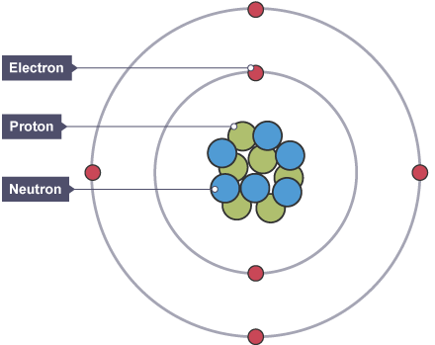
The structure of the atom
Atoms themselves have a particular structure, as shown below.
At the centre of the atom is the nucleus. This is surrounded by electrons arranged in shells.
The nucleus is tiny compared to the atom as a whole.
The nucleus of the atom contains subatomic particles called protons and neutrons.
Task: Draw and label a picture of an atom.

Slide 49
Modelling task
Have a look around your house for any round objects that could be used to represent electrons, protons and neutrons (such as marbles, bottle top lids, coins, M&Ms! etc…)
Task: Use these objects that you have found to make a model of an atom.
Be as creative as you can! You could make your model on paper so that you can draw labels.
When you have finished, take a picture and send it to me by email. I look forward to seeing your models!

Slide 50
Subatomic particles
Protons, neutrons and electrons are called subatomic particles. This is because they are found inside the atom.

Slide 51
Subatomic particles
All subatomic particles have a mass and a charge.
The masses of subatomic particles are very tiny. Instead of writing their actual masses in kilograms, we often use their relative masses.

Slide 52
Subatomic particles
You need to know the masses and charges of the subatomic particles.
Task: Copy out the table below and learn it!
The mass of an electron is very small compared to a proton or a neutron. Since the nucleus contains protons and neutrons, most of the mass of an atom is concentrated in its nucleus.

Slide 53
The structure of the atom
Watch this video to find out more about the structure of the atom!
https://www.youtube.com/watch?v=4sl-E_l_1pk

Slide 54
Questions
Answer these questions about the structure of the atom:
Draw the structure of an atom, and label: the nucleus, protons, neutrons and electrons.
Give the definition of a subatomic particle.
State the mass and charge of each subatomic particle.
Explain why we state the relative mass of the subatomic particles, not the real mass.

Slide 55
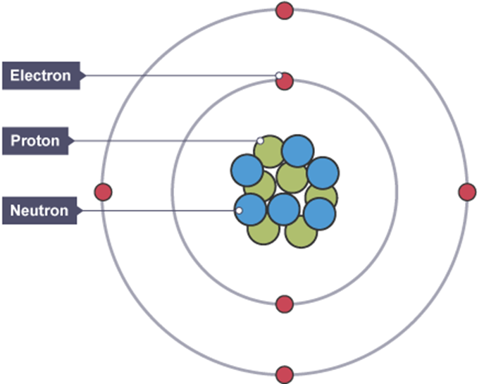
Questions
Mark your answers!
A structure that is found inside an atom.
h
Because the real mass is far too small.

Slide 56
Working out the structure of the atom
Scientists haven’t known about the structure of the atom forever – they had to work it out and it took a long time!

Slide 57
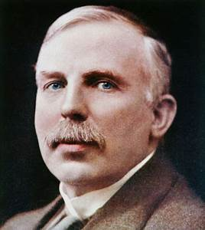
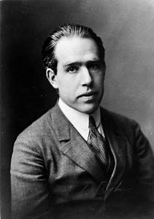
Working out the structure of the atom
There are several scientists who contributed to this work. Some of them include Dalton, Thomson, Rutherford and Bohr.

Slide 58
Working out the structure of the atom
On the next slide are some questions for you to complete about these four scientists.
Using the 2 websites below, answer the questions about the contributions each scientist made to working out the structure of the atom.
https://www.bbc.co.uk/bitesize/guides/zwn8b82/revision/1
https://www.bbc.co.uk/bitesize/guides/zwn8b82/revision/2

Slide 59
Questions
Use the websites on the previous slides to answer the following questions:
In what year was the word ‘atom’ first used?
Which scientists first used the word ‘atom’ to describe what matter was made of?
Which subatomic particle did Thomson discover?
What model of the atom did Thomson suggest and what did this look like?
In what year did Rutherford test the model suggested by Thomson?
How did Rutherford test this model?
What did Rutherford find out from this experiment?
What was Rutherford’s new model of the atom called and what did this look like?
What did Bohr discover about the structure of the atom?
Which subatomic particle did Chadwick discover and when?
What is the name of the model of the atom that we use today?

Slide 60
Questions
Mark your answers!
1803.
John Dalton.
The electron.
The plum pudding model. The atom is a ball of positive charge with negative electrons embedded in it - like currants in a Christmas pudding.
1909.
Positively charged alpha particles were fired at thin gold foil.
Most alpha particles went straight through the foil. But a few were scattered in different directions.
The nuclear model. The mass of an atom is concentrated at its centre, the nucleus, which is positively charged.
His calculations led him to suggest that electrons orbit the nucleus in shells. The shells are at certain distances from the nucleus. After more experiments, Bohr suggested that the nucleus must contain small, positive protons.
The neutron, in 1932.
The atomic model.

Slide 61
Discovery of the atom
If you would like to know more about Atomic Theory, watch the video below!
https://www.youtube.com/watch?v=xazQRcSCRaY

Slide 62
Writing task
Write a letter to the scientist Niels Bohr explaining why his discoveries were so important for working out the structure of the atom.
In your letter, you might want to include a suggestion of what might have happened if Bohr hadn’t made the discoveries he did.
When you finish your letter, take a picture and email it to Miss Ravenscroft for some feedback!

Slide 63
Test your knowledge!
True or False?
An atom is the smallest unit of a substance.
A subatomic particle is a structure found inside an atom.
The three subatomic particles are protons, neutrons and atoms.
Protons are positive and electrons are negative.
Protons and neutrons are found inside the nucleus of atoms.
Electrons have a relative mass of 1.
Protons have a relative mass of 1.
The first scientist to use the word ‘atom’ was John Dalton.
Rutherford’s nuclear model of the atom is correct.
The model of the atom that we use today is the plum pudding model.

Slide 64
Test your knowledge!
Mark your answers!
An atom is the smallest unit of a substance.
A subatomic particle is a structure found inside an atom.
The three subatomic particles are protons, neutrons and atoms.
Protons are positive and electrons are negative.
Protons and neutrons are found inside the nucleus of atoms.
Electrons have a relative mass of 1.
Protons have a relative mass of 1.
The first scientist to use the word ‘atom’ was John Dalton.
Rutherford’s nuclear model of the atom is correct.
The model of the atom that we use today is the plum pudding model.

Slide 65
End of lesson 3
Well done for completing lesson 3!
If you have any questions about the content, don’t hesitate to send me an email.

Slide 66
Lesson 4: Atomic and Mass Numbers
Spaced Retrieval
Spiral
Draw the scientific drawing for a beaker.
Explain why you have to use a heatproof mat when using a Bunsen burner.
Knowledge Organiser Recall
Draw and label a picture of an atom.
What is the name of this model of the atom?
What charge do protons, neutrons and electrons have?
Before starting lesson 4, try answering these questions without looking up the answers!

Slide 67
Lesson 4: Atomic and Mass Numbers
Spaced Retrieval – Answers
Spiral
Draw the scientific drawing for a beaker.
Explain why you have to use a heatproof mat when using a Bunsen burner.
So that if any hot material is dropped, it does not burn the desk you are working on.
Knowledge Organiser Recall
Draw and label a picture
of an atom.
What is the name of this model of the atom?
The atomic model.
What charge do protons, neutrons and electrons have?
Protons = +1
Electrons = -1
Neutrons = no charge (0)
Mark your work! How many did you get correct?

Slide 68
Lesson 4: Atomic and Mass Numbers
To understand how to find out the number of protons, neutrons and electrons in an element.
Define the atomic and mass number of an element.
Calculate the number of subatomic particles in an atom (from the first twenty elements).
Explain how isotopes are formed.

Slide 69
Elements
In previous lessons, we have seen that there are more than 100 different elements that exist.
The reason these elements are all different is because they have different numbers of protons.
For example, all sodium atoms have 11 protons inside their nucleus. If an atom does not have 11 protons, it is not a sodium atom.

Slide 70
Atomic number
The atomic number of an element tells you the number of protons it has.
So the atomic number of sodium is 11.
Atomic number

Slide 71
Mass number
The mass number of an element tells you the number of protons AND neutrons.
Mass number
The mass number of sodium is 23. if the number of protons is 11, this must mean that the number of neutrons is 12.
(23 -11 = 12)

Slide 72
Number of electrons
The number of electrons in an atom is always the same as the number of protons.
So the number of electrons in sodium must be 11.

Slide 73
Summary
Mass number
Number of protons AND neutrons
Number of protons | Number of neutrons | Number of electrons
11 (same as atomic number) | 12 (mass number minus atomic number) | 11 (same as number of protons)
Atomic number
Number of protons

Slide 74
Test your understanding!
How many protons, neutrons and electrons would you find in lithium?

Slide 75
Test your understanding!
How many protons, neutrons and electrons would you find in lithium?
Number of protons | Number of neutrons | Number of electrons
3 | 4 | 3

Slide 76
Test your understanding!
How many protons, neutrons and electrons would you find in helium?

Slide 77
Test your understanding!
How many protons, neutrons and electrons would you find in helium?
Number of protons | Number of neutrons | Number of electrons
2 | 2 | 2

Slide 78
Test your understanding!
How many protons, neutrons and electrons would you find in carbon?

Slide 79
Test your understanding!
How many protons, neutrons and electrons would you find in carbon?
Number of protons | Number of neutrons | Number of electrons
6 | 6 | 6

Slide 80
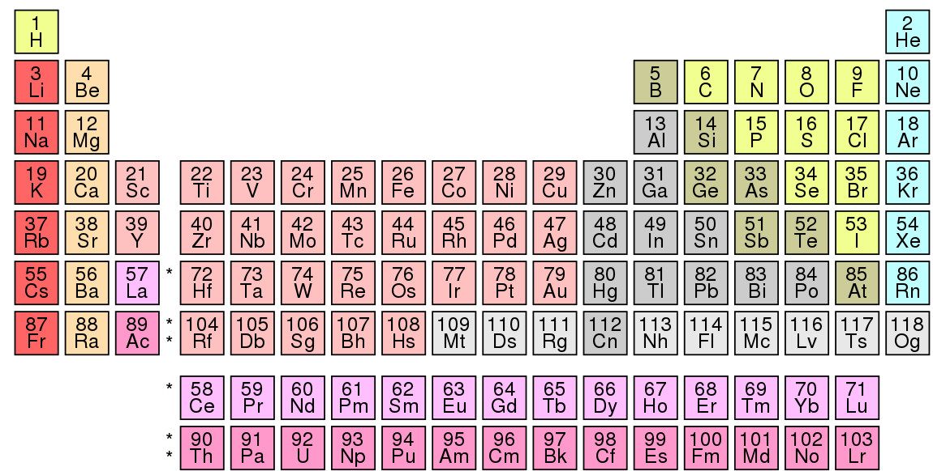
The Periodic Table
The Periodic Table is a list of all of the elements that exist.

Slide 81
The Periodic Table
The elements are listed in order of increasing atomic (proton) number.

Slide 82
The Periodic Table
So hydrogen comes first, because it has an atomic number of 1.

Slide 83
The Periodic Table
Sodium comes eleventh, because it has an atomic number of 11.

Slide 84
The Periodic Table
Carbon comes sixth, because it has an atomic number of 6.

Slide 85
The Periodic Table
If you need to find the atomic number of any element, just look in the Periodic Table!

Slide 86
Questions
Use the Periodic Table from the previous slides to answer these questions:
How many protons can you find in:
Boron (B)?
Lithium (Li)?
Oxygen (O)?
Neon (Ne)?
Nitrogen (N)?
Fluorine (F)?

Slide 87
Questions
Mark your answers!
How many protons can you find in:
Boron (B)? 5
Lithium (Li)? 3
Oxygen (O)? 8
Neon (Ne)? 10
Nitrogen (N)? 7
Fluorine (F)? 9

Slide 88
Challenge!
While you are isolating, see if you can learn the first 10 elements of the Periodic Table off by heart!
(From Hydrogen to Neon)
If you can recite these to me from memory when we are back at school, you will get a positive point!

Slide 89
Isotopes
Remember, all atoms of a given element have the same number of protons. Atoms of the same element cannot have a different number of protons.
However, atoms of a given element can have a different number of neutrons.

Slide 90
Isotopes
Isotopes are two or more chemical elements that have the same number of protons, but a different number of neutrons.
(So they have the same atomic number but different mass numbers)

Slide 91
Isotopes
Watch this video to learn more about isotopes!
https://www.youtube.com/watch?v=Q-wPwtCAj0I

Slide 92
Isotopes of hydrogen
There are three different isotopes of hydrogen:
Hydrogen-1
Hydrogen-2
Hydrogen-3

Slide 93
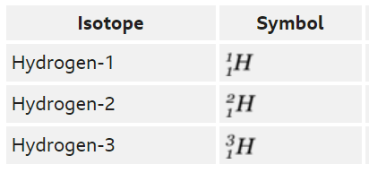
Isotopes of hydrogen
Task: Using the chemical symbols to help you, can you work out the number of protons, neutrons and electrons in each isotope?

Slide 94
Isotopes of hydrogen
Mark your answers! Did you get the numbers right?

Slide 95
Isotopes of hydrogen
All three isotopes of hydrogen have identical chemical properties. This is because the number of electrons determines chemical properties, and all three isotopes have one electron in their atoms.

Slide 96
Questions
Answer these questions about isotopes:
What are isotopes?
How many isotopes does hydrogen have?
Why can isotopes not have different numbers of protons?
Why does changing the number of neutrons not change the chemical properties of isotopes?

Slide 97
Questions
Mark your work!
Isotopes are two or more chemical elements that have the same number of protons, but a different number of neutrons.
Hydrogen has 3 different isotopes.
Changing the number of protons would change the element, it would not create an isotope.
The chemical properties are determined by the number electrons, and all isotopes have the same number of electrons.

Slide 98
End of lesson 4
Well done for completing lesson 4!
If you have any questions about the content, don’t hesitate to send me an email.

Slide 99
Final Task!
You have now finished all 4 lessons!
Task: Create some flashcards that you could use to test someone else in year 7! Write the question on the front of the flashcard and write the answer on the back so the person can turn it over if they are stuck. Include questions from all four of the lessons you have just covered.
I look forward to reading some of your flashcards when we are back at school! ☺

