Slide 1
Year 7 Maths Summer Term 1
Fortnight beginning 20th April 2020
Rounding and Estimation

Slide 2
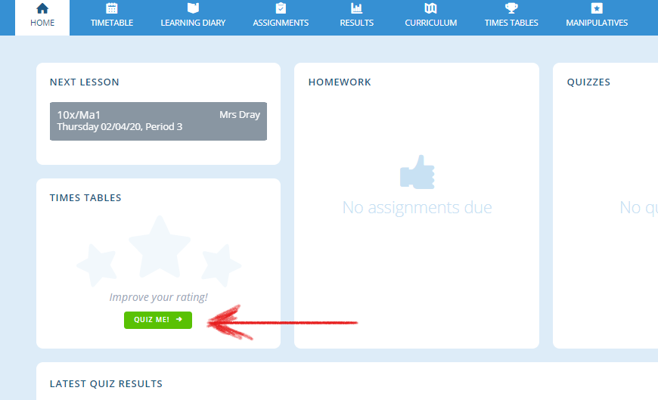
Lesson Overviews – how maths lessons will work for now
Log into www.completemaths.com and complete the multiplication tables. Click on “Quiz Me”
Complete 20 multiplication questions.

Slide 3
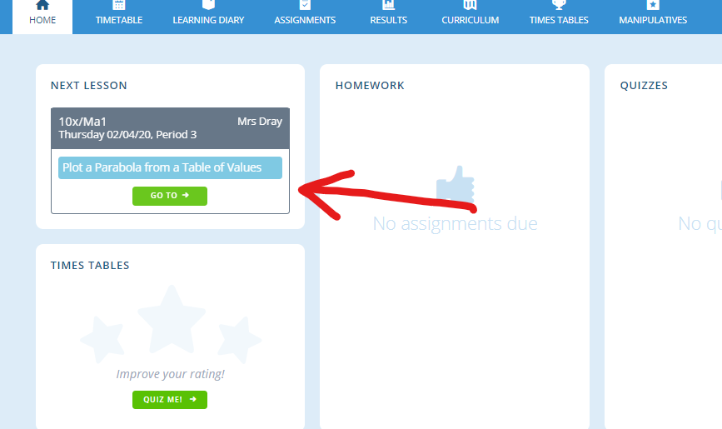
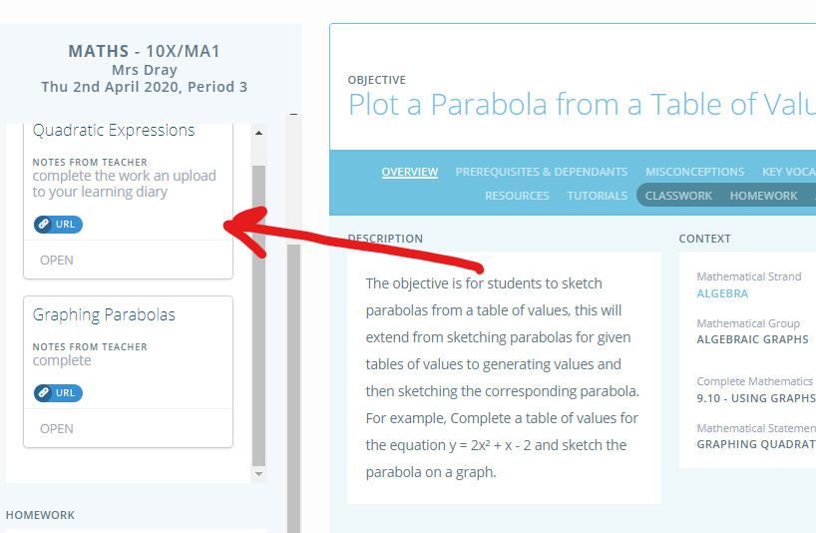
Lesson Overviews – how maths lessons will work for now
Click on the lesson shown
“Open” the task set and complete the work on paper.

Slide 4
Lesson Overviews – how maths lessons will work for now
Each lesson will follow this structure
Task 1) Complete 20 multiplications
Task 2) Knowledge Organiser work or recall task for this lesson
Task 3) Main task from classwork on complete maths to be uploaded to learning diary
A copy of this terms knowledge organiser is at the end of this PowerPoint

Slide 5
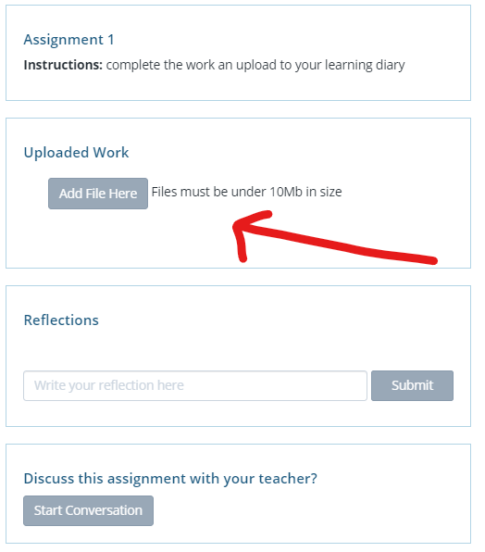
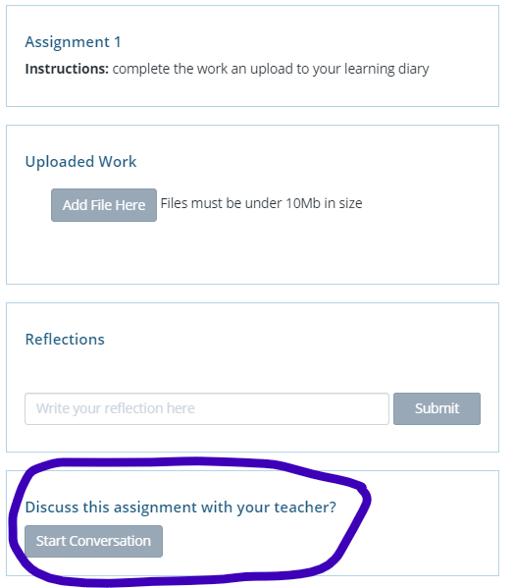
Lesson Overviews – how maths lessons will work for now
Once completed, upload the completed task to your learning diary. Take a photo of the work and upload the file
You can also start a conversation with me if you have any problems.

Slide 6
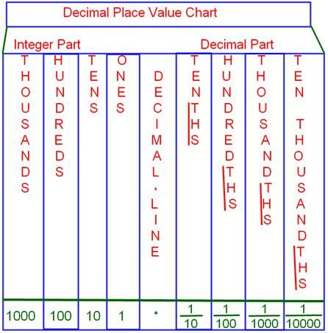
Lesson 1 – Place Value
Task 1) Complete 20 multiplications
Task 2) Sketch this diagram from your knowledge
organiser
Task 3)
Watch the video on Place value, here and make notes on the video.
Your task – have a go at finding the place value for each of these numbers underlined. You can type on a word document and upload
548
2797
27982
389436
3732027
373034984
Please upload this task to your learning Journey

Slide 7
Lesson 2 – Large number problems
Task 1) Complete 20 multiplications
Task 2) Make flashcards for the keywords used in this topic
Task 3)
Watch the video on hours, minutes and seconds, here and make notes on the video using appropriate diagrams
Your task – try and work out the following based upon what you have learnt
Total Number of Hours in a week
Total number of minutes in a week
Total number of hours in a year
Total number of minutes in a year
Total number of minutes in a day
Total number of hours in a decade
Please upload this task to your learning Journey

Slide 8
Lesson 3 – Rounding
Task 1) Complete 20 multiplications
Task 2) Make flashcards for division rules from your knowledge organiser
Task 3)
Watch the video here and make notes ready to upload to complete maths.
Once you have done this, complete the worksheet that is on Complete Maths and upload your answers.

Slide 9
Lesson 4 – Rounding decimal places
Task 1) Complete 20 multiplications
Task 2) Watch and make notes on the video here on how to round decimal numbers.
Task 3)
Open up the document Rounding lesson 4 and complete the questions and upload your answers to Complete Maths

Slide 10
Lesson 5 – Rounding whole numbers
Task 1) Complete 20 multiplications
Task 2)
Main task – watch the video assigned to your classwork and answer these questions.
What is the formula for the volume of a cuboid?
Why does a cuboid have the name cuboid?
Once completed, have a go at the worksheet that has been set for homework.
Extension - Draw a cuboid accurately (your choice of dimensions/lengths) and then find the volume.
Upload your notes and the worksheet answers to your learning diary.

Slide 11
Lesson 6 – Rounding to significant figures
Task 1) Complete 20 multiplications
Task 2) Write down the rules for rounding to the nearest 10, 100 and 1000
Task 3)
Watch the video assigned to your classwork, make notes on these.
Complete the worksheet Lesson 7 Rounding significant figures
Extension – Complete the extra worksheet – Extension Only questions 1, 5 and 6

Slide 12
Lesson 7 – Estimation
Task 1) Complete 20 multiplications
Task 2) Make notes on section 4 of your knowledge organiser and create your own example
Task 3)
Watch the video here and make notes on the information given
Complete the worksheet from Complete Maths - if you finish this, you can complete the extension sheet
Upload your answers to your learning diary.

Slide 13
Lesson 8 – Recap of past 2 weeks
Task 1) Complete 20 multiplications
Task 2) Write down what a significant number is and give an example
Task 3)
Go through all your notes from the lessons that you have been completing.
Main task –
Complete the quiz that has been made. After you have completed the quiz, if there were any questions you were unsure about start a conversation with me on complete maths (look back to slide 5 if unsure how to do that)

Slide 14
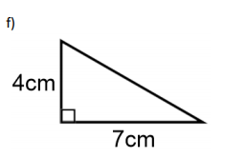
Maths Summer Term 1
Section 1. Keywords – Make Flashcards
Place Value– Place Value The value of where a digit is in the number. Example: In 352, the 5 is in the "tens" place, so its place value is 10 Example: In 17.591, the 9 is in the "hundredths" place, so its place value is 0.01
Significant Figures – Another way of rounding numbers is to count only the first few digits that have a value attached to them..
Estimation– Finding a value that is close enough to the right answer, usually with some thought or calculation involved.
The lower limit is the smallest value that would round up to the estimated value.
The upper limit is the smallest value that would round up to the next estimated value
Decimal Places – The position of a digit after the decimal point
Section 3 – Division rules– Make Flashcards and LEARN
When we divide by 10 , every digit moves one place to the right. Thousands become hundreds, hundreds become tens and tens become units.
27.301 2.7301
When we divide by 100 , every digit moves two places to the right. Thousands become tens, hundreds become units, and tens and units become fractions of a unit.
227.1 2.271
When we divide by 1000, every digit moves three places to the right. Thousands become tens, hundreds become units, and tens and units become fractions of a unit.
3629.4 3.6924
Section 2 – Read, Cover, Write
Step 2: Answer the following questions:
Write down the value of underlined digit in each of the numbers below
(a) 548 (b) 902 (c) 623 (d) 3841
Section 4 – Estimating answers to questions
Section 5 – Read, Learn and do another example with other numbers
Calculate the minimum and maximum area of a shape like this
Minimum = 3.5cm*6.5cm = 22.75cm
= 11.375cm²
Maximum = 4.5cm*7.5cm = 33.75cm
= 11.375cm²
Example: you want to plant a row of flowers. The row is 58.3cm long. The plants should be 6cm apart. How many do you need?
h
58.3cm
b
Answer : 58.3 is nearly 60, and 60 divided by 6 is 10, so 10 plants should be enough
4.5*7.5
2

