Slide 1
Year 8 Maths Summer Term 1
Fortnight beginning 20th April 2020
3D Geometry

Slide 2
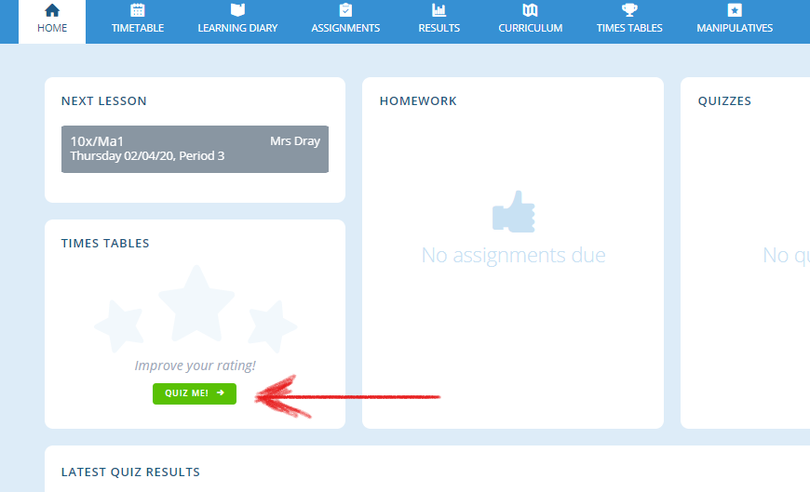
Lesson Overviews – how maths lessons will work for now
Log into www.completemaths.com and complete the multiplication tables. Click on “Quiz Me”
Complete 20 multiplication questions.

Slide 3
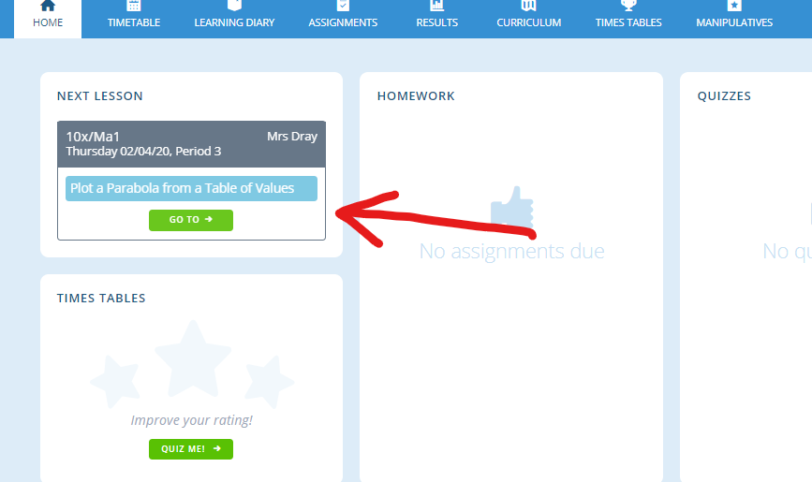
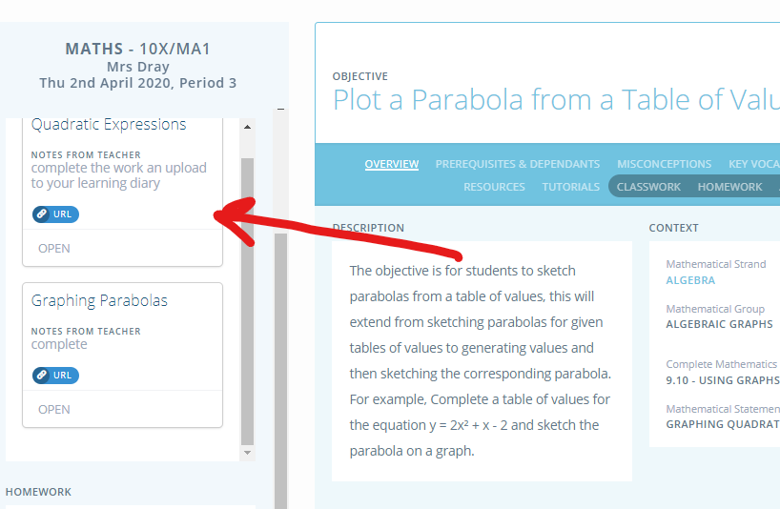
Lesson Overviews – how maths lessons will work for now
Click on the lesson shown
“Open” the task set and complete the work on paper.

Slide 4
Lesson Overviews – how maths lessons will work for now
Each lesson will follow this structure
Task 1) Complete 20 multiplications
Task 2) Knowledge Organiser work or recall task for this lesson
Task 3) Main task from classwork on complete maths to be uploaded to learning diary
A copy of this terms knowledge organiser is at the end of this PowerPoint

Slide 5
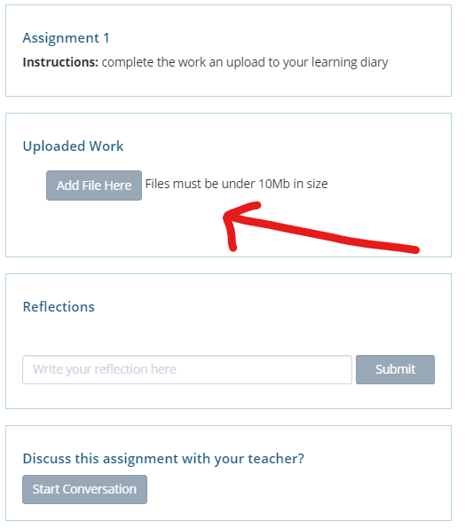
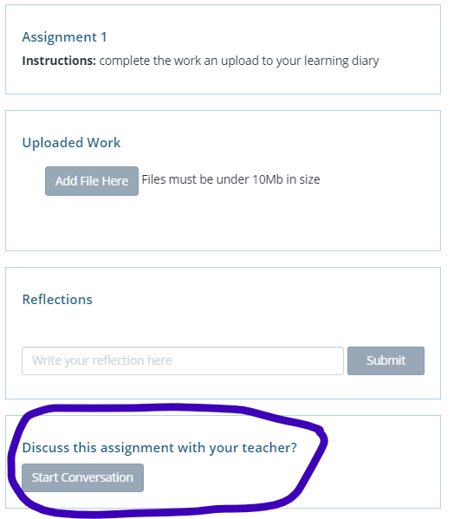
Lesson Overviews – how maths lessons will work for now
Once completed, upload the completed task to your learning diary. Take a photo of the work and upload the file
You can also start a conversation with me if you have any problems.

Slide 6
Lesson 1 – Draw 3D shapes
Task 1) Complete 20 multiplications
Task 2) Sketch this cube from your knowledge organiser
Task 3)
Print the worksheet if possible, if not you can still participate with squared, lined, or plain paper. On the worksheet, there is already 1 cube drawn.
Your task - have a go at drawing shapes with these volumes.
4 cubes
8 cubes
12 cubes
16 cubes
You do not have to draw a symmetrical shape. The most adventurous shapes will receive a positive point.
Upload the task to your learning diary.

Slide 7
Lesson 2 – Plans and elevations
Task 1) Complete 20 multiplications
Task 2) Make flashcards for plan, elevation, and compound shapes from your knowledge organiser.
Task 3)
Watch the video assigned to your classwork and then answer these question.
- What are the terms we can use for side 1 and side 2? (shape 1)
- In your own words, what is the difference between a plan and an elevation? (knowledge organiser to help) (shape 1)
- Explain why you cannot see the depth for the plan view? (shape 2)
- Why is the plan straight when the elevation is slanted? (shape 3)
Upload your answers to your learning diary

Slide 8
Lesson 3 – Plans and elevations
Task 1) Complete 20 multiplications
Task 2) Complete section 2 of Knowledge Organiser
Task 3)
Complete the worksheet on plain paper by numbering your answers.
Extension – draw the plan view, side elevation, and front elevation for question 6.
Upload your answers to your learning diary

Slide 9
Lesson 4 – Plans and elevations
Task 1) Complete 20 multiplications
Task 2) Make flashcards for plan, elevation, and compound shapes from your knowledge organiser.
Task 3)
Choose a 3-D object that you find interesting. For example,
• Lunch boxes • Pencil cases • Clocks • Computers games systems • Household items • Food containers.
Take a photograph of your item from the front, back, sides and plan view (from above) and upload to learning diary
Your task is
Make a poster of all of your photographs.
The poster should include all elevations and should be labelled.
Give your collage an interesting title.
Upload your poster to your learning diary

Slide 10
Lesson 5 – Volume of a cuboid
Task 1) Complete 20 multiplications
Task 2) Make flashcards for volume from your knowledge organiser. Think about real life examples where you have used volume before.
Task 3)
First - make sure you are familiar with area (Spring 1 – January/February knowledge organiser)
Main task – watch the video assigned to your classwork and answer these questions.
What is the formula for the volume of a cuboid?
Why does a cuboid have the name cuboid?
Once completed, have a go at the worksheet that has been set for homework.
Extension - Draw a cuboid accurately (your choice of dimensions/lengths) and then find the volume.
Upload your notes and the worksheet answers to your learning diary.

Slide 11
Lesson 6 – Volume of a cuboid (finding missing length)
Task 1) Complete 20 multiplications
Task 2) Write down how to work out the volume of a cuboid.
Task 3)
Watch the video assigned to your classwork and answer these questions (if you are stuck use google to find the answer)
Why has he changed 2000ml into 2000$cm^{3}$
Make a poster to explain what he has done – include every step and why.
Extension – if a cuboid has a volume of 90$cm^{3}$ and a length of 5, what are the 3 pairs possibilities for the other sides?
Upload your answer and poster to your learning diary.

Slide 12
Lesson 7 – Volume of shapes made from a cuboid
Task 1) Complete 20 multiplications
Task 2) Complete section 4 of your knowledge organiser – if struggling with this, go back to Spring 1 knowledge organiser (January/February)
Task 3)
Write a sentence to describe the relationship between area and volume
Complete the worksheet
Use task 2 to help you
(work out the volume of ‘two’ separate shapes)
Upload your answers to your learning diary.

Slide 13
Lesson 8 – Recap of past 2 weeks
Task 1) Complete 20 multiplications
Task 2) Write down how to work out the volume of a cuboid.
Task 3)
Go through all your notes from the lessons that you have been completing.
Main task –
Complete the quiz that has been made. After you have completed the quiz, if there were any questions you were unsure about start a conversation with me on complete maths (look back to slide 5 if unsure how to do that)
Go to the webpage on your classwork and build a cuboid. Use any plain paper.
Upload a picture of your finished cuboid to the learning diary.

Slide 14
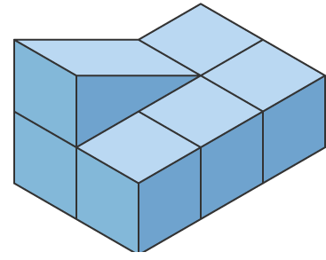
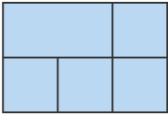
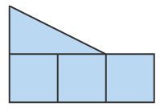
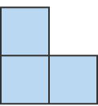
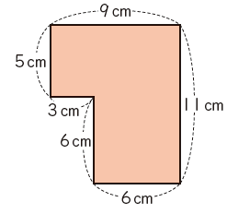
Maths Summer Term 1
Section 1. Keywords – Make Flashcards
Plan - A plan is a scale drawing showing a 3D shape when it is looked at from above.
Elevation - An elevation is the view of a 3D shape when it is looked at from the side or from the front
Compound Shapes - A compound shape is shape made up of two or more basic shapes. An example of this is that you can place a thin rectangle horizontally on top of a thin rectangle placed vertically so that you form a T shape.
Volume - Volume is a measure of how much space an object takes up. For example two shoe boxes together have twice the volume of a single box, because they take up twice the amount of space.
Surface Area - The total area of the surface of a three-dimensional object. Example: the surface area of a cube is the area of all 6 faces added together
Section 3 – Volume Rules– Make Flashcards and LEARN
Volume of a prism
$$V=Area of cross section ×height$$
Volume of a cylinder
$$V=πr^{2}h$$
Volume of a cone
$$V=πr^{2}\frac{h}{3}$$
Volume of a pyramid
$$V=\frac{lwh}{3}$$
Section 2 – Read, Cover, Write
A plan is a scale drawing showing a 3D shape when it is looked at from above.
An elevation is the view of a 3D shape when it is looked at from the side or from the front.
Plan
Plan
^{Side Elevation}
Front Elevation
Front Elevation
^{Side Elevation}
Section 5 – Read, Learn and do another example with other numbers
$$V=\frac{lwh}{3}$$
Where $l$=length w = width, h=height,
Example:
$$\frac{6×8×9}{3}$$
=144cm³
Volume of a Pyramid
Section 4 – Replace the dimensions with other numbers and solve
9cm
Example: Calculate the area of this compound shape.
Solution:
Shape A: 5cm*9cm = 45cm²
Shape B: 6cm*6cm = 36cm²
Total area of compound shape: 45cm+36cm = 81cm²
8cm
6cm
A
B

