Slide 1
Spaced Retrieval
Spiral
State the mode of the following:
1,1,5,5,2,1,6,6,6,1,2,2
Last lesson
What is a mole?
Last Month
What is meant by atom economy?
Last Year
Describe the difference between an ionic bond and a covalent bond in terms of electrons.
Knowledge Organiser recall
How many moles are in 36g of Carbon – 12?
In silence, on your own, from memory. You must write something.

Slide 2
Spaced Retrieval
Spiral
State the mode of the following:
1,1,5,5,2,1,6,6,6,1,2,2
1
Last lesson
What is a mole?
The amount of a substance that contains 6.02x10^23 atoms or molecules.
Last Month
What is meant by atom economy?
The percentage of atoms you started with that end up in the product you require.
Last Year
An ionic bond is formed when electrons are lost or gained. In covalent bonding electrons are always shared.
Knowledge Organiser recall
How many moles are in 36g of Carbon – 12?
3moles.
In silence, on your own, from memory. You must write something.

Slide 3
Hydrocarbons
Understand what is meant by the term hydrocarbon.
Must: Define a hydrocarbon.
Stretch: Describe how crude oil is formed.
Challenge: Detrmine the number of carbon and hydrogen atoms in different types of alkanes.

Slide 4
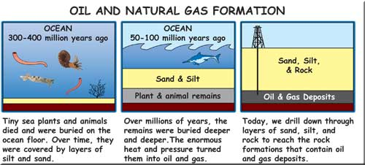
What is a hydrocarbon?
Hello everybody, I hope you and your families are all safe and well.
I have put 6 lessons together on the topic of crude oil and combustion
Enjoy!
Mr Hulse
Must: Define a hydrocarbon.
Stretch: Describe how crude oil is formed.
Challenge: Determine the number of carbon and hydrogen atoms in different types of alkanes.
Crude oil is formed from dead animals and plants. Using the diagram, describe how you think crude oil may have been formed.
Extension: Why is some oil drilled for on land rather than at sea?

Slide 5
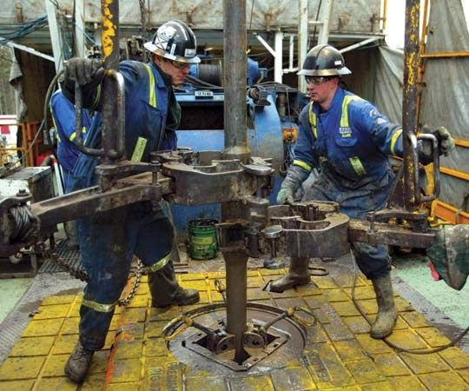
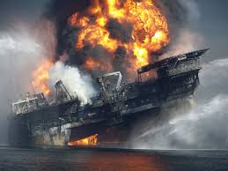
What is a hydrocarbon?
Complete the following:
Must: Define a hydrocarbon.
Stretch: Describe how crude oil is formed.
Challenge: Determine the number of carbon and hydrogen atoms in different types of alkanes.
Crude oil is a n____-_________, finite resource. It will run out!
Crude oil is a d __________, smelly, v__________ liquid.
It is formed u ____________ and can be e____________ from certain locations.
Crude oil is a hydrocarbon. This is a m___________ of different chemical compounds that only contain c ___________ and h___________.

Slide 6
What is a hydrocarbon?
MARK IT.:
Must: Define a hydrocarbon.
Stretch: Describe how crude oil is formed.
Challenge: Determine the number of carbon and hydrogen atoms in different types of alkanes.
Crude oil is a non-renewable, finite resource. It will run out!
Crude oil is a dark, smelly, viscous (thick and goopy) liquid.
It is formed underground and can be extracted from certain locations.
Crude oil is a hydrocarbon. This is a mixture of different chemical compounds that only contain carbon and hydrogen.

Slide 7
What is a hydrocarbon?
Have a go at completing the worksheet on the naming and drawing of the first 5 alkanes.
Must: Define a hydrocarbon.
Stretch: Describe how crude oil is formed.
Challenge: Determine the number of carbon and hydrogen atoms in different types of alkanes.
GENERAL FORMULA FOR ALKANES
C_{n}H_{2n+2}
Extension Task
E.g. What is the formula of octane with eight carbon atoms? You double the number of carbon atoms and add 2:
C₈H₁₈
What is the formula of decane with ten carbon atoms?
Dodecane has 26 hydrogen atoms in it. How many carbon atoms does dodecane contain?

Slide 8
What is a hydrocarbon?
What do you notice about the boiling points as the alkanes become larger in size? __________________________________________________
Complete the table below by filling the empty boxes.
Alkanes all end in __________.
Must: Define a hydrocarbon.
Stretch: Describe how crude oil is formed.
Challenge: Determine the number of carbon and hydrogen atoms in different types of alkanes.
Complete the sentences below:
Crude _______ is a _____________ of hydrocarbons. The ____________ are made up of carbon and hydrogen _________ only.
___________ are one type of hydrocarbon found in crude oil. They exist as different __________ molecules.
Alkanes are ______________ molecules because it contains a ___________ carbon-carbon covalent bond. This means the molecule contains as many _____________ atoms as they possibly can.
ATOMS HYDROGEN SIZED OIL MIXTURE ALKANES SATURATED COMPOUNDS SINGLE
No. of Carbon Atoms | Displayed Formula | Molecular Formula | Name | Boiling Point (°C)
1 |  |  | Methane | -162
 |  | C₂H₆ | Ethane | -89
3
 |  |  |  | 0
5 |  | C₅H₁₂ |  | 32
The general formula for alkanes is C_{n}H_{2n+2}. What is the molecular formula for:
An alkane containing 10 carbon atoms.
An alkane containing 22 hydrogen atoms.
Use the internet or your revision guide
To help you.

Slide 9
What is a hydrocarbon?
What do you notice about the boiling points as the alkanes become larger in size? The boiling points increase as they become larger in size.
Complete the table below by filling the empty boxes.
Alkanes all end in ane.
Must: Define a hydrocarbon.
Stretch: Describe how crude oil is formed.
Challenge: Determine the number of carbon and hydrogen atoms in different types of alkanes.
Complete the sentences below:
Crude oil is a mixture of hydrocarbons. The hydrocarbons are made up of carbon and hydrogen atoms only.
Alkanes are one type of hydrocarbon found in crude oil. They exist as different sized molecules.
Alkanes are saturated molecules because it contains a single carbon-carbon covalent bond. This means the molecule contains as many hydrogen atoms as they possibly can.
ATOMS HYDROGEN SIZED OIL MIXTURE ALKANES SATURATED COMPOUNDS SINGLE
No. of Carbon Atoms | Displayed Formula | Molecular Formula | Name | Boiling Point (°C)
1 |  |  | Methane | -162
 |  | C₂H₆ | Ethane | -89
3
 |  |  |  | 0
5 |  | C₅H₁₂ |  | 32
The general formula for alkanes is C_{n}H_{2n+2}. What is the molecular formula for:
An alkane containing 10 carbon atoms.
An alkane containing 22 hydrogen atoms.

Slide 10
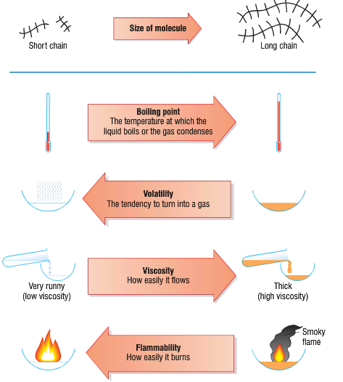
Lesson 2: What is a alkane?
Must: Define a hydrocarbon.
Stretch: Describe the properties of alkanes change as they get longer.
Challenge: Evaluate the properties of different alkanes.
1. Draw out this diagram into your exercise books using a pencil and a ruler. The written labels can be done in pen.
2. Describe what happens to the boiling point, volatility, viscosity and flammability of hydrocarbons as they increase in size.
[4 marks]

Slide 11
Lesson 2: What is a alkane?
Must: Define a hydrocarbon.
Stretch: Describe the properties of alkanes change as they get longer.
Challenge: Evaluate the properties of different alkanes.
1. Draw out this diagram into your exercise books using a pencil and a ruler. The written labels can be done in pen.
2. Describe what happens to the boiling point, volatility, viscosity and flammability of hydrocarbons as they increase in size.
[4 marks]
The boiling point increases.
The volatility decreases.
The viscosity increases.
The flammability decreases

Slide 12
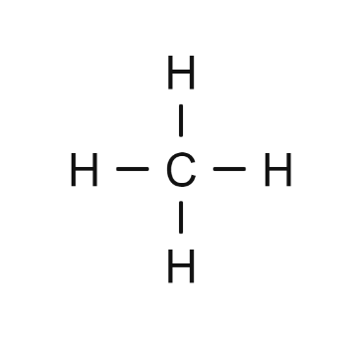
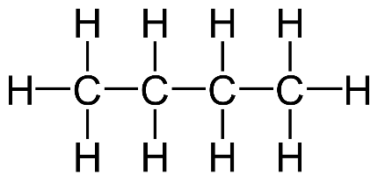
Lesson 2: What is a alkane?
Must: Define a hydrocarbon.
Stretch: Describe the properties of alkanes change as they get longer.
Challenge: Evaluate the properties of different alkanes.
METHANE
BUTANE
DECANE
1. Draw out the three diagrams shown above and label them.
2. Which of the molecules has got the highest boiling point?
3. Which of the molecules has got the lowest viscosity?
4. Which of the molecules has got the highest volatility?
5. Which of the molecules has got the lowest flammability?
6. Which of these molecules is not a gas at room temperature?
7. Which of these molecules is most likely to burn with a black smoky flame?
8. Write down the molecular formulae for each of the molecules.

Slide 13
Lesson 3: What is a fractional distillation?
What do we mean by the terms ‘boiling point’, ‘evaporation’ and ‘condensation’.
Watch the video by clicking the link below. You will use the information from this video to help you with today’s lesson.
Must: Define evaporation and condensation
Stretch: Describe what fractional distillation is.
Challenge: Explain the process of fractional distillation.
https://youtu.be/86WY2mV9jiU

Slide 14
Lesson 3: What is a fractional distillation?
Must: Define evaporation and condensation
Stretch: Describe what fractional distillation is.
Challenge: Explain the process of fractional distillation.
Fractional Distillation
Boiling Point
Average Number of Carbon Atoms
Fraction
Liquid Petroleum Gas
< 25ºC
3
40ºC
Petrol
25 – 60ºC
8
Naphtha
60 – 180ºC
10
Paraffin
180 – 220ºC
12
Diesel
220 – 250ºC
20
Fuel Oil
250 – 300ºC
40
Lubricating Oil
300 – 350ºC
80
350ºC
Bitumen
> 350ºC
120
Heated Crude Oil

Slide 15
Lesson 3: What is a fractional distillation?
Fractional Distillation
Must: Define evaporation and condensation
Stretch: Describe what fractional distillation is.
Challenge: Explain the process of fractional distillation.
1. Copy and complete the sentence below:
Fractional _________ is a process used to _________ crude oil into different sized hydrocarbons with _________ boiling _________. These separated hydrocarbons are called _________. Each hydrocarbon fraction contains molecules with a similar number of _________ atoms. Each of these fractions _________ at a different temperature _________ because of the different _________ molecules in it.
2. Answer the questions below using full sentences:
a) How does the size of the hydrocarbon molecule affect its boiling point?
b) Why do fractions containing small hydrocarbon molecules make good fuels?

Slide 16
Lesson 3: What is a fractional distillation?
Fractional Distillation – mark it.
Must: Define evaporation and condensation
Stretch: Describe what fractional distillation is.
Challenge: Explain the process of fractional distillation.
1. Copy and complete the sentence below:
Fractional distillation is a process used to separate crude oil into different sized hydrocarbons with different boiling points. These separated hydrocarbons are called fractions. Each hydrocarbon fraction contains molecules with a similar number of carbon atoms. Each of these fractions boils at a different temperature points because of the different length molecules in it.
2. Answer the questions below using full sentences:
a) How does the size of the hydrocarbon molecule affect its boiling point? The larger the molecule the hugher the boiling point.
b) Why do fractions containing small hydrocarbon molecules make good fuels? They are very flammable.

Slide 17
Lesson 3: What is a fractional distillation?
The different fractions are collected as liquids at different levels.
Task: drag and rearrange the diagram and statements.
Crude oil is heated and fed into the bottom of a tall fractioning column as a hot vapour.
Must: Define evaporation and condensation
Stretch: Describe what fractional distillation is.
Challenge: Explain the process of fractional distillation.
Hydrocarbons with the largest molecules have the highest boiling points and are removed at the bottom of the fractioning column where it is hotter.
The hydrocarbon gases rise up the column.
The gases condense when they reach the temperature of their boiling points.
Hydrocarbons with the smallest molecules have the lowest boiling points and are removed at the top of the fractioning column where is it cooler.

Slide 18
Lesson 4: What is a fractional distillation?
Fractional Distillation
1. Crude oil is heated and fed into the bottom of a tall fractioning column as a hot vapour.
Must: Define a hydrocarbon.
Stretch: Describe how crude oil is formed.
Challenge: Determine the number of carbon and hydrogen atoms in different types of alkanes.
2. The hydrocarbon gases rise up the column.
3. The gases condense when they reach the temperature of their boiling points.
4. The different fractions are collected as liquids at different levels.
5. Hydrocarbons with the smallest molecules have the lowest boiling points and are removed at the top of the fractioning column where is it cooler.
6. Hydrocarbons with the largest molecules have the highest boiling points and are removed at the bottom of the fractioning column where it is hotter.

Slide 19
Lesson 4: What is Cracking?
Watch this video: https://www.youtube.com/watch?v=Ehcq4cARkMI
Cracking
Must: Define what cracking is.
Stretch: Describe how cracking can be carried out.
Challenge: Explain why cracking is a useful process.
Cracking is the process of breaking down long chain alkanes into smaller alkanes and alkenes.
Heavy, long chain hydrocarbons from crude oil are NOT useful. They are not good fuels as they do not burn easily due to low flammability and low volatility.
Describe what is meant by ‘cracking’.
What do we start with in the ‘cracking’ process?
What are the two products of ‘cracking’?
Why do we need to ‘crack’ long chain hydrocarbons?

Slide 20
Lesson 4: What is Cracking?
Cracking – mark it.
Must: Define what cracking is.
Stretch: Describe how cracking can be carried out.
Challenge: Explain why cracking is a useful process.
Describe what is meant by ‘cracking’.
Cracking is when we break down long chain Alkanes in shorter more useful alkanes,
an alkene is also made
What do we start with in the ‘cracking’ process?
A long chain alkane
What are the two products of ‘cracking’?
A short chain alkane and an alkene.
Why do we need to ‘crack’ long chain hydrocarbons?
Because they are not very useful.

Slide 21
Lesson 4: What is Cracking?
The long chain hydrocarbon is heated to a very high temperature (500-800°C) and the vapours are passed over a broken clay pot catalyst. The hydrocarbon chain breaks down through thermal decomposition.
Must: Define what cracking is.
Stretch: Describe how cracking can be carried out.
Challenge: Explain why cracking is a useful process.
Read the information and attempt to:
Draw a labelled diagram without looking.
State the conditions needed for cracking.

Slide 22
Lesson 4: What is Cracking?
Cracking
Small alkanes and alkenes are the products of cracking. The alkanes make good fuels and the alkenes are used to make polymers.
Must: Define what cracking is.
Stretch: Describe how cracking can be carried out.
Challenge: Explain why cracking is a useful process.
ALKANES
They contains C-C single bonds.
The compounds will always end in –ane.
They have the general formula C_{n}H_{2n+2}.
Addition of bromine water and it will remain orange.
ALKENES
They contains C=C double bonds.
The compounds will always end in –ene.
They have the general formula C_{n}H_{2n}.
Addition of bromine water and it will turn colourless.
What are the similarities and differences between an alkane and an alkene?
How can Bromine water help us determine if we have an alkane or and alkene?

Slide 23
Lesson 4: What is Cracking?
Cracking
Must: Define what cracking is.
Stretch: Describe how cracking can be carried out.
Challenge: Explain why cracking is a useful process.
Complete the following questions on cracking. Remember the principle of ‘conservation of mass’. The overall number of atoms of each element on both sides of the arrow must be the same.
Small Chain Alkane
Small Chain Alkene
Q1. Large Chain Alkane → __________ + __________
Q2. C₂₅H₅₂ → C₁₄H₃₀ + __________
Q3. C₃₄H₇₀ → C₂₁H₄₄ + __________
Q4. C₁₇H₃₆ → __________ + C₄H₈
Q5. __________ → C₁₅H₃₂ + C₁₅H₃₀
Q6. Octane → Propane + __________
Q7. __________ → Ethane + Butene
C₁₁H₂₂
C₁₃H₂₆
C₁₃H₂₈
C₃₀H₆₂
Pentene
Hexane

Slide 24
Lesson 5: What is combustion?
Must: Define what combustion is.
Stretch: Describethe differences between complete and incomplete combustion.
Challenge: Explain why incomplete combustion is dangerous.
Starter Activity – research.
What are the three requirements of the fire triangle? You may wish to draw it out using a pencil and a ruler.
What would happen if you were to remove any on of these three areas of the fire triangle?
Explain how a water fire extinguisher and a carbon monoxide fire extinguisher work?
Keywords
COMPLETE
INCOMPLETE
FUEL
OXYGEN
CARBON DIOXIDE
WATER
CARBON MONOXIDE
LIMEWATER
COBALT PAPER

Slide 25
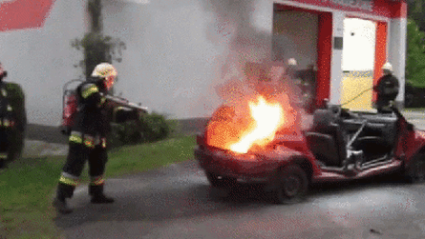
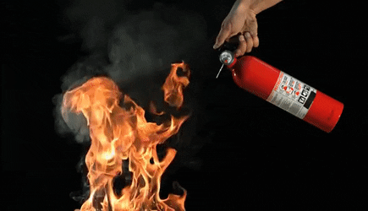
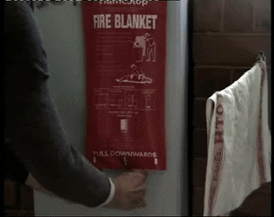
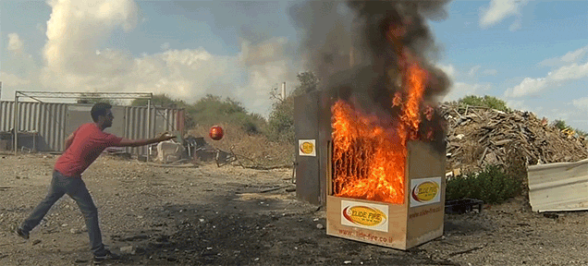
Lesson 5: What is combustion?
Must: Define what combustion is.
Stretch: Describethe differences between complete and incomplete combustion.
Challenge: Explain why incomplete combustion is dangerous.

Slide 26
Lesson 5: What is combustion?
When a fuel burns in pure oxygen we call it complete _______________.
The fuel we use is a ________________ as it is made up of only carbon and _____________.
Small chain alkanes are good as fuels because they _________ well. This is due to their low _____________ points and high ________________.
The two products that are produced when a fuel burns in oxygen are ___________ ____________ and ___________.
Must: Define what combustion is.
Stretch: Describethe differences between complete and incomplete combustion.
Challenge: Explain why incomplete combustion is dangerous.
FLAMMABILITY HYDROGEN BOILING WATER COMBUSTION HYDROCARBON BURN
CARBON DIOXIDE

Slide 27
Lesson 5: What is combustion?
Mark it.
Must: Define what combustion is.
Stretch: Describethe differences between complete and incomplete combustion.
Challenge: Explain why incomplete combustion is dangerous.
When a fuel burns in pure oxygen we call it complete combustion.
The fuel we use is a hydrocarbon as it is made up of only carbon and hydrogen.
Small chain alkanes are good as fuels because they burn well. This is due to their low boiling points and high flammability.
The two products that are produced when a fuel burns in oxygen are Carbon dioxide and water.
FLAMMABILITY HYDROGEN BOILING WATER COMBUSTION HYDROCARBON BURN
CARBON DIOXIDE

Slide 28
Lesson 5: What is combustion?
Must: Define what combustion is.
Stretch: Describethe differences between complete and incomplete combustion.
Challenge: Explain why incomplete combustion is dangerous.
Draw and label the diagram shown above. Do this in pencil and use a ruler.
Write a word equation for the reaction taking place in this experiment.
What is the purpose of the limewater? What will happen to it?
What is the purpose of the ice water?
What is the purpose of the cobalt paper? What colour is it at the start? What colour is it at the end of the reaction?
Why does the fuel sometimes produce black smoke?

Slide 29
Lesson 5: What is combustion?
Mark it.
Must: Define what combustion is.
Stretch: Describethe differences between complete and incomplete combustion.
Challenge: Explain why incomplete combustion is dangerous.
Draw and label the diagram shown above. Do this in pencil and use a ruler.
Write a word equation for the reaction taking place in this experiment.
Natural gas + oxygen → Carbon dioxide + water
2. What is the purpose of the limewater? What will happen to it?
Limewater tests for carbon dioxide. It turns a milky colour when its present.
3. What is the purpose of the ice water?
To condense the water vapour into a liquid.
4. What is the purpose of the cobalt paper? What colour is it at the start? What colour is it at the end of the reaction?
Cobalt paper tests for water. It starts off a blue colour and changes to white if water is present.
5. Why does the fuel sometimes produce black smoke?
One of the products of incomplete combustion is Carbon (soot)

Slide 30
Lesson 5: What is combustion?
Have a look at the symbol equation for the combustion of methane gas.
CH₄ + O₂ → CO₂ + H₂O
Q1. Are there the same number of each atom on either side of the arrow?
Q2. How could you ensure that there are equal numbers of each atom on either side of the arrow? Write the equation and your answer down.
SEE IF YOUR PARENT OR CARER CAN HELP YOU COMPLETE THE questions ON BALANCING EQUATIONS!
Must: Define what combustion is.
Stretch: Describethe differences between complete and incomplete combustion.
Challenge: Explain why incomplete combustion is dangerous.

Slide 31
Lesson 5: What is combustion?
METHANE + OXYGEN → CARBON DIOXIDE + WATER
CH₄ + O₂ → CO₂ + H₂O
Must: Define what combustion is.
Stretch: Describethe differences between complete and incomplete combustion.
Challenge: Explain why incomplete combustion is dangerous.
1
2
1
2
BUTANE + OXYGEN → CARBON DIOXIDE + WATER
C₄H₁₀ + O₂ → CO₂ + H₂O
6.5
4
PROPANE + OXYGEN → CARBON DIOXIDE + WATER
C₃H₈ + O₂ → CO₂ + H₂O
5
4
HEXANE + OX8GEN → CARBON DIOXIDE + WATER
C₆H₁₄ + O₂ → CO₂ + H₂O
PENTANE + OXYGEN → CARBON DIOXIDE + WATER
5
1
C₅H₁₂ + O₂ → CO₂ + H₂O

Slide 32
Lesson 5: What is combustion?
How did you do?
Must: Define what combustion is.
Stretch: Describethe differences between complete and incomplete combustion.
Challenge: Explain why incomplete combustion is dangerous.
METHANE + OXYGEN → CARBON DIOXIDE + WATER
CH₄ + O₂ → CO₂ + H₂O
1
2
1
2
BUTANE + OXYGEN → CARBON DIOXIDE + WATER
C₄H₁₀ + O₂ → CO₂ + H₂O
1
6.5
4
5
PROPANE + OXYGEN → CARBON DIOXIDE + WATER
3
C₃H₈ + O₂ → CO₂ + H₂O
1
5
4
HEXANE + OX8GEN → CARBON DIOXIDE + WATER
1
9.5
C₆H₁₄ + O₂ → CO₂ + H₂O
6
7
PENTANE + OXYGEN → CARBON DIOXIDE + WATER
5
6
C₅H₁₂ + O₂ → CO₂ + H₂O
1
8

Slide 33
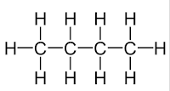
Lesson 6: Revision.
Attempt as many of these questions as you can to check your understanding.
You can use the previous slides to help you.
Must: Define what combustion is.
Stretch: Describethe differences between complete and incomplete combustion.
Challenge: Explain why incomplete combustion is dangerous.
Hydrocarbon | Chemical formula | Displayed formula
methane
 | C₂H₆
propane

Slide 34
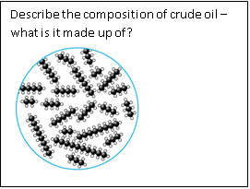
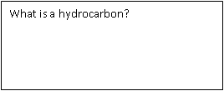
Lesson 6: Revision.
Must: Define what combustion is.
Stretch: Describethe differences between complete and incomplete combustion.
Challenge: Explain why incomplete combustion is dangerous.
Complete the sentences to describe how the chain length affects the properties of hydrocarbons:
As chain length increases, viscosity………………………………………………….
As chain length decreases, flammability ……………………………………………
…………………………………………………………………………….., boiling point increases.
………………………………………………………………………………, the colour gets darker.
Give the GENERAL formula of:
An ALKANE:
An ALKENE

Slide 35
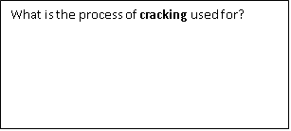
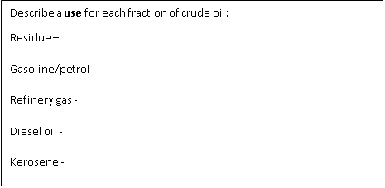
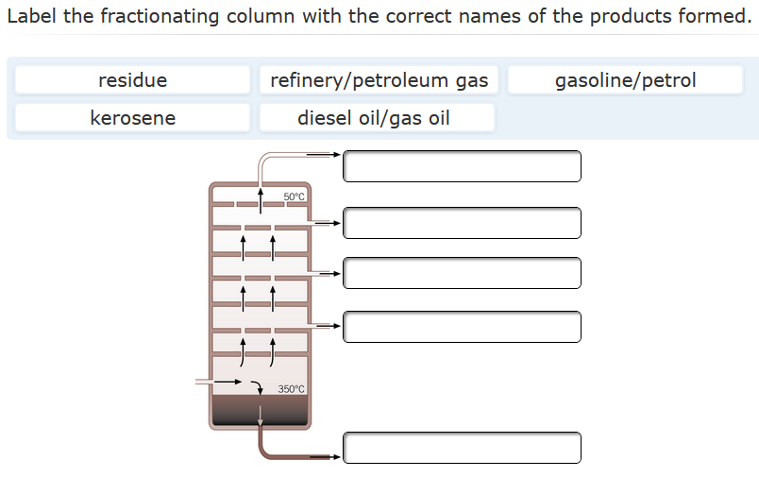
Lesson 6: Revision.
Must: Define what combustion is.
Stretch: Describethe differences between complete and incomplete combustion.
Challenge: Explain why incomplete combustion is dangerous.

Slide 36
Lesson 6: Revision.
Must: Define what combustion is.
Stretch: Describethe differences between complete and incomplete combustion.
Challenge: Explain why incomplete combustion is dangerous.
What is the difference between complete and incomplete combustion?
Write a word equation to describe the complete combustion of butane:
Write a word equation for the incomplete combustion of methane:
How can you use bromine water to show that an alkene is present?
Stay indoors
Stay safe
See you all soon. Mr Hulse

