Slide 1
Year 10 – Term 5
Language Paper 2 – Non-fiction
Lesson 1 - Planning
Learning objective:
To understand the requirements of Paper 2 Reading and the components required to achieve optimum marks.
Learning outcome:
Must: Understand the format of Paper 2, Section A.
Stretch: Communicate ideas effectively, using appropriate form and tone.
Challenge: Use a range of grammatical and structural features to convey ideas and viewpoints.

Slide 2
Writers’ Viewpoints and Perspectives
You will have one hour to read and answer questions on two non-fiction texts.
One text will always be from the 19th century and one text will be from the 20th or 21st century.
You will have to answer four questions.
You should spend about 15 minutes reading the extracts and questions before you begin to write up your answers.
👨‍🏫
Question | Marks | AOs | Focus | Timing
1 | 4 | 1 | True or false – identify explicit and implicit info. | 5
2 | 8 | 1 | Synthesise and summarise info from both texts. | 8
3 | 12 | 2 | Explain, comment on and analyse language/structure. | 12
4 | 16 | 3 | Compare ideas and attitudes in both texts. | 20
Manage your time carefully to answer all the questions.
Aim to spend about one minute-per-mark.

Slide 3
👨‍🏫
Task (10 minutes)
Complete a Y-frame to explore the character’s experience in that moment.
(Sight, sound & touch.)
Add as much detail as you can.
Watch this trailer for the film American Sniper.
https://youtu.be/99k3u9ay1gs
👀
👂
🖐️
Extension:
Develop your descriptive notes by considering the senses of smell and taste in the scene.

Slide 4
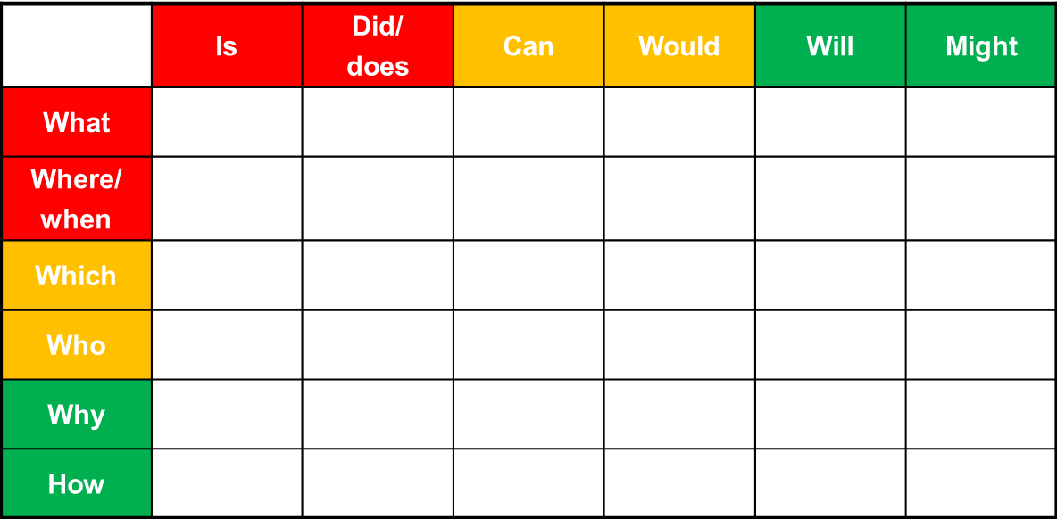
👨‍🏫
Imagine you could pause the scene here. What questions would you put to the character?
Use this question matrix to generate five questions you could ask him. (Ten minutes)
👨‍🏫
Now, write the answers you’d imagine he might give. (Ten more minutes)
Notes:
Optional extension task as a think/pair/share activity

Slide 5
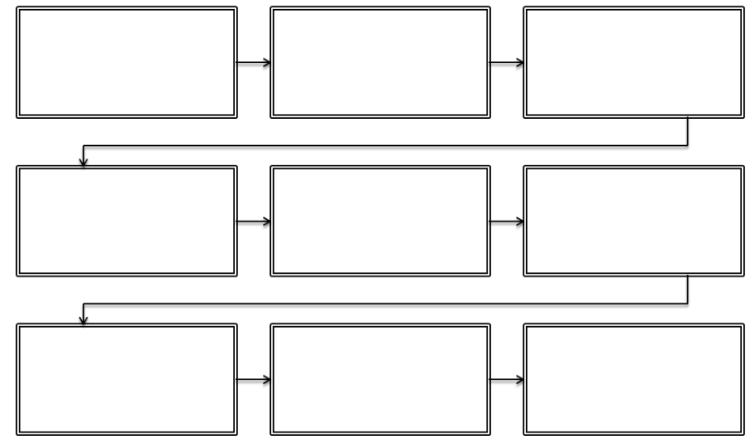
👨‍🏫
Planning task (20 minutes)
Next lesson, you’ll write a creative, descriptive passage, imagining you are a soldier walking through a war-torn town after the fighting has finished.
First you need to plan: Use this flow-chart to organize your ideas.
Think about the soldier’s surroundings as well as their thoughts and feelings.
Using your ideas from the Y Frame, complete a flow map to sequence your description.
First impressions – striking sights and sounds
What are your emotions now that the fighting has ended?
What time of day is it? Does this change? Describe the change.
Describe a change in the weather or setting e.g. an explosion.
Walk past a ruined landmark or familiar location.
What can you see up close or in the distance?

Slide 6
👨‍🏫
Here’s some image prompts to help you.
Think about the different sights, the sounds, the textures, etc…

Slide 7
Year 10 – Term 5
Language Paper 2 – Non-fiction
Lesson 2 – Descriptive Writing
Learning objective:
To understand the requirements of Paper 2 Reading and the components required to achieve optimum marks.
Learning outcome:
Must: Understand the format of Paper 2, Section A.
Stretch: Communicate ideas effectively, using appropriate form and tone.
Challenge: Use a range of grammatical and structural features to convey ideas and viewpoints.

Slide 8
👩🏽‍🏫
Today, you’ll develop your prior planning into a piece of creative, descriptive writing about the soldier’s surroundings as well as their thoughts and feelings as they walk through war-torn surroundings.
Spend about half an hour writing.
Pay close attention, to make sure you employ the techniques mentioned in the following slides…

Slide 9
👩🏽‍🏫
Remember to vary your sentence openings…
You must write out three sentences linking to your flow map beginning with an adverb, an adjective and a verb.
You should include a semicolon and colon at least once.
You could vary your sentences further by including a subordinate or embedded clause.
Adverbs | Adjectives | Verbs
Carefully | Decayed | Walking
Forlornly | Shattered | Limping
Dejectedly | Ruined | Heaving
Wearily | Gloomy | Resisting
Purposefully | Stark | Crying
👩🏽‍🏫
Remember to vary your punctuation…
Colons:
A colon is used to introduce a list or a following example. The abandoned room contained: a cracked mirror, a dusty chair and most interesting of all – a locked chest.
Semicolons:
It is used to join two complete sentences into a single written sentence. The rain lashed down from the sky; the storm seemed to last for days.

Slide 10
👩🏽‍🏫
Here’s some more ideas to help you…
Vocabulary Ideas
Structural Ideas
repetition
short sentences
paragraphing / separate sections
links/ threads running through narrative
beginning and ending links
Punctuation Ideas
What about a non-linear narrative..?
Notes:
Give students some time now to write up their descriptions – it maybe that they only focus on the first and second paragraphs.
Display this as students write up descriptions.

Slide 11
👩🏽‍🏫
Here’s some more creative prompts…
The city was blanketed in darkness…
Ruined buildings surrounded me…
The darkness covered me…
In the distance I could see….
Looking at the sky…
A terrible sight greeted my eyes…
Over there…
Listening carefully I heard…
The world around him appeared like hell on Earth; the grass no longer showing due to the torrential rain, bombs and shells attacking it through the day and night. Clouds closed in on him and threatened to suffocate him in their glum, grey state.
! | Ends sentences to make something seem dramatic!
? | Always use when you have asked a question.
: | Used to introduce a list or following example.
; | Used to join two complete sentences into one longer sentence or to separate longer items in a list.
👀
👂
👃
👄
🖐️
Sight: ruined buildings, rubble, shattered glass
Sound: distant gunfire, wind whistling, footsteps
Smell: choking dust, putrid water.
Taste: sickening taste of fear.
Feel: icy cold breeze, pain from old wounds
Notes:
Additional sheet for students who need further support with the writing and planning process.

Slide 12
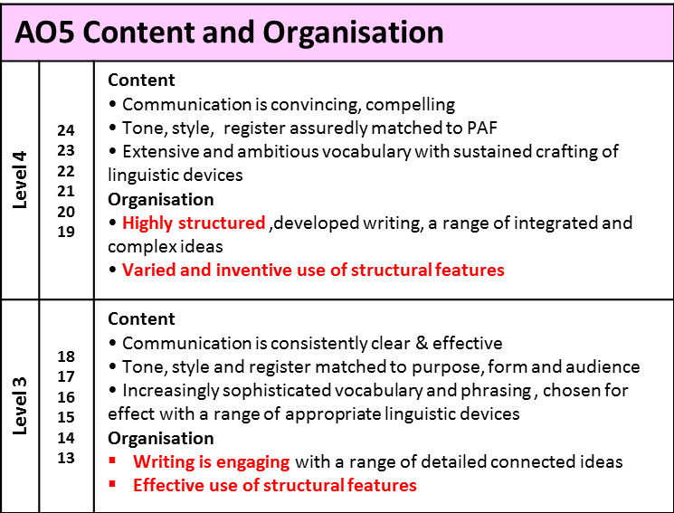
Self-assessment:
Is there a variety of sentence openings?
Have the senses been used effectively?
Have short sentences been used for effect?
Has a range of punctuation been used?
👩🏽‍🏫
Redrafting Challenge:
Include some personification
Include some sibilance
Rewrite a sentence to begin with an –ing word or –ly word
Include an example of pathetic fallacy
Include some plosive alliteration
Include a rhetorical question
👩🏽‍🏫

Slide 13
👩🏽‍🏫
Grammar
You’re = you are
Your = it belongs to you
They’re = they are
Their = it belongs to them
There = a place
To = moving ‘to’ somewhere
Two = the number 2
Too = also, in addition, as well
Fix
Look through your work from today & improve five things.
Punctuation
Capital letters
Full stops
Commas
Or maybe:
Colon
Semi colon
Inverted commas
Improve your connectives:
And > in addition/furthermore/moreover
But > however/nevertheless/although
So > therefore/consequently/subsequently
Because > as a result/ due to/ as
Vocabulary
Underline key words
Check and correct key word spelling
Extend your vocabulary (find more interesting or creative words)
Presentation
Underline date/title
Use a ruler for tables/ diagrams

Slide 14
Year 10 – Term 5
Language Paper 2 – Non-fiction
Lesson 3 – Understanding the text
Learning objective:
Understanding the narrative.
Learning outcome:
Must: Identify different kinds of non-fiction text types.
Stretch: Sequence the events in the narrative.
Challenge: Correctly identify four true statements about the extract.

Slide 15
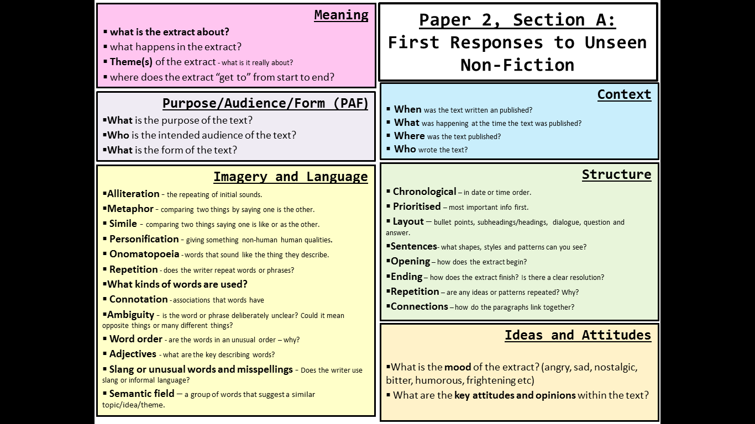
👨‍🏫
Introduction
To begin to access & analyse a non-fiction text we must:
Identify the PAF of the text.
Sequence the main ideas in the text.
Analyse the impact on the reader of the language techniques used by the writer.

Slide 16
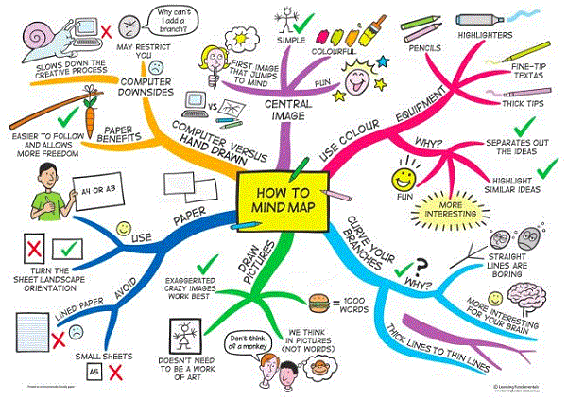
👨‍🏫
Task (10 minutes)
Make a mind-map to recall as many different non-fiction text types as you can…

Slide 17
👨‍🏫
How may did you get?
Diaries
Letters
Speeches
Autobiographies
Biographies
Journalism – newspapers, magazines, blogs, etc.
Travel writing
Reviews
Recipes
Instructions
Many non-fiction texts use the same ‘literary’ techniques we associate with fiction & poetry, e.g. metaphor, repetition, alliteration, etc…

Slide 18
👨‍🏫
Writers’ Viewpoints and Perspectives
You will have one hour to read and answer questions on two non-fiction texts.
One text will always be from the 19th century and one text will be from the 20th or 21st century.
You will have to answer four questions.
You should spend about 15 minutes reading the extracts and questions before you begin to write up your answers.
Remember, these are the skills being tested in section A of Paper 2…
Question | Marks | AOs | Focus | Timing
1 | 4 | 1 | True or false – identify explicit and implicit info. | 5
2 | 8 | 1 | Synthesise and summarise info from both texts. | 8
3 | 12 | 2 | Explain, comment on and analyse language/structure. | 12
4 | 16 | 3 | Compare ideas and attitudes in both texts. | 20

Slide 19
Paper 2, Section A: First Responses to Unseen Non-Fiction
👨‍🏫
Meaning
what is the extract about?
what happens in the extract?
Theme(s) of the extract - what is it really about?
where does the extract “get to” from start to end?
Context
When was the text written an published?
What was happening at the time the text was published?
Where was the text published?
Who wrote the text?
Purpose/Audience/Form (PAF)
What is the purpose of the text?
Who is the intended audience of the text?
What is the form of the text?
These are the questions you need to ask yourself when you’re looking at the non-fiction texts in Paper 2…
(You could learn these questions and revise them.)
Imagery and Language
Alliteration - the repeating of initial sounds.
Metaphor - comparing two things by saying one is the other.
Simile - comparing two things saying one is like or as the other.
Personification - giving something non-human human qualities.
Onomatopoeia - words that sound like the thing they describe.
Repetition - does the writer repeat words or phrases?
What kinds of words are used?
Connotation - associations that words have
Ambiguity - is the word or phrase deliberately unclear? Could it mean opposite things or many different things?
Word order - are the words in an unusual order – why?
Adjectives - what are the key describing words?
Slang or unusual words and misspellings - Does the writer use slang or informal language?
Semantic field – a group of words that suggest a similar topic/idea/theme.
Structure
Chronological – in date or time order.
Prioritised – most important info first.
Layout – bullet points, subheadings/headings, dialogue, question and answer.
Sentences- what shapes, styles and patterns can you see?
Opening – how does the extract begin?
Ending – how does the extract finish? Is there a clear resolution?
Repetition – are any ideas or patterns repeated? Why?
Connections – how do the paragraphs link together?
Ideas and Attitudes
What is the mood of the extract? (angry, sad, nostalgic, bitter, humorous, frightening etc)
What are the key attitudes and opinions within the text?

Slide 20
Paper 2, Section A: First Responses to Unseen Non-Fiction
Meaning
what is the extract about?
……………………………………………………………………………………………………………………………………………………………………………………………………………………………………………………………………...............................................................................................
👨‍🏫
Context
When
………………………………………………………………………………………..
Where
………………………………………………………………………………………..
Who
………………………………………………………………………………………..
Purpose/Audience/Form (PAF)
What is the purpose of the text?
……………………………………………………………………………………………
Who is the intended audience of the text?
………………………………………………………………………………………..
What is the form of the text?
………………………………………………………………………………………..
This version only has the prompts…
Structure
Opening – how does the extract begin?
…………………………………………………………………………………………………………………………………………………………………………………………
Ending – how does the extract finish? Is there a clear resolution?
…………………………………………………………………………………………………………………………………………………………………………………………
Repetition – are any ideas or patterns repeated? Why?
…………………………………………………………………………………………………………………………………………………………………………………………
Connections – how do the paragraphs link together?
…………………………………………………………………………………………………………………………………………………………………………………………
Imagery and Language
Alliteration ……………………………………………………………………….
Metaphor ………………………………………………………………………
Simile …………………………………………………………………………….
Personification ………………………………………………………….....
Onomatopoeia ………………………………………………………………
Repetition ……………………………………………………………………..
Adjectives …………………………………………………………………………
……………………………………………………………………………………………
Slang or unusual words and misspellings …………………………...............................................................
Semantic field ………………………………………………………………………………..........
Ideas and Attitudes
………………………………………………………………………………………………………………………………………………………………………………………………………………………………….
Notes:
Differentiated sheet for lower ability students

Slide 21
Paper 2, Section A: First Responses to Unseen Non-Fiction
Meaning
👨‍🏫
Purpose/Audience/Form (PAF)
Context
This version is entirely blank for when you’ve learned the prompts…
Eventually, you won’t need the grid at all. You’ll just remember the prompts & annotate the text from memory…
Imagery and Language
Structure
Ideas and Attitudes
Notes:
Blank sheet for students to complete as they read the text. AQA have said that students should be taught to read the whole text independently from the outset.

Slide 22
👨‍🏫
Extract from American Sniper: The Autobiography of the Most Lethal Sniper in U.S. Military History by Chris Kyle with Scott McEwen and Jim DeFelice, published 2012
Late March 2003. In the area of Nasiriya, Iraq
I looked through the scope of the sniper rifle, scanning down the road of the tiny Iraqi town. Fifty yards away, a woman opened the door of a small house and stepped outside with her child.
The rest of the street was deserted. The local Iraqis had gone inside, most of them scared. A few curious souls peeked out from behind curtains, waiting. They could hear the rumble of the approaching American unit. The Marines were flooding up the road, marching north to liberate the country from Saddam Hussein.
It was my job to protect them. My platoon had taken over the building earlier in the day, sneaking into position to provide “overwatch”—prevent the enemy from ambushing the Marines as they came through.
It didn’t seem like too difficult a task—if anything, I was glad the Marines were on my side. I’d seen the power of their weapons and I would’ve hated to have to fight them. The Iraq army didn’t stand a chance. And, in fact, they appeared to have abandoned the area already.
The war had started roughly two weeks before. My platoon, “Charlie” (later “Cadillac”) of SEAL Team 3, helped kick it off during the early morning of March 20. We landed on al-Faw Peninsula and secured the oil terminal there so Saddam couldn’t set it ablaze as he had during the First Gulf War. Now we were tasked to assist the Marines as they marched north toward Baghdad.
I was a SEAL, a Navy commando trained in special operations. SEAL stands for “SEa, Air, Land,” and it pretty much describes the wide ranges of places we operate. In this case, we were far inland, much farther than SEALs traditionally operated, though as the war against terror continued, this would become common. I’d spent nearly three years training and learning how to become a warrior; I was ready for this fight, or at least as ready as anyone can be.
The rifle I was holding was a .300 WinMag, a bolt-action, precision sniper weapon that belonged to my platoon chief. He’d been covering the street for a while and needed a break. He showed a great deal of confidence in me by choosing me to spot him and take the gun. I was still a new guy, a newbie or rookie in the Teams. By SEAL standards, I had yet to be fully tested.
I was also not yet trained as a SEAL sniper. I wanted to be one in the worst way, but I had a long way to go. Giving me the rifle that morning was the chief’s way of testing me to see if I had the right stuff.
We were on the roof of an old rundown building at the edge of a town the Marines were going to pass through. The wind kicked dirt and papers across the battered road below us. The place smelled like a sewer—the stench of Iraq was one thing I’d never get used to.
“Marines are coming,” said my chief as the building began to shake. “Keep watching.”
I looked through the scope. The only people who were moving were the woman and maybe a child or two nearby.
I watched our troops pull up. Ten young, proud Marines in uniform got out of their vehicles and gathered for a foot patrol. As the Americans organized, the woman took something from beneath her clothes, and yanked at it.
She’d set a grenade. I didn’t realize it at first.
“Looks yellow,” I told the chief, describing what I saw as he watched himself. “It’s yellow, the body—“
“She’s got a grenade,” said the chief. “That’s a Chinese grenade.”
“Hell.”
“Take a shot.”
“But—“
“Shoot. Get the grenade. The Marines—“
I hesitated. Someone was trying to get the Marines on the radio, but we couldn’t reach them. They were coming down the street, heading toward the woman.
“Shoot!” said the chief.
I pushed my finger against the trigger. The bullet leapt out. I shot. The grenade dropped. I fired again as the grenade blew up.
It was the first time I’d killed anyone while I was on the sniper rifle. And the first time in Iraq—and the only time—I killed anyone other than a male combatant.
It was my duty to shoot, and I don’t regret it. The woman was already dead. I was just making sure she didn’t take any Marines with her.
This non-fiction text is from an autobiography.
Chis Kyle wrote about his real-life experiences as a Navy SEAL.
Bradley Cooper played him in the movie adaptation.

Slide 23
👨‍🏫
The first question to ask yourself: What is the extract about?
Task:
Sequence the main events of the narrative in a flow map.

Slide 24
I looked through the scope of the sniper rifle.
A woman opened the door of a small house.
She stepped outside with her child…
The marines were flooding up the road.
A few curious souls peeked out from behind curtains
Notes:
Activity designed to get students to retrieve info and ideas from the extract.
Students work in teams of 4 to complete the task.
1 person from the group comes up to the front to look at the map then returns to main group to sketch out what they can remember – keep strict timings to make it competitive.
Students need to remember all the key images and then revisit the opening of the extract to find the key quotation.
Group with the most accurate map wins.

Slide 25
👨‍🏫
Read again the first four paragraphs of the source.
Choose four statements below which are TRUE.
Shade the boxes of the ones you think are true.
Choose a maximum of four statements.
Question 1 makes sure you understand what’s happening in the text.
It’s only worth four marks, so don’t spend any longer than five minutes answering it.
AO1
A | It is late March in 2003.
B | The street is crowded with people.
C | A woman comes out of a house that is 50 yards away.
D | The woman is accompanied by two children.
E | The platoon took over the building yesterday.
F | The American unit can be heard approaching.
G | The writer does not think the Marines stand a chance against the Iraqis.
H | The Iraqi army are nowhere to be seen.

Slide 26
👨‍🏫
Self-assess – how did you do?
If you made any mistakes, look at the text again to make certain you understand it.
Read again the first four paragraphs of the source.
Choose four statements below which are TRUE.
Shade the boxes of the ones you think are true.
Choose a maximum of four statements.
AO1
A | It is late March in 2003.
B | The street is crowded with people.
C | A woman comes out of a house that is 50 yards away.
D | The woman is accompanied by two children.
E | The platoon took over the building yesterday.
F | The American unit can be heard approaching.
G | The writer does not think the Marines stand a chance against the Iraqis.
H | The Iraqi army are nowhere to be seen.
✅
✅
✅
✅

Slide 27
Year 10 – Term 5
Language Paper 2 – Non-fiction
Lesson 4 – Technique & Impact
👩🏽‍🏫
On Paper 2, question 2 compares two non-fiction texts. So, for now, we’re going to jump straight to question 3.
Learning objective: Identifying writers’ viewpoints and perspectives.
Learning outcome:
Must: Identify writers viewpoints and methods of communicating ideas.
Stretch: Explain effect the writers choices have on YOU.
Challenge: Identify writer’s techniques & analyse their impact.

Slide 28
Question 3 is worth 12 marks, so you should aim to spend about 12 minutes on your answer.
AO2
Read the American Sniper source again from the 11th paragraph beginning; “I looked through the scope,” to the end of the paragraph beginning; “It was my duty to shoot.”
How does the writer use language to make you, the reader, feel part of the scene?
👩🏽‍🏫
You must focus on the effect of the writer’s language choices and techniques.
What impact does it have on the reader?
Select quotations with precision – focus on the impact of specific words.
Pay attention the section of the extract you have been asked to read.

Slide 29
Structure your answer in 3 or 4 PEEL paragraphs – each focusing on a different technique…
AO2
Read the American Sniper source again from the 11th paragraph beginning; “I looked through the scope,” to the end of the paragraph beginning; “It was my duty to shoot.”
How does the writer use language to make you, the reader, feel part of the scene?
👩🏽‍🏫
You could analyse such techniques as:
Don’t forget to use the correct terminology in your answer.
1) Use your topic sentence to make a point relevant to the question.
Point
2) Select evidence from the text – pick out a key quotation.
Emotive language
Simile
Metaphor
Personification
Nouns
(Dynamic) Verbs
Adjectives
Adverbs
Semantic Field
Evidence
3) Explain the evidence – this should be the longest part of the paragraph.
Explain
4) Finish the paragraph by establishing a link back to the question.
Link

Slide 30
AO2
👩🏽‍🏫
Read the American Sniper source again from the 11th paragraph beginning; “I looked through the scope,” to the end of the paragraph beginning; “It was my duty to shoot.”
How does the writer use language to make you, the reader, feel part of the scene?
Complete this grid using the quotes provided:
What techniques does the writer use?
What impact do those techniques have on you, the reader?
Point (technique) | Evidence (Quote) | Explain (Impact)
 | “Ten young, proud Marines in uniform got out of their vehicles and gathered for a foot patrol.”
 | ““But—“ “Shoot. Get the grenade. The Marines—“”
 | “but we couldn’t reach them. They were coming down the street, “
 | “The bullet leapt out. I shot. The grenade dropped.”

Slide 31
AO2
👩🏽‍🏫
Read the American Sniper source again from the 11th paragraph beginning; “I looked through the scope,” to the end of the paragraph beginning; “It was my duty to shoot.”
How does the writer use language to make you, the reader, feel part of the scene?
Here’s what a good one looks like:
This is one PEEL paragraph, examining the impact of emotive adjectives.
A complete answer would go on to analyse two or three other techniques, too.
Initially, the writer uses well-chosen, emotive adjectives to create a bond between the reader and the Marines depicted in the extract: “Ten young, proud Marines in uniform got out of their vehicles and gathered for a foot patrol.” Interestingly, the writer chooses to place the adjective “young” at the start of the description which instantly makes the reader feel sympathy for these soldiers as it emphasises their vulnerability in this situation. Furthermore, the adjective “proud” emphasises the positive character traits of the soldiers as opposed to the enemy. This positive description creates a connection between the reader and the soldiers as we want them to overcome the enemy.

Slide 32
AO2
👩🏽‍🏫
Read the American Sniper source again from the 11th paragraph beginning; “I looked through the scope,” to the end of the paragraph beginning; “It was my duty to shoot.”
How does the writer use language to make you, the reader, feel part of the scene?
Your task:
Refer back to your grid, where you identified the techniques used, and analysed their impact.
Write at least one more PEEL paragraph to extend the WAGOLL answer.
Initially, the writer uses well-chosen, emotive adjectives to create a bond between the reader and the Marines depicted in the extract: “Ten young, proud Marines in uniform got out of their vehicles and gathered for a foot patrol.” Interestingly, the writer chooses to place the adjective “young” at the start of the description which instantly makes the reader feel sympathy for these soldiers as it emphasises their vulnerability in this situation. Furthermore, the adjective “proud” emphasises the positive character traits of the soldiers as opposed to the enemy. This positive description creates a connection between the reader and the soldiers as we want them to overcome the enemy.

Slide 33
👩🏽‍🏫
Here’s some useful hints & tips.
Useful sentence starters:
This metaphor/simile/personification is used to show...
The clever use of this adverb/verb/adjective/image represents...
The writer is trying to symbolise...
This image is effective because...
The use of the adjective/noun/verb evokes a sense of…
1) Use your topic sentence to make a point relevant to the question.
Point
2) Select evidence from the text – pick out a key quotation.
Evidence
3) Explain the evidence – this should be the longest part of the paragraph.
Explain
Remember to write a lot about a little!
As well as
Furthermore
In addition to
Also
Moreover
4) Finish the paragraph by establishing a link back to the question.
Link
This suggests… | This links to… | Alternatively, it might… | This indicates…
We can argue that… | The reader will… | This demonstrates… | This reveals…

Slide 34
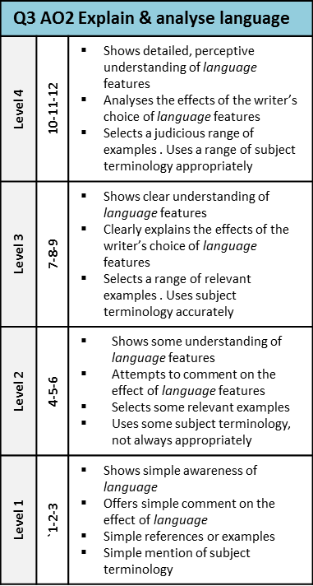
Have you made a range of clear points about the language techniques used?
Have you included a range of quotations?
Have you explained the effect of the language techniques on the reader?
Have you tried to develop a range of interpretations of the language?

Slide 35
👩🏽‍🏫
Self-assessment:
Have you made a range of clear points about the language techniques used?
Have you included appropriate quotations?
Have you explained the effect of the language techniques on the reader?
Have you tried to develop a range of interpretations of the language?

Slide 36
👩🏽‍🏫
Grammar
You’re = you are
Your = it belongs to you
They’re = they are
Their = it belongs to them
There = a place
To = moving ‘to’ somewhere
Two = the number 2
Too = also, in addition, as well
Fix
Look through your work from today & improve five things.
Punctuation
Capital letters
Full stops
Commas
Or maybe:
Colon
Semi colon
Inverted commas
Improve your connectives:
And > in addition/furthermore/moreover
But > however/nevertheless/although
So > therefore/consequently/subsequently
Because > as a result/ due to/ as
Vocabulary
Underline key words
Check and correct key word spelling
Extend your vocabulary (find more interesting or creative words)
Presentation
Underline date/title
Use a ruler for tables/ diagrams

Slide 37
Year 10 – Term 5
Language Paper 2 – Non-fiction
Lesson 5 – Comparing Two Texts
👩🏽‍🏫
On Paper 2, question 2 compares two non-fiction texts. So, we’re going to look at two texts together now.
Learning objective: Compare the differences and similarities between two different pieces of non-fiction writing.
Learning outcome:
Must: Identify the ideas, feelings and attitudes between two different non-fiction texts.
Stretch: summarise the differences and similarities between the two texts.
Challenge: Find quotes from both texts as evidence of those similarities and differences.

Slide 38
👩🏽‍🏫
Do you remember the anthology poem, The Charge of the Light Brigade, by Alfred, Lord Tennyson?
The first text we’re going to look at is a Nineteenth Century newspaper report about that same ill-fated cavalry charge from the Crimean War…
Half a league, half a league, Half a league onward, All in the valley of Death Rode the six hundred. “Forward, the Light Brigade! Charge for the guns!” he said. Into the valley of Death Rode the six hundred.

Slide 39
The Charge of the Light Brigade, 1854, William Howard Russell
"They swept proudly past, glittering in the morning sun in all the pride and splendor of war. We could hardly believe the evidence of our senses! Surely that handful of men were not going to charge an army in position? Alas! it was but too true - their desperate valor knew no bounds, and far indeed was it removed from its so-called better part - discretion.
They advanced in two lines, quickening their pace as they closed towards the enemy. A more fearful spectacle was never witnessed than by those who, without the power to aid, beheld their heroic countrymen rushing to the arms of death. At the distance of 1200 yards the whole line of the enemy belched forth, from thirty iron mouths, a flood of smoke and flame, through which hissed the deadly balls. Their flight was marked by instant gaps in our ranks, by dead men and horses, by steeds flying wounded or riderless across the plain.
The first line was broken - it was joined by the second, they never halted or checked their speed an instant. With diminished ranks, thinned by those thirty guns, which the Russians had laid with the most deadly accuracy, with a halo of flashing steel above their heads, and with a cheer which was many a noble fellow's death cry, they flew into the smoke of the batteries; but ere they were lost from view, the plain was strewed with their bodies and with the carcasses of horses. They were exposed to an oblique fire from the batteries on the hills on both sides, as wed as to a direct fire of musketry.
Through the clouds of smoke we could see their sabres flashing as they rode up to the guns and dashed between 'them, cutting down the gunners as they stood… We saw them riding through the guns, as I have said; to our delight we saw them returning, after breaking through a column of Russian infantry, and scattering them like chaff, when the flank fire of the battery on the hill swept them down, scattered and broken as they were.
TEXT A
Wounded men and dismounted troopers flying towards us told the sad tale… At the very moment when they were about to retreat, an enormous mass of lancers was hurled upon their flank. Colonel Shewell, of the 8th Hussars, saw the danger, and rode his few men straight at them, cutting his way through with fearful loss. The other regiments turned and engaged in a desperate encounter. With courage too great almost for credence, they were breaking their way through the columns which enveloped them, when there took place an act of atrocity without parallel in the modem warfare of civilized nations.
The Russian gunners, when the storm of cavalry passed, returned to their guns. They saw their own cavalry mingled with the troopers who had just ridden over them, and to the eternal disgrace of the Russian name the miscreants poured a murderous volley of grape and canister on the mass of struggling men and horses, mingling friend and foe in one common ruin. It was as much as our Heavy Cavalry Brigade could do to cover the retreat of the miserable remnants of that band of heroes as they returned to the place they had so lately quitted in all the pride of life.
At twenty-five to twelve not a British soldier, except the dead and dying, was left in front of these bloody Muscovite guns."

Slide 40
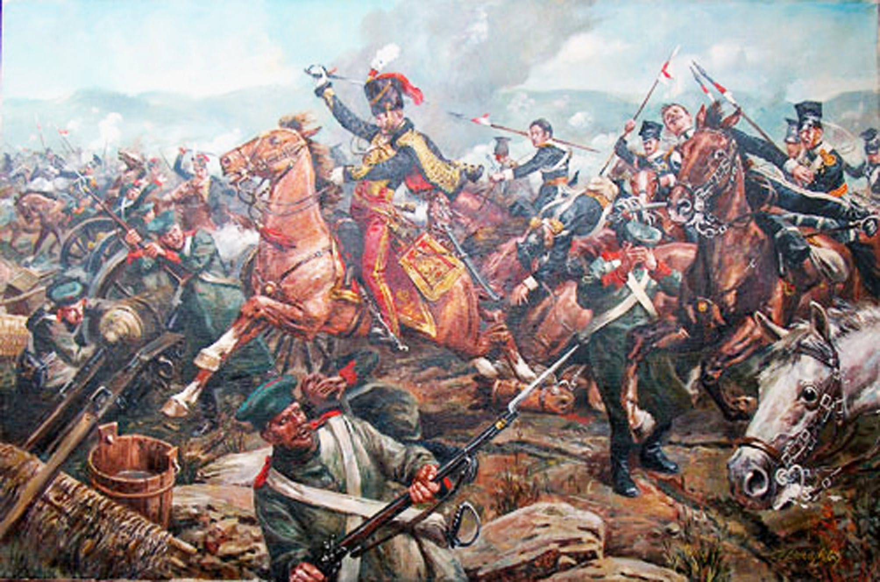
This extract was written by William Howard Russell who was a journalist who witnessed the battle.
The article was published in The Times in 1854.
It was Russell’s description that prompted Tennyson to write his poem.
TEXT A
👩🏽‍🏫
First Response Task:
Sequence the key ideas of the extract in a flow map.

Slide 41
👩🏽‍🏫
AO1
Read again the first three paragraphs of the source.
Choose four statements below which are TRUE.
Shade the boxes of the ones you think are true.
Choose a maximum of four statements.
Let’s answer question one about Owen’s letter too.
As usual: four marks, five minutes!
A | The writer is shocked by the number of British troops in the charge.
B | The soldiers advanced in five lines towards the enemy.
C | As the soldiers approached the enemy they slowed down.
D | The enemy attacked them with thirty canons.
E | The writer is in awe of the soldiers’ bravery in the face of danger.
F | The second line begins to retreat from the guns.
G | The Russians are not accurate when firing the guns at the men.
H | The spectators could see the many casualties of soldiers and horses.

Slide 42
👩🏽‍🏫
AO1
Read again the first three paragraphs of the source.
Choose four statements below which are TRUE.
Shade the boxes of the ones you think are true.
Choose a maximum of four statements.
How did you do?
A | The writer is shocked by the number of British troops in the charge.
B | The soldiers advanced in five lines towards the enemy.
C | As the soldiers approached the enemy they slowed down.
D | The enemy attacked them with thirty canons.
E | The writer is in awe of the soldiers’ bravery in the face of danger.
F | The second line begins to retreat from the guns.
G | The Russians are not accurate when firing the guns at the men.
H | The spectators could see the many casualties of soldiers and horses.
✅
✅
✅
✅

Slide 43
👩🏽‍🏫
TEXT B
Letter to my mother – Wilfred Owen, 16TH January 1917
Although he had joined up in October 1915, following his training, Owen had only been in France for two and a half weeks at the time he wrote this letter.
I can see no excuse for deceiving you about these last four days. I have suffered seventh hell. – I have not been at the front. – I have been in front of it. – I held an advanced post, that is, a ‘dug-out’ in the middle of No Man’s Land.
We had a march of three miles over shelled road, then nearly three along a flooded trench. After that we came to where the trenches had been blown flat out and had to go over the top. It was of course dark, too dark, and the ground was not mud, not sloppy mud, but an octopus of sucking clay, three, four, and five feet deep, relieved only by craters full of water…
Three quarters dead… we reached the dug-out, and relieved the wretches therein…
My dug-out held twenty-five men tight packed. Water filled it to a depth of one or two feet, leaving say four feet of air. One entrance had been blown in and blocked. – So far, the other remained.
The Germans knew we were staying there and decided we shouldn’t. Those fifty hours were the agony of my happy life. – Every ten minutes on Sunday afternoon seemed an hour. - I nearly broke down and let myself drown in the water that was now slowly rising over my knees.
Towards 6 o’clock, when, I suppose, you would be going to church, the shelling grew less intense and less accurate: so that I was mercifully helped to do my duty and crawl, wade, climb and flounder over No Man’s Land to visit my other post. It took me half an hour to move about hundred and fifty yards…
In the platoon on my left the sentries over the dug-out were blown to nothing… I kept my own sentries half way down the stairs during the most terrific bombardment. In spite of this, one lad was blown down and I am afraid, blinded.
Now, let’s look at the second text, which was written very early in the Twentieth Century, during the First World War…

Slide 44
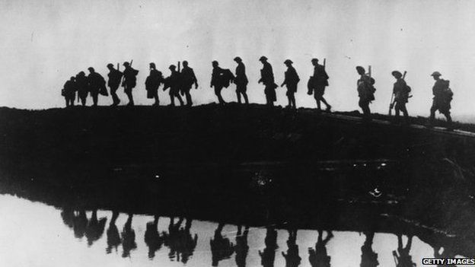
TEXT B
This letter was written by Wilfred Owen to his mother in 1917. He had only been in France for a matter of weeks and was already horrified by the harsh reality of war.
👩🏽‍🏫
First Response Task:
Sequence the key ideas of the extract in a flow map.

Slide 45
👩🏽‍🏫
AO1
Read again the first three paragraphs of the source.
Choose four statements below which are TRUE.
Shade the boxes of the ones you think are true.
Choose a maximum of four statements.
Let’s quickly practise question one. Remember, it’s worth four marks, so only spend five minutes on it.
A | Owen wants to protect his mother from the truth about the war.
B | Owen has had to hold a position in ‘No Man’s Land’.
C | Owen writes positively about his first experiences of war.
D | The soldiers had to march nearly six miles.
E | Owen’s dugout held 25 men.
F | The soldiers they relieve from the dugout are in good spirits.
G | The dugout is filled with water.
H | Apart from the water, the dugout is in good condition.
Notes:
Optional task – students wouldn’t be expected to complete a T/F activity on Text B but you may wish to complete this activity as practice for question 1 and to ensure that students are familiar with the ideas in the text before moving on.

Slide 46
👩🏽‍🏫
AO1
Read again the first three paragraphs of the source.
Choose four statements below which are TRUE.
Shade the boxes of the ones you think are true.
Choose a maximum of four statements.
How did you do?
A | Owen wants to protect his mother from the truth about the war.
B | Owen has had to hold a position in ‘No Man’s Land’.
C | Owen writes positively about his first experiences of war.
D | The soldiers had to march nearly six miles.
E | Owen’s dugout held 25 men.
F | The soldiers they relieve from the dugout are in good spirits.
G | The dugout is filled with water.
H | Apart from the water, the dugout is in good condition.
✅
✅
✅
✅
Notes:
Optional task – students wouldn’t be expected to complete a T/F activity on Text B but you may wish to complete this activity as practice for question 1 and to ensure that students are familiar with the ideas in the text before moving on.

Slide 47
👩🏽‍🏫
For question two of the exam you need to be able to compare the ideas, feelings and attitudes in both texts which means looking for similarities and differences. You will then be asked to write a summary of the similarities or differences.
TASK:
Complete a double bubble map to identify the similarities and differences of the writers’ experiences.
Charge of the Light Brigade
Wilfred Owen Letter

Slide 48
👩🏽‍🏫
Did you get these..?
Bravery of the soldiers
Over almost instantly
Lasts a long time – 50 hours
TASK:
Find quotations to support each of these points.
Huge losses/ casualties
Charge of the Light Brigade
Wilfred Owen Letter
Third-person account
First-person account
Both face a ruthless enemy
Fighting seems far away
First-hand description
Poor leadership /direction

Slide 49
Year 10 – Term 5
Language Paper 2 – Non-fiction
Lesson 6 – Comparing Two Texts
👨‍🏫
Paper 2, question 2 compares two non-fiction texts. We’re now going to look at making inferences from the texts.
Learning outcome:
Must: Identify the meaning and tone of two non-fiction texts and attempt to link ideas.
Stretch: Show a clear understanding of both texts through inference and connotation based on textual evidence and personal experience.
Challenge: Offer a perceptive interpretation of both texts using a judicious range of quotes.

Slide 50
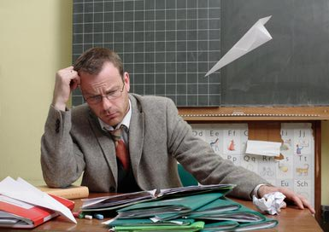
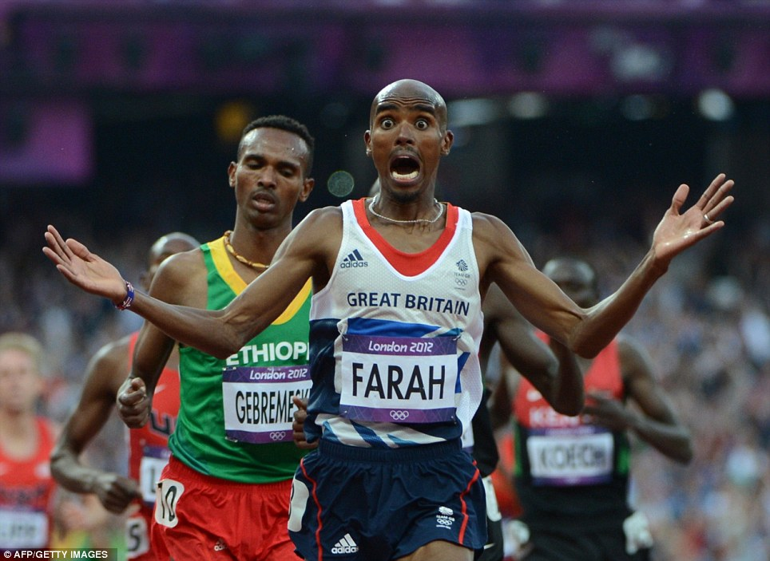
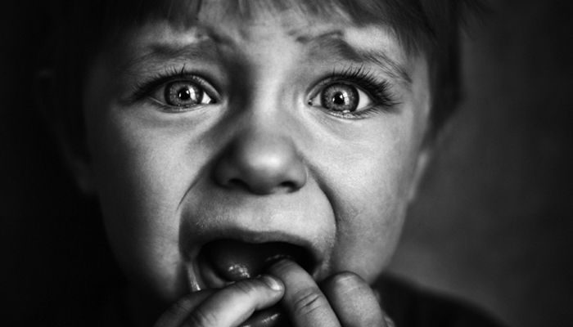
When you INFER or make INFERENCES you use clues from the text plus your own background knowledge to come to an informed conclusion about the text.
👨‍🏫
What can you infer about the people in these images? What led you to your conclusions?

Slide 51
👨‍🏫
A summary is turning this…
…into this.
Task:
Looking at these two images, in your own words write down your own definition of what you think an effective summary is.

Slide 52
👨‍🏫
AO1
Let’s look at Question Two now.
Over the next few slides, we’re going to model writing an answer…
Question two is worth eight marks, so you should spend about eight minutes on it in the exam.
You need to refer to source A (The Charge of the Light Brigade newspaper article,) and source B (Wilfred Owen’s letter to his mother,) for this question.
The writers’ experiences of war are similar.
Use details from both sources to write a summary of the similarities.

Slide 53
The Charge of the Light Brigade, 1854, William Howard Russell
"They swept proudly past, glittering in the morning sun in all the pride and splendour of war. We could hardly believe the evidence of our senses! Surely that handful of men were not going to charge an army in position? Alas! it was but too true - their desperate valour knew no bounds, and far indeed was it removed from its so-called better part - discretion.
They advanced in two lines, quickening their pace as they closed towards the enemy. A more fearful spectacle was never witnessed than by those who, without the power to aid, beheld their heroic countrymen rushing to the arms of death. At the distance of 1200 yards the whole line of the enemy belched forth, from thirty iron mouths, a flood of smoke and flame, through which hissed the deadly balls. Their flight was marked by instant gaps in our ranks, by dead men and horses, by steeds flying wounded or riderless across the plain.
The first line was broken - it was joined by the second, they never halted or checked their speed an instant. With diminished ranks, thinned by those thirty guns, which the Russians had laid with the most deadly accuracy, with a halo of flashing steel above their heads, and with a cheer which was many a noble fellow's death cry, they flew into the smoke of the batteries; but ere they were lost from view, the plain was strewed with their bodies and with the carcasses of horses. They were exposed to an oblique fire from the batteries on the hills on both sides, as wed as to a direct fire of musketry.
Through the clouds of smoke we could see their sabres flashing as they rode up to the guns and dashed between 'them, cutting down the gunners as they stood… We saw them riding through the guns, as I have said; to our delight we saw them returning, after breaking through a column of Russian infantry, and scattering them like chaff, when the flank fire of the battery on the hill swept them down, scattered and broken as they were.
TEXT A
Wounded men and dismounted troopers flying towards us told the sad tale… At the very moment when they were about to retreat, an enormous mass of lancers was hurled upon their flank. Colonel Shewell, of the 8th Hussars, saw the danger, and rode his few men straight at them, cutting his way through with fearful loss. The other regiments turned and engaged in a desperate encounter. With courage too great almost for credence, they were breaking their way through the columns which enveloped them, when there took place an act of atrocity without parallel in the modem warfare of civilized nations.
The Russian gunners, when the storm of cavalry passed, returned to their guns. They saw their own cavalry mingled with the troopers who had just ridden over them, and to the eternal disgrace of the Russian name the miscreants poured a murderous volley of grape and canister on the mass of struggling men and horses, mingling friend and foe in one common ruin. It was as much as our Heavy Cavalry Brigade could do to cover the retreat of the miserable remnants of that band of heroes as they returned to the place they had so lately quitted in all the pride of life.
At twenty-five to twelve not a British soldier, except the dead and dying, was left in front of these bloody Muscovite guns."

Slide 54
Letter to my mother – Wilfred Owen, 16TH January 1917
Although he had joined up in October 1915, following his training, Owen had only been in France for two and a half weeks at the time he wrote this letter.
I can see no excuse for deceiving you about these last four days. I have suffered seventh hell. – I have not been at the front. – I have been in front of it. – I held an advanced post, that is, a ‘dug-out’ in the middle of No Man’s Land.
We had a march of three miles over shelled road, then nearly three along a flooded trench. After that we came to where the trenches had been blown flat out and had to go over the top. It was of course dark, too dark, and the ground was not mud, not sloppy mud, but an octopus of sucking clay, three, four, and five feet deep, relieved only by craters full of water…
Three quarters dead… we reached the dug-out, and relieved the wretches therein…
My dug-out held twenty-five men tight packed. Water filled it to a depth of one or two feet, leaving say four feet of air. One entrance had been blown in and blocked. – So far, the other remained.
The Germans knew we were staying there and decided we shouldn’t. Those fifty hours were the agony of my happy life. – Every ten minutes on Sunday afternoon seemed an hour. - I nearly broke down and let myself drown in the water that was now slowly rising over my knees.
TEXT B
Towards 6 o’clock, when, I suppose, you would be going to church, the shelling grew less intense and less accurate: so that I was mercifully helped to do my duty and crawl, wade, climb and flounder over No Man’s Land to visit my other post. It took me half an hour to move about hundred and fifty yards…
In the platoon on my left the sentries over the dug-out were blown to nothing… I kept my own sentries half way down the stairs during the most terrific bombardment. In spite of this, one lad was blown down and I am afraid, blinded.

Slide 55
AO1
👨‍🏫
You need to refer to source A (The Charge of the Light Brigade newspaper article,) and source B (Wilfred Owen’s letter to his mother,) for this question.
The writers’ experiences of war are similar.
Use details from both sources to write a summary of the similarities.
Answering question two, you need to:
Demonstrate a clear connections between texts.
Select relevant quotations from both texts to support summary.
Begin to interpret both texts.
x3
Point
Quote
Inference
Make a clear statement about the connections.
Quote details from both sources.
Make an inference which shows understanding.

Slide 56
👨‍🏫
AO1
Details: similar experiences of war.
To answer this question, you need quotes from both texts, that demonstrate similar experiences.
Here’s some examples…
Charge of the Light Brigade
Wilfred Owen’s Letter
“from thirty iron mouths, a flood of smoke and flame, through which hissed the deadly balls.”
“I have suffered seventh hell.”
“their desperate valour knew no bounds”
“I held an advanced post … in the middle of No Man’s Land.”
“there took place an act of atrocity without parallel in the modem warfare of civilized nations.”
“The Germans knew we were staying there and decided we shouldn’t.”

Slide 57
👨‍🏫
AO1
Adding a point…
Now, you can develop points, which identify the similarities between pairs of quotes…
Charge of the Light Brigade
Wilfred Owen’s Letter
In both texts, the soldiers suffer and face extreme conditions and hardships.
“from thirty iron mouths, a flood of smoke and flame, through which hissed the deadly balls.”
“I have suffered seventh hell.”
In addition to this, the bravery of the soldiers is presented in both extracts.
“their desperate valour knew no bounds”
“I held an advanced post … in the middle of No Man’s Land.”
Another similarity between the two texts is the negative presentation of the enemy.
“there took place an act of atrocity without parallel in the modem warfare of civilized nations.”
“The Germans knew we were staying there and decided we shouldn’t.”

Slide 58
👨‍🏫
Putting it together in a summary:
You need to refer to source A (The Charge of the Light Brigade newspaper article,) and source B (Wilfred Owen’s letter to his mother,) for this question.
The writers’ experiences of war are similar.
Use details from both sources to write a summary of the similarities.
Finally, complete a summary paragraph by adding your inference – that is, your personal interpretation based on the clues.
Point
Despite the fact that the texts are produced about two very different wars, both texts emphasise the suffering of the soldiers in the extreme conditions and hardships that they face. In source B, Owen writes that he has “suffered seventh hell,” suggesting he is overwrought by the violence he has witnessed and in source A the soldiers are forced to charge into “a flood of smoke and flame.” which is a similarly hellish and violent description of the soldiers’ experience which suggests that both wars were an extremely dangerous and hostile environment for the soldiers.
Quote
Inference

Slide 59
Task:
Extend this answer.
Write two more summary paragraphs.
Use the quote pairs, and points, from the previous slides.
Add your own inferences.
Putting it together in a summary:
👨‍🏫
You need to refer to source A (The Charge of the Light Brigade newspaper article,) and source B (Wilfred Owen’s letter to his mother,) for this question.
The writers’ experiences of war are similar.
Use details from both sources to write a summary of the similarities.
Here’s some vocabulary to help you:
Point
Despite the fact that the texts are produced about two very different wars, both texts emphasise the suffering of the soldiers in the extreme conditions and hardships that they face. In source B, Owen writes that he has “suffered seventh hell,” suggesting he is overwrought by the violence he has witnessed and in source A the soldiers are forced to charge into “a flood of smoke and flame.” which is a similarly hellish and violent description of the soldiers’ experience which suggests that both wars were an extremely dangerous and hostile environment for the soldiers.
Quote
Similarly
Likewise
As with
Like
Equally
Alternatively
Whereas
Unlike
Instead of
In contrast
Inference

Slide 60
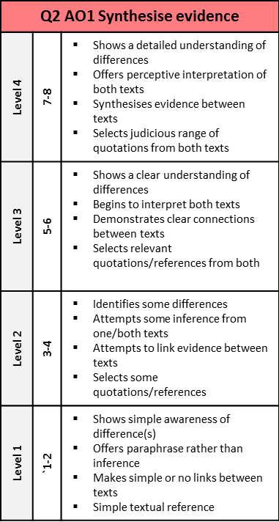
👨‍🏫
Self-Assessment:
Have you made two points about each text?
Have you included textual details or quotations?
Have you been able to infer meaning from the textual details you’ve used?
Do your comments show similarities between the two writers’ experiences of conflict?

Slide 61
👨‍🏫
Grammar
You’re = you are
Your = it belongs to you
They’re = they are
Their = it belongs to them
There = a place
To = moving ‘to’ somewhere
Two = the number 2
Too = also, in addition, as well
Fix
Look through your work from today & improve five things.
Punctuation
Capital letters
Full stops
Commas
Or maybe:
Colon
Semi colon
Inverted commas
Improve your connectives:
And > in addition/furthermore/moreover
But > however/nevertheless/although
So > therefore/consequently/subsequently
Because > as a result/ due to/ as
Vocabulary
Underline key words
Check and correct key word spelling
Extend your vocabulary (find more interesting or creative words)
Presentation
Underline date/title
Use a ruler for tables/ diagrams

Slide 62
Year 10 – Term 5
Language Paper 2 – Non-fiction
Lesson 7 – Comparing Two Texts
👩🏽‍🏫
Let’s look at Paper 2, question 3 again.
Learning objective: Identifying language techniques and explaining their impact on the reader.
Learning outcome:
Must: Recall key language terminology.
Stretch: Analyse the language of an extract.
Challenge: Evaluate the quality of your response.

Slide 63
Question 3 is worth 12 marks, so you should aim to spend about 12 minutes on your answer.
AO2
Read source A again from the 2nd paragraph beginning; “They advanced in two lines,” to the end of the paragraph beginning; “Through the clouds of smoke.”
How does the writer use language to show the horror of the battle?
👩🏽‍🏫
You must focus on the effect of the writer’s language choices and techniques.
What impact does it have on the reader?
Select quotations with precision – focus on the impact of specific words.
Pay attention the section of the extract you have been asked to read.

Slide 64
Structure your answer in 3 or 4 PEEL paragraphs – each focusing on a different technique…
AO2
Read source A again from the 2nd paragraph beginning; “They advanced in two lines,” to the end of the paragraph beginning; “Through the clouds of smoke.”
How does the writer use language to show the horror of the battle?
👩🏽‍🏫
You could analyse such techniques as:
Don’t forget to use the correct terminology in your answer.
1) Use your topic sentence to make a point relevant to the question.
Point
2) Select evidence from the text – pick out a key quotation.
Emotive language
Simile
Metaphor
Personification
Nouns
(Dynamic) Verbs
Adjectives
Adverbs
Semantic Field
Evidence
3) Explain the evidence – this should be the longest part of the paragraph.
Explain
4) Finish the paragraph by establishing a link back to the question.
Link

Slide 65
The Charge of the Light Brigade, 1854, William Howard Russell
"They swept proudly past, glittering in the morning sun in all the pride and splendour of war. We could hardly believe the evidence of our senses! Surely that handful of men were not going to charge an army in position? Alas! it was but too true - their desperate valour knew no bounds, and far indeed was it removed from its so-called better part - discretion.
They advanced in two lines, quickening their pace as they closed towards the enemy. A more fearful spectacle was never witnessed than by those who, without the power to aid, beheld their heroic countrymen rushing to the arms of death. At the distance of 1200 yards the whole line of the enemy belched forth, from thirty iron mouths, a flood of smoke and flame, through which hissed the deadly balls. Their flight was marked by instant gaps in our ranks, by dead men and horses, by steeds flying wounded or riderless across the plain.
The first line was broken - it was joined by the second, they never halted or checked their speed an instant. With diminished ranks, thinned by those thirty guns, which the Russians had laid with the most deadly accuracy, with a halo of flashing steel above their heads, and with a cheer which was many a noble fellow's death cry, they flew into the smoke of the batteries; but ere they were lost from view, the plain was strewed with their bodies and with the carcasses of horses. They were exposed to an oblique fire from the batteries on the hills on both sides, as wed as to a direct fire of musketry.
Through the clouds of smoke we could see their sabres flashing as they rode up to the guns and dashed between 'them, cutting down the gunners as they stood… We saw them riding through the guns, as I have said; to our delight we saw them returning, after breaking through a column of Russian infantry, and scattering them like chaff, when the flank fire of the battery on the hill swept them down, scattered and broken as they were.
TEXT A
Wounded men and dismounted troopers flying towards us told the sad tale… At the very moment when they were about to retreat, an enormous mass of lancers was hurled upon their flank. Colonel Shewell, of the 8th Hussars, saw the danger, and rode his few men straight at them, cutting his way through with fearful loss. The other regiments turned and engaged in a desperate encounter. With courage too great almost for credence, they were breaking their way through the columns which enveloped them, when there took place an act of atrocity without parallel in the modem warfare of civilized nations.
The Russian gunners, when the storm of cavalry passed, returned to their guns. They saw their own cavalry mingled with the troopers who had just ridden over them, and to the eternal disgrace of the Russian name the miscreants poured a murderous volley of grape and canister on the mass of struggling men and horses, mingling friend and foe in one common ruin. It was as much as our Heavy Cavalry Brigade could do to cover the retreat of the miserable remnants of that band of heroes as they returned to the place they had so lately quitted in all the pride of life.
At twenty-five to twelve not a British soldier, except the dead and dying, was left in front of these bloody Muscovite guns."

Slide 66
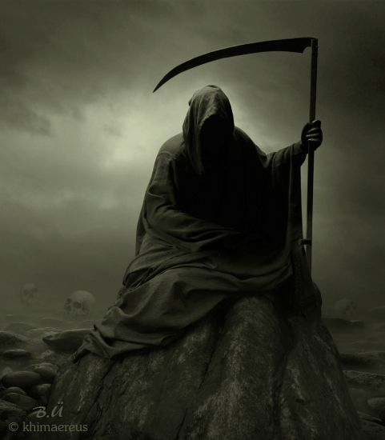
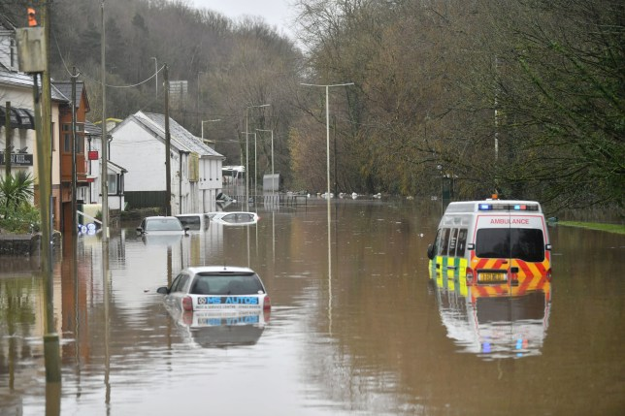
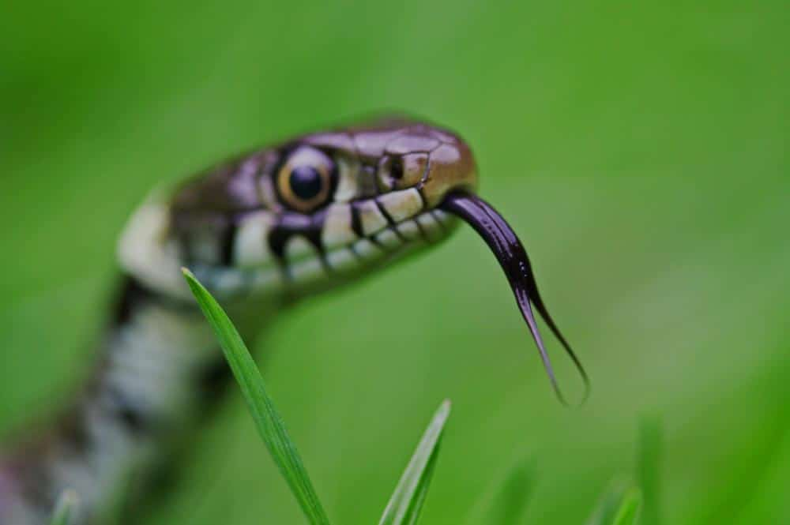
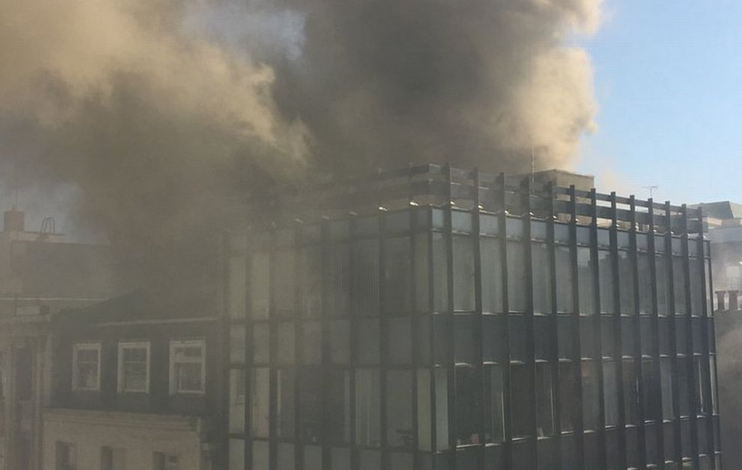
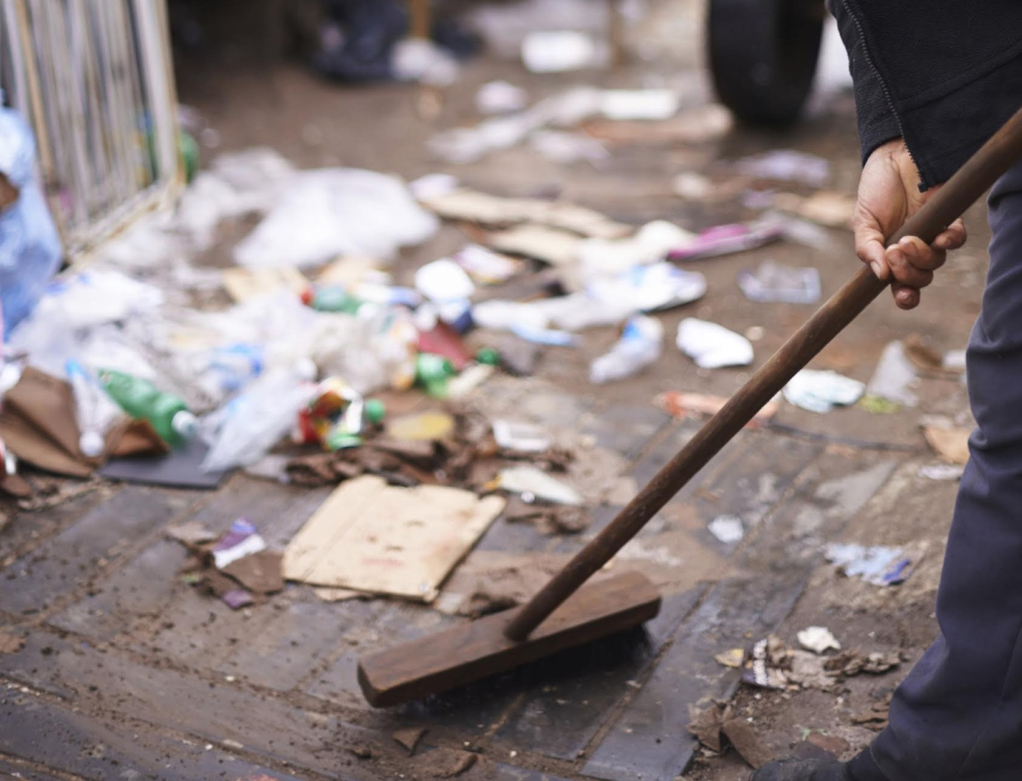
👩🏽‍🏫
Image | Evidence | Ideas and Analysis
 | “heroic countrymen rushing to the arms of death,”
 | “belched forth, from thirty iron mouths, a flood of smoke and flame.”
 | “through which hissed the deadly balls”
 | “clouds of smoke”
 | “swept them down, scattered and broken as they were.”
These quotes evoke images in our imagination.
What impact could these images have upon the reader?
Extension:
What techniques does the writer use to create these images?

Slide 67
AO2
👩🏽‍🏫
Read source A again from the 2nd paragraph beginning; “They advanced in two lines,” to the end of the paragraph beginning; “Through the clouds of smoke.”
How does the writer use language to show the horror of the battle?
Now you’ve connected imagery to impact, complete this grid:
What techniques does the writer use?
What impact do those techniques have on you, the reader?
Point (technique) | Evidence (Quote) | Explain (Impact)
 | “heroic countrymen rushing to the arms of death,”
 | “belched forth, from thirty iron mouths, a flood of smoke and flame.”
 | “through which hissed the deadly balls”
 | “clouds of smoke”
 | “swept them down, scattered and broken as they were.”

Slide 68
Task:
Now, use your notes to answer the question.
Aim to write 3 or 4 PEEL paragraphs.
Spend twelve minutes writing your answer.
👩🏽‍🏫
AO2
Read source A again from the 2nd paragraph beginning; “They advanced in two lines,” to the end of the paragraph beginning; “Through the clouds of smoke.”
How does the writer use language to show the horror of the battle?
Useful sentence starters:
This metaphor /simile /personification is used to show...
The clever use of this adverb/verb/adjective/image represents...
The writer is trying to symbolise...
This image is effective because...
The use of the adjective/noun/verb evokes a sense of…
1) Use your topic sentence to make a point relevant to the question.
Point
As well as
Furthermore
In addition to
Also
Moreover
2) Select evidence from the text – pick out a key quotation.
Evidence
3) Explain the evidence – this should be the longest part of the paragraph.
Explain
Remember to write a lot about a little!
4) Finish the paragraph by establishing a link back to the question.
Link
This suggests… | This links to… | Alternatively, it might… | This indicates…
We can argue that… | The reader will… | This demonstrates… | This reveals…

Slide 69
👩🏽‍🏫
Self-assessment:
Have you made a range of clear points about the language techniques used?
Have you included appropriate quotations?
Have you explained the effect of the language techniques on the reader?
Have you tried to develop a range of interpretations of the language?

Slide 70
👩🏽‍🏫
😰
😎
How confident are you with each question, so far?
Write a sentence to explain why underneath.
…………………………………………………………………………………………………………………………………………………………………………………………………………………………………………………………………………………………
😰
😎
…………………………………………………………………………………………………………………………………………………………………………………………………………………………………………………………………………………………
😰
😎
…………………………………………………………………………………………………………………………………………………………………………………………………………………………………………………………………………………………

Slide 71
Year 10 – Term 5
Language Paper 2 – Non-fiction
Lesson 8 – Comparing Two Texts
👨‍🏫
Learning objective:
Sort ideas into a clear structure in order to evaluate the quality of writing.
Learning outcome:
Must: Select key details from a text.
Stretch: Sort ideas into a clear structure.
Challenge: Sort ideas into a clear structure.

Slide 72
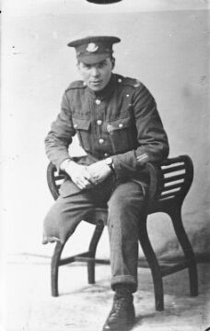
👨‍🏫
A Beautiful Job – Gunner William Towers
I was in a carriage on a stretcher fixed on the wall and when I looked round Sergeant Emsley was next to me. He’d been wounded in the leg as well. They took us to a hospital at Étaples and then put me in a bed and fitted me with a Thomas splint, a round wooden ring with iron bands and a footrest.
The pain from my knee was getting terrible so when I saw an officer coming up with his arm around two sisters and laughing, I said, ‘Excuse me, Sir, could you have a look at my knee? The pain is driving me crazy.’ He came over and he stank of whisky. When the nurses took the bandages off he said, ‘Oh there’s fluid above the knee. We’ll tap that tonight.’
So they came for me to go to the theatre and I thought, ‘Thank God for that.’ But when I woke up in the early hours of the morning I thought, ‘Oh my God. My leg’s gone.’ They’d guillotined it off without saying a word. There had been no hint at all that I was going to lose my leg. They hadn’t even looked at it until I asked the doctor.
That day, I prayed to die. All I could think of were the men who stood begging on street corners with a crutch and a tin can. And I was a footballer and that was finished. It was terrible. Late in the afternoon, a nurse came up, took the blanket off and started tearing the gauze off that had dried on. As she was pulling it. I think I called her every name I knew. I said, ‘You’re inhuman, woman!’ but she didn’t take any notice, she must have been deaf. She could have wet it, which would have made it come off easily, but she wouldn’t. I was in agony.
TEXT C
After that, they put me on a boat and I was taken to Stockport General Hospital. A civilian doctor, Mr Fenwick, came to look at me and when he took the bandages off the smell was terrible. The flesh had receded, two inches of bone stuck out and it had gone black. He said, ‘Send a telegram* for his mother and father to come right away.’ He thought I was going to die. He told a Sister to get a bowl of sterilised water with peroxide in it and that my leg had to be syringed with this solution every four hours.
And then it started to get better. The wound became beautiful clean red flesh. Mr Fenwick said, ‘We’re going to win, Willie.’ My parents came, and my future wife, whom I’d met when I was home on leave. I think it was her that pulled me through. And Mr Fenwick was an angel. He arranged for a friend of his, a surgeon who specialised in amputations, to re-amputate the leg and make a proper stump. He did it and it was perfect. Everybody seeing it said, ‘What a beautiful job.’
Let’s look at a new text.
This is a piece of autobiographical writing by a soldier who was seriously wounded in battle in France during the First World War.
* Telegram: a message sent by telegraph, then printed & hand-delivered. Often the fastest form of long-distance communication before everyone had a telephone.

Slide 73
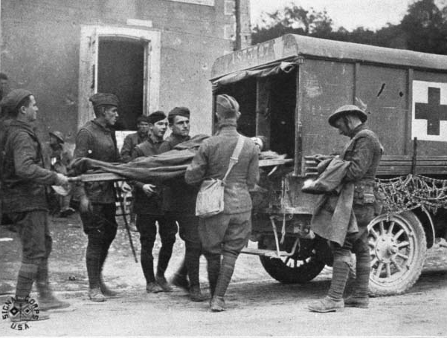
👨‍🏫
The first question to ask yourself: What is the extract about?
Task:
Sequence the main events of the narrative in a flow map.

Slide 74
👨‍🏫
Read again the first four paragraphs of the source.
Choose four statements below which are TRUE.
Shade the boxes of the ones you think are true.
Choose a maximum of four statements.
Firstly, let’s make sure you understand what’s happening in the text.
Remember, question one is only worth four marks, so don’t spend any longer than five minutes answering it.
AO1
A | The soldier has been wounded in both arms.
B | The soldier is not told he will lose his leg.
C | The soldier is treated well at the hospital in France.
D | The doctor is under the influence of alcohol in France.
E | Back in England, the doctor thinks the soldier will die.
F | His parents are told to stay away from the hospital.
G | The amputation was done badly in France.
H | It is thought he will lose his other leg.

Slide 75
👨‍🏫
Read again the first four paragraphs of the source.
Choose four statements below which are TRUE.
Shade the boxes of the ones you think are true.
Choose a maximum of four statements.
Self-assess – how did you do?
If you made any mistakes, look at the text again to make certain you understand it.
AO1
A | The soldier has been wounded in both arms.
B | The soldier is not told he will lose his leg.
C | The soldier is treated well at the hospital in France.
D | The doctor is under the influence of alcohol in France.
E | Back in England, the doctor thinks the soldier will die.
F | His parents are told to stay away from the hospital.
G | The amputation was done badly in France.
H | It is thought he will lose his other leg.
✅
✅
✅
✅

Slide 76
👨‍🏫
Extension Questions:
What point is the writer trying to make about the way injured soldiers were treated?
What impression is given of the doctors and nurses?
Why is a telegram sent to his mother and father?

Slide 77
Paper 2, Section A: First Responses to Unseen Non-Fiction
👨‍🏫
Meaning
what is the extract about?
what happens in the extract?
Theme(s) of the extract - what is it really about?
where does the extract “get to” from start to end?
Context
When was the text written an published?
What was happening at the time the text was published?
Where was the text published?
Who wrote the text?
Purpose/Audience/Form (PAF)
What is the purpose of the text?
Who is the intended audience of the text?
What is the form of the text?
Remember, as you read and analyse these texts, these First Responses prompts may help you to organize your thoughts.
Imagery and Language
Alliteration - the repeating of initial sounds.
Metaphor - comparing two things by saying one is the other.
Simile - comparing two things saying one is like or as the other.
Personification - giving something non-human human qualities.
Onomatopoeia - words that sound like the thing they describe.
Repetition - does the writer repeat words or phrases?
What kinds of words are used?
Connotation - associations that words have
Ambiguity - is the word or phrase deliberately unclear? Could it mean opposite things or many different things?
Word order - are the words in an unusual order – why?
Adjectives - what are the key describing words?
Slang or unusual words and misspellings - Does the writer use slang or informal language?
Semantic field – a group of words that suggest a similar topic/idea/theme.
Structure
Chronological – in date or time order.
Prioritised – most important info first.
Layout – bullet points, subheadings/headings, dialogue, question and answer.
Sentences- what shapes, styles and patterns can you see?
Opening – how does the extract begin?
Ending – how does the extract finish? Is there a clear resolution?
Repetition – are any ideas or patterns repeated? Why?
Connections – how do the paragraphs link together?
Ideas and Attitudes
What is the mood of the extract? (angry, sad, nostalgic, bitter, humorous, frightening etc)
What are the key attitudes and opinions within the text?

Slide 78
👨‍🏫
Grammar
You’re = you are
Your = it belongs to you
They’re = they are
Their = it belongs to them
There = a place
To = moving ‘to’ somewhere
Two = the number 2
Too = also, in addition, as well
Fix
Look through your work from today & improve five things.
Punctuation
Capital letters
Full stops
Commas
Or maybe:
Colon
Semi colon
Inverted commas
Improve your connectives:
And > in addition/furthermore/moreover
But > however/nevertheless/although
So > therefore/consequently/subsequently
Because > as a result/ due to/ as
Vocabulary
Underline key words
Check and correct key word spelling
Extend your vocabulary (find more interesting or creative words)
Presentation
Underline date/title
Use a ruler for tables/ diagrams

Slide 79
Year 10 – Term 5
Language Paper 2 – Non-fiction
Lessons 9 & 10 – Comparing Two Texts
👩🏽‍🏫
On Paper 2, question 2 compares two non-fiction texts. So, for now, we’re going to jump straight to question 3.
Learning objective: Identifying writers’ viewpoints and perspectives.
Learning outcome:
Must: Identify writers viewpoints and methods of communicating ideas.
Stretch: Explain effect the writers choices have on YOU.
Challenge: Identify writer’s techniques & analyse their impact.

Slide 80
👩🏽‍🏫
The Death of Lord Nelson, William Beatty, 1807
The ball struck the epaulette on his left shoulder, and penetrated his chest. He fell with his face on the deck. Captain Hardy, who was on his right (the side furthest from the enemy) and advanced some steps before his lordship, on turning round, saw the Sergeant Major of Marines with two seamen raising him from the deck; where he had fallen on the same spot on which, a little before, his secretary had breathed his last, with whose blood his lordship's clothes were much soiled. Captain Hardy expressed a hope that he was not severely wounded; to which the gallant Chief replied: 'They have done for me at last, Hardy.' - 'I hope not,' answered Captain Hardy. 'Yes,' replied his lordship; 'my backbone is shot through.'
Captain Hardy ordered the seamen to carry the Admiral to the cockpit. . .
His lordship was laid upon a bed, stripped of his clothes, and covered with a sheet. While this was effecting, he said to Doctor Scott, "Doctor, I told you so. Doctor, I am gone;" and after a short pause he added in a low voice, "I have to leave Lady Hamilton, and my adopted daughter Horatia, as a legacy to my country." The surgeon then examined the wound, assuring his lordship that he would not put him to much pain in endeavoring to discover the course of the ball; which he soon found had penetrated deep into the chest, and had probably lodged in the spine. This being explained to his lordship, he replied, "he was confident his back was shot through."
The back was then examined externally, but without any injury being perceived; on which his lordship was requested by the surgeon to make him acquainted with all his sensations. He replied, that "he felt a gush of blood every minute within his breast: that he had no feeling in the lower part of his body: and that his breathing was difficult, and attended with very severe pain about that part of the spine where he was confident that the ball had struck; for," said he, "I felt it break my back." These symptoms, but more particularly the gush of blood which his lordship complained of, together with the state of his pulse, indicated to the surgeon the hopeless situation of the case; but till after the victory was ascertained and announced to his lordship, the true nature of his wound was concealed by the surgeon from all on board except only Captain Hardy, Doctor Scott, Mr. Burke, and Messrs. Smith and Westemburg the assistant surgeons.
TEXT D
The Victory's crew cheered whenever they observed an enemy's ship surrender. On one of these occasions, Lord Nelson anxiously inquired what was the cause of it; when Lieutenant Pasco, who lay wounded at some distance from his lordship, raised himself up, and told him that another ship had struck, which appeared to give him much satisfaction. He now felt an ardent thirst; and frequently called for drink, and to be fanned with paper, making use of these words: 'Fan, fan,' and 'Drink, drink.'
He evinced great solicitude for the event of the battle, and fears for the safety of his friend Captain Hardy. Doctor Scott and Mr. Burke used every argument they could suggest, to relieve his anxiety. Mr. Burke told him 'the enemy were decisively defeated, and that he hoped His lordship would still live to be himself the bearer of the joyful tidings to his country.' He replied, 'It is nonsense, Mr. Burke, to suppose I can live: my sufferings are great, but they will all be soon over.' Doctor Scott entreated his lordship 'not to despair of living,' and said 'he trusted that Divine Providence would restore him once more to his dear country and friends.' — 'Ah, Doctor!' replied lordship, 'it is all over; it is all over.'
An hour and ten minutes however elapsed, from the time of his lordship's being wounded, before Captain Hardy's first subsequent interview with him. . . They shook hands affectionately, and Lord Nelson said: 'Well, Hardy, how goes the battle? How goes the day with us?'- 'Very well, my Lord,' replied Captain Hardy. . . 'I am a dead man, Hardy. I am going fast: it will be all over with me soon. Come nearer to me. Pray let my dear Lady Hamilton [Lord Nelson's mistress] have my hair, and all other things belonging to me.' . . .Captain Hardy observed, that 'he hoped Mr. Beatty could yet hold out some prospect of life.' – 'Oh! no,' answered his lordship; 'it is impossible. My back is shot through. Beatty will tell you so.' Captain Hardy then returned on deck, and at parting shook hands again with his revered friend and commander.
Lord Nelson was the most famous admiral of the Napoleonic Wars who has been celebrated ever since as the greatest sea warrior in British history
This extract is written by Dr. William Beatty who was a physician aboard the Victory and attended Nelson as he lay dying. The doctor published his account soon after the battle.

Slide 81
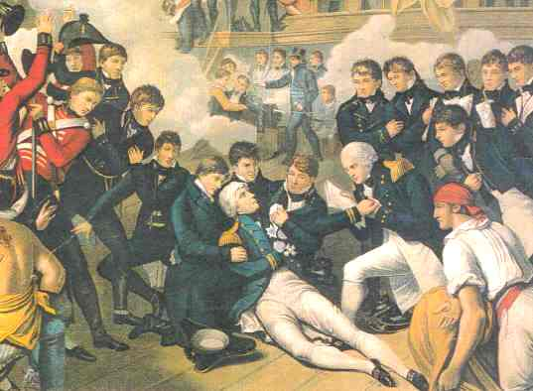
👩🏽‍🏫
The first question to ask yourself: What is the extract about?
Task:
Sequence the main events of the narrative in a flow map.

Slide 82
AO1
👩🏽‍🏫
You need to refer to source C (“A Beautiful Job”,) and source D (The Death of Lord Nelson,) for this question.
The way the that the men are treated after their injuries is different.
Use details from both sources to write a summary of the differences.
Answering question two, you need to:
Demonstrate a clear connections between texts.
Select relevant quotations from both texts to support summary.
Begin to interpret both texts.
x3
Point
Quote
Inference
Make a clear statement about the connections.
Quote details from both sources.
Make an inference which shows understanding.

Slide 83
Every time you complete a Q2 you should follow this process:
AO1
👩🏽‍🏫
1. Pick out the point of connection (question focus)
2. Search for textual details (quotes)
3. Work out what you can infer from the quotes
4. Bring together the two sets of details (and implied meanings) in a summary
Making Inferences – ask yourself these questions:
What does this suggest to me about…?
What might I imply from this about…?
What does it make me realise?
Writing the Summary
You can either:
write a single, combined paragraph as a response to both sources
write two connected (or linked) paragraphs
Make sure you use connectives to link your ideas

Slide 84
AO1
👩🏽‍🏫
 | Text C | Text D | What’s different and might be inferred from this?
How the two men are treated | “He came over and stank of whisky” | “Captain Hardy expressed a hope he was not severely wounded” | Lord Nelson is treated with respect and affection and gets immediate attention perhaps due to his rank and status in the army. The doctor in Text C is unprofessional and uncaring and does not carry out his duties properly perhaps due to the sheer volume of casualties or perhaps due to the low rank of the soldier who has been wounded.
 | “I was in a carriage on a stretcher fixed on the wall” | “His lordship was laid upon a bed”
 | “I said, ‘You’re inhuman woman!’ but she didn’t take any notice.” | “Assuring his lordship he would not put him to much pain”
 | “They hadn’t even looked at it until I asked the doctor.” | “Frequently called for drink, and to be fanned with paper”
These quotes have been selected for you.
What can you infer from each pair of quotes about the different ways the two injured men are treated?

Slide 85
👩🏽‍🏫
Putting it together in a summary:
You need to refer to source C (“A Beautiful Job”,) and source D (The Death of Lord Nelson,) for this question.
The way the that the men are treated after their injuries is different.
Use details from both sources to write a summary of the differences.
WAGOLL:
Here’s an example of a partial answer to question two.
It uses the first pair of quotes from the previous grid.
Point
Both texts focus on the treatment of a wounded soldier but whereas in Text D, Nelson is treated with kindness and compassion and immediate attention when Captain Hardy “expressed a hope he was not severely wounded” in Text C the soldier is neglected and the doctor’s treatment is callous and unprofessional as “he stank of whisky” and only comes over when the soldier calls out to him. This might suggest that Nelson gets preferential treatment due to his rank and status whereas the ordinary soldier in Text C is ignored. Perhaps this also suggests the scale of the casualties in WW1 and that the doctors just couldn’t cope.
Quote
Inference

Slide 86
Task:
Extend this answer.
Write two more summary paragraphs.
Use the quote pairs, and points, from the previous slides.
Add your own inferences.
👩🏽‍🏫
Putting it together in a summary:
You need to refer to source C (“A Beautiful Job”,) and source D (The Death of Lord Nelson,) for this question.
The way the that the men are treated after their injuries is different.
Use details from both sources to write a summary of the differences.
Here’s some vocabulary to help you:
Point
Both texts focus on the treatment of a wounded soldier but whereas in Text D, Nelson is treated with kindness and compassion and immediate attention when Captain Hardy “expressed a hope he was not severely wounded” in Text C the soldier is neglected and the doctor’s treatment is callous and unprofessional as “he stank of whisky” and only comes over when the soldier calls out to him. This might suggest that Nelson gets preferential treatment due to his rank and status whereas the ordinary soldier in Text C is ignored. Perhaps this also suggests the scale of the casualties in WW1 and that the doctors just couldn’t cope.
Similarly
Likewise
As with
Like
Equally
Alternatively
Whereas
Unlike
Instead of
In contrast
Quote
Inference
This might suggest that…
You could infer from this that…

Slide 87
👩🏽‍🏫
Self-Assessment:
Have you made two points about each text?
Have you included textual details or quotations?
Have you been able to infer meaning from the textual details you’ve used?
Do your comments show similarities between the two writers’ experiences of conflict?

Slide 88
👩🏽‍🏫
Grammar
You’re = you are
Your = it belongs to you
They’re = they are
Their = it belongs to them
There = a place
To = moving ‘to’ somewhere
Two = the number 2
Too = also, in addition, as well
Fix
Look through your work from today & improve five things.
Punctuation
Capital letters
Full stops
Commas
Or maybe:
Colon
Semi colon
Inverted commas
Improve your connectives:
And > in addition/furthermore/moreover
But > however/nevertheless/although
So > therefore/consequently/subsequently
Because > as a result/ due to/ as
Vocabulary
Underline key words
Check and correct key word spelling
Extend your vocabulary (find more interesting or creative words)
Presentation
Underline date/title
Use a ruler for tables/ diagrams

