Slide 1
Where in the world has the least access to water, food and energy? Why?
Write down a list of all the foods you have eaten since the Monday

Slide 2
PROJECT:
Write a food diary for one day and find out where each of the items is from (in the world, not the supermarket!).
This means you may need to research online or look at food packages.

Slide 3
Making Predictions …
What do you believe the global distribution of the below resources are;
Water
Food
Energy
You need to shade on your maps where you think has
- a high usage/ access to these items,
- a medium access/ usage
- a low access/ usage.
Create a key.
Be ready to justify your reasoning

Slide 4
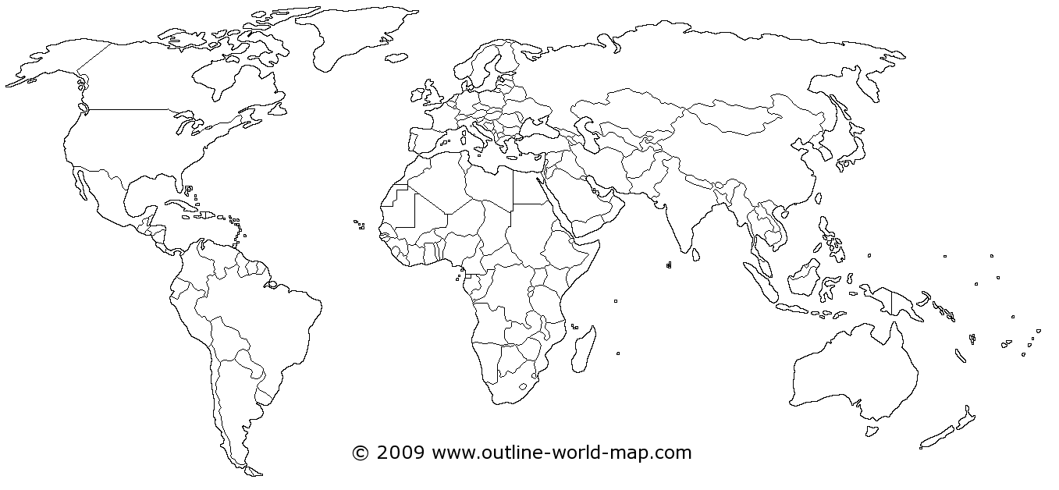
= areas that use lots of water
= areas that use little water
= areas that use lots of energy
= areas that use little energy
= areas that uses lots of food
= area that uses very little food
Notes:
Recap with students the names of the continents and have them write this on their work
Help pupils use 3 colours – solid shade for high amounts and striped for low amounts.

Slide 5
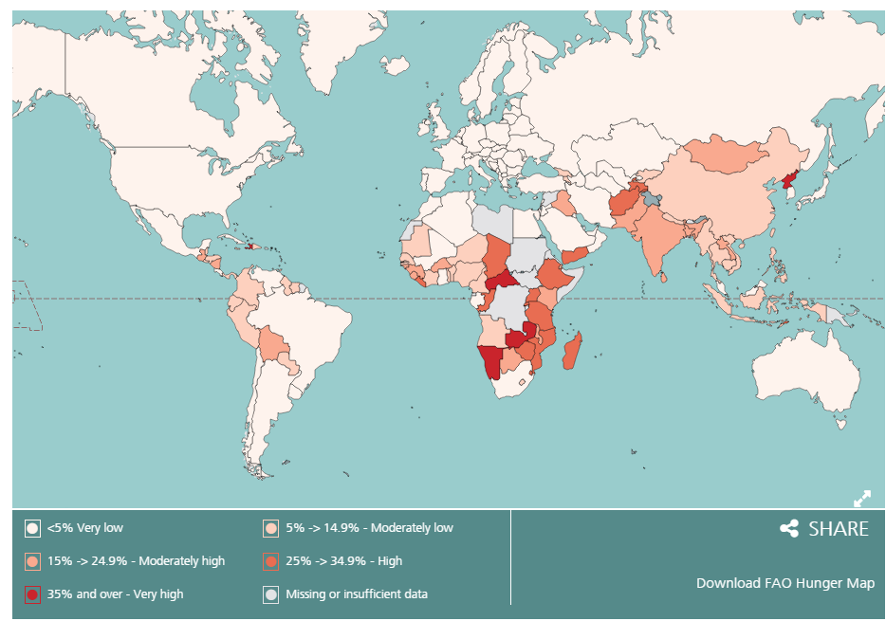
Undernourishment

Slide 6
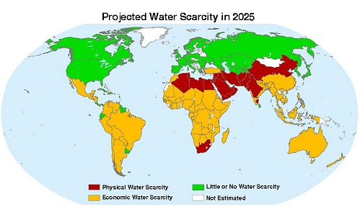
Water Scarcity

Slide 7
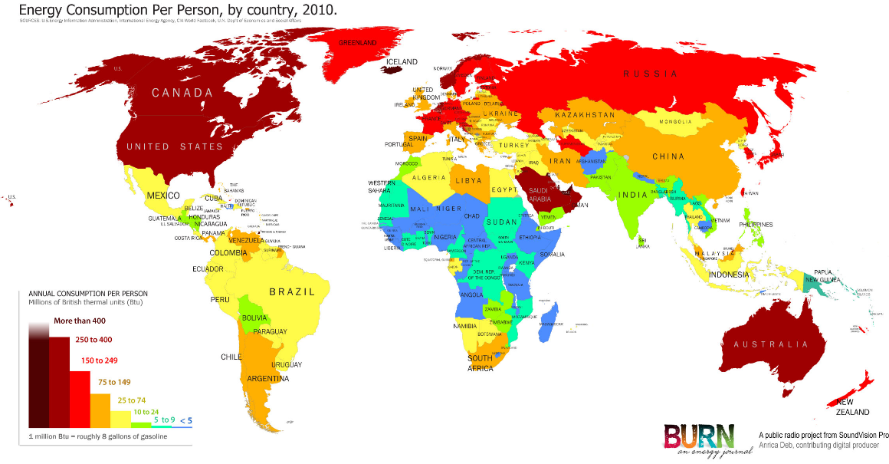

Slide 8
The real situation…
These 3 maps show the water scarcity, undernourishment and energy usage across the world.
You need to describe the pattern of distribution for each of these resources.
Use the questions on the next slide and your own knowledge to help you bullet point explanations as to why these patterns may occur.
How much do you think physical geography influences the usage of these 3 resources ?
Exam skill up
Use location and continent to specifically locate areas.
Use named countries to highlight anomalies
Use geographic words:
Northern, southern, eastern, western, central, coastal.
Europe, Asia, Africa, North America, South America, Oceania,
HIC, NEE, LIC
Prompts:
Areas with high usage of food/water/ energy are usually found in…
This is because these countries are able to …

Slide 9
Undernourishment
Describe the global distribution of food
The areas with secure access to food are…
The areas with medium access to food are…
The areas with low access to food are …
Describe the global distribution of water
The areas with secure access to water are…
The areas with physical water scarcity are…
The areas with economic water scarcity are…
Describe the global distribution of energy use
The areas with high energy consumption are…
The areas with medium energy consumption are…
The areas with low energy consumption are…

Slide 10
Plenary: Write down where in the world you think has the access to the least food, water and energy ?
How does this compare to your initial guess ?

Slide 11
Undernourishment
Water scarcity
Energy consumption

Slide 12
Areas of similarity across my predictions are;
Areas of difference are;
= areas that uses lots of food
= area that uses very little food
= areas that use lots of water
= areas that use little water
= areas that use lots of energy
= areas that use little energy
Notes:
Recap with students the names of the continents and have them write this on their work
Help pupils use 3 colours – solid shade for high amounts and striped for low amounts.

