Slide 1
How to complete lessons
This PowerPoint contains four hours worth of lessons.
It is broken down into four topics. You will need to complete all tasks provided, unless it is a challenge which is optional!
For any questions or help, please email Miss Slack.
sslack@bluecoatmeres.co.uk

Slide 2
Structure of the Atom
To understand the structure of an atom.
Recap the mass, charge and position of the three sub-atomic particles.
Calculate the number of sub-atomic particles from the atomic mass and atomic number.
Explain why atoms have no net charge.

Slide 3
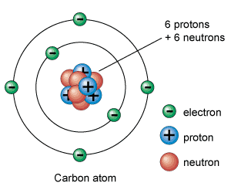
Recall: Draw the structure of an atom on a piece of paper.
It should look something like this, with protons and neutrons in the nucleus and electrons orbiting around the outside.

Slide 4
Watch the video, then copy and complete the table
https://www.youtube.com/watch?v=cpBb2bgFO6I
Particle | Mass | Charge | Position
Proton
Neutron
Electron

Slide 5
Answers!
https://www.youtube.com/watch?v=cpBb2bgFO6I
Particle | Mass | Charge | Position
Proton | 1 | +1 (positive) | Nucleus
Neutron | 1 | 0 (neutral) | Nucleus
Electron | 0 | -1 (negative) | Orbiting nucleus

Slide 6
Atomic Mass and Atomic Number
https://www.youtube.com/watch?v=_S7ov25y3_M
Watch the video.

Slide 7
Atomic Mass and Atomic Number
What does the atomic mass tell you about an atom?
What does the atomic number tell you about an atom?
What is the symbol for the mass number?
What is the symbol for the atomic number?

Slide 8
Atomic Mass and Atomic Number
Atomic mass tells you the number of protons and neutrons.
Atomic number tells you the number of protons or electrons.
The symbol for the mass number is A.
The symbol for the atomic number is Z.

Slide 9
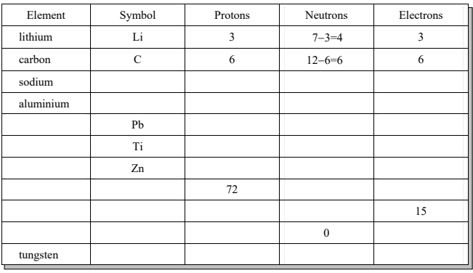
Copy and complete the table. Use a periodic table to help!
https://filestore.aqa.org.uk/resources/science/AQA-8462-8464-8465-INS-PT.PDF

Slide 10
Answers
https://filestore.aqa.org.uk/resources/science/AQA-8462-8464-8465-INS-PT.PDF
Na
11
23-11=12
11
Al
13
27-13=14
13
lead
82
207-82=125
82
titanium
22
48-22=26
22
zinc
30
65-30=35
30
hafnium
Hf
178-72=106
72
phosphorous
P
15
31-15=16
hydrogen
H
1
1
W
74
184-74=110
74

Slide 11
Exam-style questions

Slide 12
Answer

Slide 13
Questions

Slide 14
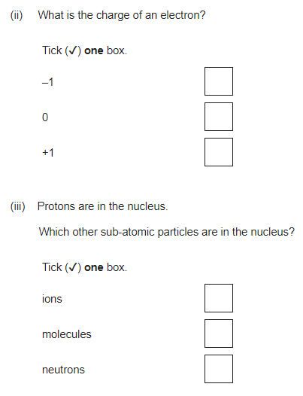

Slide 15
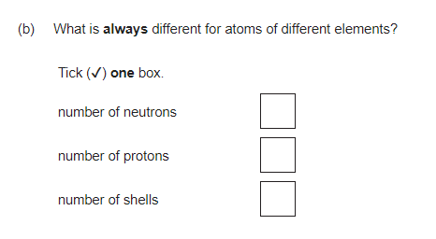

Slide 16
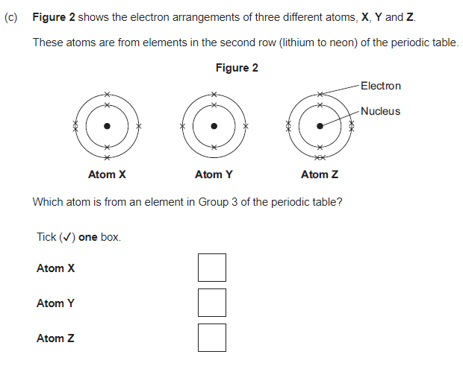

Slide 17
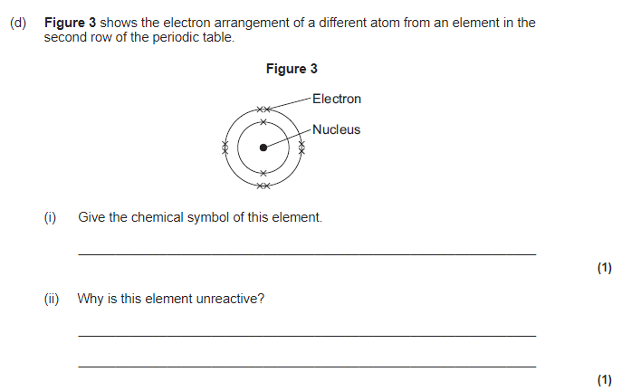

Slide 18
Answers

Slide 19
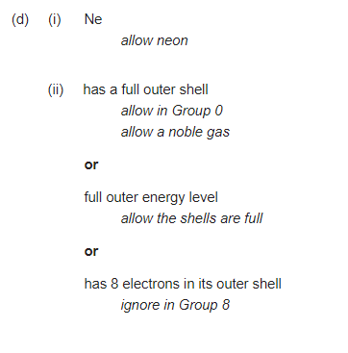
Answers

Slide 20
Ions, Atoms and Isotopes
To understand what ions, atoms and isotopes are.
State what an atom is.
Describe how ions and isotopes are formed.
Explain the differences between isotopes of an atom.

Slide 21
What is an atom?
Write down what you think.
An atom is the smallest particle of an element that can exist.

Slide 22
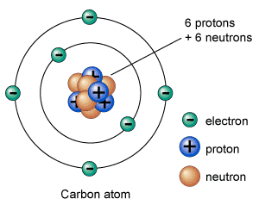
Atoms
Atoms that have the same number of protons as electrons are neutral (have no charge) overall.

Slide 23
Atoms
Without using a periodic table, calculate the mass number and atomic number of carbon (below).
Mass number = 6+6 = 12
Atomic number = 6

Slide 24
Watch the video
https://www.youtube.com/watch?v=n1rrMrEpGn4

Slide 25
Questions
What defines carbon?
What is an isotope?
What is an ion?
Can an isotope also be an ion?
Which is easier to form, an ion or an isotope and why?

Slide 26
Answers
Carbon is defined by having 6 protons (atomic number =6).
An isotope is an atom that has lost or gained neutrons.
An ion is an atom that has lost or gained electrons so has an electrical charge.
Yes, an isotope can be an ion as well.
An ion is easier to form because it’s quite easy for an atom to lose or gain electrons.

Slide 27
Ions
Ions are atoms that have lost or gained electrons.
Remember, electrons are negative so if an ion has a negative charge (F⁻), it means that it has gained an electron. If it has a positive charge (Na⁺), it has lost an electron.

Slide 28
Ion Example
F⁻ is the fluoride ion.
To calculate the number of protons, neutrons and electrons we use the mass number and the atomic number.

Slide 29
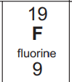
Ion Example
F⁻ is the fluoride ion.
From the periodic table we can see that for F:
Atomic mass = 19
Atomic number = 9

Slide 30
Ion Example
Therefore we can calculate that for the neutral atom F:
Protons = 9
Neutrons = 19-9 = 10
Electrons = 9

Slide 31
Ion Example
F⁻ is the fluoride ion.
It has the same number of protons and neutrons as the neutral atom F, but it has a negative charge so it has one more electron!

Slide 32
Ion Example
F⁻ is the fluoride ion.
Therefore we can calculate that for the ion F⁻:
Protons = 9
Neutrons = 19-9 = 10
Electrons = 9+1 = 10

Slide 33
Questions – Atoms and ions

Slide 34
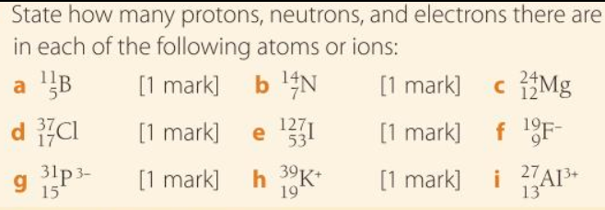
Answers – Atoms and ions
a: P = 5 N = 6 E = 5
b: P = 7 N = 7 E = 7
c: P = 12 N = 12 E = 12
d: P = 17 N = 20 E = 17
e: P = 53 N = 74 E = 53
f: P = 9 N = 10 E = 10
g: P = 15 N = 16 E = 18
h: P = 19 N = 20 E = 18
i: P = 13 N = 14 E = 10

Slide 35
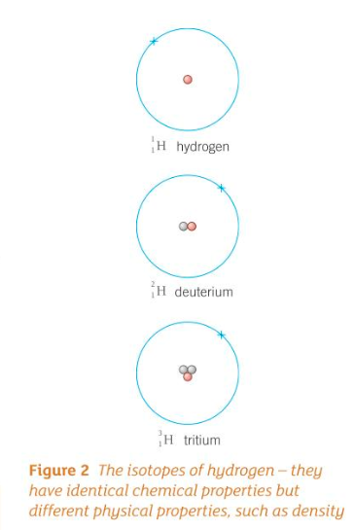
Isotopes

Slide 36
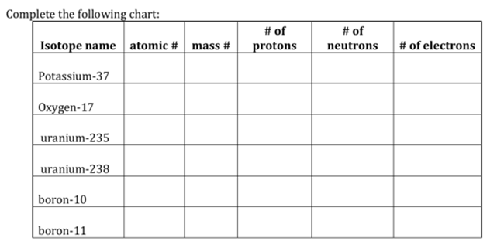
Task – complete the table
Use the periodic table to help!
https://filestore.aqa.org.uk/resources/science/AQA-8462-8464-8465-INS-PT.PDF
19 37 19 18 19
92
92

Slide 37
Answers
https://filestore.aqa.org.uk/resources/science/AQA-8462-8464-8465-INS-PT.PDF
19 37 19 37 – 19 = 18 19
8 17 8 17 – 8 = 9 8
92 235 92 235 – 92 = 143 92
92 238 92 238 – 92 = 147 92
5 10 5 10 – 5 = 5 5
5 11 5 11 – 5 = 6 5

Slide 38
Isotopes Question
Below are three isotopes of carbon. Explain the differences and similarities that you might expect to see between the isotopes.

Slide 39
Isotopes Answer
Isotopes often have different physical properties (density, boiling point etc.) but have the same chemical properties. This is because isotopes have the same number of electrons and it is the electronic structure that dictates the chemical properties of an element.

Slide 40
Extra Challenge
Attempt this question if you’re up for a challenge!
Watch the video first.
https://www.youtube.com/watch?v=OY_lPQVXENI

Slide 41
Challenge Questions
Email Miss Slack for answers!
sslack@bluecoatmeres.co.uk

Slide 42
Electronic Structure
To understand the electronic structure of a different atoms.
Recall the number of electrons in an atom or ion.
Describe and draw the electronic structure of atoms and ions.
Explain how electronic structure of atoms dictates the ions formed.

Slide 43
How many electrons are in the following atoms/ions?
Use the periodic table to help.
https://filestore.aqa.org.uk/resources/science/AQA-8462-8464-8465-INS-PT.PDF

Slide 44
How many electrons are in the following atoms/ions?
Na
K⁺
O
Si
Cl⁻
O²⁻
Mg
Xe
I⁻
Li⁺
H⁺
He

Slide 45
How many electrons are in the following atoms/ions?
Na - 11
K⁺ - 18
O - 8
Si - 14
Cl⁻ - 17
O²⁻ - 10
Mg - 12
Xe - 54
I⁻ - 53
Li⁺ - 2
H⁺ - 0
He - 2
If you do understand how to calculate these go back to last lesson for the explanation!

Slide 46
Watch the video
https://www.youtube.com/watch?v=hSkJzE2Vz_w

Slide 47
Questions
How many electrons can be held in the first shell?
How many electrons can be held in the second and third shell?
Draw the electronic structure of an oxygen atom and write down the short-hand.

Slide 48
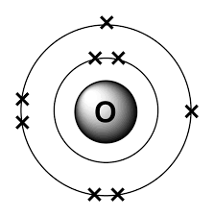
Answers
2 electrons
8 electrons
Oxygen – 2, 6

Slide 49
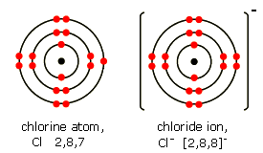
Ions
When drawing the electronic structure of an ion, you must put square brackets around it and write the charge of the ion.
Here is an example of the Cl⁻ ion.
Neutral atom →
←Negative ion

Slide 50
Practice drawing the electronic structure for the following atoms/ions
F⁻
Na⁺
Li
Be
Ca
Mg²⁺

Slide 51
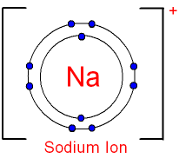
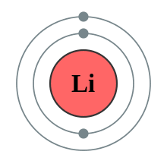
Answers
F⁻
Na⁺
Li

Slide 52
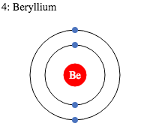
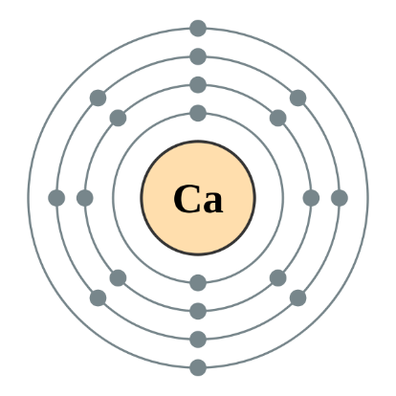
Answers
Be
Ca
Mg²⁺

Slide 53
Task
Write a guide for another student, explaining how to draw the electronic structure of S²⁻.
Make sure to include -
How to calculate the number of electrons.
How many electrons fit in each shell.
How to arrange the electrons in the shells.

Slide 54
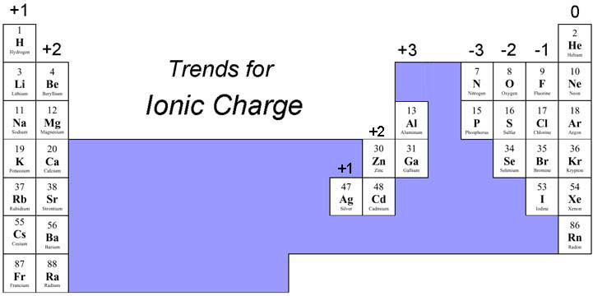
Ions in the periodic table
What do you notice about the charge of the ions that form in the periodic table and their position?

Slide 55
Ions in the periodic table
Elements in groups 1 have 1 electron in their outer shell.
E.g. Na
Atoms want to have a full outer shell because it makes them more stable.
How can Na form a full outer shell?
By losing an electron!

Slide 56
Ions in the periodic table
Sodium loses an electron therefor it forms an ion with a +1 charge.

Slide 57
Ions in the periodic table
Fluorine is in group 7, so it has 7 electrons in its outer shell.
How can fluorine form a full outer shell?
By gaining an electron!

Slide 58
Ions in the periodic table
The fluoride ion has a -1 charge because fluorine gains 1 electron to form a full outer shell!

Slide 59
Question
Explain why Mg forms an ion with a 2+ charge.

Slide 60
Answer
Magnesium has 12 electrons and is in group 2…
Therefore it has 2 electrons in its outer shell.
It wants a full outer shell for stability
So it loses two electrons to form Mg²⁺.

Slide 61
C1 Summary Questions
To understand the C1 AQA topic
Recall the topics from C1
Answer the summary questions.
Answer the practice questions.

Slide 62
Answer the summary questions provided!
For help on a specific question feel free to email Miss Slack.
sslack@bluecoatmeres.co.uk

Slide 63
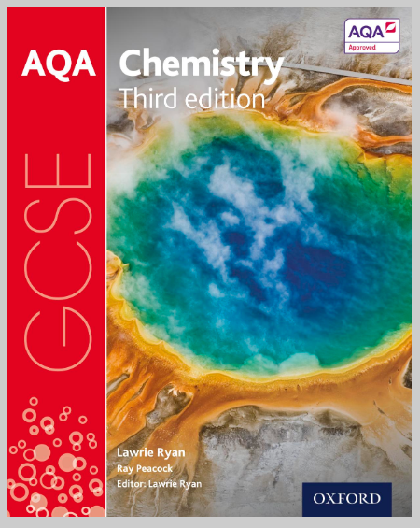
Kerboodle
Use chapter one of this textbook on Kerboodle to help you!

Slide 64
Answer the Summary Questions

Slide 65
Answer the Summary Questions

Slide 66
Answer the Summary Questions

Slide 67
Answer the Summary Questions

Slide 68
Answer the Summary Questions

Slide 69
Answer the Summary Questions

Slide 70
Now answer the practice questions!

Slide 71
Practice Questions

Slide 72
Practice Questions

Slide 73
Practice Questions

Slide 74
Practice Questions

Slide 75
Practice Questions

Slide 76
Practice Questions

