Slide 1
Development of the Periodic Table
To understand how the periodic table developed.
State how Dalton and Newton arranged the elements.
Describe how Mendeleev developed the structure of the periodic table.
Explain how atomic structure is related to the periodic table.

Slide 2
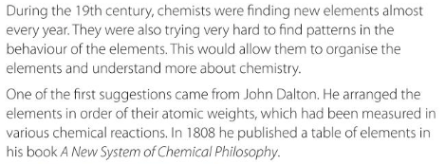
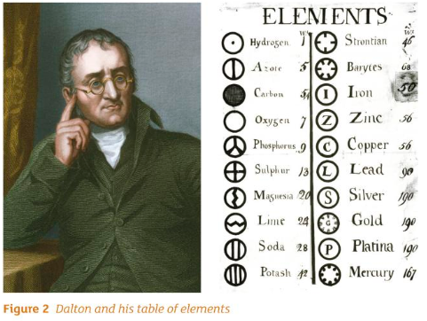
Dalton and the Periodic Table

Slide 3
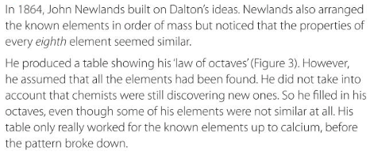
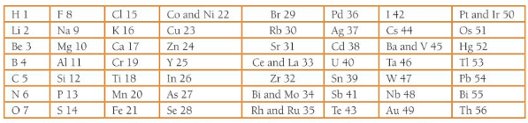
Newlands and the Periodic Table

Slide 4
Questions
How did Dalton arrange the elements in his periodic table?
How did Newlands arrange the elements in his periodic table?
What mistake did Newlands make when he created his table of octaves?
Challenge: Why did the pattern break after calcium?

Slide 5
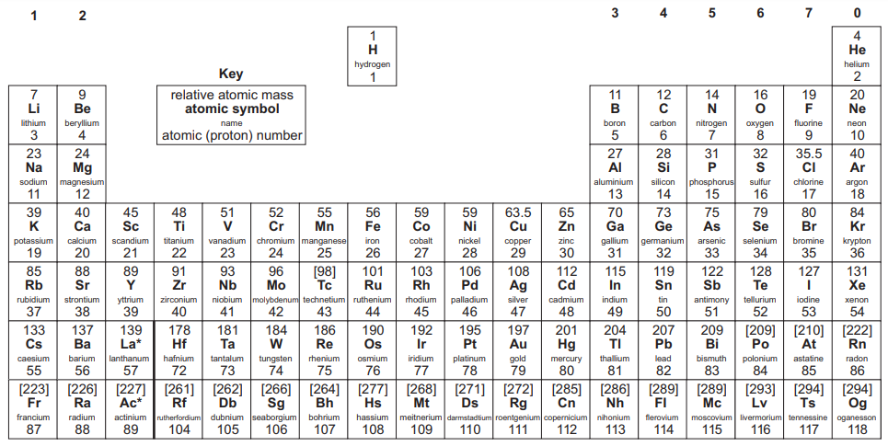
Questions
Dalton arranged the elements by atomic mass.
Newlands also arranged the elements by atomic mass, but he noticed that every eighth element had similar properties.
Newlands did not account for elements that had not been discovered.
Challenge: Calcium is the last element before the transition metals, which alter the pattern of ‘octaves’.

Slide 6
Mendeleev
https://www.youtube.com/watch?v=oylTOhzpJL4
Watch the video then answer the questions!

Slide 7
Mendeleev
In what year did Mendeleev work out the basis of the modern periodic table?
What did Mendeleev do that was different to other scientists’ attempts?
How did Mendeleev prove that his periodic table was correct?
Challenge: The modern periodic table is slightly different to the one that Mendeleev created, how is this?

Slide 8
Mendeleev
1869
He left gaps in the periodic table for undiscovered elements, and predicted their atomic mass and properties.
Elements that were later discovered fitted with the predictions he had made about them.
Challenge: Mendeleev ordered the elements by increasing atomic mass, now they are ordered by increasing atomic number.

Slide 9
What does the position of an element in the periodic table tell us about the structure of that atom?
From the group (column) we can predict chemical properties.
E.g. An element in group 1 is a metal, it is quiet soft and reacts with water and oxygen.
From the period (row) we can estimate the size of the atom, as the size of atoms increase as you move down a group.
E.g. An element in period 2 of a group is smaller than an element in period 4 of the same group.

Slide 10
What does the position of an element in the periodic table tell us about the structure of that atom?
From the group (column) we know how many electrons are in the outer shell of that atom.
E.g. An element in group 7 has 7 electrons in its outer shell.
An element in group 3 has 3 electrons in its outer shell.

Slide 11
Questions – Periodic Table on next slide!
What can you predict about the size of a magnesium (Mg) atom compared to a strontium (Sr) atom?
How many electrons does oxygen (O) have in its outer shell?
How many electrons does H have in its outer shell?
Challenge: What properties would an element in group 0 have?

Slide 13
Answers
Magnesium is smaller than strontium.
Oxygen has 6 electrons in its outer shell.
Hydrogen has 1 electron in its outer shell – it only has 1 electron!
Challenge: An element in group 0 is a noble gas, therefore it is very unreactive.

Slide 14
The Structure of the Periodic Table
To understand the structure of the periodic table.
State the difference between metals and non-metals.
Describe the structure of the periodic table.
Explain why noble gases are unreactive.

Slide 15
Watch the video
https://www.youtube.com/watch?v=uN2cVakPD-c

Slide 16
Metals and non-metals
Sort the characteristics into metals and non-metals!
Shiny, dull, low density, high density, weak, strong, malleable (can bend), brittle (break easily), good conductor of heat, poor conductor of heat, good conductor of electricity, poor conductor of electricity, no magnetic properties, some elements have magnetic properties, make a ringing sound when hit, make a dull sound when hit, form acidic oxide, form alkaline oxide.
Metal | Non-Metal

Slide 17
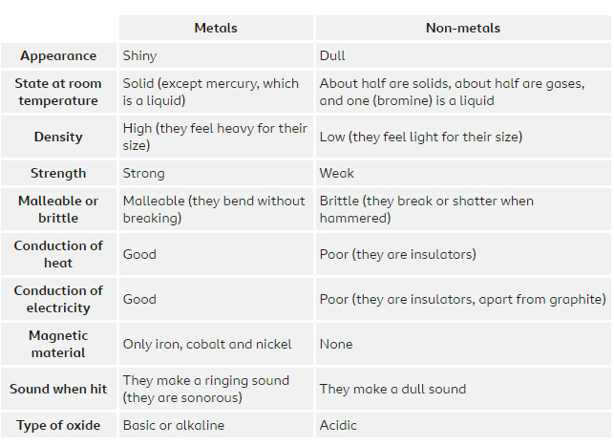
Answers

Slide 18
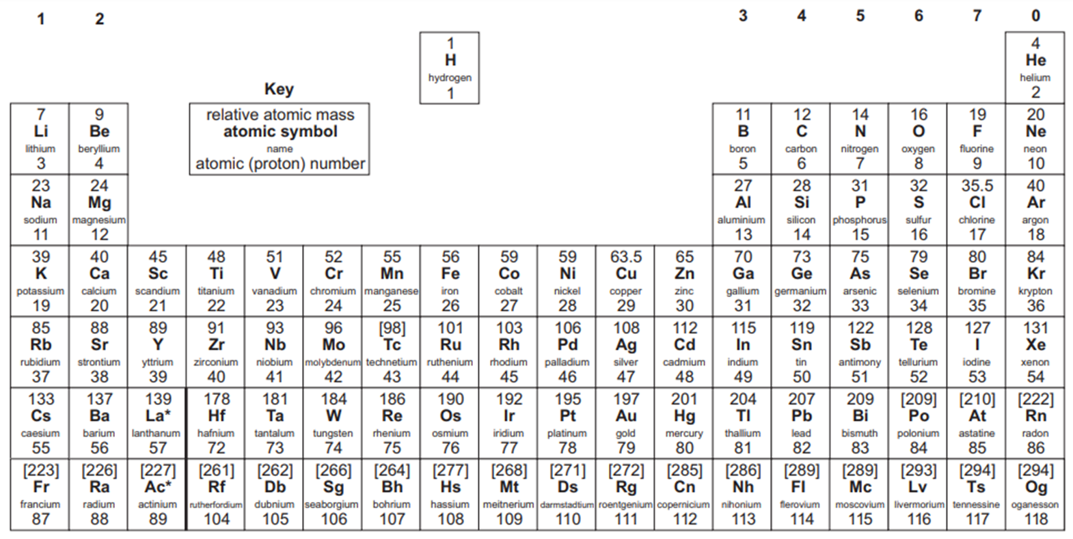
Metals
The metal elements on the periodic table are found on the left-hand side and centre of the periodic table.
There are two distinct types of metals that can be identified. The reactive metals (in red) and the transition metals (in blue).

Slide 19
Metals
The metals in group 1, 2 and 3 lose electrons to form positive ions.
E.g. Li in group 1 forms Li⁺.
Mg in group 2 forms Mg ²⁺.
Al in group 3 forms Al³⁺.

Slide 20
Non-Metals
The non-metal elements are found in the top right-hand corner of the periodic table (above the staircase). The atoms of elements in group 5, 6 and 7 can gain electrons to form negative ions.

Slide 21
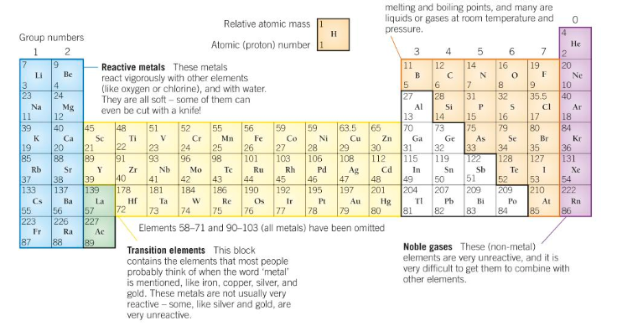
Non-Metals
E.g. F gains one electron to form F⁻.
S gains two electrons to form S²⁻.

Slide 22
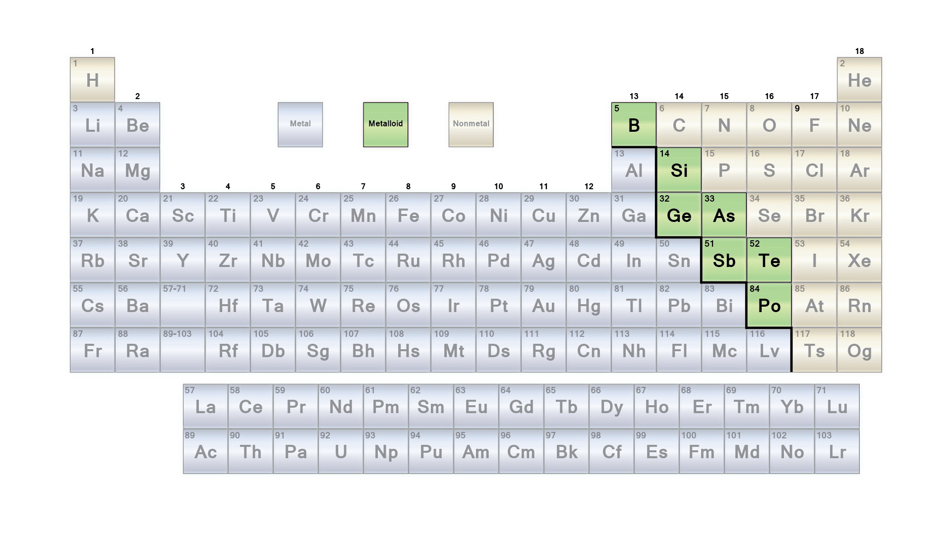
Metalloids (semi-metals)
The elements that are found on the border of metals and non-metals often have properties of both metals and non-metals. For this reason, we call them metalloids, or semi-metals.

Slide 23
Electronic Structure
Elements form ions because they are more stable when they have a full outer shell.
We already know that an element in group 1 has 1 electron in its outer shell.
Therefore a group 1 element only needs to lose 1 electron to have a full outer shell.
Once this electron is lost, it will have a +1 charge because electrons are negative.

Slide 24
Electronic Structure
Draw the electronic structure of a beryllium atom.
How many electrons does it have in its outer shell?
Draw the beryllium ion.
Make sure you draw square brackets around it and write its charge.

Slide 25
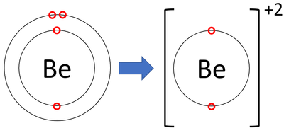
Electronic Structure
The beryllium atom has 2 electrons in its outer shell. It loses those 2 electrons to form an ion with a +2 charge.

Slide 26
Noble Gases
The noble gases are group 0.
They are very unreactive.
Draw the electronic structure of the first two elements in the noble gases.
Explain why noble gases are so unreactive, taking into account what you have just learnt about forming ions.

Slide 27
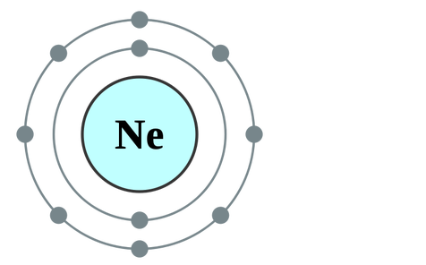
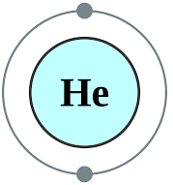
Answers
1.
2. Elements form ions because having a full outer shell makes them more stable. The noble gases already have a full outer shell, which we can tell by their group number so they do not need to lose or gain electrons. For this reason, the noble gases are very unreactive.

Slide 28
The Alkali Metals
To understand the alkali metals and their reactivity.
Describe the behaviour of the alkali metals.
Explain how the reactivity of alkali metals changes as you go down the group.
Predict the products of reactions of the alkali metals.

Slide 29
The Alkali Metals
https://www.youtube.com/watch?v=CmiitvJiCPc
Watch the video.

Slide 30
Questions
Name the alkali metals, going down the group.
What ion do the alkali metals form?
Why are the alkali metals stored in oil?
How does the reactivity of the alkali metals change as you go down the group?
How does the softness of the alkali metals change as you go down the group?
How does the melting and boiling points of the alkali metals change as you go down the group?
Challenge: Why are they called the alkali metals?

Slide 31
Answers
Lithium, sodium, potassium, rubidium, caesium, francium.
The alkali metals form 1+ ions because the lose one electron.
The alkali metals are stored in oil because they react readily with water and oxygen.
The alkali metals become more reactive as you go down the group.
The alkali metals become softer as you go down the group.
The melting and boiling points of the alkali metals decrease as you go down the group.
Challenge: They are called the alkali metals because an alkaline solution is formed when they react with water.

Slide 32
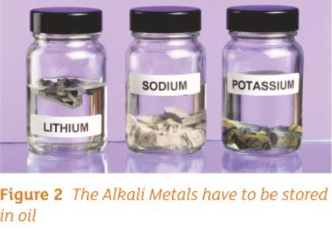
Properties
The properties of this unusual group of metals is due to their electronic structure.
They all have one electron in the outer shell, which makes them very reactive as it is easy to lose this electron.
They react with non-metals to form an ionic bond.

Slide 33
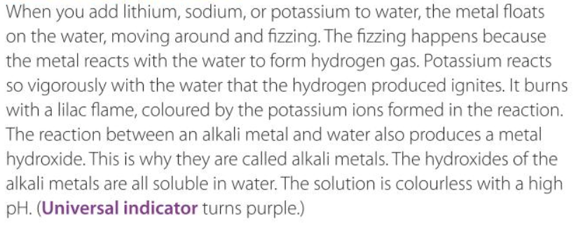
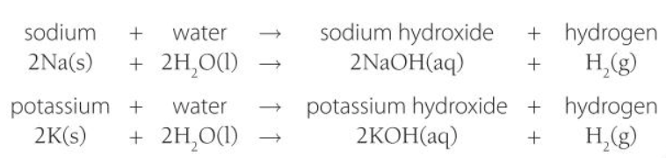
Reaction with water

Slide 34
Reaction with water
Write a word and chemical equation for the reaction of lithium with water.
2Li (s) 2H₂O (l) → 2LiOH (aq) + H₂ (g)
Lithium + water → lithium hydroxide + hydrogen

Slide 35
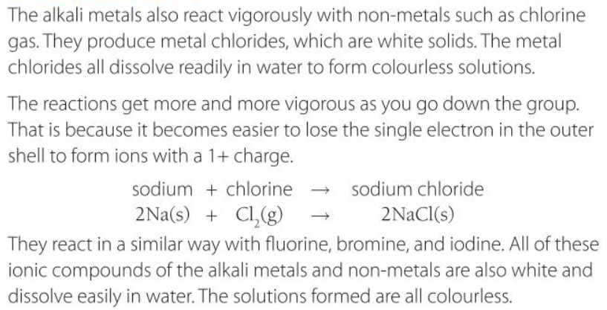
Other Reactions

Slide 36
Other Reactions
Write the word and chemical equation for the reaction of potassium with bromine.
2K + Br₂ → 2KBr
potassium + bromine → potassium bromide

Slide 37
The Halogens
To understand the halogens and their reactivity.
Describe the behaviour of the halogens.
Explain how the reactivity of the halogens changes as you go down the group.
Predict the products of reactions of the halogens.

Slide 38
Watch the video
https://www.youtube.com/watch?v=yW_C10cEzMk

Slide 39
Questions
What group are the halogens in?
Name the elements in the halogens.
What ions do the halogens form?
How do melting and boiling points change as you go down the group?
How does reactivity change as you go down the group?
Describe when a displacement reaction with a halogen will occur.
What is produced when a halogen reacts with a metal?
Challenge: How would you form a hydrogen halide?

Slide 40
Answers
Group 7
Fluorine, chlorine, bromine, iodine and astatine.
What ions do the halogens form?
How do melting and boiling points change as you go down the group?
The halogens become less reactive as you go down the group.
A more reactive halogen will replace a less reactive halogen in a compound.
A metal halide is produced.
Challenge: React hydrogen with a halogen. For example, chlorine and hydrogen forms hydrogen chloride.

Slide 41
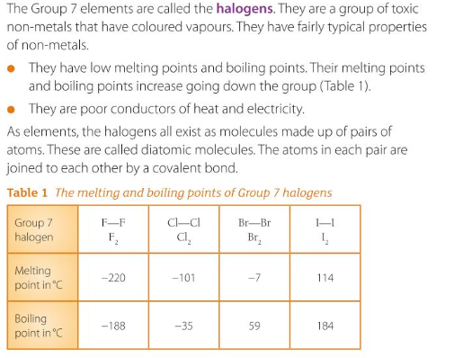
The Halogens

Slide 42
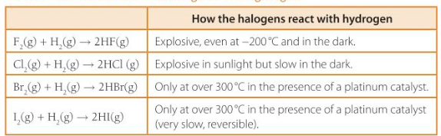
Reaction with hydrogen
By observing their reaction with hydrogen, which of the halogens is the most reactive and how can you tell? Write this down.

Slide 43
Reaction with hydrogen - Answers
Fluorine, because it reacts very easily with hydrogen; at a very low temperature and with no light.
Other halogens require more energy and some need a catalyst.

Slide 44
Displacement Reactions
A more reactive halogen with replace a less reactive halogen from a solution of its salts.

Slide 45
Formation of metal halides
Halogens will react with metals to form a metal halide.
E.g. Fluorine + lithium → lithium fluoride.

Slide 46
Questions
Chlorine + magnesium →​
Bromine + hydrogen →​
Fluorine + potassium bromide →​
Chlorine + potassium fluoride →​
Bromine + sodium iodide →

Slide 47
Answers
Chlorine + magnesium → magnesium chloride​
Bromine + hydrogen → hydrogen bromide​
Fluorine + potassium bromide → bromine + potassium fluoride​
Chlorine + potassium fluoride → no change​
Bromine + sodium iodide → iodine + sodium bromide

