Slide 1
Yr7 Art
Each lesson should take 1 hour.
Use whatever materials you have, pencils, pens, crayons, felt tips, paints. Any paper you are allowed to use, old envelopes, packaging, papers.
I am not expecting you to buy anything.
I am expecting you to try your BEST! HIGH QUALITY DRAWING!
Any questions email me at:
Tbainbridge@Bluecoatmeres.co.uk
Week 1 Draw from your shoe as we have in class: Work lightly, use basic shapes to build your drawing, add detail, tone and texture, then self assess
Week 2 Draw another shoe this time in the style of Andrea Joseph. Answer the questions about her work, and if you have time perhaps find out some more information about her and her work.

Slide 2
Yr7 Shoe Observational Drawing Week One 20/4/20
Lesson Objective:
Observational drawing skills focussing on the formal elements, line, shape, tone, form, texture and pattern, using mark making, shadow and detail.
Learning Outcomes:
Must: Demonstrate skills in observation and shape. Grade C/4​
Challenge: Explore the application of detail through the use of Mark Making. ​Grade B/6​
Stretch: Analyse where tone could be added to your work. Grade A/8​
Extension: Evaluate your composition and refine your work by adding detail through mark-making Grade A*/9​

Slide 3
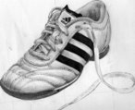
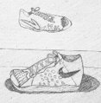
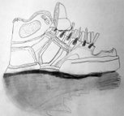
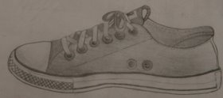
Shoe Observational Drawing Week One 20/4/20
Well Below –Below—Inline-- Above—Well Above

Slide 4
Shoe Observational Drawing Week One 20/4/20
15 Mins to concentrate on observation and shape.​
15Mins to focus on detail and texture.​
15 Mins to apply tone and shadow.​
5 Mins to self assess your work using the criteria on the next slide
Basic shapes drawn lightly with a sharp pencil, refine shapes, add more details, tone, texture, mark making and directional shading

Slide 5
Shoe Observational Drawing Week One 20/4/20
Self Assessment- Did you….
Quality of Observation: Draw what you SEE, the object in front of you, not what you THINK it looks like!
Shape: Use of basic shapes triangle, circles and squares to construct object. Refine basic shapes into more accurate shapes adding curves and creases in the fabric.
Tone: Includes 3-5 grades of tone. Use directional marks to create form. Build up layers of tone to show darks, midtones and lights. Use a softer pencil.
Scale/Composition: Object should be in the centre of the page and fill as much of the page as possible. Have you included a horizon line to suggest the object is on a table.
Texture: Use smooth transitions, blending when shading to create the illusion that the object is smooth and shiny, use mark making techniques to show fabric textures.
Shadow: Have you included the shadow? Shadows should be attached to the object, tones on the shadow should be darker nearer the object.
Detail :Have you shown the creases in the shoe? Have you included the details such as stitching and decoration?
Self Assessment :Have you included your art vocabulary? Have you included the techniques that you used e.g. cross hatching or blending

Slide 6
Yr7 Andrea Joseph Artist Research Week Two
Lesson Objective:
Demonstrate analytical and critical understanding of artists and movements
Explore media materials techniques and processes ​
Learning Outcomes:
Must: Demonstrate skills in observation and shape. Grade C/4​
Challenge: Explore the application of detail through the use of Mark Making. ​Grade B/6​
Stretch: Analyse where tone could be added to your work. Grade A/8​
Extension: Evaluate your composition and refine your work by adding detail through mark-making Grade A*/9​

Slide 7
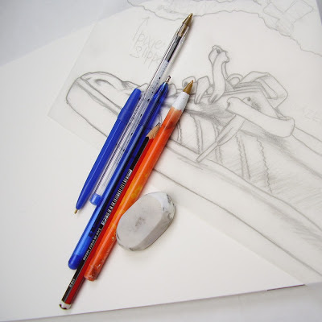
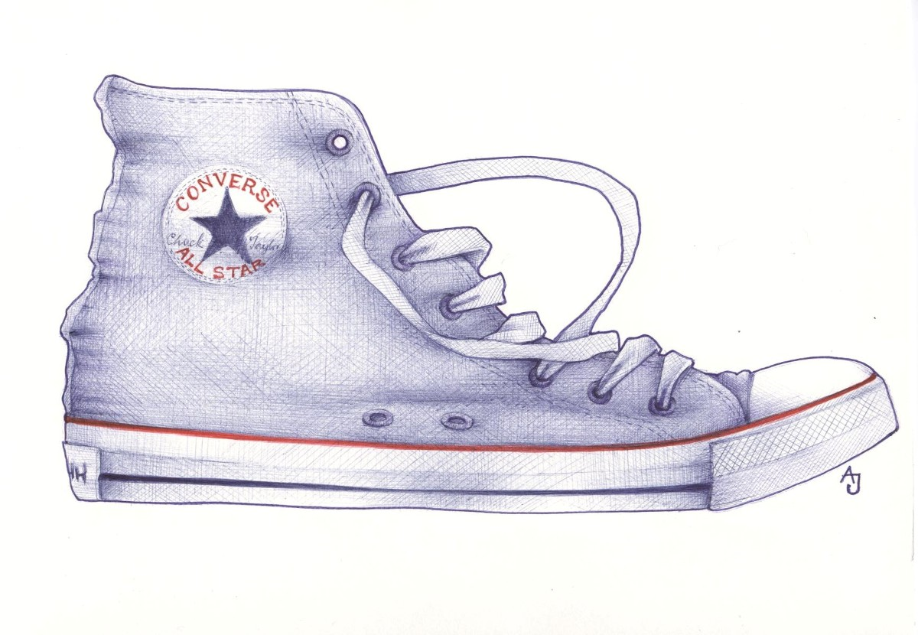
Yr7 Andrea Joseph Artist Research Week Two
After you have finished your drawing add the following information to it-
DESCRIBE, What words would you use to describe this work?​
​​RELATE, What things do you recognise in this work? What things seem new to you? ​
​ANALYSE, What colour is used the most in his work? Look at colour examples.​
​INTERPRET, What title would you give to this work? What made you decide on that title? ​
​​EVALUATE, What do you think is good about this work? What is not so good?
Draw another shoe, but this time use biro in the style of Andrea Joseph.
See how she uses cross hatching to create tones.
http://www.emptykingdom.com/featured/empty-kingdom-interview-andrea-joseph/

Slide 8
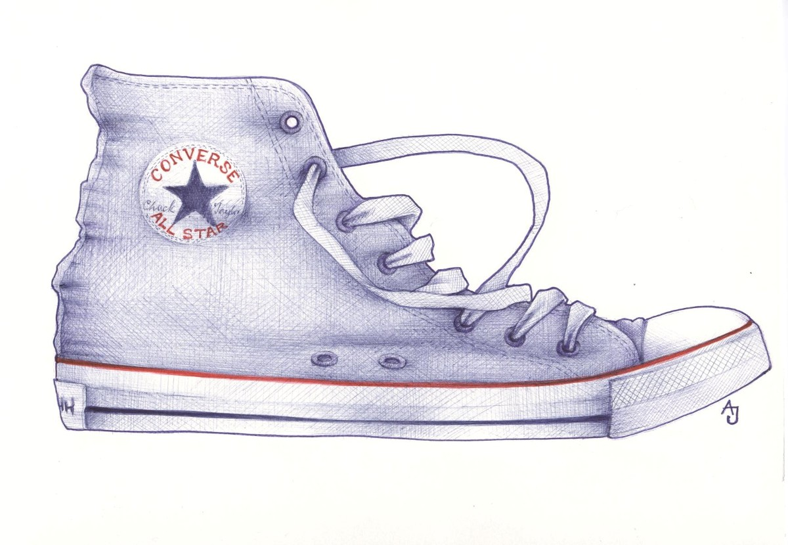
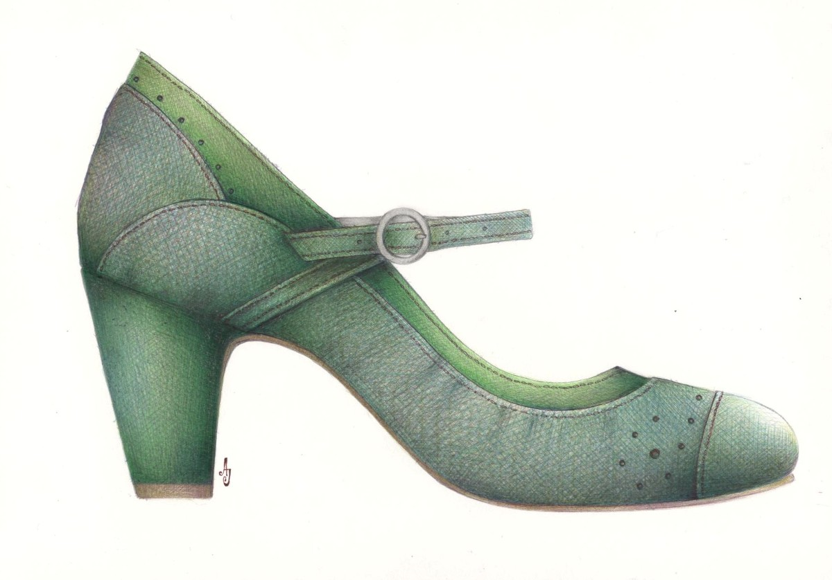
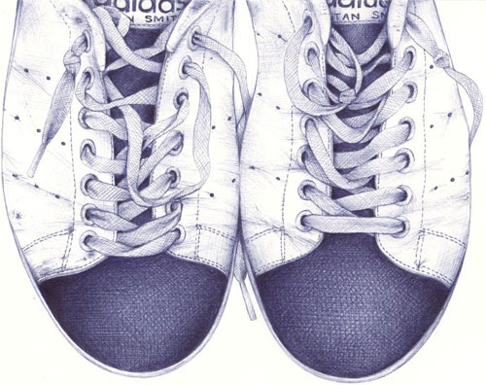
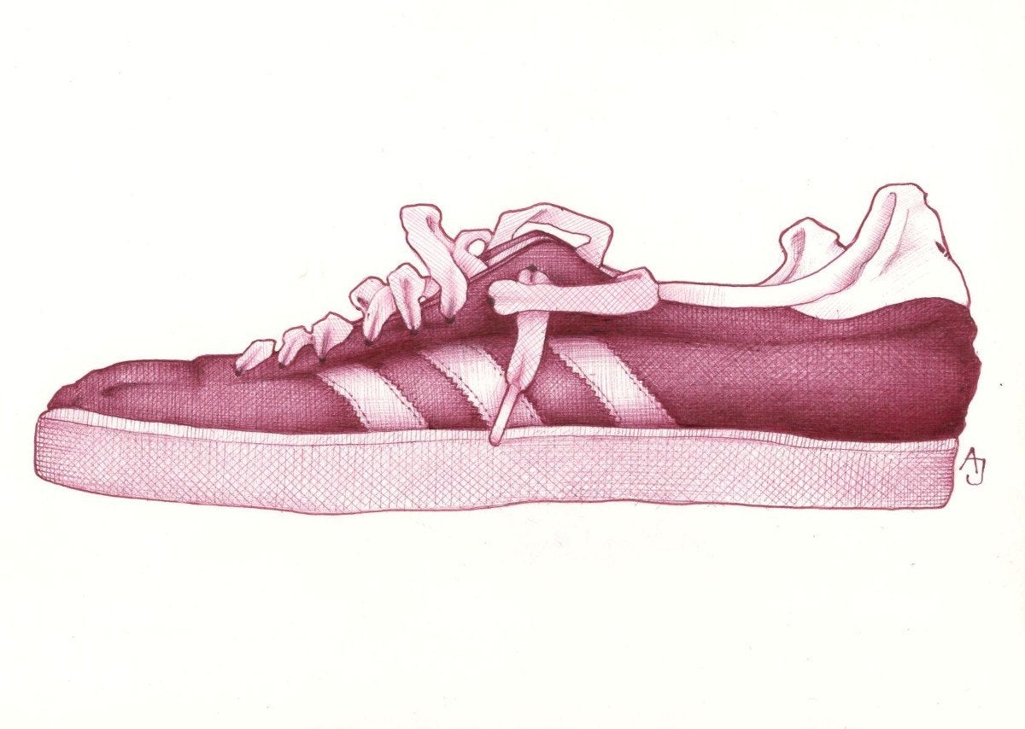
Yr7 Andrea Joseph Artist Research Week Two
Andrea Joseph is an award winning illustrator from sunny Port Talbot, in Wales, now living and drawing in Derbyshire. Andrea started drawing again, about four years ago, after a ten year break. She hasn't stopped since. She is entirely self taught. Her illustrations celebrate the unexpected beauty of the everyday objects that we surround ourselves with. In 2009 Andrea's children's book illustrations were selected for the prestigious Bologna Children's Book Fair. Her work has been exhibited worldwide.

Slide 9
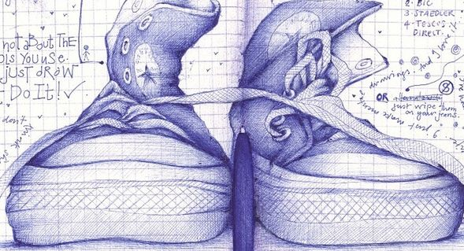
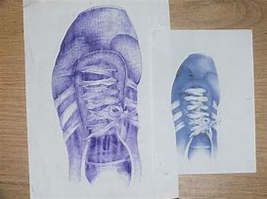
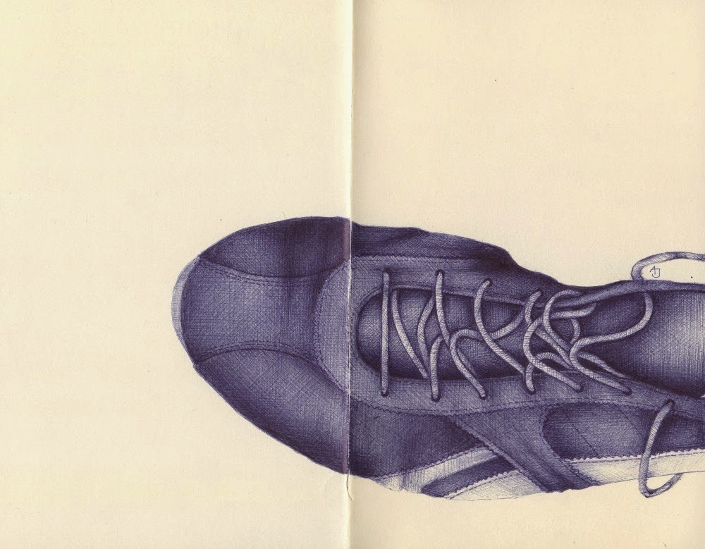
Yr7 Andrea Joseph Artist Research Week Two

Slide 10
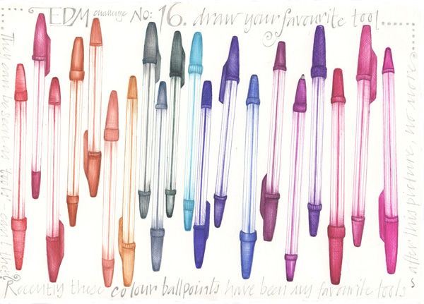
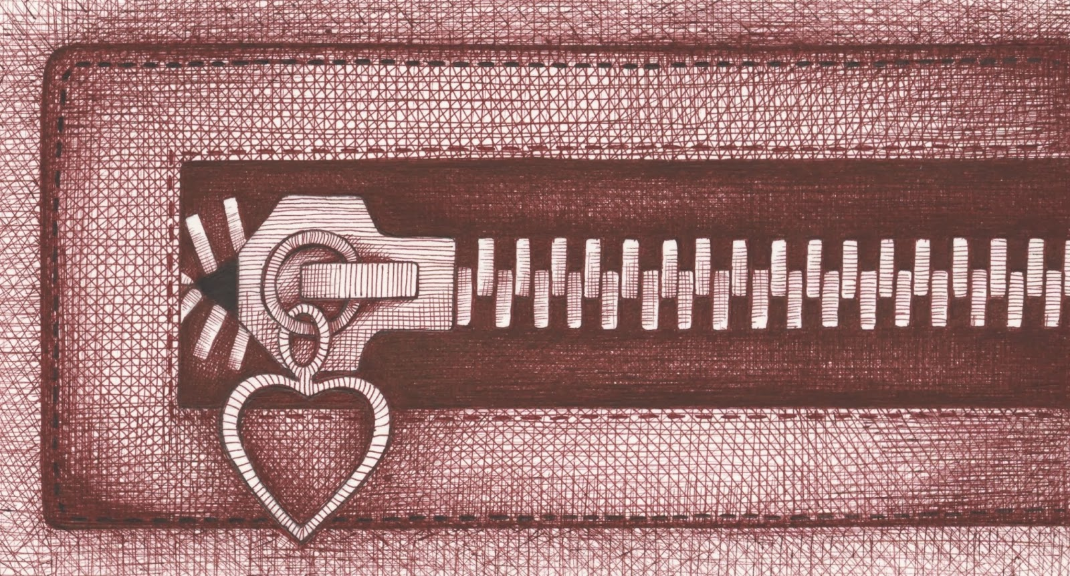
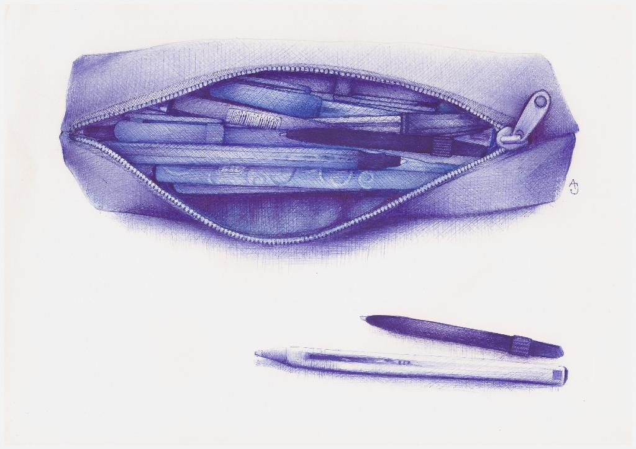
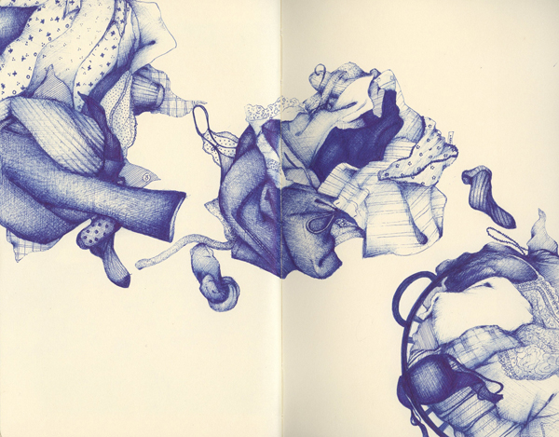
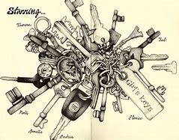
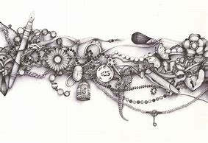
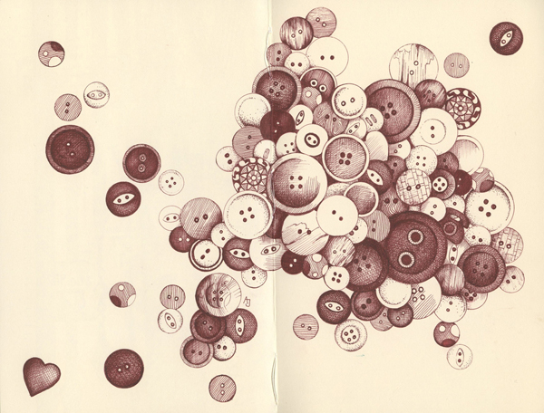
Yr7 Andrea Joseph Artist Research Week Two
When you have completed your artist research page, you could try drawing other objects in her style.

