Slide 1
The Lost Words
Term 5 – Year 7
Week beginning 20th April
Week ending 1st May

Slide 2
Arrow of Progress
Discovering
Developing
Securing
Mastering
Learning Objectives:
Knowledge and Understanding (MUST): To... Identify key words specific to movements Application and Analysis (STRETCH): To... Demonstrate how vocabulary can create specific effects and meanings Evaluation and Creativity (CHALLENGE): To... Compose a piece of writing where you are a shape-shifter
Key Word:
Synonyms

Slide 3
The Lost Words
Otter
https://www.youtube.com/watch?v=vEzycu_paF4

Slide 4
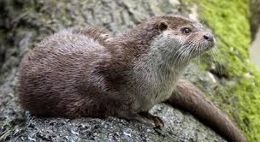
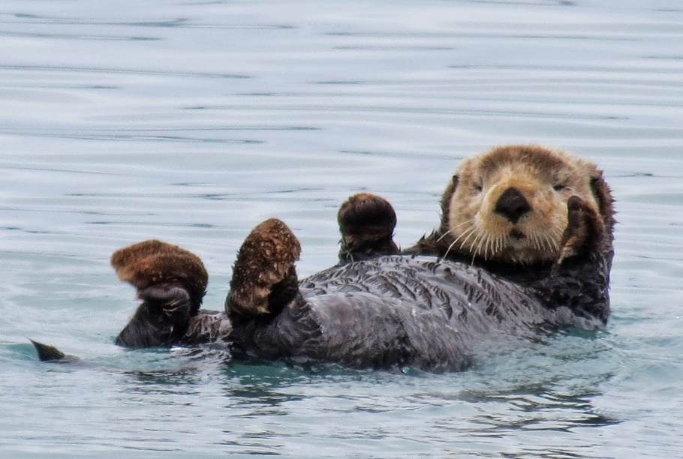
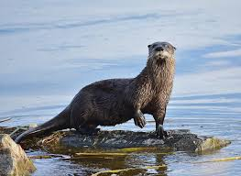
https://www.youtube.com/watch?v=84P7CJHdt9U
What animal is this?
What do you know about this creature?
Mindmap your knowledge around the image

Slide 5
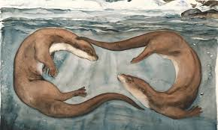
Task 1
Wonder words
What do these mean?
◆ falter
◆ holt
◆ skein
◆ ore
◆ silver-miner
◆ delves
Task 2
Vocabulary challenge
Thinking about the images you saw and heard in the video, discussions we have had abut the otters, mindmap as many nouns, adjectives and adverbs you can around this image.

Slide 6
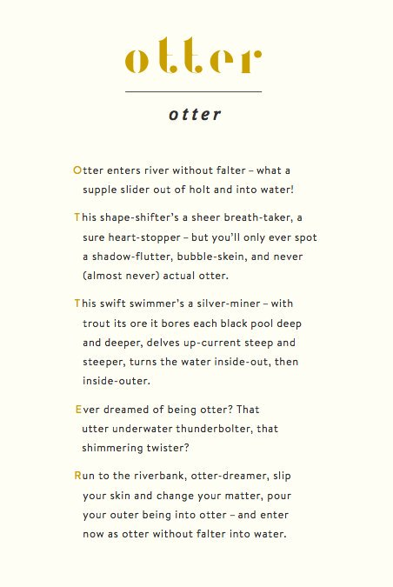
Let us read the poem.
Highlight the verbs.
What does this suggest about the otter?
What do the stanzas imply about the movement of the otter?
What other language devices can you identify?
What do you notice about the structure of the poem; first and last lines.
Using the question root, answer in full sentences.

Slide 7
You can choose your style; poem, descriptive or narrative writing.
Writing task
‘Ever dreamed of being…’
Which creature would you like to shape-shift into?
Make a collection of verbs, adverbs, similes and metaphors that you would relate to your chosen animal.
Visualise shifting and describe in detail how you change shape.

Slide 8
Resources

Slide 9
Resources

Slide 10
Arrow of Progress
Discovering
Developing
Securing
Mastering
Learning Objectives:
Knowledge and Understanding (MUST): To... Identify key words specific to movements Application and Analysis (STRETCH): To... Demonstrate how vocabulary can create specific effects and meanings Evaluation and Creativity (CHALLENGE): To... Compose a script between two animals making an observations about their appearance
Key Word:
Synonyms

Slide 11
The Lost Words
Lesson Two

Slide 12
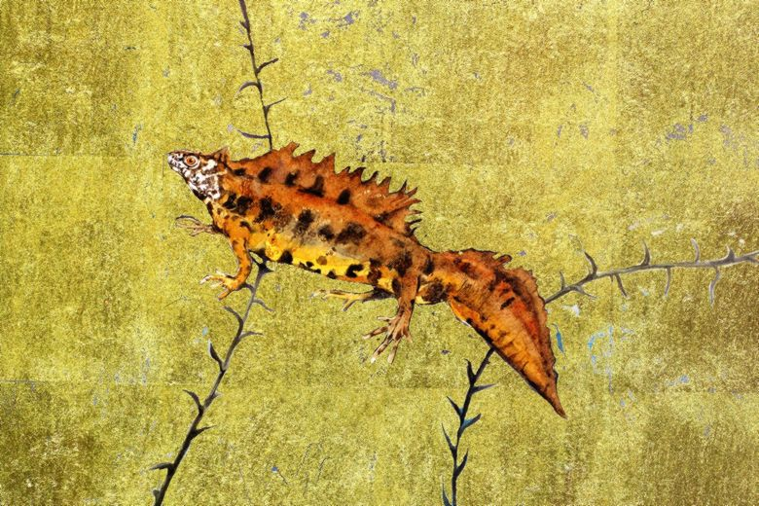
What type of animal is this?
Notes:
A newt is from the Salamander family and considered an amphibian
There are 3 species of newt specific to the UK; great crested, palmate and smooth

Slide 13
What class of animals does this one belong to?
Which different kinds can be found in the United Kingdom?
Judging from the outline, which sort do you think this is?
What sort of plant do you think is in this picture?
https://www.youtube.com/watch?v=r_aJlGJq7uk

Slide 14
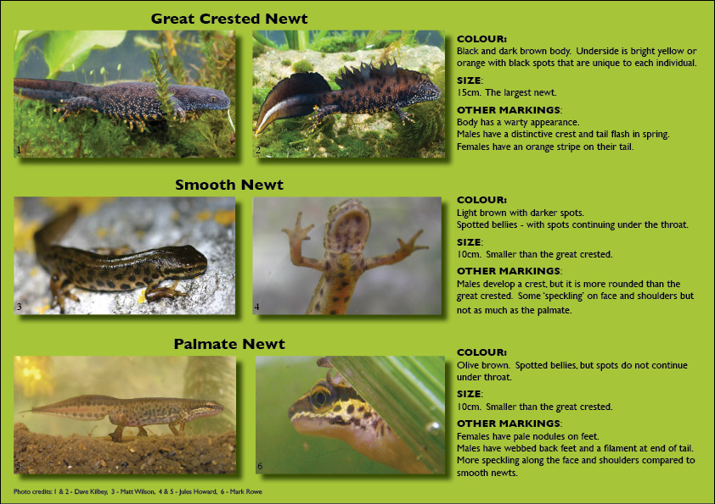

Slide 15
What do these words suggest about the poem we are going to read?
Be prepared to offer an answer if you are asked!
Wonder words;
What do these mean?
◆ emoted –
◆ coot –
◆ unhirsute –
◆ unastute –
◆ disrepute –

Slide 16
Wonder words;
◆ emoted – to portray an emotions in a theatrical way
◆ coot –an aquatic bird with black plumage
◆ unhirsute –lacking hair, bald.
◆ unastute –not having the ability to assess a situation
◆ disrepute – being held in low esteem by the public
What do these words suggest about the poem we are going to read?
Use the sentence starter to answer the question.
These wonder words relate to a newt. These words suggest……………..

Slide 17
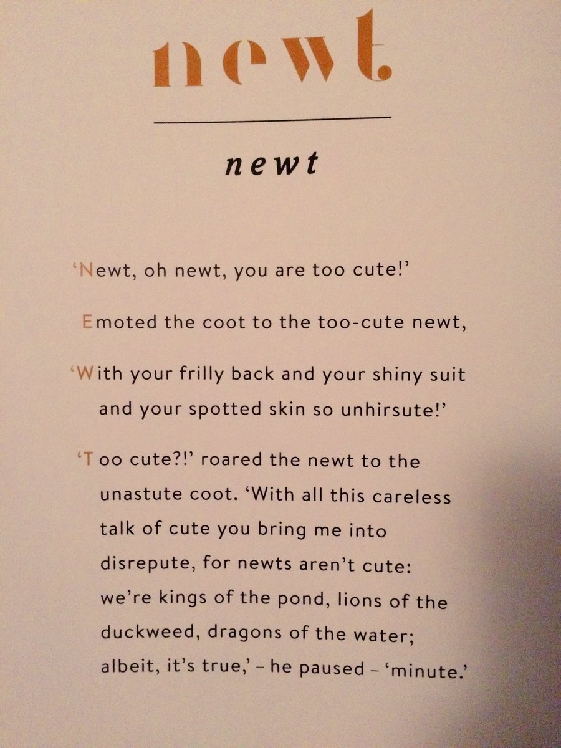
Can you find any synonyms
and antonyms?
Try using them
with a partner by creating different sentences.
Seek, find, speak
What techniques has the
writer used?
What sort of effect is created?
What other words rhyme
with coot?
Read the poem…

Slide 18
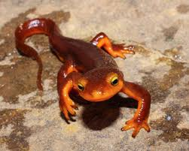
What do you think about my ideas of kings, lions and dragons?
How do you think I feel?
Explain.
I have used synonyms and antonyms in my poem.
Can you spot them?
Why do you think I pause at the end of poem?
Why have I used antonyms and synonyms?

Slide 19
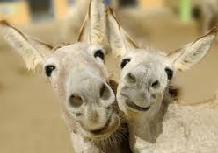
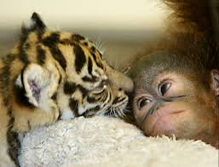
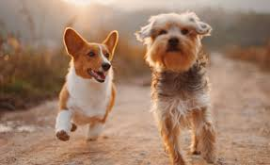
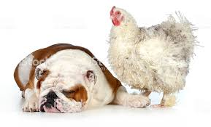
Writing challenge
Choose two creatures that can have a conversation with each other.
One needs to comment on the other’s character and appearance.
Decide how they will be answered
and write it up as a short play
script.

Slide 20
Read out your work to someone at home and get them to make a comment at the end of it

Slide 21
Resources

Slide 22
Arrow of Progress
Discovering
Developing
Securing
Mastering
Learning Objectives:
Knowledge and Understanding (MUST): To... Identify key information relating to an object Application and Analysis (STRETCH): To... Present key vocabulary in a logical order Evaluation and Creativity (CHALLENGE): To... Evaluate how meaning is conveyed through the poem, Willow
Key Word:
Synonyms

Slide 23
The Lost Words
Lesson Three - six

Slide 24
What is a Willow?
What does it look like? Do a quick sketch in your book.
Where do you usually find one?
You might know this one!
https://www.youtube.com/watch?v=Lhi1bOuIj0E

Slide 25
Read the information on slides 5 and 6.
Using a minimum of 10 facts from the leaflet
Create a leaflet about the qualities of the willow tree
Notes:
This task should take at least 20 minutes – do not rush the reading especially as this is the first time they will have done it – the goal for this task is identifying the key words that the students can hear – and ask them to explain why they have selected the information they have.
This links the NLT ideas of Dictogloss – demonstrates how S&L supports development of writing through oral rehearsal. This is supportive developing EAL and weaker learners who may not be able to produce extended writing alone.

Slide 26
Notes:
This task should take at least 20 minutes – do not rush the reading especially as this is the first time they will have done it – the goal for this task is identifying the key words that the students can hear – and ask them to explain why they have selected the information they have.
This links the NLT ideas of Dictogloss – demonstrates how S&L supports development of writing through oral rehearsal. This is supportive developing EAL and weaker learners who may not be able to produce extended writing alone.

Slide 27
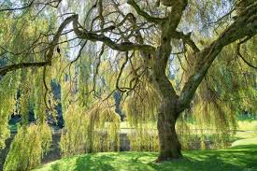
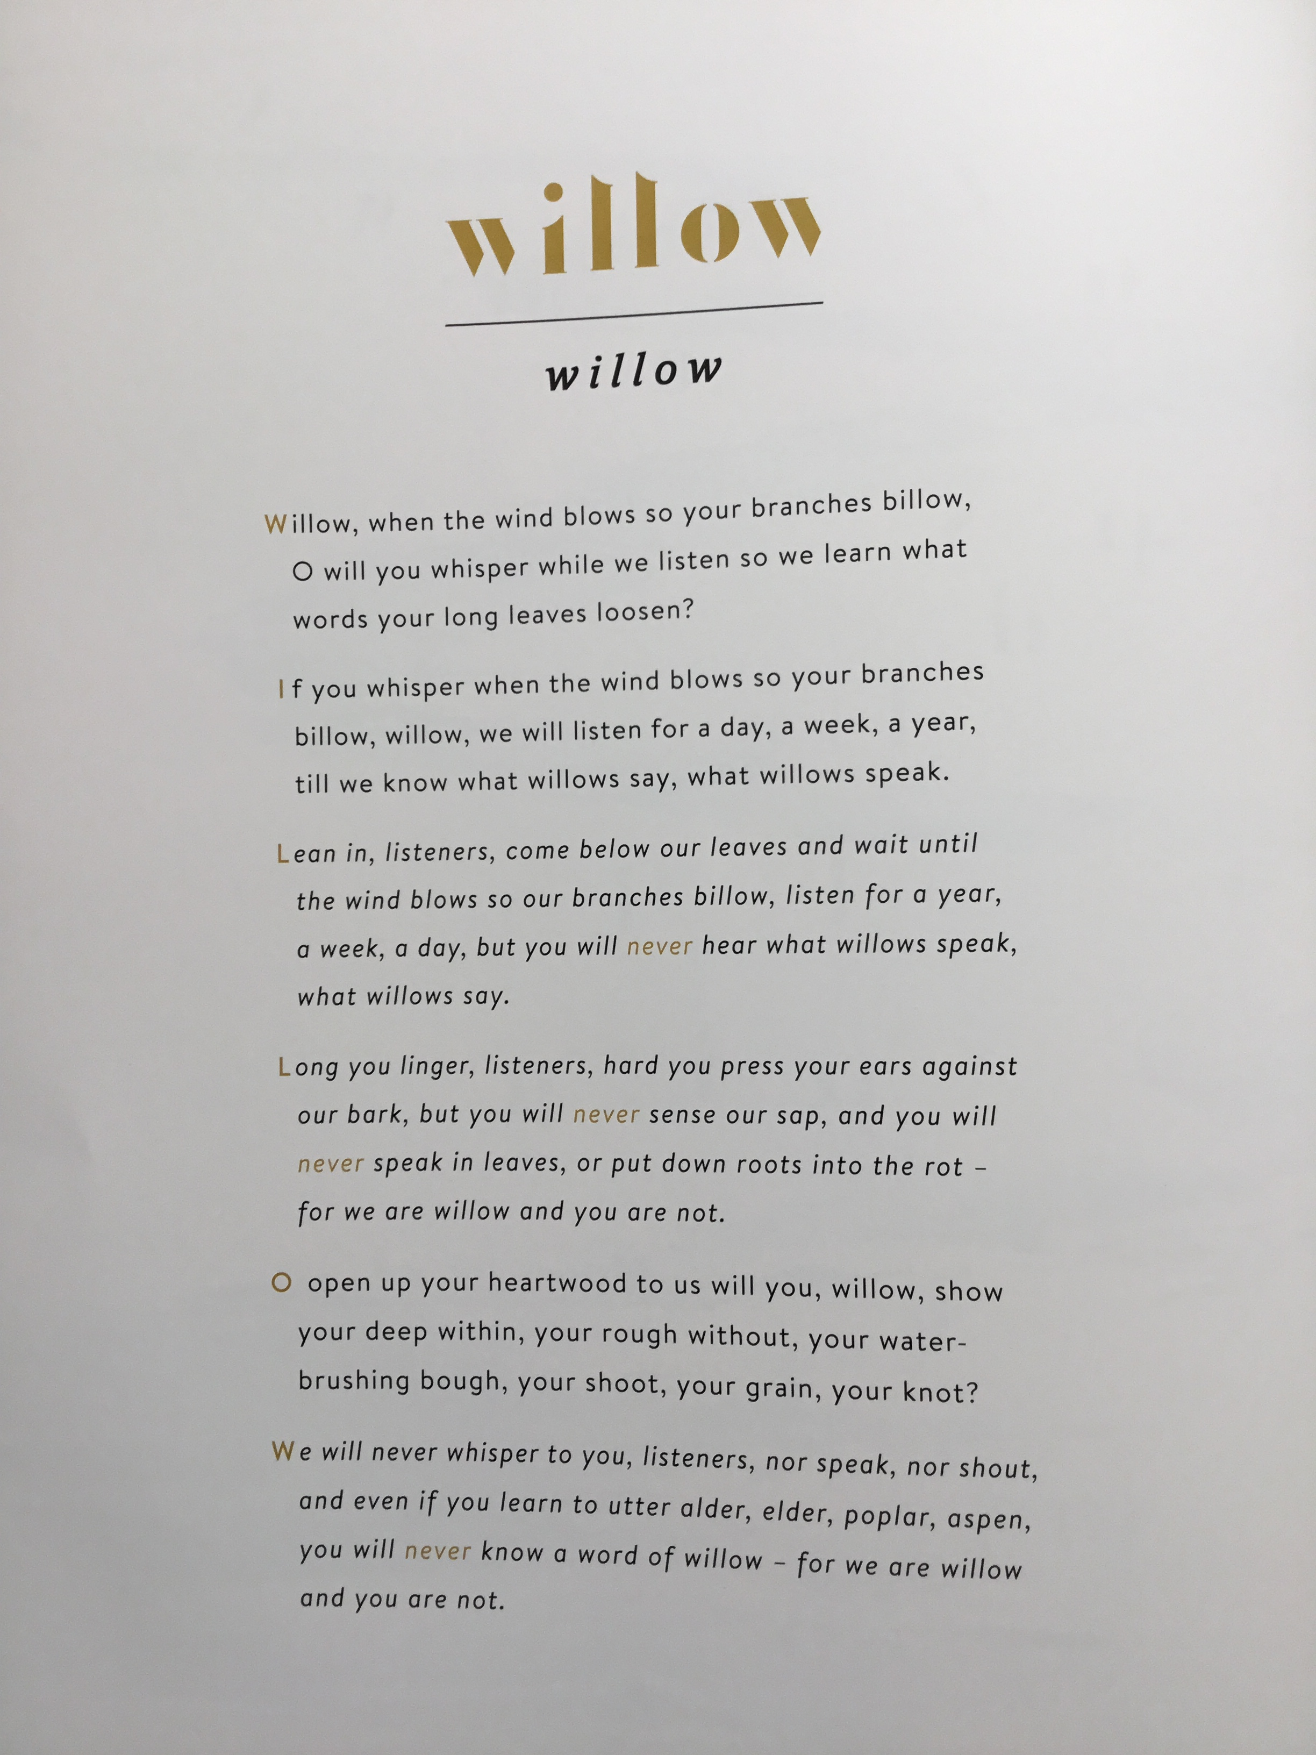
Willow
Read the poem
Wonder words
What do these mean?
◆ billow
◆ heartwood
◆ bough
◆ grain
◆ knot
Find two synonyms for each of these words.

Slide 28
Willow
What is the poet trying to tell us about the tree?
In no more than 50 words, write a response to this question
Wonder words
What do these mean?
◆ billow – A rolling mass that resembles a high wave
◆ heartwood – the dense inner part of a tree trunk, yielding the hardest timber
◆ bough – main branch of a tree
◆ grain – textures of the tree produced by fibres of a growing tree
◆ knot – visible imperfections in a wood grain

Slide 29
What do you think this poem is about?
What other trees are mentioned in the final stanza.
Describe the shapes of the trees and the leaves using quotes?
How has the poet done this? (language device)
What characters do these trees suggest to you? Be prepared to explain!
What secrets do you think the different trees might possess?
Read the poem again, this time your understanding of the poem needs to deepen.

Slide 30
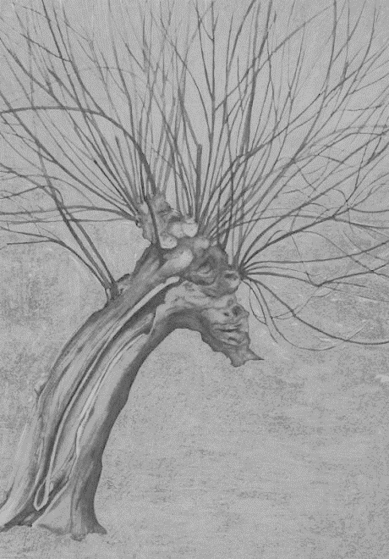
Over to you!
Look at the poem, Willow again.
You are going to annotate the poem to identify the following:
What makes this poem a spell? (look at rhyme and rhythm of the lines)
Who is speaking in this spell?
Identify the language techniques the writer has used?
What does the poem suggest about the character of willow?
Do you think trees can communicate?
Explain.
What questions might you ask of willow?
20 minutes
End
Notes:
[Question and answer, alliteration, internal and end rhymes,
repetition]

Slide 31
How does the poet present the feelings and attitudes of the willow tree?
S The way that the poet shows…
S The tone of the poem is…
S The poet has chosen the compare the city to the jungle because
S The structure of the poem suggests…
Q This is seen in the quote…
Q For example…
Q This is clear in the stanzas…
Q This is seen when poet refers to…
A The quote suggests…
A The writer wants the reader to
…
A The reader infers from this that…
A This makes the audience think/feel…because…
D The use of the word(s) ‘_______’ is significant because…
D Notably, the word(s) ‘_______’ suggest…
D Furthermore, the word ‘_______’ is used to…

Slide 32
How does the poet present the feelings and attitudes of the willow tree? PEER ASSESS
S The way that the poet shows…
S The tone of the poem is…
S The poet has chosen the compare the city to the jungle because
S The structure of the poem suggests…
Q This is seen in the quote…
Q For example…
Q This is clear in the stanzas…
Q This is seen when poet refers to…
A The quote suggests…
A The writer wants the reader to
…
A The reader infers from this that…
A This makes the audience think/feel…because…
D The use of the word(s) ‘_______’ is significant because…
D Notably, the word(s) ‘_______’ suggest…
D Furthermore, the word ‘_______’ is used to…
Identify where the following has been used:
Using the sentence starter worksheet and the codes down the side, identify where the work incudes:
Statement
Quote
Understanding the purpose of the poem
Analysis of effect on reader
Define how this has been achieved using language device
WWW:
EBI:

Slide 33
Arrow of Progress
Discovering
Developing
Securing
Mastering
Learning Objectives:
Knowledge and Understanding (MUST): To... Understand how meanings can be conveyed through stories from around the world. Application and Analysis (STRETCH): To... Break down meanings by identifying the language devices used. Evaluation and Creativity (CHALLENGE): To... Compare and contrast different texts and develop and informed response.
Key Word:
Synonyms

Slide 34
The Lost Words
Lesson seven - ten

Slide 35
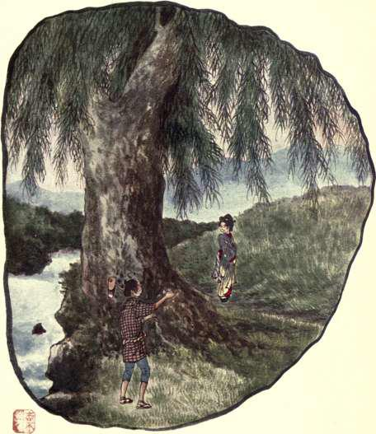
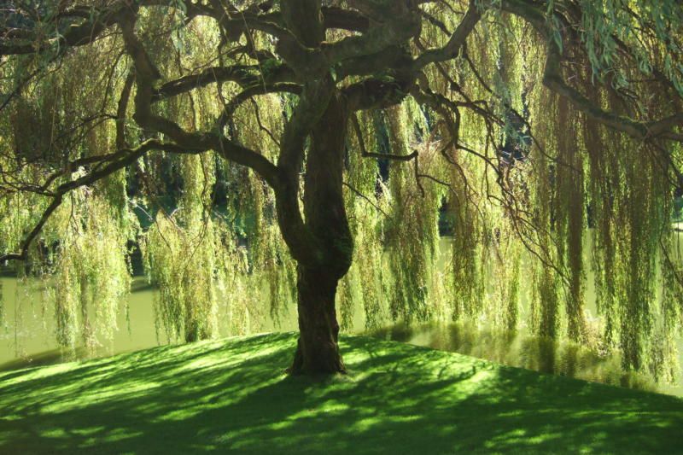
Writing challenge
Having seen how a poem can imply different meanings by using various structural and language features, you are now going to see how these messages are conveyed in different cultures and styles of writing.
The Willow Wife
Spirit of the Willow
The Willow Story
Notes:
Depending on your group – decide which Japanese fable you choose; Willow Wife or Spirit of the Willow Tree. You will also present them with the story of the Willow from the Scottish Forestry,

Slide 36
Which was your favourite story?
Why?
How was the story structured.
What language devices were used and why were they effective.
What image did it create in your mind.
Draw it!
Task 1
The Willow Wife
Spirit of the Willow
The Willow Story
Notes:
Depending on your group – decide which Japanese fable you choose; Willow Wife or Spirit of the Willow Tree. You will also present them with the story of the Willow from the Scottish Forestry,

Slide 37
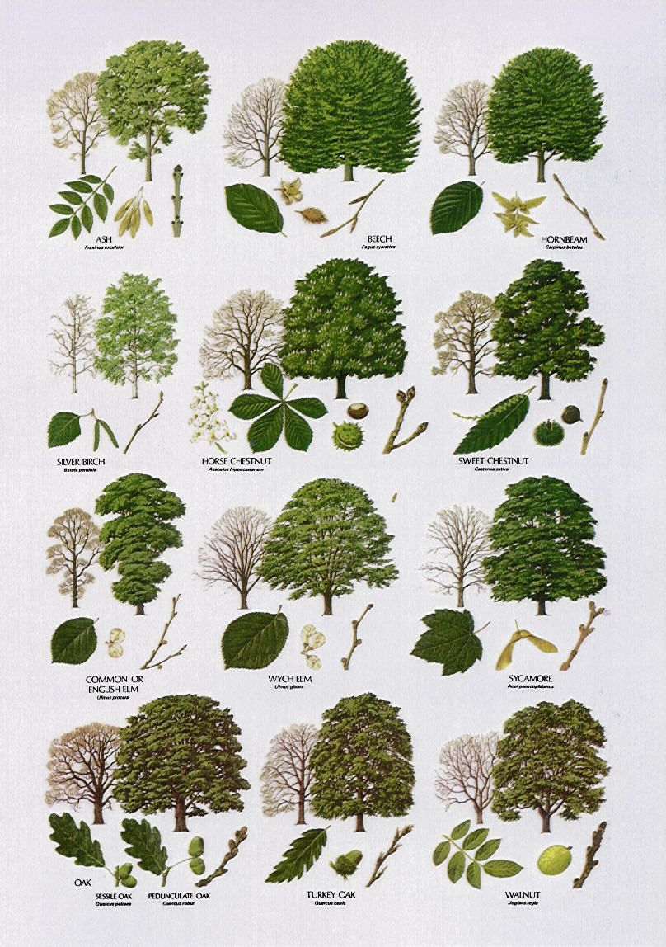
Choose a tree from the list on p16 of your booklet.
Consider and mindmap the following:
Think about where your tree is growing; country, climate, season, vicinity, use
What it might see and experience
Which creatures visit
What is the purpose of your tree
You can choose to write a spell, poem or story:
You could write the spell in the shape of the tree or its leaves or from a mystical stance.
Poem describing what you see and hear beneath you leaves; your experiences through seasons; effects on climate change.
Story in first person, descriptive and involving other animals that live on you, so use of dialogue.
Think about alliteration, rhythm, internal and end rhymes.
You must use at least three different language devices identified in previous lessons.
Paragraphs / stanzas
Task 2
Planning

Slide 38
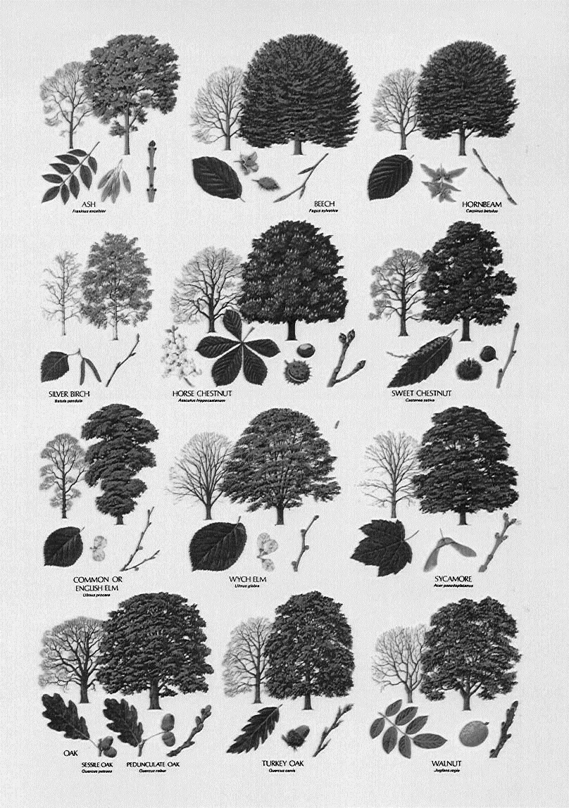
Task 3 writing
Extended writing:
Based on your plan, you are now going to write up your poem, spell or story
Think about alliteration, rhythm, internal and end rhymes.
You must use at least three different language devices identified in previous lessons.
Look at your knowledge organiser – what other features can you use.
Use some creative vocabulary, so refer to the synonyms and antonyms we have been looking at.
Check spelling and punctuation – use a dictionary or ask for help if you need to.
Vary punctuation: ‘
,
!
”…”
// -
40 minutes

