Slide 1
Title: What is weather and climate?
Lesson objectives.
To know the difference between the terms Weather and Climate.
Understand how latitude affects Climate.
Understand how Altitude affects climate.
Understand what the climate of the UK is like.
1. Use a dictionary to find out the meaning of the following words.
Weather
Meteorology
Climate
Altitude
Maritime climate
Continental climate
is the local day to day changes in the atmosphere, including temperature, rainfall and wind.
is the study of the weather.
is the average weather conditions for a place over a large area.
means the height above sea level, usually measured in metres.
means a climate mostly influenced by the sea/ocean.
means a climate mostly influenced by the land.

Slide 2
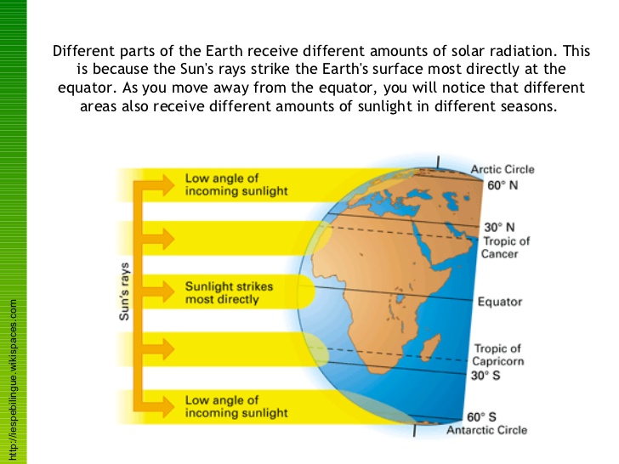
Why is it hotter at the Equator than at the Poles?
2. Use the following diagram to explain why it is hotter at the equator than at the Poles.
At the equator the sunlight is at its most intense because the Sun is mostly overhead. At the Poles sunlight strikes the Earth at an angle and is therefore spread out over a larger area, making the Sun`s radiation less intense.

Slide 3
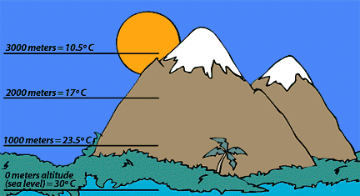
Use the following diagram to describe the effect of altitude on temperature .
Why does it get colder the higher up you go?
3. Use the following diagrams to explain why it is colder the higher up you go.
Low air pressure.
3. The air is thin so there are less modules in the air to retain heat.
1. Air molecules
2. Earth's atmosphere is about 300 miles thick, but most of it is within10 miles the surface.
High air pressure.
5. The air is dense so there are more modules in the air to retain heat.
Gravity
4. At sea level, air pressure 1 kilogram per square cm.
At sea level you have about 14 pounds per square inch of air pressure pushing down on you. This high air pressure means the air is dense and can retain heat, so it is warm.
High up in the atmosphere air pressure drops, the air becomes less dense and can not hold on to heat, so it is cold.

Slide 4
What is Britain`s weather like?
Mild summers and winters. Wet.
Mild summers and cold winters. Dry.
Warm summers and cold winters. Dry.
Warm summers and mild winters. Wet.
Prevailing wind

Slide 5
What can Climate graphs tell us?
What do the letters along the x-axis (the bottom of the graph) represent?
What do you think the RED line means?
What do you think the BLUE bars are showing?
Where in the British Isles are Fort William and Margate?
Looking at the information, which location is further North?
How can you tell?
Fort William,
Margate,

Slide 6
Title: What is Britain`s weather like?
Label the following places on the UK map.
Penzance Fort William Margate Aberdeen
2. Label the Atlantic Ocean.
3. Label the arrow `Prevailing wind`.
4. Write the correct description next to each of the graphs
Mild summers and cold winters. Dry.
Mild summers and winters. Wet.
Warm summers and cold winters. Dry.
Warm summers and mild winters. Wet.
5. Draw and complete this table.
6. Explain why Aberdeen has lower
temperatures than Margate.
Temperature | January | August
Aberdeen
Margate
7. Draw and complete these tables.
8. Explain why the west of Britain
has more rainfall than the east.
Total Rainfall | Fort William | Aberdeen | Difference
mm
Total Rainfall | Penzance | Margate | Difference
mm

Slide 7
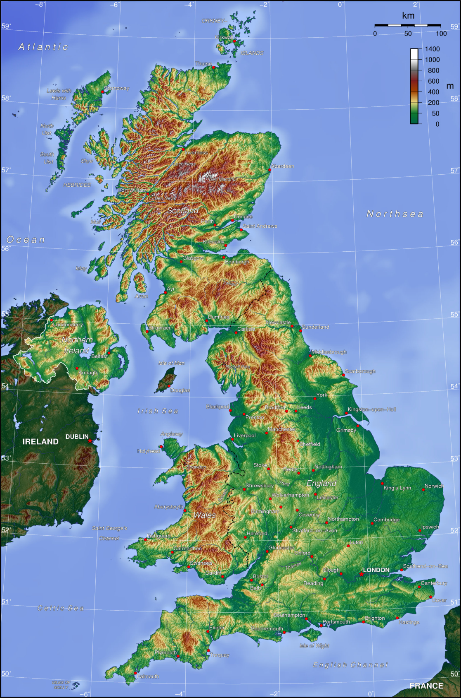

Slide 8
What is Britain`s weather like?
Mild summers and winters. Wet.
Mild summers and cold winters. Dry.
Aberdeen
Fort William
Warm summers and mild winters. Wet.
Margate
Penzance
Warm summers and cold winters. Dry.
Atlantic Ocean
Prevailing wind

Slide 9
Why does the west of Britain get more rain than the east?
Total Rainfall | Fort William | Aberdeen | Difference
mm | 2020 | 640 | 1380
Prevailing wind from the south west brings moisture from the Atlantic Ocean. This air is forced to rise above the hills and mountains in the west of Britain, resulting in relief rainfall. As the air continues to travel eastwards it passes over lower land so it sinks back down, resulting in less rainfall .
DRY
WET
Total Rainfall | Penzance | Margate | Difference
mm | 1050 | 540 | 510
Prevailing wind
Atlantic Ocean

Slide 10
Why is Margate warmer than Aberdeen?
Temperature | January | August
Aberdeen | 3 | 15
The curvature of the Earth spreads out the sunshine the Earth receives over a larger area in the north than in the south.
Therefore, Aberdeen, which is located further north than Margate, receives less intense sunshine and has cooler temperatures.
Atlantic Ocean
Temperature | January | August
Margate | 5 | 18
Prevailing wind

Slide 11
Watch this YouTube video….
What are the three types of rainfall?
What are the 3 types of rainfall?
Describe how all three cause rain, use diagrams in your explanation?
What do they all have in common, what do they make clouds do?
Which type effects the British Isles the most?
FRONTAL PRECIPITATION (rainfall)
CONVECTIONAL PRECIPITATION (rainfall)
RELIEF PRECIPITATION (rainfall)

Slide 12
Title: What is weather and climate?
What does Weather mean?
2. What does Climate mean?
3. What happens to temperature the further from the equator you travel?
4. What happens to temperature the higher up you go?
5. Which part of the UK has the Warmest and wettest climate?
6. Which part of the UK has the coolest and driest climate?
7. Which part of the UK has the warmest and driest climate?
How do the following three factors effect the UK`s climate?
8. Latitude
9. Prevailing wind
10. Relief (Shape of the land)

Slide 13
Recap: What is weather and climate?
What does Weather mean?
2. What does Climate mean?
3. What happens to temperature the further from the equator you travel?
4. What happens to temperature the higher up you go?
5. Which part of the UK has the Warmest and wettest climate?
6. Which part of the UK has the coolest and driest climate?
7. Which part of the UK has the warmest and driest climate?
How do the following three factors effect the UK`s climate?
8. Latitude
9. Prevailing wind
10. Relief (Shape of the land)
The day to day changes in the atmosphere over a small area
The average weather conditions over a long time and large area.
Temperature decreases the further from the equator you travel.
Temperature decreases the higher up in the atmosphere you go.
The south west
The north east
The south east
The UK is about half way between the equator and the North Pole and it therefore has a moderate climate, not too hot or too cold.
The south west prevailing wind brings moisture from the Atlantic Ocean. Although this brings us rain, it also warms the climate in the winter and cools the climate in the summer.
The hills and mountains in the west of the UK force the air to rise, this results in more rainfall in the west of the UK than in the east.

