Slide 1
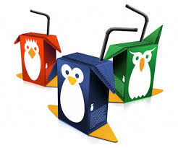
KS3 Packaging Project

Slide 2
Lesson Aims:
• To use the correct equipment at all times.
• To be aware of the need to understand a design brief and
what is expected of me.
By the end of the lesson:
• All will have completed the tasks that are set taking
care to be neat and tidy at all times
• Most should have worked accurately at all times.
• Some will pay attention to the quality of finish at all times.

Slide 3
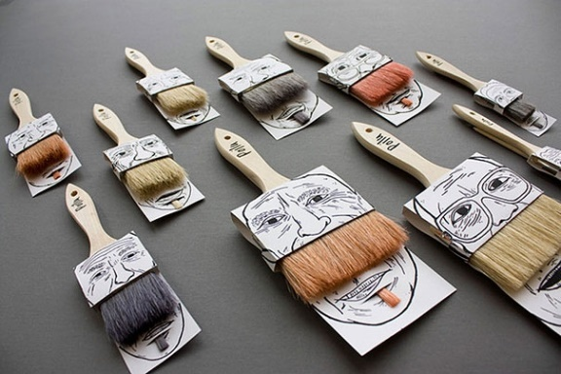
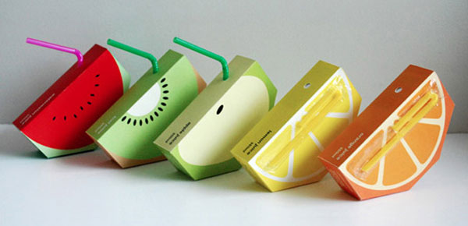
Why do we need packaging?
Packaging is used everyday and all around us.
Why is packaging such an important thing?
List on paper all the reasons we need packaging.
What kind of materials might be used in
Packaging and why?
Bonus work: What is the environmental impact of packaging?
Literacy

Slide 4
Task 1 : Why do we need packaging?
• Using the information that we have talked about and collected start to create a mind map with the word 'packaging' at the centre.
Here are some sub headings to start you off.
Materials
Purpose
Manufacture (how it's made)
Safety
Environmental impact
15 minutes
End

Slide 5
The BRIEF!
• Grantham Sainsburys are about to launch a new range of fruit drinks for children aged between 5 and 10 (primary school age). The want the packaging to be playful, fun and be based on a theme e.g A certain cartoon, sport of public festival such as Christmas or Easter.
The drinks carton must include the following information:
A catchy name for the product
An image that is relevant to the theme
A barcode
A price
A list of basic ingredients / flavour
Using the skills you have gained from the last project, make sure that you include some high quality rendering and either an isometric element or a perspective element. So for example, you could design the name of the product in isometric form or you could draw an image on the product that is in one or two point perspective.

Slide 6
Task 2 : Research.
• We need to now start to look at some research
Why is research important?
What type of research do we need to do? Questionnaires? Looking at products allready being sold? List on paper as many different types of research you can think of.
you need to collect as many images as you can that relate to packaging and fill your page with them and any key information that you think is needed.
KEEP IT NEAT AND TIDY!!!!
20 minutes
End

Slide 7
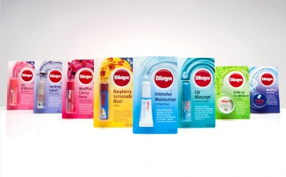
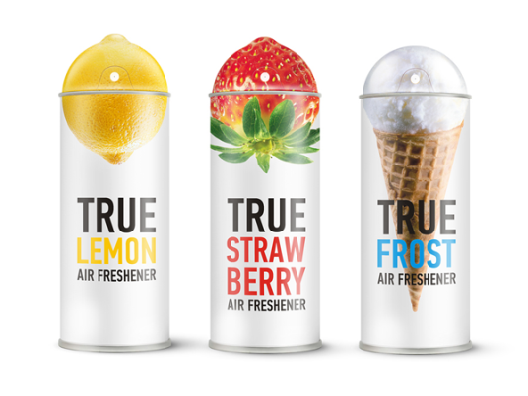
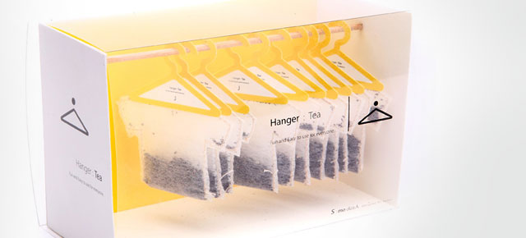
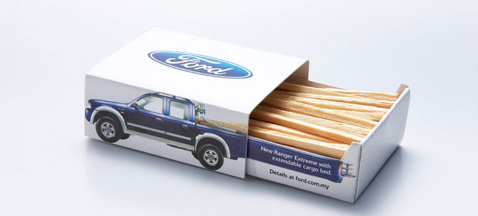
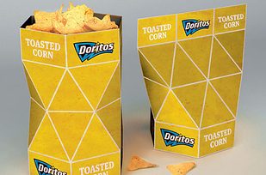
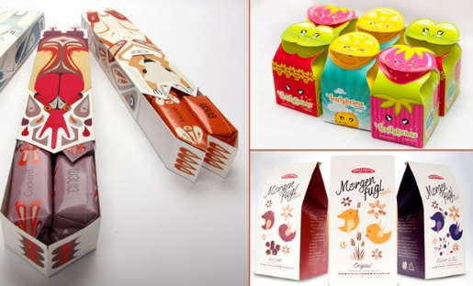
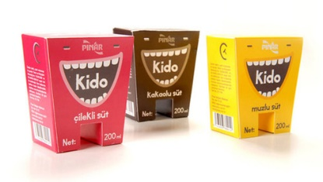
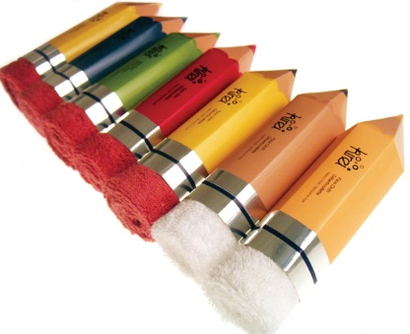
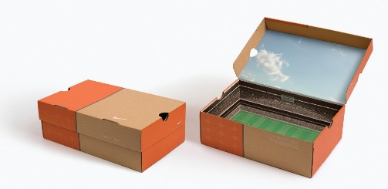
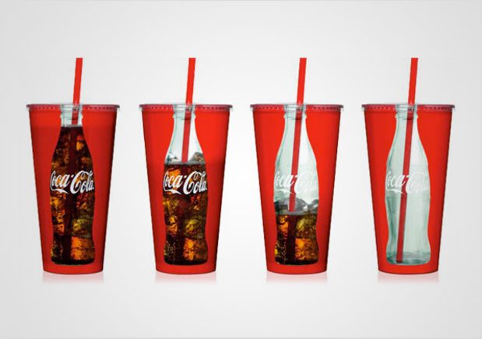
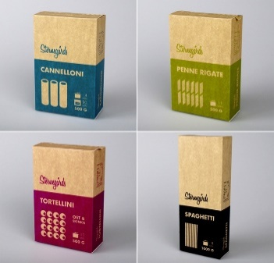
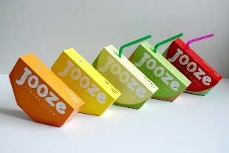
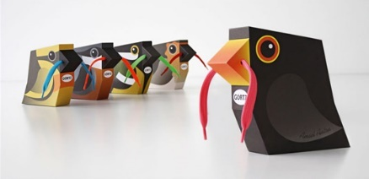

Slide 8
What have we learnt? :
Who can tell me why we need to use packaging?
What is the purpose of good packaging?
What is a design brief and why is it important?

Slide 9
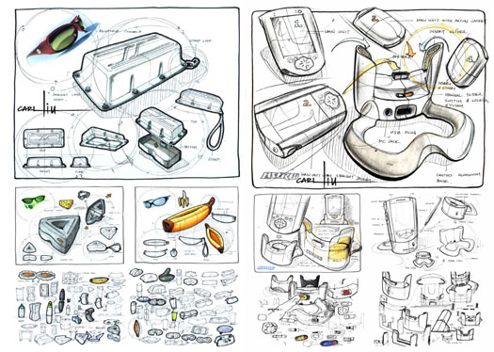
What will we learn next week? :
How to create design ideas.

