Slide 1
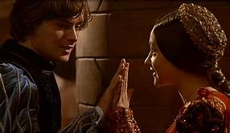
Romeo and Juliet Act 2 Act 3 and Act 4
Two weeks of work

Slide 2
Objectives
Lesson One
Outcomes
To be able to recite the different themes – make flashcards
To be able to write down different areas of form
To be able to bullet point the plot of the play
To revisit and understand the plot
To Learn the themes and identify them in the text
To research different areas of form and learn

Slide 3
WOOSH!
Read the Woosh of Romeo and Juliet to refresh your memory of the play.

Slide 4
Romeo and Juliet: WHOOSH!
Once upon a time in the city of Verona, there were two great families: the Capulets and the Montagues. On one side of the city lived Lord Capulet, who was rich and powerful.
He lived with his wife Lady Capulet, who always stood by her man, and they had an only child – a daughter, Juliet, who was fourteen. Like most wealthy young girls of the time, Juliet spent most of her time at home, under the watchful eye of her parents, BUT the person she learnt most about the world from was her Nurse. The Nurse loved Juliet with all her heart: she had worked for the Capulets since Juliet was born, and she was more like a mum to Juliet than Lady Capulet was. These two whispered their secrets to each other and were the best of friends. The Capulets also had a nephew called Tybalt of whom they were very fond, despite his bad temper.
On the other side of town were Lord and Lady Montague and their son Romeo.
Romeo was a lover, not a fighter. He sighed, and he dreamed of perfect love, and the only thing that could distract Romeo from romance were his mates, Benvolio and Mercutio, the lads. Verona’s finest, they strutted around the streets together.
For as long as anyone could remember, the Capulets and the Montagues had hated one another. They scowled and shook their fists at each other. No-one knew what it was about, but the feud was deep and bitter.
WHOOSH!
One day this ancient grudge broke to new mutiny. A gang of Capulets and a gang of Montagues faced each other in the street. The Capulets shouted, ‘Down with the Montagues’ and the Montagues shouted, ‘Down with the Capulets!’ and they bit their thumbs at each other, which was the worst insult that you can imagine. And then they all drew out their swords, and cried, ‘Cowards!’.
Luckily, at that moment Prince Escalus arrived – he was in charge of law and order in the city. So, when he raised his hand, the street fell silent. As he walked between the warring families he declared, ‘If ever you disturb our streets again, your lives shall pay the forfeit of the peace … On pain of death, all men depart!’
WHOOSH!

Slide 5
Meanwhile, the Montagues were worried about their son Romeo. He was depressed and moody, so they called on his cousin Benvolio to find out what the matter was, then hastily moved to a discreet distance and waited to find out what Benvolio could discover.
Benvolio tried to cheer Romeo up, but Romeo was in love with a girl called Rosaline, who had sworn to become a nun. There was no way she was ever going to return Romeo’s love. She would continue to turn her back on him. Benvolio said, ‘Be ruled by me; forget to think of her!’ but Romeo simply shook his head and said, ‘O, teach me how I should forget to think.’ And with a hand on his heart, and another on his brow,
he wandered off.
WHOOSH!
Love and marriage were also in the thoughts of Verona’s most eligible young bachelor, Paris. He was very rich, and he was Prince Escalus’ nephew, so as he walked around the streets every young woman tried to catch his eye. But Paris made a deal with Lord Capulet. When Juliet was old enough she would be Paris’ wife. They shook hands on this arrangement, and then Lord Capulet decided that he would throw a great big party where Paris and Juliet could be introduced. He sent for a servant, Peter, and gave him a long list of guests to invite.
Off Peter set to deliver the invitations. He turned the list one way and then the other, but he could not read, so he went out all around Verona, giving invitations to everyone. EVEN Romeo and his mates Benvolio and Mercutio got invited by mistake.
WHOOSH!
At the Capulets’ house, Juliet was getting ready for the big night helped by her Nurse.
In came her mother, Lady Capulet, who announced, ‘The County Paris seeks you for his love!’ The Nurse was delighted but Juliet shrugged. She would wait to see what this Paris was like. In came Lord Capulet striding around the room, hosting the party, and welcoming the guest of honour, Paris. Paris approached Juliet and bowed, she curtsied and away they danced around the room. Meanwhile Tybalt, Juliet’s cousin, acted as bouncer: he kept a close eye on everything, one hand on his sword. Things were going very well, until Romeo, Benvolio and Mercutio entered the party in disguise.

Slide 6
Tybalt recognised Romeo and drew out his sword, but Lord Capulet calmed him down, not wanting anything to spoil his daughter’s big night. Across the crowded room, Romeo and Juliet spotted each other. They fell instantly in love, and moved towards each other.
Their fingertips touched, and Romeo bent to kiss Juliet’s hand. But suddenly, the Nurse was at Juliet’s side, pulling her away, and Benvolio pulled Romeo away. The party was over.
WHOOSH!
But … Romeo did not go home. Instead, he found his way to Juliet’s bedroom window. High above him was a balcony. Soon, Juliet appeared and called out, ‘O Romeo, Romeo, wherefore art thou Romeo?’ Romeo climbed up the balcony, went down on one knee and asked Juliet for ‘The exchange of thy love’s faithful vow for mine.’
Juliet, overjoyed, cried, ‘If that thy bent of love be honourable, thy purpose marriage, I’ll follow thee my lord throughout the world.’
WHOOSH!
Next morning Romeo rushed to see his friend, the local priest, Friar Laurence. He begged the Friar to perform a secret wedding ceremony and the Friar, hoping that this might bring peace between the Montagues and Capulets, agreed. The wedding was on.
Juliet and the Nurse sneaked out of the Capulet house, through the streets of Verona to the church, then Juliet knelt with Romeo in front of the Friar, with the Nurse acting as best woman. The Friar blessed their marriage, the nurse threw confetti, and the deed was done. Romeo and Juliet were married.
WHOOSH!
Later, on the streets of Verona, tensions were running high. Benvolio and Mercutio were out and about. It was hot and sticky and Benvolio could see that trouble was brewing. He said to Mercutio, ‘The day is hot, the Capulets abroad, / And if we meet we shall not scape a brawl, / For now is the mad blood stirring.’
Sure enough, along came Tybalt with his gang from one direction, and Romeo from another. Tybalt, still angry that Romeo had gatecrashed the party, drew his sword and challenged Romeo, saying, ‘I hate hell, all Montagues, and thee!’. But Romeo held out his hands in peace, and would not fight. Mercutio couldn’t stand by and see his friend Romeo insulted, so he drew out his sword, and fought with Tybalt. Romeo tried
desperately to stop them, but as he jumped in between them, Tybalt stabbed Mercutio under Romeo’s arm, and Mercutio fell to the floor. Romeo desperately tried to help his friend but Mercutio, with his last breath, said, ‘A plague on both your houses!’ and died!

Slide 7
Romeo leapt up with fury burning in his heart. Now he faced Tybalt and drew out his sword. Back and forth they parried, until Romeo stabbed Tybalt right through the heart and Tybalt fell to the floor, dead. There was a moment of disbelieving silence, then Romeo ran away. Just at that moment, in came Prince Escalus with his police officers. The officers took hold of all the young men. In ran Lord and Lady Capulet and Lord and Lady Montague. They gasped in horror when they saw the bodies of Mercutio and Tybalt. Lady Capulet turned to the Prince and cried bitterly, ‘I beg for justice, which thou, Prince, must give! Romeo slew Tybalt, Romeo must not live!’ But Benvolio fell on his knees and told the Prince what had happened, and the Prince, hearing how Romeo had tried not to fight, was merciful. He declared, ‘For that offence, immediately we do exile him hence.’ Lady Montague was so upset at the thought of never seeing her son again, she died of grief.
WHOOSH!
Back at Juliet’s house, Juliet was pacing up and down in her room, waiting for Romeo, when in came the Nurse with the terrible news: ‘Tybalt is killed, and Romeo is banished.’ Juliet was horrified: she wept, then sent the Nurse to find Romeo. The nurse went straight to Friar Laurence and found Romeo. Once again, in secret, the Friar and the Nurse arranged for Romeo to climb up to Juliet’s window. (Ssh!) Then they tiptoed away, leaving Romeo and Juliet to enjoy their wedding night.
WHOOSH!
Next morning, Romeo and Juliet were lying in each other’s arms, saying a last tearful goodbye, when there was a knock at the door. Romeo leapt up, climbed out through the window and down the balcony as quickly as he could, and ran off to exile in Mantua. In burst Lady Capulet and the Nurse. Lady Capulet pulled her daughter to her feet, dried her tears and told her that it had been arranged for her to marry Paris next Thursday.
continued
Juliet stamped her foot and said ‘No!’ but then in came her father, Lord Capulet. When he heard that Juliet had refused Paris, he was incredibly angry. He went up to Juliet, as close as he could, and jabbed a finger into her face, warning her: ‘An you be mine, I’ll give you to my friend. An you be not, hang, beg, starve, die in the streets!’ Then he stormed out, closely followed by Lady Capulet and the Nurse.
Juliet was alone. She went to see the Friar, who came up with a cunning plan. Into a little bottle, he put a pinch of herbs. He gave it a shake and handed it to Juliet. It was a sleeping potion that was so strong, it would make her appear dead. The Friar wrote a letter to Romeo explaining the plan and asking him to come and take Juliet away to Mantua. The Friar then gave the letter to another priest to take to Romeo in Mantua.
WHOOSH!

Slide 8
That night, Juliet went to her bedroom alone. She took out the bottle, swigged the sleeping potion and fell, as if dead, to the floor. Next morning, the day of the wedding, the Nurse came to wake the bride-to-be. She shook Juliet gently, then more vigorously, but she could not wake her and cried ‘O woeful day!’ In came Lady Capulet, Paris, Lord Capulet and the Friar. They gasped, and shook Juliet, but no one could wake her. She was surely dead! So, they lifted her up to take her to her funeral.
WHOOSH!
Romeo leapt up with fury burning in his heart. Now he faced Tybalt and drew out his sword. Back and forth they parried, until Romeo stabbed Tybalt right through the heart and Tybalt fell to the floor, dead. There was a moment of disbelieving silence, then Romeo ran away. Just at that moment, in came Prince Escalus with his police officers. The officers took hold of all the young men. In ran Lord and Lady Capulet and Lord and Lady Montague. They gasped in horror when they saw the bodies of Mercutio and Tybalt. Lady Capulet turned to the Prince and cried bitterly, ‘I beg for justice, which thou, Prince, must give! Romeo slew Tybalt, Romeo must not live!’ But Benvolio fell on his knees and told the Prince what had happened, and the Prince, hearing how Romeo had tried not to fight, was merciful. He declared, ‘For that offence, immediately we do exile him hence.’ Lady Montague was so upset at the thought of never seeing her son again, she died of grief.
WHOOSH!
Back at Juliet’s house, Juliet was pacing up and down in her room, waiting for Romeo, when in came the Nurse with the terrible news: ‘Tybalt is killed, and Romeo is banished.’ Juliet was horrified: she wept, then sent the Nurse to find Romeo. The nurse went straight to Friar Laurence and found Romeo. Once again, in secret, the Friar and the Nurse arranged for Romeo to climb up to Juliet’s window. (Ssh!) Then they tiptoed away, leaving Romeo and Juliet to enjoy their wedding night.
WHOOSH!
Next morning, Romeo and Juliet were lying in each other’s arms, saying a last tearful goodbye, when there was a knock at the door. Romeo leapt up, climbed out through the window and down the balcony as quickly as he could, and ran off to exile in Mantua. In burst Lady Capulet and the Nurse. Lady Capulet pulled her daughter to her feet, dried her tears and told her that it had been arranged for her to marry Paris next Thursday.
continued

Slide 9
Juliet stamped her foot and said ‘No!’ but then in came her father, Lord Capulet. When he heard that Juliet had refused Paris, he was incredibly angry. He went up to Juliet, as close as he could, and jabbed a finger into her face, warning her: ‘An you be mine, I’ll give you to my friend. An you be not, hang, beg, starve, die in the streets!’ Then he stormed out, closely followed by Lady Capulet and the Nurse.
Juliet was alone. She went to see the Friar, who came up with a cunning plan. Into a little bottle, he put a pinch of herbs. He gave it a shake and handed it to Juliet. It was a sleeping potion that was so strong, it would make her appear dead. The Friar wrote a letter to Romeo explaining the plan and asking him to come and take Juliet away to Mantua. The Friar then gave the letter to another priest to take to Romeo in Mantua.
WHOOSH!
That night, Juliet went to her bedroom alone. She took out the bottle, swigged the sleeping potion and fell, as if dead, to the floor. Next morning, the day of the wedding, the Nurse came to wake the bride-to-be. She shook Juliet gently, then more vigorously, but she could not wake her and cried ‘O woeful day!’ In came Lady Capulet, Paris, Lord Capulet and the Friar. They gasped, and shook Juliet, but no one could wake her. She was surely dead! So, they lifted her up to take her to her funeral.
WHOOSH!
Meanwhile the priest carrying the letter for Romeo was suspected of having the plague and was kept from travelling by two armed guards. They would not let him leave and the letter was never delivered to Romeo. Meanwhile, in Mantua, Romeo was sitting sighing and pining for his wife when in came his servant Balthasar to tell him the news that Juliet was dead. Romeo was devastated, so much so that he wanted to die.
He bought a tiny bottle of deadly poison, which he put in his pocket, then set off back to Verona to the tomb where Juliet lay.
WHOOSH!

Slide 10
At the tomb lay Juliet, as still as stone, mourned by Paris, who knelt by her body and wept. In came Romeo. They drew swords and fought until Paris was wounded and died. Then Romeo reached into his pocket and pulled out his little bottle of poison; drinking it down, he kissed Juliet one last time, and cried, ‘Thus with a kiss, I die’. Moments later, Juliet stirred and awoke. When she saw Romeo dead, she pulled out his dagger and stabbed herself. Just then, in rushed Friar Laurence, the Prince, Lord and Lady Capulet, and Lord Montague. As one, they drew back in horror. The Prince was first to speak. He stepped forward, saying, ‘Where be these enemies? Capulet? Montague? See, what a scourge is laid upon your hate … all are punished.’ Lord Capulet held out his hand to Lord Montague. They shook hands and made peace. Then,all Verona stood to pay their respects to the young lovers as the Prince declared, ‘For never was a story of more woe, Than this of Juliet and her Romeo.’
THE END
Bullet point the plot in ten key points.

Slide 11
Themes
Learn these themes and see if you can identify them as you read the following two acts.

Slide 12
Form
Aside
Soliloquy Sound effect Entrances and exits Props Character list Stage directions Tragedy Dialogue
Prose Poetry Iambic pentameter Trochaic pentameter
Form is the way in which the play has been written- what Shakespeare has used, where he has used each one and why he has used them. You need to understand all of these so your task is to research the word/phrase, write down the definition and read, cover and write them down from memory. Make some flash cards with icons.
Shakespeare uses them all in all of his plays so this will be useful all the way through school.

Slide 13
Objectives
Lesson Two
Outcomes
To use adjectives to describe Romeo
To write about Shakespeare and the time he lived in
To create a piece of writing evaluating a given statement.
To be able to understand character
To be able to comment on context
To be able to create a piece of work considering context and character

Slide 14
ACTIVITIES TO COMPLETE
Presentation of Romeo
Write a list of words which describe Romeo at the start of the play.
Read them to your parents and discuss what type of character is being described- can they guess who you are talking about?
What themes link with Romeo?
Shakespeare
Who is he?
What did he write?
Where did he live?
When was he born/when did he die?

Slide 15
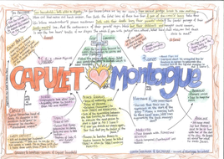
ACTIVITY
What should you be doing at age 13/14?
Discuss with your parents/mindmap
At what age do you and they think you should..?
Start dating?
Kiss someone?
Get married?
Buy a house?
Have children?
Do you have different views?
Young people should be able to marry from a much earlier age. To what extent do you agree? Write a page explaining your views using the following:
I agree with the statement because...
Some people might argue that...
But I would say to them...

Slide 16
Objectives
Lesson Three
Outcomes
To make flash cards based on terminology
To write a modern version of the scene
To read Act 2 scene 1 and label for language devices
To understand and be able to use the term soliloquy (and other terminology)
To create a piece of text based on the scene from the play

Slide 17
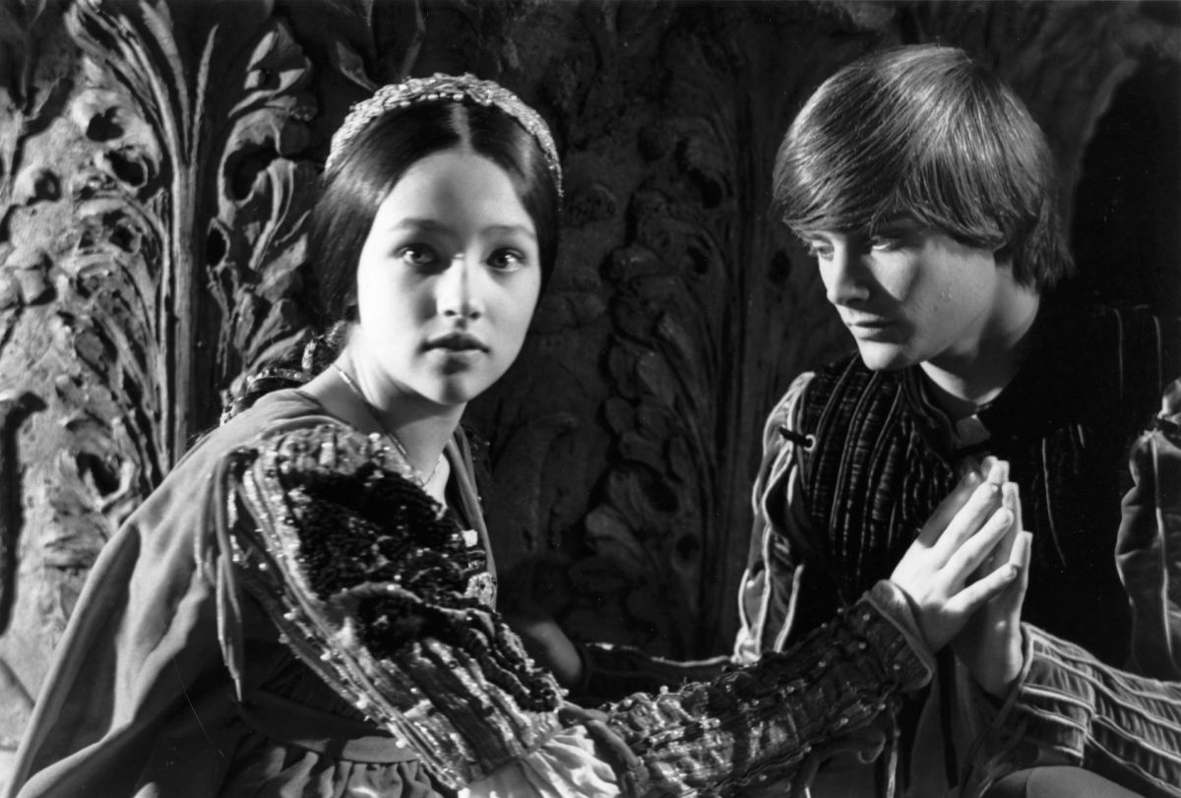
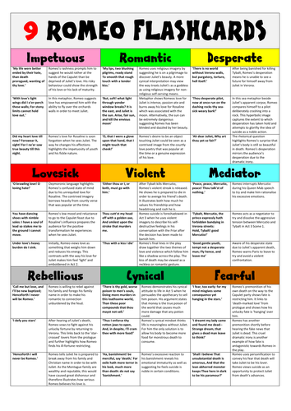
Romeo’s thoughts and feelings in the balcony scene.
Read Act 2, Scene 1. Summarise what has happened in this scene in one or two paragraphs.
Read Act 2, Scene 2
What is a soliloquy? Why is it used? What does it tell us about a character? Who can hear a soliloquy?
Focus on Romeo’s soliloquy (on next slide).
First impressions – what is he saying about Juliet?
Key words:
Soliloquy
Tragedy
Fatal Flaw
Tragic hero
Fate
Dramatic irony
Foreshadowing
Read,cover, write these words until you know them all - make flash cards to help you

Slide 18
Romeo: Act 2, Scene 2, ll. 1-25
He jests at scars that never felt a wound.
But soft! What light through yonder window breaks?
It is the east, and Juliet is the sun.
Arise, fair sun, and kill the envious moon,
Who is already sick and pale with grief,
That thou, her maid, art far more fair than she.
Be not her maid since she is envious.
Her vestal livery is but sick and green,
And none but fools do wear it. Cast it off!
It is my lady. Oh, it is my love.
Oh, that she knew she were!
She speaks, yet she says nothing. What of that?
Her eye discourses. I will answer it.—
I am too bold. 'Tis not to me she speaks.
Two of the fairest stars in all the heaven,
Having some business, do entreat her eyes
To twinkle in their spheres till they return.
What if her eyes were there, they in her head?
The brightness of her cheek would shame those stars
As daylight doth a lamp. Her eye in heaven
Would through the airy region stream so bright
That birds would sing and think it were not night.
See how she leans her cheek upon her hand.
Oh, that I were a glove upon that hand
That I might touch that cheek!
Label with the following methods:
Verb
Adverb
Adjective
Noun
Pronoun
Imagery
Metaphor
Simile
Oxymoron
Foreshadowing
Personification
Semantic field
Rhetorical question
Dramatic pause
Exclamatory words/phrases
Write your own version of this scene in modern English
https://www.youtube.com/watch?v=S0qao2xINsE

Slide 19
Objectives
Lesson Four
Outcomes
To create a mind map
To write a newspaper article based on events
To analyse character traits
To create a mindmap based on character
To create a newspaper report based on the characters of Romeo and the Friar

Slide 20
Language which foreshadows death
Think: What qualities would someone look for in a husband?
Mindmap – adjectives to describe Romeo so far add links to themes and where Shakespeare has used foreshadowing
Discuss with someone at home: Do you think Romeo is a good match for Juliet? Do you believe Romeo is really in love with Juliet? Justify your responses.
Read Act 2, Scene 3
Key words:
Foreshadowing
Fate
Tragedy
Fatal flaw

Slide 21
FRIAR LAWRENCE:
So smile the heavens upon this holy act
That after-hours with sorrow chide us not.
ROMEO:
Amen, amen. But come what sorrow can,
It cannot countervail the exchange of joy
That one short minute gives me in her sight.
Do thou but close our hands with holy words,
Then love-devouring death do what he dare;
It is enough I may but call her mine.
FRIAR LAWRENCE:
These violent delights have violent ends
And in their triumph die, like fire and powder,
Which, as they kiss, consume. The sweetest honey
Is loathsome in his own deliciousness
And in the taste confounds the appetite.
Therefore love moderately. Long love doth so.
Too swift arrives as tardy as too slow.
Read the extract.
Highlight word/phrases which link to death.
Label with writer’s methods.
Annotate labelled quotes with effect.
Write a newspaper article explaining how Friar Lawrence was partly responsible for the deaths of Romeo and Juliet.
Which theme links to this extract?

Slide 22
Objectives
Lesson Five
Outcomes
To make a list of words and phrases in the form of a poster
To create a piece of written work based on a given question
To highlight where they have written about Plot/Character/Theme/Dramatic Devices/Social Context
To read Act 3 scene 1
To identify words and phrases
To write an essay style answer

Slide 23
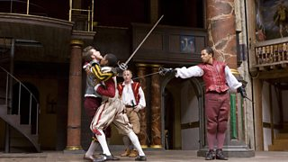
Love and conflict (Act 3, Scene 1)
Key words:
Dramatic irony
Foreshadowing
Tragedy
Read Act 3, Scene 1 -https://www.sparknotes.com/nofear/shakespeare/romeojuliet/page_136/
Highlight words and phrases which link to conflict and hate
Look out for words and phrases which foreshadow events to come.
Make a list of words and phrases which link to conflict and hate in A3, S1.
Annotate with what the words/phrases suggest.
Turn your ideas into a revision poster
’
https://www.youtube.com/watch?v=IRHODZaSVpY

Slide 24
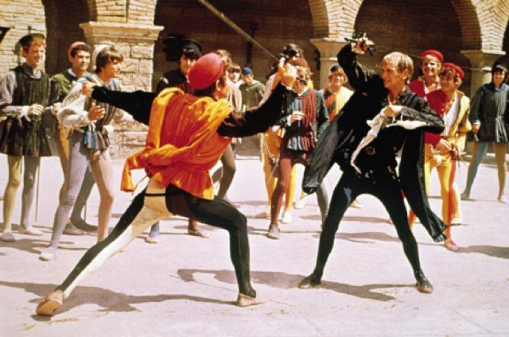
5 stage essay plan:
Introduction- introducing the idea of conflict
Write about the characters who are in conflict
Write about HOW Shakespeare has used language in this scene to show conflict
Write about where else you see conflict in the play
Summarise your ideas and add a comment on WHY Shakespeare may have chosen to portray the characters in this way- this will be in your opinion.
How has the writer used language to present conflict in Romeo and Juliet? In your response you could: - Write about how Shakespeare has used language to present conflict in Act 3, Scene 1. - Write about how Shakespeare has used language to present conflict elsewhere in the play. - Include relevant textual detail.
Write a response as an essay.

Slide 25
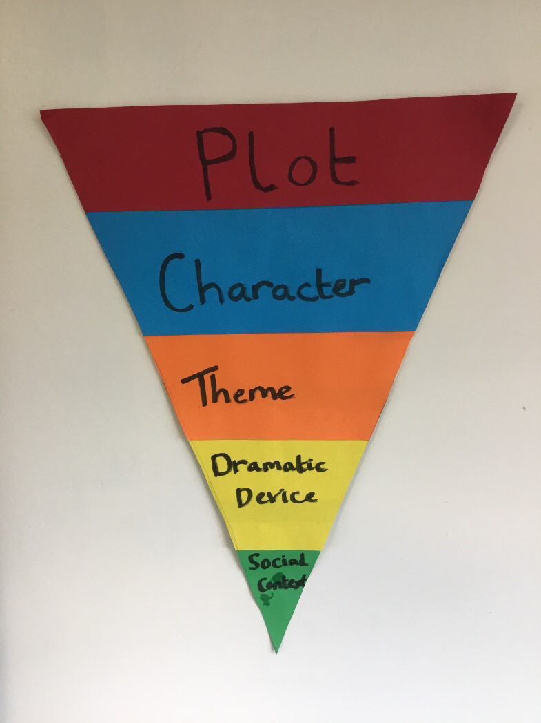
Mark your own work:
Have you written about-
PLOT
CHARACTER
THEME
DRAMATIC DEVICES
SOCIAL CONTEXT

Slide 26
Objectives
Lesson Six
Outcome
Newspaper article
To understand how to write an article
To create an article based on the play

Slide 27
Writing an article
Use RASORS to structure your answer:
Paragraph one- use a rhetorical question
Paragraph two- use an anecdote
Paragraph three / four / five – write three clear lines of argument
Paragraph six- consider the opposite opinion, what might they think?
Paragraph seven- respond back to the opposition re-stating your point of view
Paragraph eight- summarise your argument, use your original rhetorical question and answer it!
Alliteration
Fact
Opinion
Rhetorical Question/Repetition
Emotive Language
Statistics
Triplet
You should use your opinion to base your ideas within your piece of writing.
Watch the scene on the next slide to help you understand the plot.

Slide 29
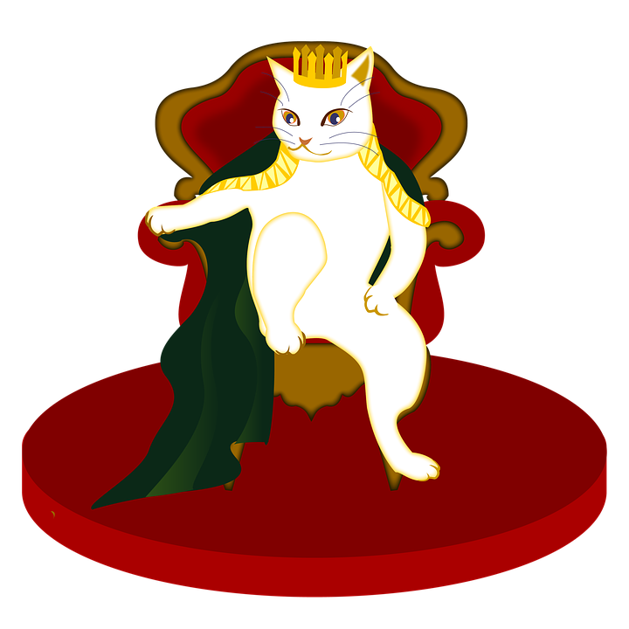
Write an article for the Verona Times about Mercutio and Tybalt’s deaths.
Use RASORS to structure your answer:
Paragraph one- use a rhetorical question
Paragraph two- use an anecdote
Paragraph three / four / five – write three clear lines of argument
Paragraph six- consider the opposite opinion, what might they think?
Paragraph seven- respond back to the opposition re-stating your point of view
Paragraph eight- summarise your argument, use your original rhetorical question and answer it!
You can make it more fun by adding your own images like in a real newspaper.

Slide 30
Objectives
Lesson Seven
Outcomes
Discussion points based on a given question
To write an essay style answer (at least one page) based on the given text.
Exam style question:
How has Shakespeare presented the relationship between Juliet and her parents? - To write about how Shakespeare has presented the relationship between Juliet and her parents in Act 3, Scene 5 -To write about how Shakespeare has presented the relationship between Juliet and her parents elsewhere in the text.

Slide 31
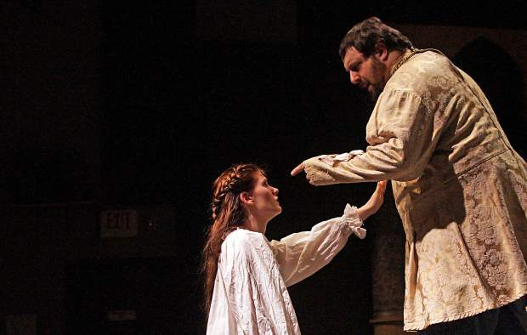
Juliet’s relationship with her parents
Thinking question – pose a problem linked to Juliet’s dilemma, eg. You have been invited to birthday party but have already promised your parents you will visit your elderly grandparents. You know your friend will be upset if you say no. What can you do?
Activity based on form:
Tragic flaw
Plot
Fate
Charisma
Realisation
Catharsis
Read Act 3, Scene 5
First impressions of relationship between Juliet and her father.
watch the clip- https://www.youtube.com/watch?v=7vHjpUN7RDQ
Watch the scene on the link below and note down some ideas about the relationship between Juliet and her parents.

Slide 32
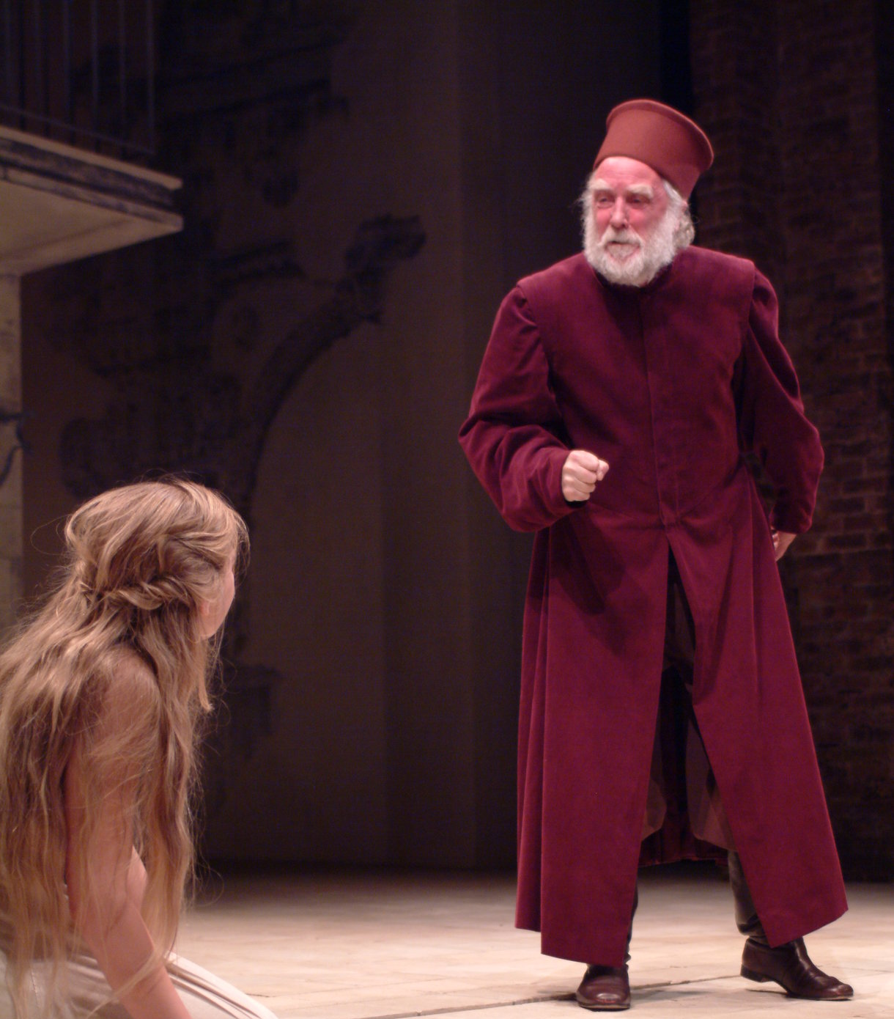
Make a list of pro’s and con’s for both characters
https://www.sparknotes.com/nofear/shakespeare/romeojuliet/page_186/
Use the link to view the text.

Slide 33
Exam style question:
How has Shakespeare presented the relationship between Juliet and her parents? In your response you could: - Write about how Shakespeare has presented the relationship between Juliet and her parents in Act 3, Scene 5, lines 126-242. - Write about how Shakespeare has presented the relationship between Juliet and her parents elsewhere in the text.
Include relevant textual detail.
Bullet point 1: Use you pro’s and con’s to help you plan your answer
Bullet point 2: Make notes on elsewhere in the play (Act 1, Scene 3, page 17 – Juliet’s mother and nurse argue about her age. Act 1, Scene 2, page 13 – Father tells Paris that Juliet is too young to marry.
Write an essay style response.

Slide 34
Lesson Eight
Objectives
To understand plot
To comment on character
To interpret meaning with regards to plot and character
Outcome
To storyboard acts 2 and 3 using Shakespeare as a narrator

Slide 36
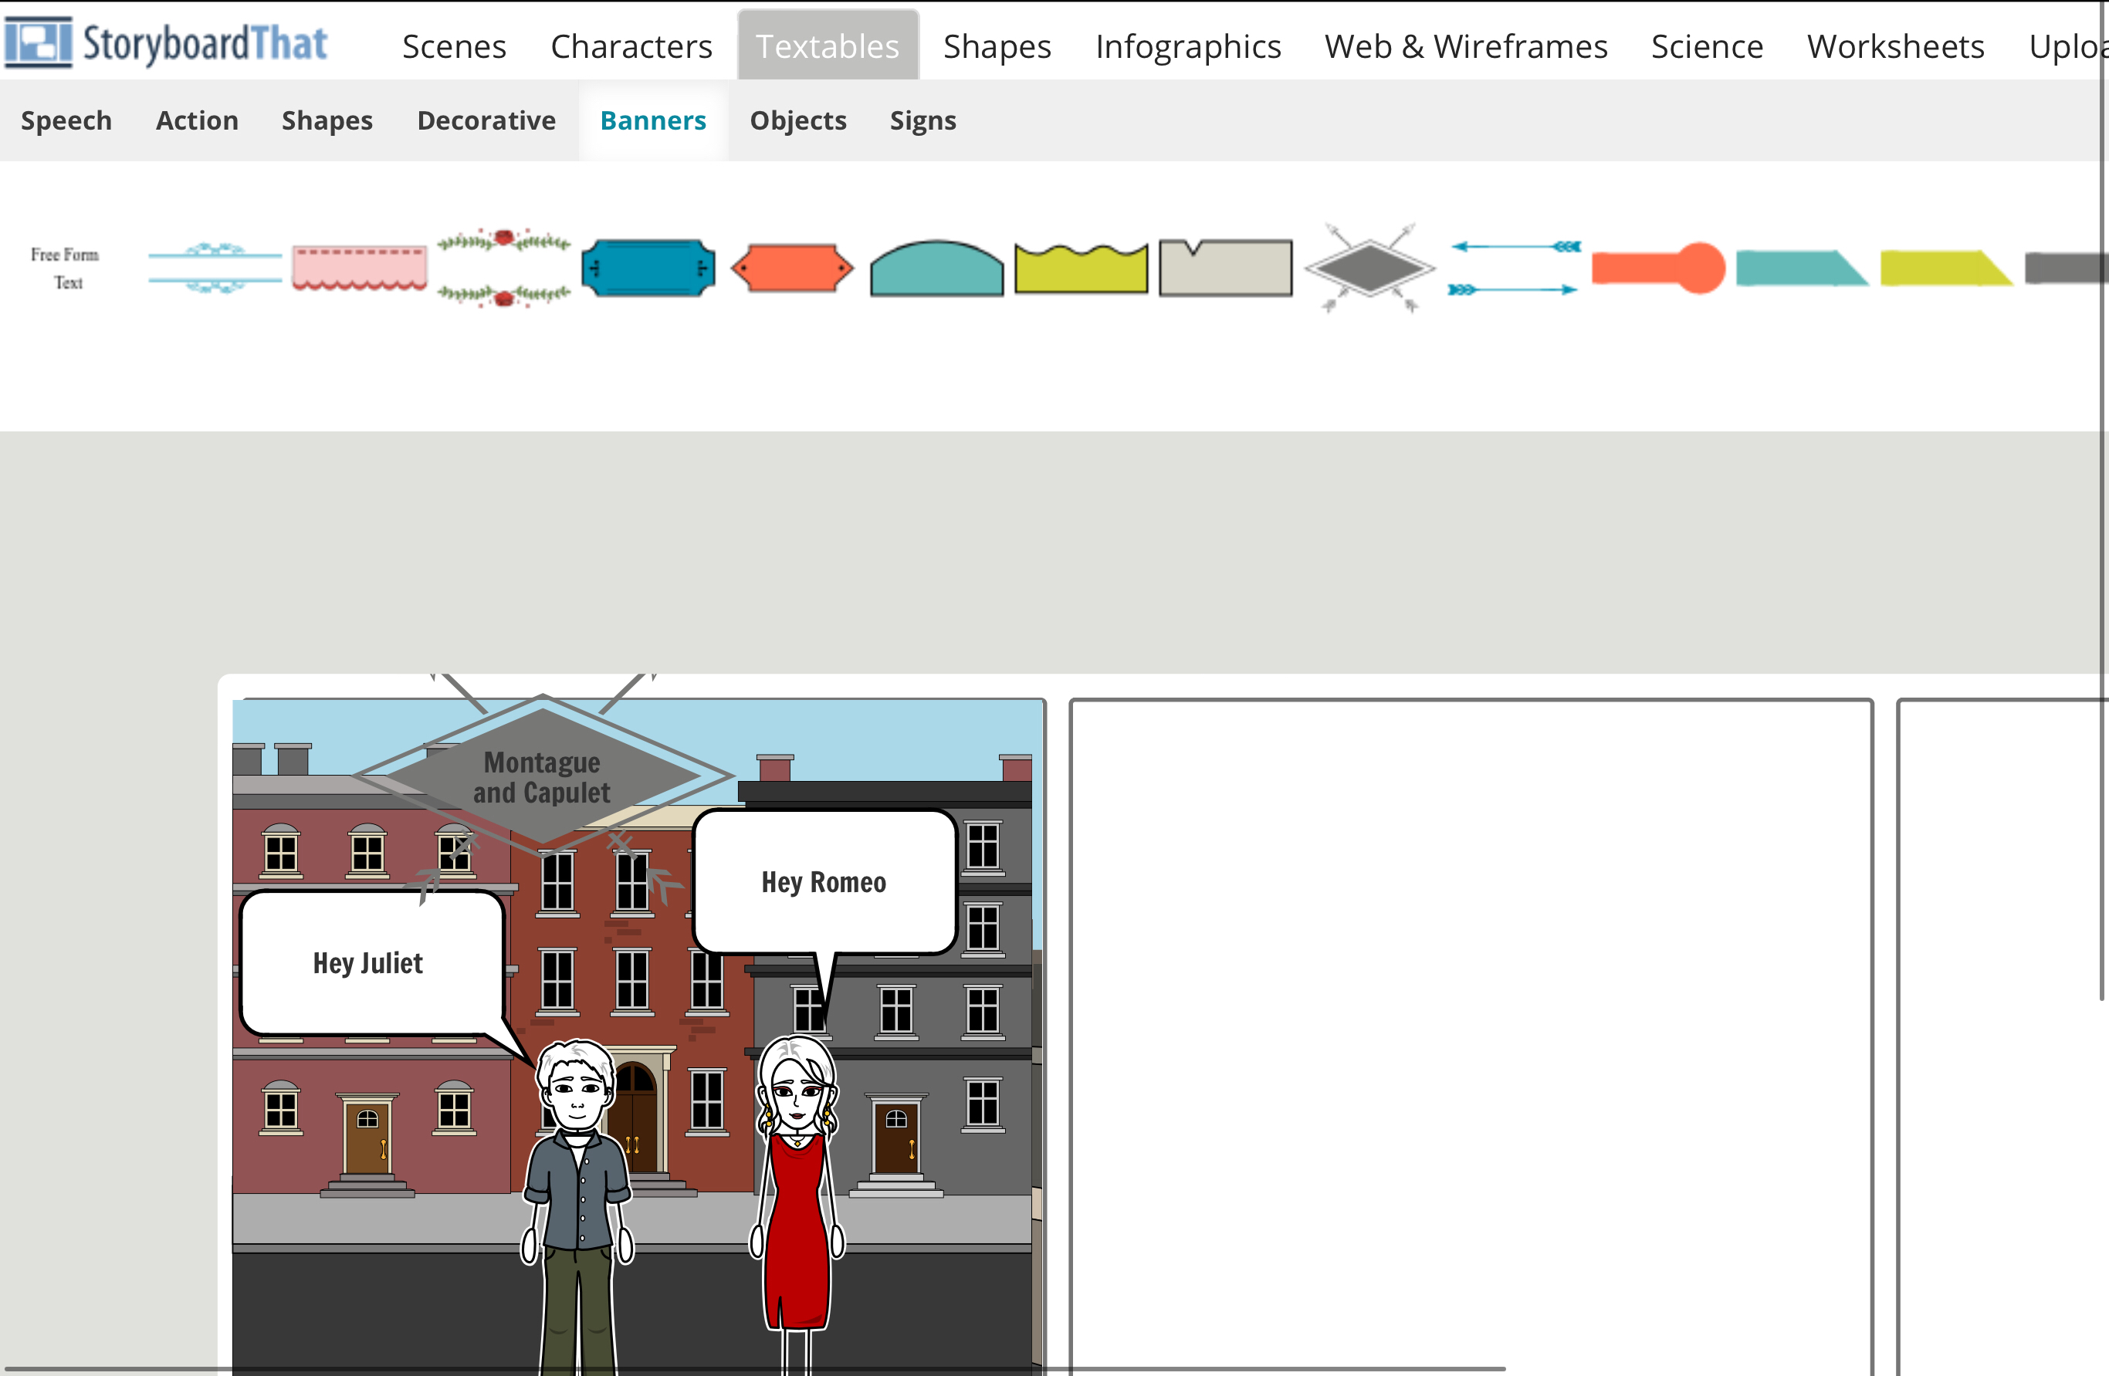
https://www.youtube.com/watch?v=dRrvQ1vZxcg
Watch the clip above to remind you of the storyline
Use Shakespeare as a narrator- the person that tells the story.
https://www.storyboardthat.com/storyboard-creator
Use this online storyboard tool to create your storyboard of acts 2 and 3

Slide 37
Lesson Nine
Objectives:
To read and interpret act 4
To understand the term dramatic irony and its use
To create a written piece of work
Outcomes:
To have a debate with family members
To create a fact sheet

Slide 38
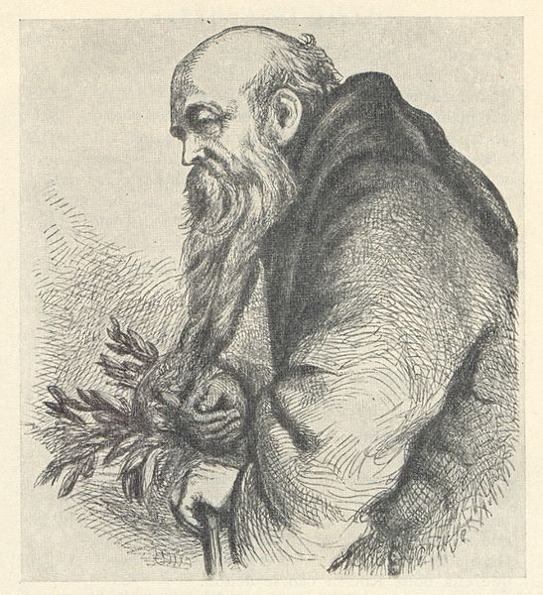
Friar Lawrence gives Juliet the potion (Act 4, Scene 1). https://www.youtube.com/watch?v=_BQ1n4TARa4
Answer the given questions
What do we mean by complicit?- use a dictionary to find the meaning
Who has been complicit so far in the play?- what might Shakespeare be trying to show the audience?
Read Act 4, Scene 1
Dramatic irony – what do we know that Paris does not?
How does this create tension in this scene?
Think about how Juliet and Paris speak to each other (short sentences, Juliet speaks in riddles to Paris.
Compare this to how Romeo and Juliet speak to each other (eg Balcony Scene)
What do the following quotes suggest?
Line 19 – ‘That may be, sir, when I may be a wife’ – when can she be a wife?
Line 25 – ‘I will confess to you that I love him’ – what is her double meaning? (loves God and Romeo)
Lines 27-28 – ‘Being spoke behind your back, than to your face’ – what will she not say to Paris’s face?
Lines 35 to 36 – what does Juliet mean when she says her face ‘is not mine own’? Who does it belong to?

Slide 39
https://www.sparknotes.com/nofear/shakespeare/romeojuliet/page_208/
Look through lines 44 to 126.
Find quotes which prove Friar Lawrence is complicit in the deaths of Romeo and Juliet.
Debate: work with your family- one side believes Friar Lawrence did the right thing trying to help Romeo and Juliet. The other side believes he did the wrong thing. In your argument, include references to the text and contextual information which might have led him to his decision to help.
Consider: did Friar Lawrence do the right thing? What should have done instead? Who should he have told?
Activity: if you knew someone was doing the wrong thing what would you do?
Who would you speak to? How could you help them do the right thing?
Create a fact sheet on ‘doing the right thing’

Slide 40
Lesson Ten
Objectives:
To understand the character of Juliet
To explore Shakespeare’s use of language and imagery
Outcomes:
To create an alternative to the scene.

Slide 41
Juliet Soliloquy, Act 4, Scene 3
https://www.youtube.com/watch?v=OpNMfzN31Z0
Make flashcards
Explore her soliloquy in Act 4 scene 3 – picking out figurative language used by Juliet and what it means:
“ I have a faint cold fear through my veins that almost freezes up the heat of life”
“whose foul mouth no healthsome air breathes in”
“as in a vault, an ancient receptacle”
“shrieks like mandrakes torn out the earth”
“and madly play with my forefathers’ joints, and pluck the mangl’d Tybalt from his shroud”
Explore the figurative language in the soliloquy – death and violent imagery
Change in confidence in front of nurse and lady Capulet to when she is alone
Comparison of earlier, more hopeful sounding quotes, exploring change in character
Links to Elizabethan beliefs on the supernatural and death
Key words:
Deuteragonist
Dramatic irony
Fate
Tragedy
Tragic flaw
Foreshadowing
Mindmap your ideas to these questions

Slide 42
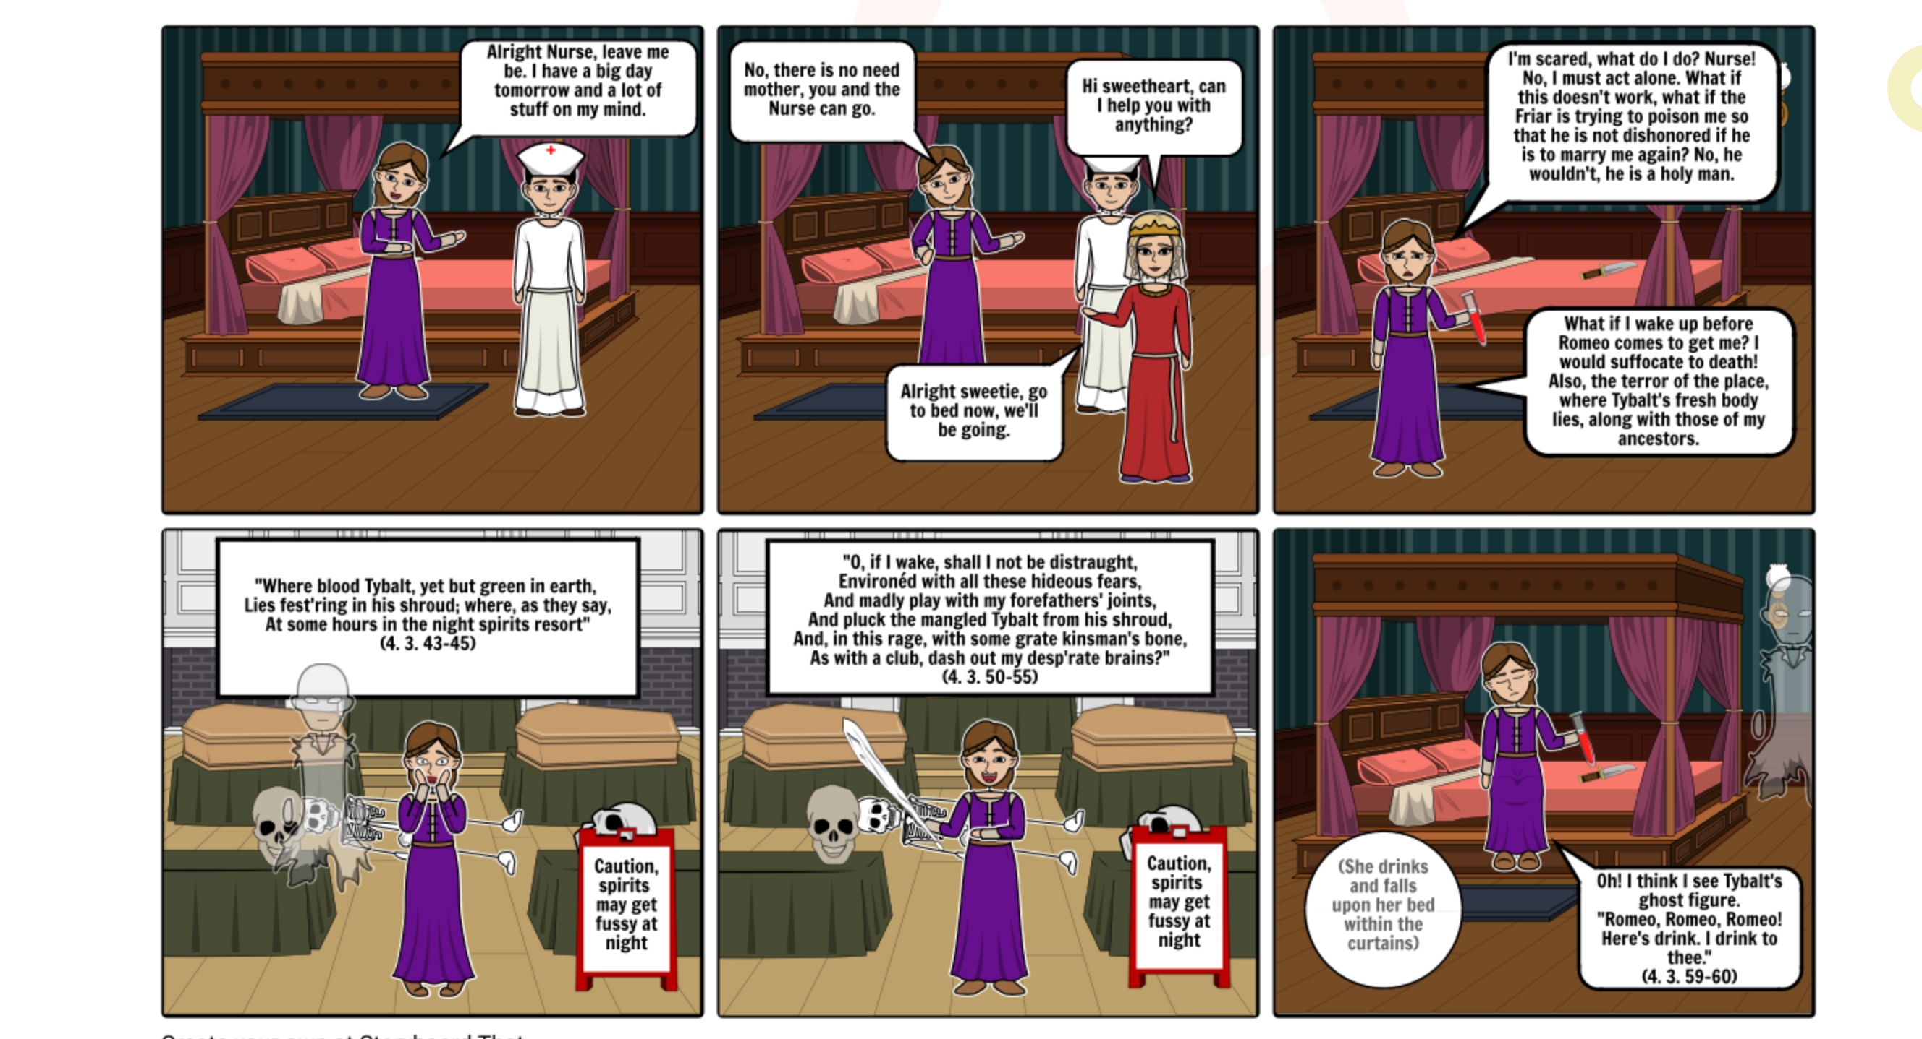
How could this have been different?
Re-write this scene in a different way. What could have happened instead? Think about everything else that has happened to this point.

