Slide 1
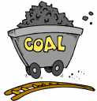
What are Energy resources?
Understand what is an energy resource.
Explain how fossil fuels are formed.
Categories the different types of energy resources
Evaluate which resources the world consumes/ uses for energy.
Analyze how this usage is changing over time.
Notes:
Left – jumbo jet
Right – zooplankton (a type of microscopic animal which lives in the oceans)

Slide 2
What is the link?
Notes:
Left – jumbo jet
Right – zooplankton (a type of microscopic animal which lives in the oceans)

Slide 3
Does this image help?
Notes:
Centre – a petrol pump with a pipe leading to a dinosaur underground.

Slide 4
Energy resources
The skeletons of millions of creatures (including zooplankton) have become trapped under layers of rock.
The pressure of the rock has turned the bones into oil. The oil is refined and used as a fuel.
Oil is a fossil fuel. What are the other two fossil fuels?
OIL
GAS
&
COAL

Slide 5
Energy resources
Definition…
Natural things that can create power through heat or movement.
Can you name any other types?

Slide 6
Categorising energy resources
Can you match up the words with the right definitions and write them out in your books
Will not run out if it is looked after carefully.
Non-renewable
Will run-out. Cannot be renewed. Also called finite (limited amount).
Renewable
Sustainable
Will not run-out. Also called infinite (unlimited amount).

Slide 7
Categorising energy resources
Can you match up the words with the right definitions and write them out in your books
Non-renewable
Will run-out. Cannot be renewed. Also called finite (limited amount).
Renewable
Will not run-out. Also called infinite (unlimited amount).
Sustainable
Will not run out if it is looked after carefully.

Slide 8
Non-renewable Renewable Sustainable
Colour-code each of the resources below into the 3 categories…

Slide 9
Non-renewable Renewable Sustainable

Slide 10
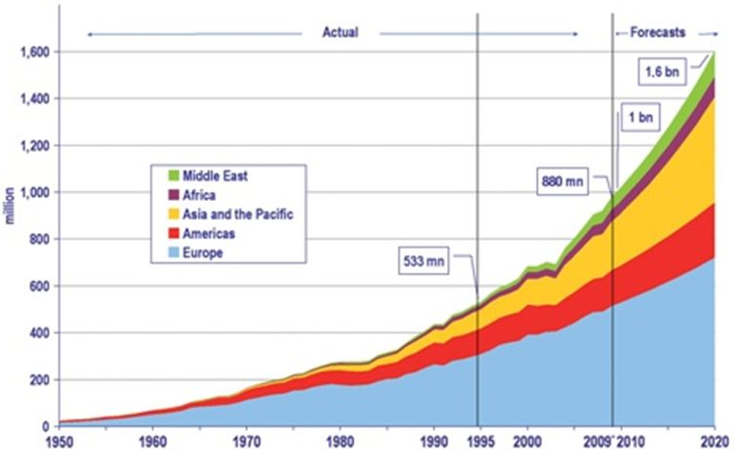
Compound line graphs
Notes:
Compound line graphs are simple to read. The width of the coloured section gives the value of that category.
Europe on this one would be read as a usual line graph. To read the Americas data you would need to read this as a usual line graph but then subtract the amount for Europe. This would give the score for the width of the Americas.

Slide 11
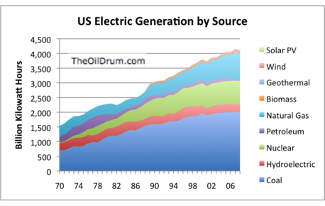
Changing world energy consumption
You are going to produce a compound line graph using the figures on your sheet.
Use a pencil.
Start with oil at the bottom – draw a line graph and colour in everything below the line in your colour for oil.
Then add the gas figure to the oil figure (4900) to work out where the line for gas goes. Colour everything below this line as far down as the oil line.

Slide 12
 | 1990 | 1995 | 2000 | 2005 | 2008 | 2010 | 2015
Coal | 7950 | 8350 | 10,000 | 11,300 | 10,900 | 12400 | 9900
Renewables | 5450 | 5750 | 7200 | 8050 | 7700 | 8900 | 9500
Hydro-electricity | 5400 | 5700 | 7100 | 7950 | 7600 | 8800 | 9300
Nuclear energy | 5100 | 5400 | 6700 | 7350 | 7000 | 7600 | 7900
Natural gas | 4900 | 5100 | 6400 | 6850 | 6500 | 7000 | 7300
Oil | 3000 | 3100 | 3500 | 3900 | 3600 | 4000 | 4100

Slide 13
Quiz
How much of the world’s energy is from non-renewable resources?
16%
66%
86%
99.6%

Slide 14
Quiz
How much of the world’s energy is from renewable resources?
9.3%
27%
14%

Slide 15
Quiz
How much of the world’s energy is from sustainable/recyclable resources?
0.5%
2.3%
4.7%

