Slide 1
1: Write the date (underline) 2: Write the title (underline) 3: Begin the Spaced Retrieval You Have 5 minutes. IN SILENCE.
Spaced Retrieval
In as much detail as possible…
WITHOUT LOOKING IN YOUR BOOKS!!!
Draw and annotate the Clarke Fisher Model of Industrialisation.
Give 2 examples of Countries in each industrial stage.
Give 1 example of a type of an industry in each industrial sector.

Slide 2
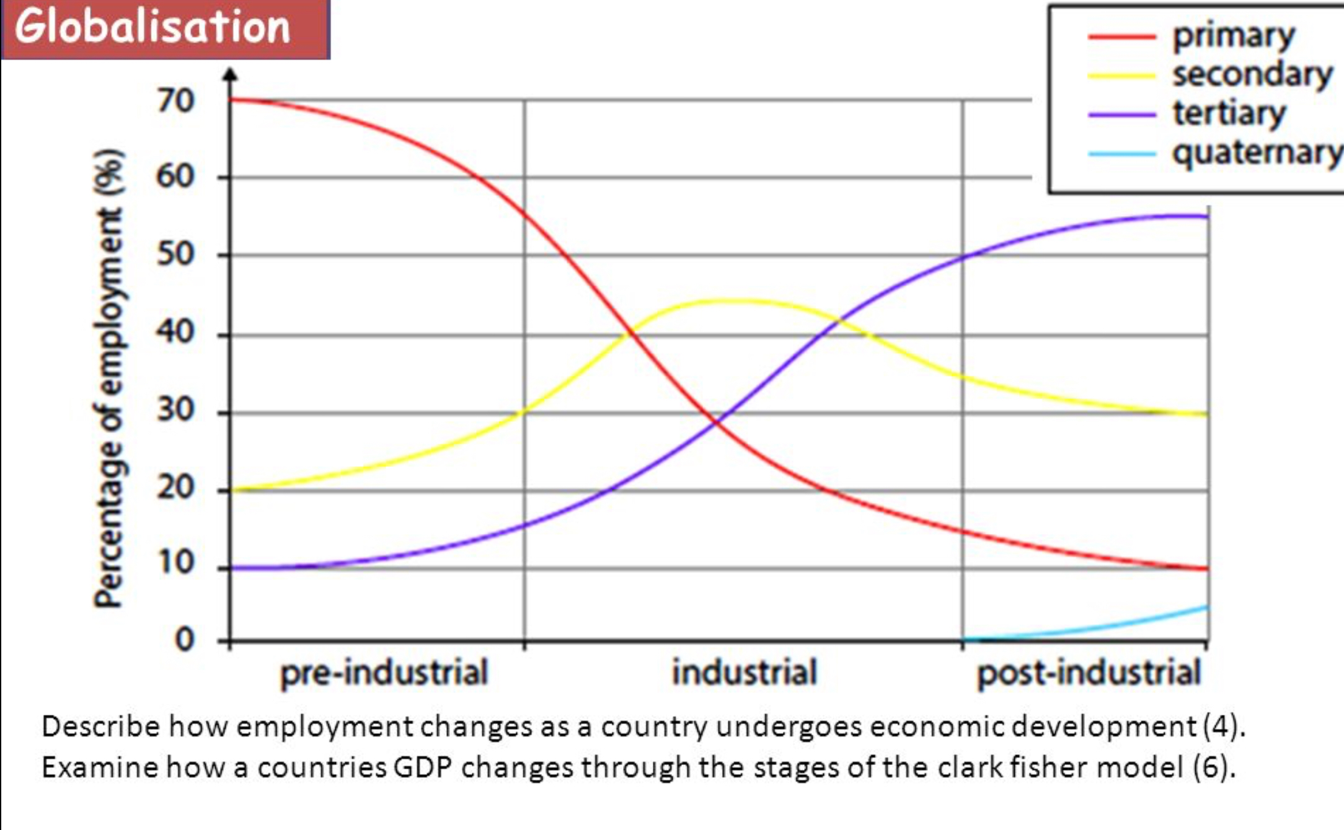

Slide 3
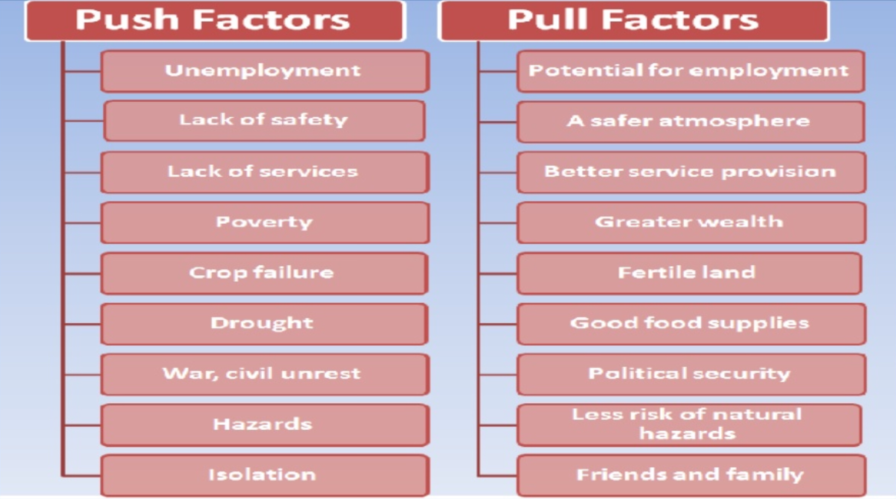
Why are an increasing number of people moving to cities?
Push Factors
Pull Factors
Categorise these factors as:
SOCIAL – ECONOMIC – POLITICAL – ENVIRONMENTAL.

Slide 4
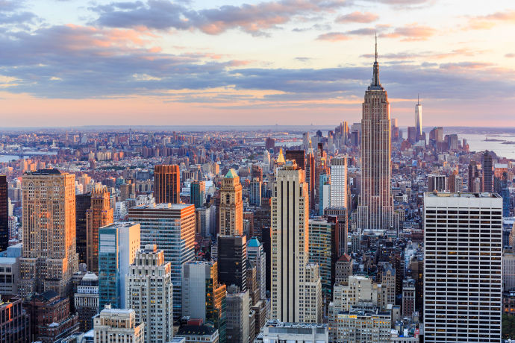
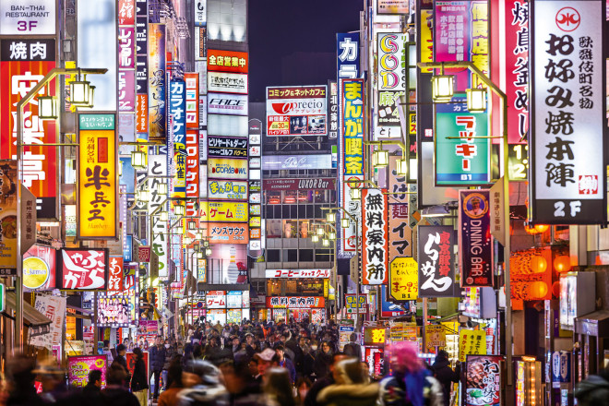
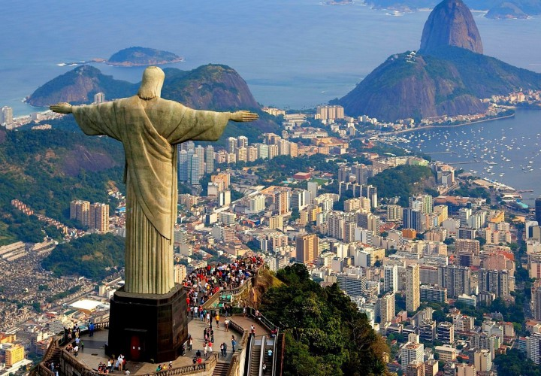
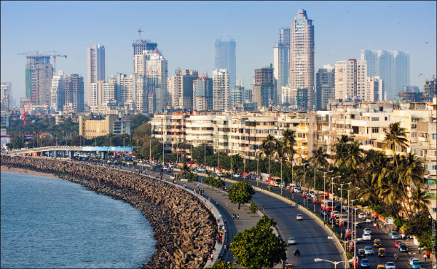
Where are these places and what have they got in common?
NEW YORK
TOKYO
RIO DE JANEIRO
MUMBAI

Slide 5
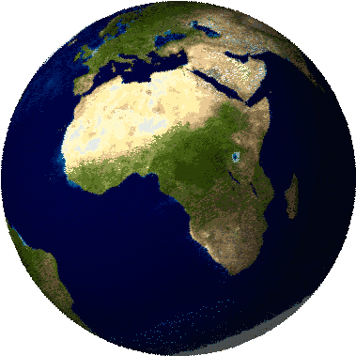
What are global
megacities?

Slide 6
Write a sentence to finish the definition using the key words
A megacity is….
Population
10 million
World
Urban
City
OR COMPLETE THE FOLLOWING…
A megacity is a very large ____ with a ________ of over __ _______ people living in it’s urban area. There are approximately 21 of these megacities around the______.

Slide 7
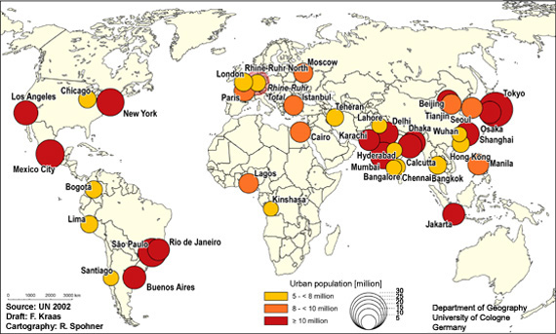
Describe global distribution of megacities (3 marks)
Think about which countries and continents these cities are in? What stages of development are they in?
What allows these cities to grow? They all have something in common, where are they positioned and why?

Slide 8
What is it like in a megacity?
India- Mumbai
https://www.youtube.com/watch?v=NLlzs4syNjc
New York
https://www.youtube.com/watch?v=zGlazD50UB0
Make notes about each video.
Compare the two lives shown in the video clips
Suggest reasons for the differences between megacities around the world

Slide 9
Types of megacities
 | Slow-growing | Growing | Rapid-growing
Where?
Features?
Examples?

Slide 10
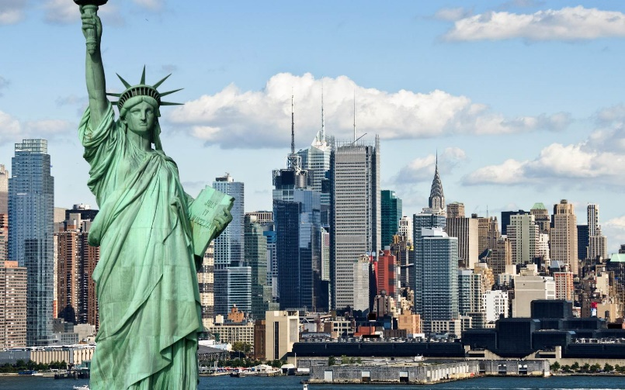
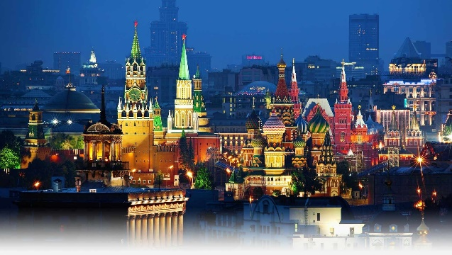
Slow-growing mega cities
Tokyo
These are mainly located in south east Asia, Europe and North America. Mostly in high income countries (HIC).
The urban population of these countries are at 70%+ and they do not feature squatter settlements / shanty towns.
New York
Moscow

Slide 11
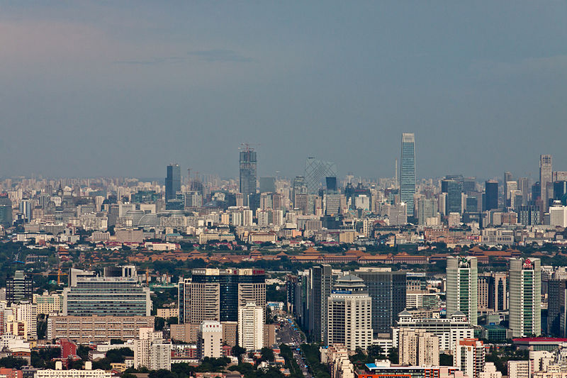
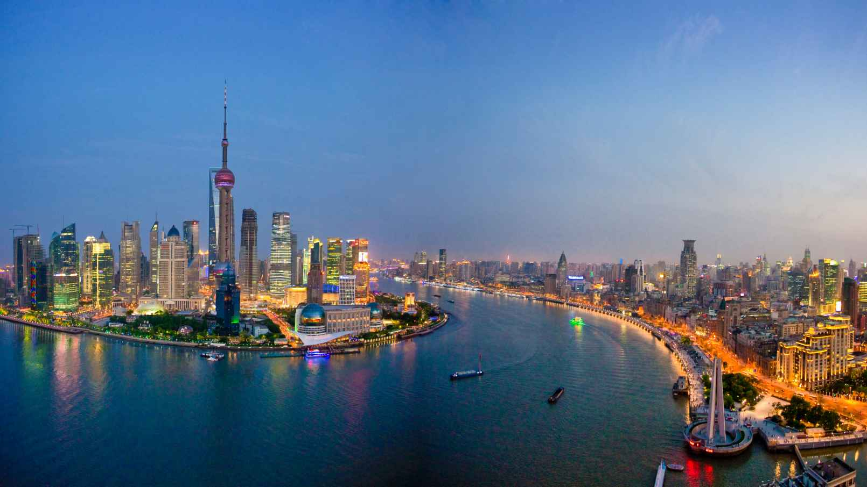
Growing mega cities
Beijing
Found in South America and South East Asia, including Brazil and China. Found mostly in newly emerging economies (NEE).
Between 40-50% of the population live in Urban areas. They do have some squatter settlements but these are under 20%
Shanghai
Rio de Janeiro

Slide 12
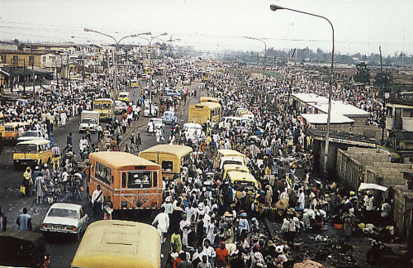
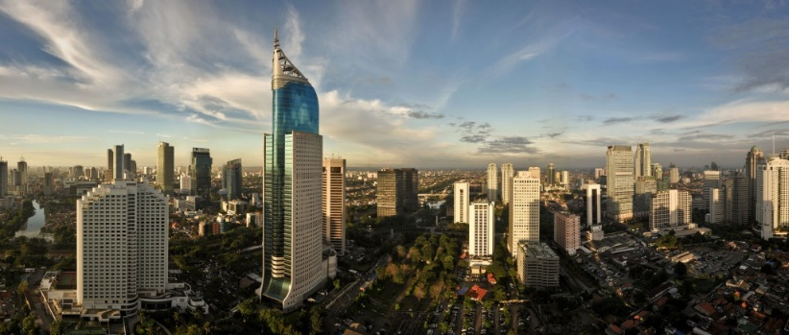
Rapid -Growing mega cities
Mumbai
Located in south-south east Asia and Africa, also includes India. This is mostly in low income countries (LICs).
Less than 50% of the population live in urban areas. There are often large squatter settlements, which account for more than 20%
Lagos
Jakarta

Slide 13
Exam practise
Define ‘megacity’ (1 mark)
Explain the push factors that lead to rural-urban migration (4 marks)
Describe the trend in urbanisation in HICs (3 marks)

