Slide 1
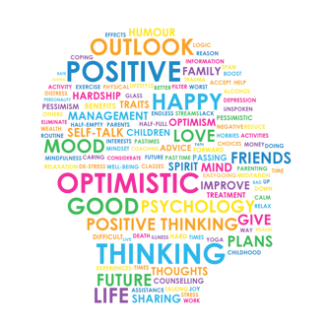
How to keep safe, healthy and mentally well during a period of self-isolation
Notes:
There are times when we all feel the strain and there are strategies that you can use to to give yourself the best chance to stay mentally healthy.
Some children and young people enjoy being away from school whilst others really struggle with the coronavirus outbreak keeping them at home and away from friends.
With nationwide and local restrictions being regularly reviewed, you may/are having to deal with self-isolating because of an outbreak in school. It's still uncertain what further changes we all may face.
Feelings like these will gradually ease for most, but there are always steps you can take to support them emotionally and help them cope with problems they face. Miss Dugan and I have put together a guide which you can ready over in your own time, with some useful tips and strategies, along with some activities that you can also do at home.

Slide 2
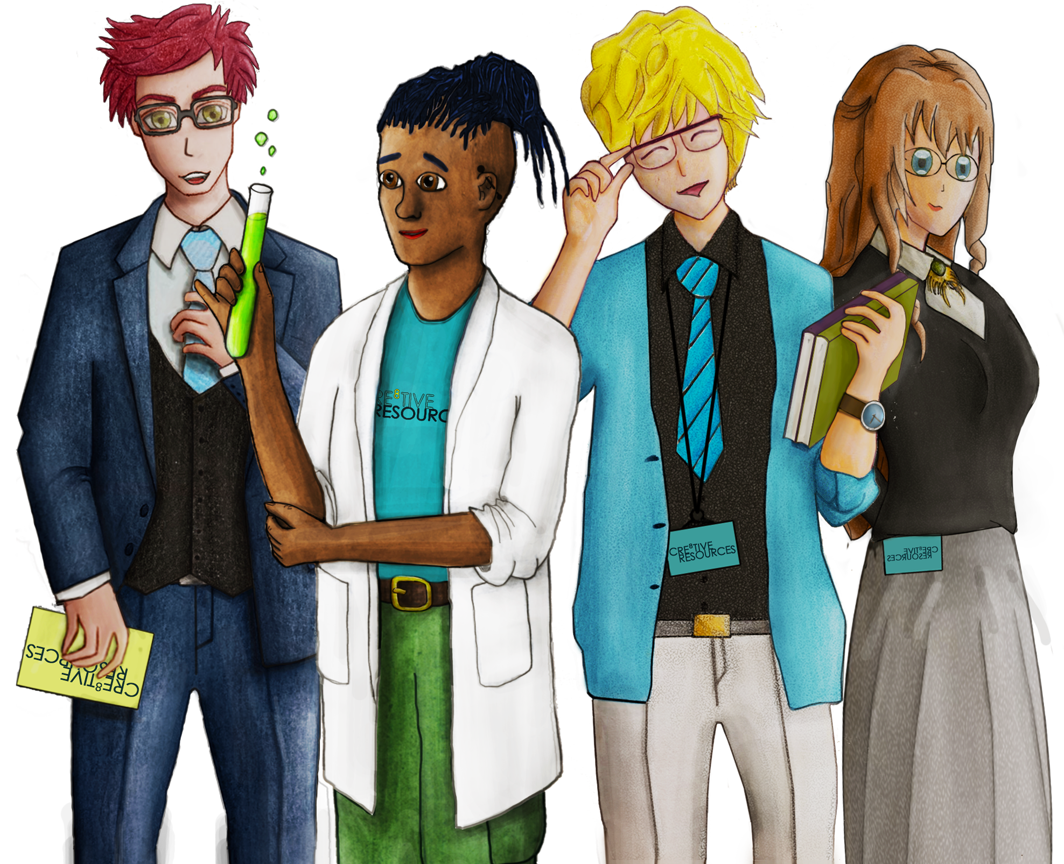
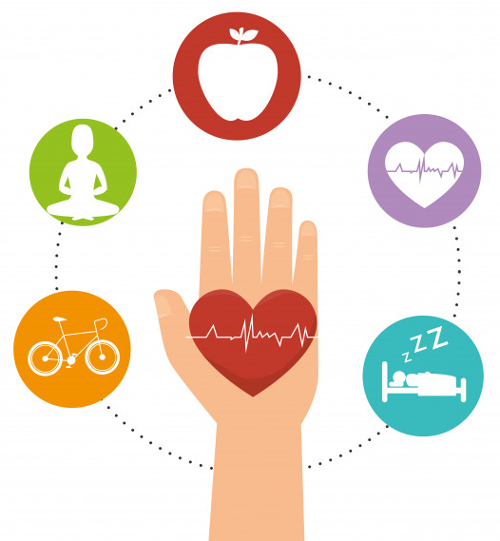
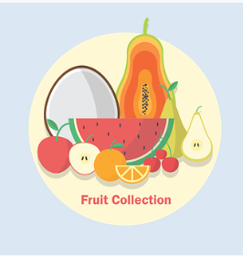
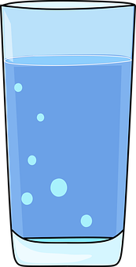
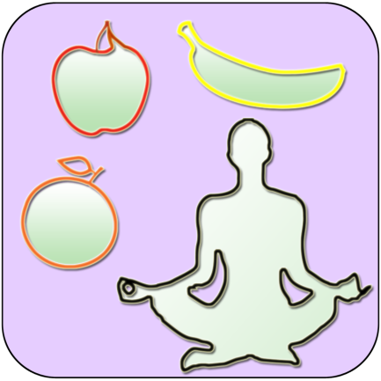
What is Emotional Health and Wellbeing
“Having a balanced mental health is to allow emotions to be present in your mind, witness them, accept them and understand that they all will pass in their due time. The balance of our thoughts and emotions will allow you to chose the actions that support your physical wellbeing, emotional wellbeing and mental wellbeing ”
What is Positive Wellbeing?
It is a state of overall good health in both body and mind and can include:
Intellectual (cognitive stimulation such as problem solving puzzles),
Spiritual (understanding sense of purpose and beyond your own existence, can be through prayer or exploration of a higher power, etc)
Social (building relationships and community support through friends and family and neighbours etc.)
Physical (Movement, whether in sports or walking, movement that brings joy.)
If you do something beneficial to your mind it will respond in a positive way that the body will react to by also releasing these same hormones.
Things that are beneficial to your mind (and spirit) is doing things that you really enjoy!!– things you are passionate about and/or good at. Making and spending time for these passions will help you keep happy.
Did you know?
Approximately 1 in 4 people in the UK will experience a mental health problem each year
1 in 6 people report experiencing a common mental health problem (such as anxiety, depression etc.)
Psychologist Robert Leahy said that the average teenager has the same level of anxiety that a psychiatric patient would have had in the 1950s
Notes:
There is no universal definition of “wellbeing”, for some people it might be feeling happy or content, or for others it may be the absence of disease. Emotional wellbeing and mental wellbeing are commonly used to describe the same thing and are commonly accepted to include a state in which an individual is comfortable, healthy or happy; but may include broader concepts such as life satisfaction, a person’s sense of purpose, and how in control they feel.

Slide 3
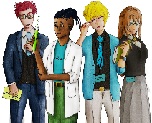
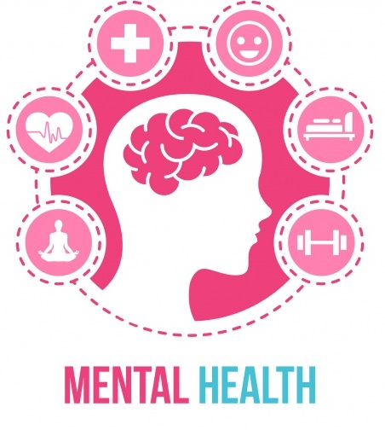
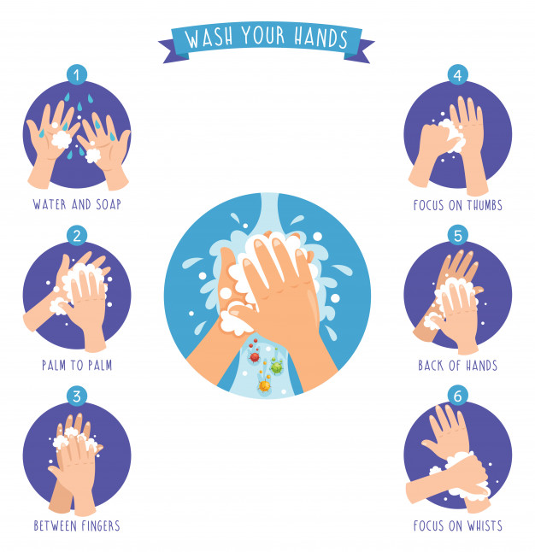
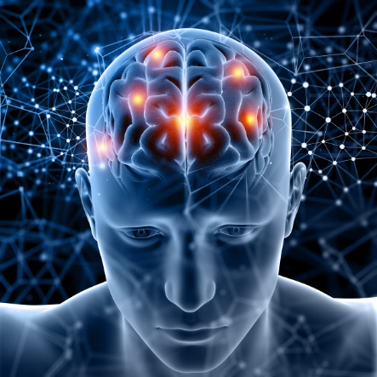
What is Mental Health?
“The state in which your mind is from a psychological wellbeing perspective”
Mental Health vs Mental Illness
Mental Health is a person’s condition with regard to their psychological
and emotional well-being
Mental Illness is a clinically diagnosable illness affecting how a person thinks and feels, behaves and interacts with other people
Good mental health indicates a balanced, stable mind where there aren’t any prolonged negative states, no long-term emotional imbalances or dysfunction, you can appropriately express how you feel or manage your emotions or seek the appropriate help where needed.
Poor mental health indicates a feeling of not being in control with your emotions, long term negative emotions, difficulty expressing yourself emotionally, feeling alone or isolated, extremes of emotional states such as rage, suicidal thoughts, feeling disconnected. Mental health can affect your physical health.
Mental health is something that can affect anyone, our environment and bodies are changing constantly and sometimes it can be stressful. It’s important to find a trusted adult you can confide in during the difficult times and celebrate the stress-free moments.
Notes:
The World Health Organisation describe mental wellbeing as “a state in which an individual realises his or her own abilities, can cope with the normal stresses of life, can work productively and fruitfully, and is able to make a contribution to his or her community”. Have a read of this slide carefully and it tells you a little more about what is mental health and the definitions of what is good and poor mental health.

Slide 4
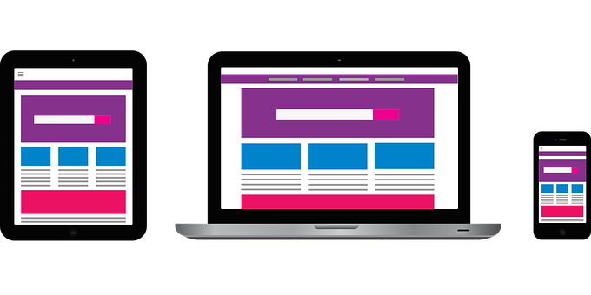
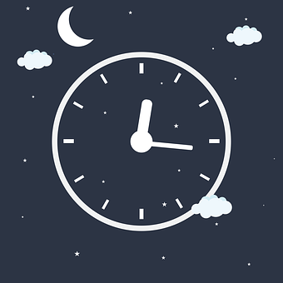
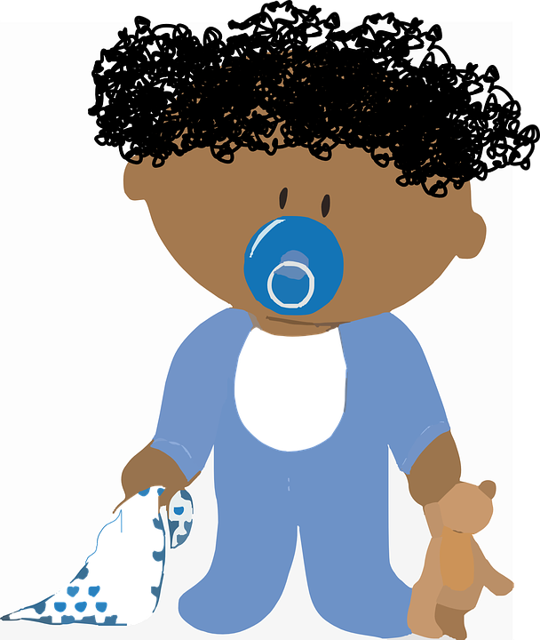
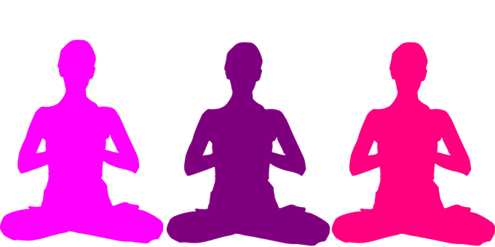
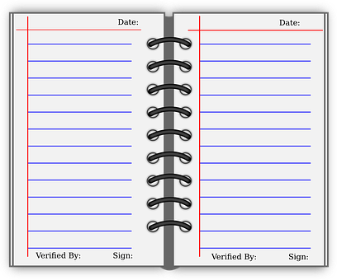
Simple practical steps to try out to get a good nights sleep
Switch off technology/phones at least one hour before bed to avoid stimulation from the blue-light emitting from technology.
Reading books, a warm shower or bath, listening to relaxing music, have a warm beverage such as a non-caffeinated herbal tea
Setting up a bedtime routine to signal to your body that you are making your way to bedtime.
Being consistent with a sleep/wake routine. Getting sunlight within a few hours of waking helps to set your body clock, even if just for 15 minutes daily.
Meditation. Close your eyes for a few minutes each day and just focus on breathing. You don’t need to do anything else but witness your thoughts and feelings.
Write your feelings on paper. Journal how the day went, self reflection and re-read them to see what kind of positive or negative state your mind is in will help ease stress and “get out of your head”
Notes:
It's important to make sure you look after your own mental wellbeing, as this will help you support yourself and those you care about.
Try to recognise and acknowledge when you're feeling low or overwhelmed. It's completely normal to be worried, scared or helpless during difficult times, and feeling this way is nothing to be ashamed of. Is there a friend, fellow parent or carer you trust enough to tell how you're feeling? Maybe there's family, friends or another trusted adult who could support you. There's plenty of help out there. You should never feel like you have to cope on your own.
Having good mental health helps us relax more, achieve more and enjoy our lives more. On the next 3 slides there is some advice and practical tips to help you look after your mental health and wellbeing. Take your time and read over them carefully.
Our physical health has a big impact on how we feel. At times like these, it can be easy to fall into unhealthy patterns of behaviour that end up making you feel worse. Try to eat healthy, well-balanced meals, drink enough water and exercise regularly.
If you are staying at home, you could try exercising indoors, as there’s lots of free online classes. Or try an easy 10-minute home workout.

Slide 5
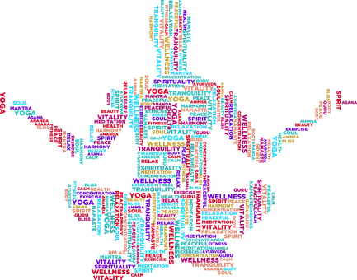
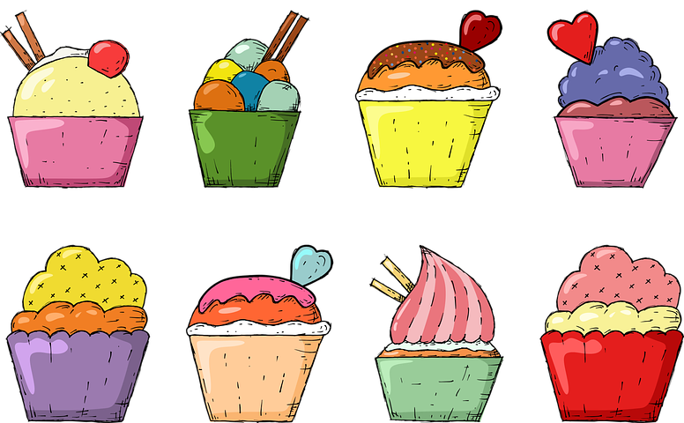
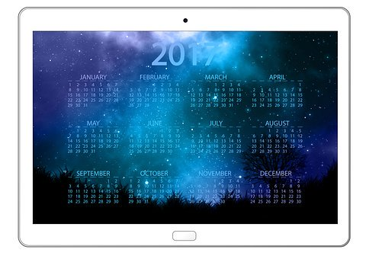
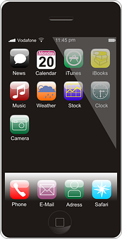
Other things you can try out to get a good nights sleep
Yoga
Yoga YouTube Channels like Cosmic Yoga for kids and specific Yoga apps are available for free. By Practicing Yoga it helps to relax the body, decreases heart rate and blood pressure and rest the mind.
Stay away from sugar
Sugar before bed will give a boost of energy (spike your blood sugar levels), you don’t want that before bed. Just a normal dinner is best. Ideally a mix of protein, a complex carbohydrate and veggies.
Limit Screen time
30-60 minutes no screen time before bed – screens are very entertaining, stimulating and engaging – bright colours – connections to friends or celebs – keeps our brains active. You need some quiet time for the brain to have a relaxing/restful sleep
Gratitude
Practice gratitude before bed by saying or writing down what we are grateful for puts us in a great mood. A mood full of appreciation fills us with Joy and love for life and the people around us who are supporting us. Happy hormone of Oxytocin is released and relaxes us making us feel at peace before we sleep conditioning the brain for happy dreams.
Breathing in for a 3-4 count, holding whilst counting to 3-4 and exhaling counting to 3-4, repeating as many times as needed to help relax your body and mind. Focuses your mind on the breath which allows the mind to rest, process all the information from your brain. This technique puts you into your body, when your attention is in the body you can feel want it needs more
This is not an exhaustive list but just some suggestions that may be helpful!
Please keep up to date with government guidance and take care of yourselves.
Notes:
Our physical health has a big impact on how we feel. At times like these, it can be easy to fall into unhealthy patterns of behaviour that end up making you feel worse. Try to eat healthy, well-balanced meals, drink enough water and exercise regularly.
If you are staying at home, you could try exercising indoors, as there’s lots of free online classes. Or try an easy 10-minute home workout.
Eating healthily, doing things you enjoy doing and trying something new as well; ensuring you communicate with as many people as you can and share your feelings with those close to you. Reward yourself as well. Treat yourself with your favourite Netflix programme when you have done a piece of work you are proud of.

Slide 6
Notes:
We also want to emphasise about staying safe online too. During a period of self-isolation more time is being spent online on our devices. The most important message is to think about your digital footprint. With every new photo or comment we post, we add a trail of information about ourselves which stays online. This is called a digital footprint. People who know us, and people who don’t, can see our digital footprints and learn about us. Our footprints can show us our good and most positive moments, but sometimes they reflect our thoughts and experiences that we later wish had been kept private.
It can be really hard to keep on top of all the things we post online. Take a moment before posting to consider everything just mentioned.
What do you need to consider?
Who is going to see this?
Am I sharing too much sensitive information about myself?
Is this going to offend anyone?
And then check your privacy settings, shut down any accounts you no longer use and choose your friends wisely. Whatever you do, think, before you post.

Slide 7
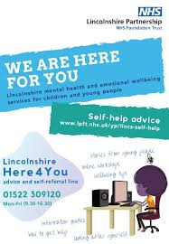

Slide 8
Contact, Contact, Contact
If you are worried or need to talk to someone at school then please get in touch with:
Tutor
Head of House
Safeguarding Team
ANY member of staff
Notes:
And lastly and most importantly, please do get in touch with your tutor if you are worried about anything, or your head of year. You can email them at school if you would like them to call you.
Please do look after yourselves and stay safe.

