Slide 1
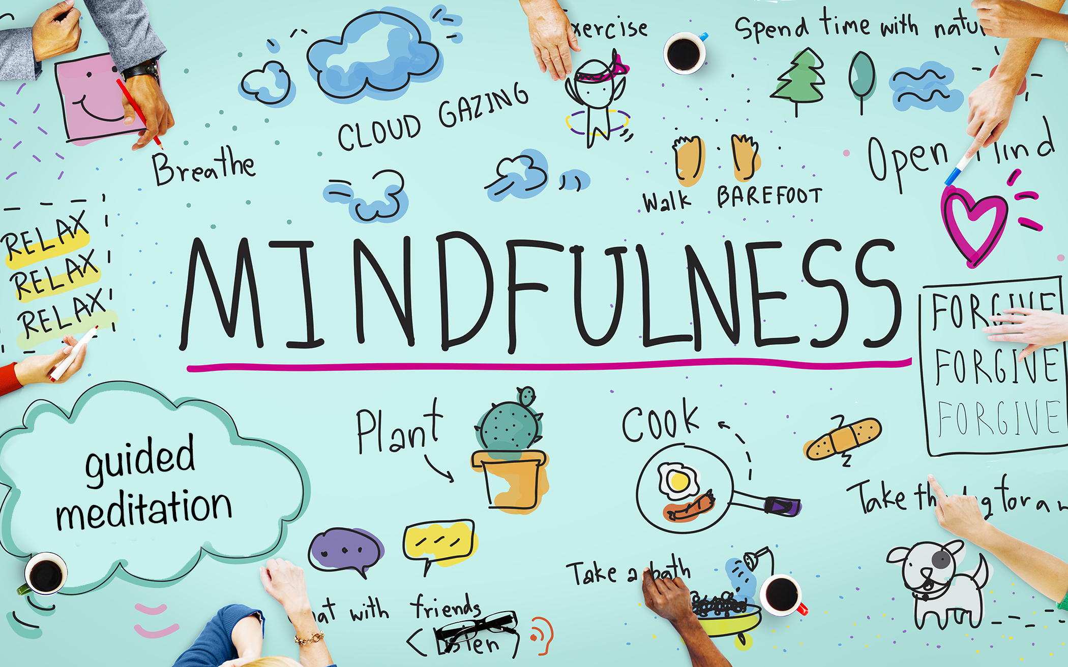
Mindfulness Activities for you all to try
Notes:
And finally, attached with this video are some slides which contact lots of activities for you have a go at during your period of self isolation. Some are creative, some involve acts of kindness and there is a breathing/meditation activity too so try the square breathing activity if it helps. We have attached some mindfulness colouring slides, this is something I particularly enjoy doing when feeling stressed.
Miss Dugan and I would love to hear back from you as well to see what tips and advice you have for good mental health and there is an activity to complete which you could send back to me and her via school email.
She and I have also attached a fun quiz for you to take part in – name the chocolate bar, country emoji and a general school quiz – send your answers in to us and we will reward you with some achievement points.

Slide 2
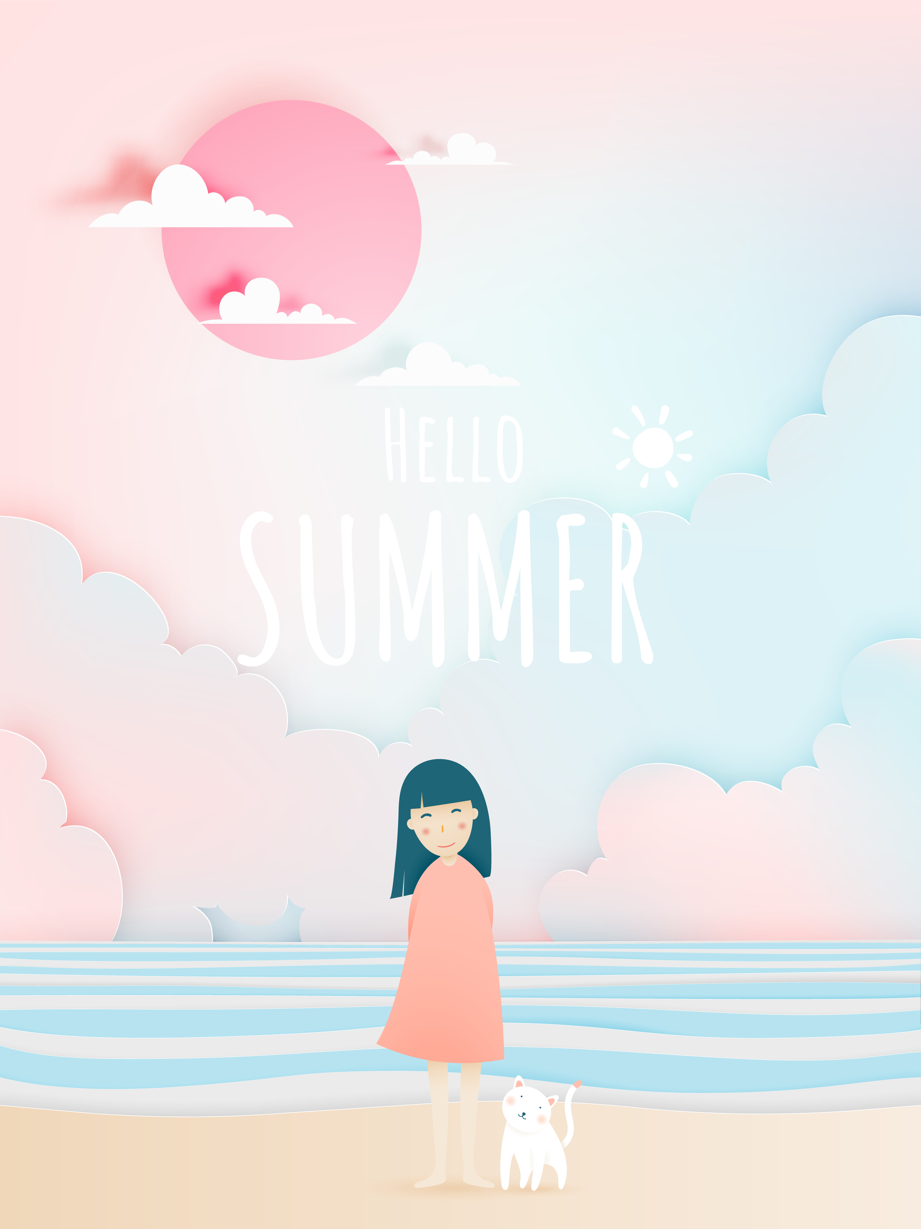
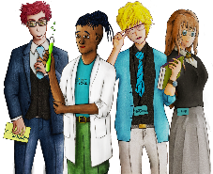
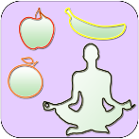
30 Day #Wellbeing Challenge
Day 1 Smile and say good morning to everyone in your household. | Day 2 Take 5 minutes to write down your feelings today. | Day 3 Do 20 Jumping Jacks and 50 knee ups.
Day 4 Visit an art gallery! Go online and explore the collections online. | Day 5 Reply to a pen pal or to someone you have not spoken to in a long time. | Day 6 Design a pair of trainers or shoes.
Day 7 Read 20 pages from the book you are reading or start a book | Day 8 Come up with a 10 question multiple choice quiz | Day 9 Listen to your favourite song and dance around the room.
Day 10 Go to bed 1 hour earlier tonight to wake up 1 hour earlier tomorrow. | Day 11 Sit down and focus on your breath for 5 minutes. | Day 12 Play a card game or board game you haven’t played in a while.
Day 13 Write a letter of appreciation to someone who helps. | Day 14 Draw and paint the most colourful thing in your house. | Day 15 Write a poem or short story.
Day 16 Ask your parent/caregiver about happy things in their life | Day 17 Research places you would like to travel to in your life time. | Day 18 Close your eyes and visualise your future life.
Day 19 Draw your favourite animal using geometric shapes. | Day 20 Use 10 French or Spanish words today. | Day 21 Make sure you get >8 hours sleep tonight. Note how you feel the next day.
Day 22 Draw but listen to your favourite music. See what flows naturally | Day 23 Do something nice for a sibling or parent/carer. | Day 24 Stretch and move your body any way that feels good for 10 minutes
Day 25 Clean a room in the house that is not your bedroom. | Day 26 Design a pair of trainers or shoes. | Day 27 Tidy your room, maybe re organise the layout.
Day 28 Ensure you have >5 fruit and veg today – Write them all day | Day 29 Do something helpful for a friend or family member today. | Day 30 Write down 10 things you love about your life
Notes:
This is not an exhaustive list but just some suggestions that may be helpful!
Please keep up to date with government guidance and take care of yourselves

Slide 3
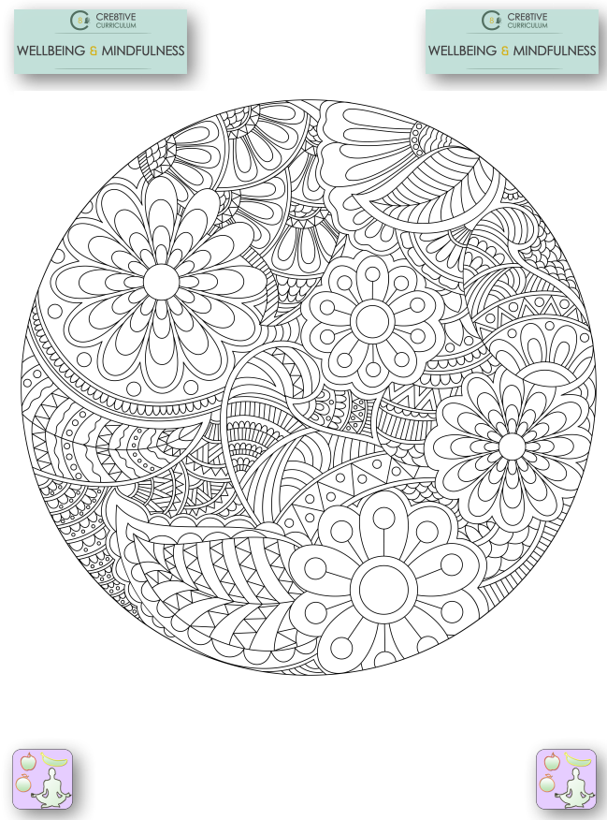

Slide 4
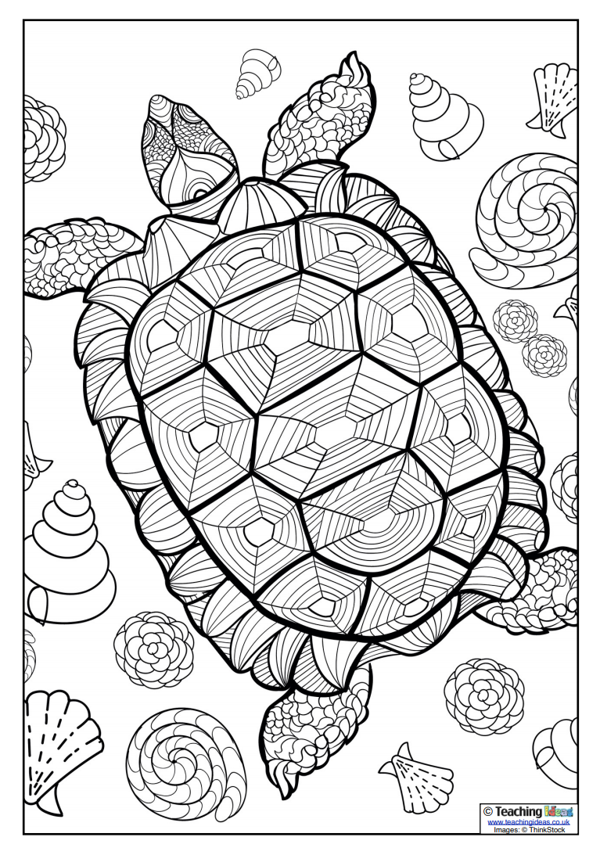

Slide 5
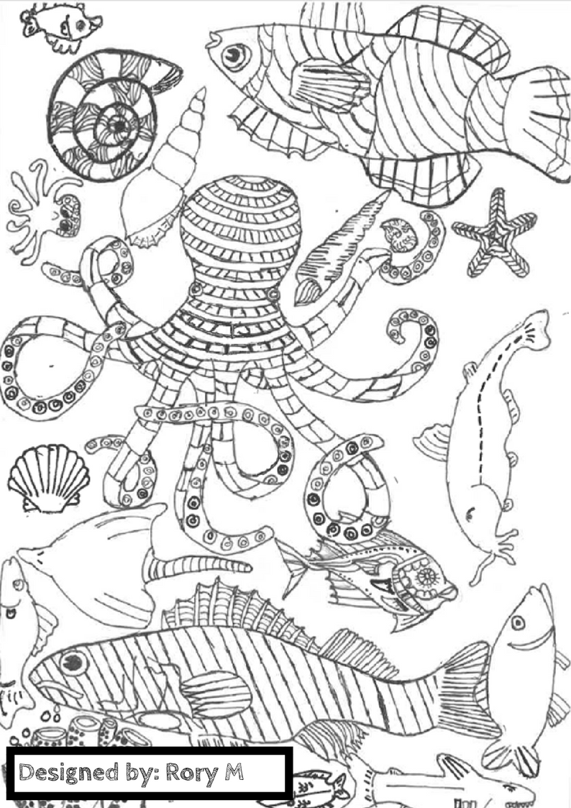

Slide 7
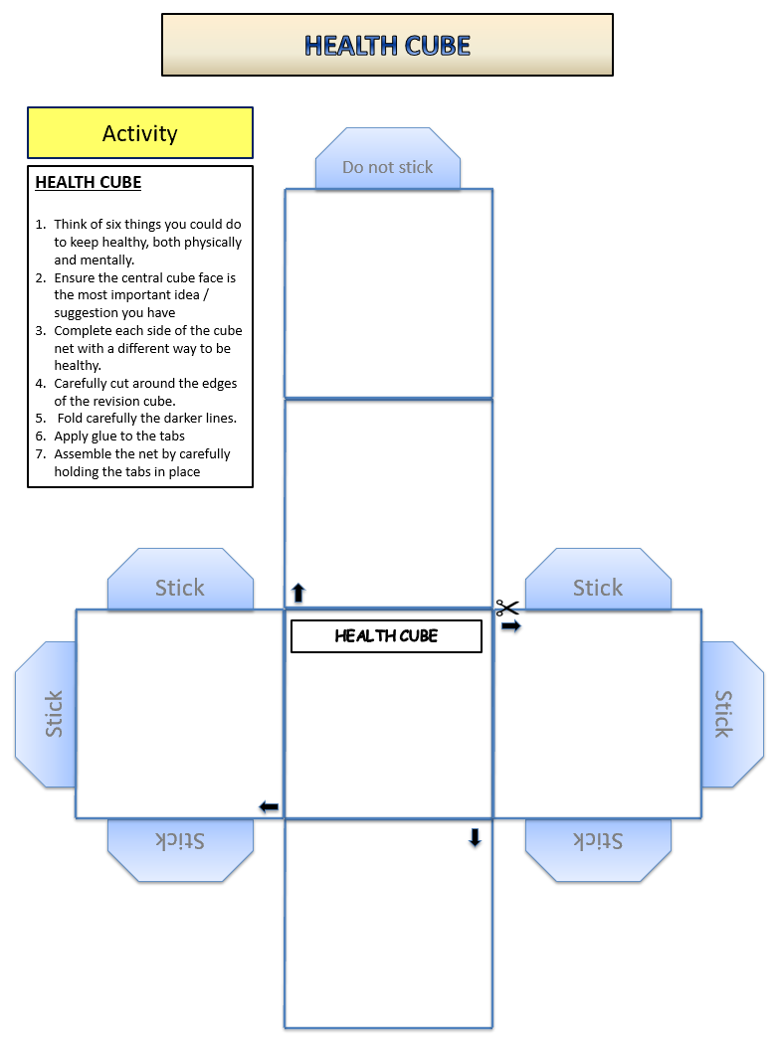

Slide 8
Square Breathing
Square breathing, also referred to as four-square breathing, is a breathing technique that helps you to feel invigorated, energized, and focused. It can also help to reduce stress and invite feelings of calmness and tranquility into your mind and body.
https://www.youtube.com/watch?v=YFdZXwE6fRE

Slide 10
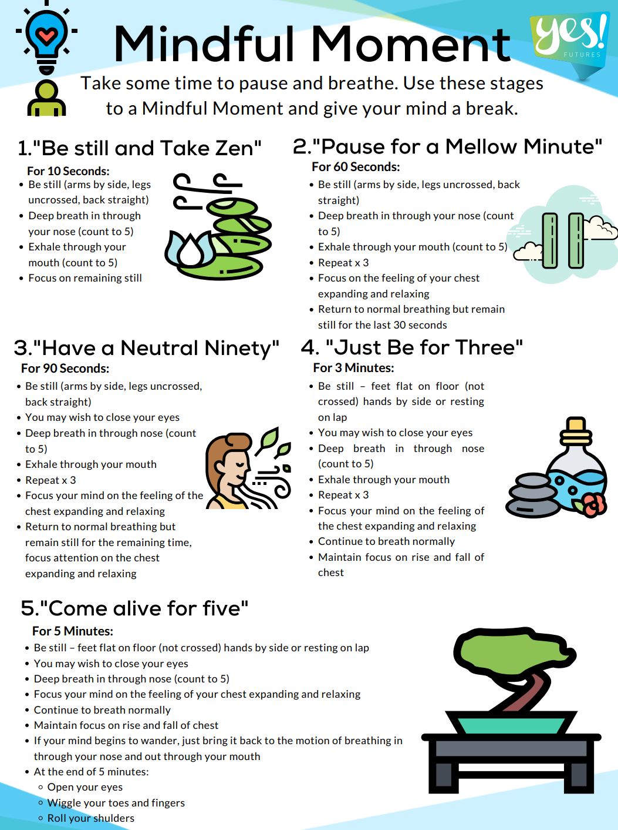

Slide 11
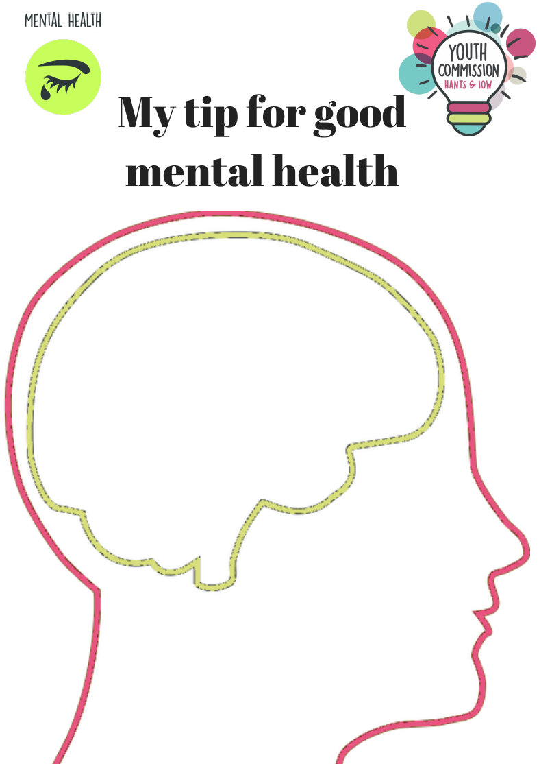

Slide 12
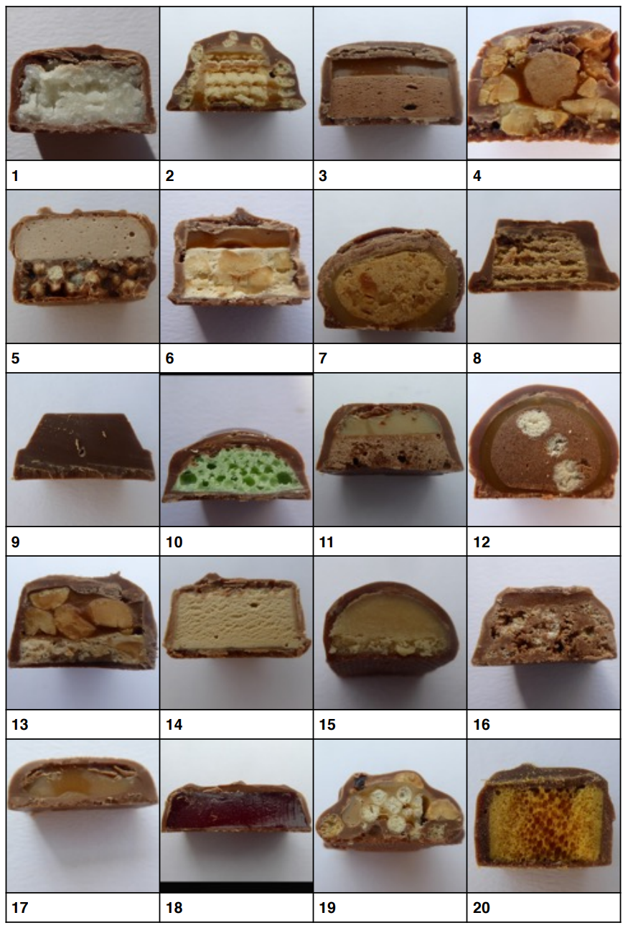
Name the Chocolate Bar!

Slide 13
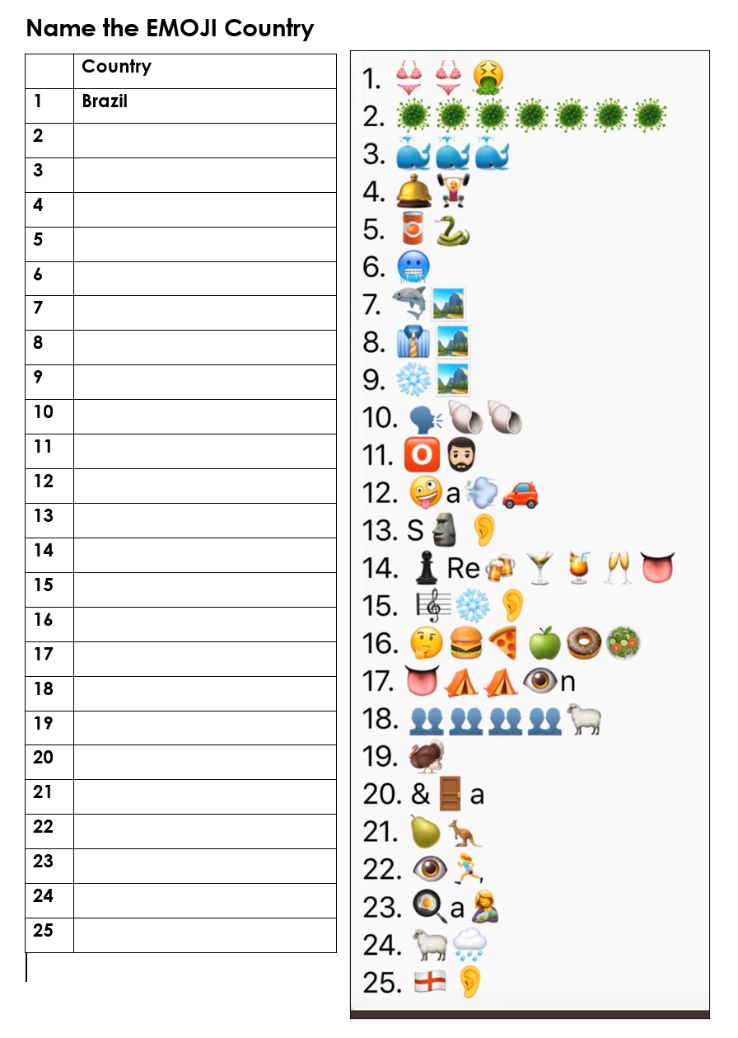

Slide 14
School Quiz! ☺
1. How many teeth does an adult human have?
2. What is the largest bird of prey in the world?
3. In which sport would you use a shuttlecock?
4. Who is fifth in line to the British throne?
5. What is the biggest state in America?
7. What is the capital of Hawaii?
8. Enchiladas originated in which country?
9. In Dirty Dancing, what is Baby's first name?
10. How many eggs does the average chicken lay per year?
12. What is a group of lions called?
13. Where would you find the River Thames?
14. What animal alive today is even bigger than a dinosaur?
15. What alcohol do you traditionally use to flame a Christmas pudding?
16. What is a baby kangaroo called?
17.What year did Rihanna achieve global success with the mega-hit 'Umbrella’?
18. Name the slowest animal in the world.
19. Is the sun a star or a planet?
20. What are the names of Harry Potter’s parents?
22. What is the capital city of Spain?
23. How many legs does a lobster have?
26. What's the best selling book of all time?
27. In which English county is the town of Stevenage?
28. Botany is the study of what?
29. To the tip - how tall is the Eiffel Tower?

