Slide 1


Knowledge Organiser
Year 8 Autumn 1 2021
Name:
Form and Tutor:

Slide 2
Year 8 Autumn 1 Term Knowledge Organiser 2021
Contents Page
Instructions for use | 3
Homework Timetable | 4
Diary pages | 5
Subject: English | Will be handed out in class
Subject: Maths | 7
Subject: Science | 8
Subject: RE | 9
Subject: Geography | 10
Subject: History | 11
Subject: PE | 12
Subject: Spanish | 13
Subject: Food Technology | 15
Subject: Music | 16
Subject: Computing/IT | 17
Subject: Drama | 18
Subject: Art | 19

Slide 3
You can use your KOs and book in a variety of ways (see next page) but you should not just copy from the Knowledge Organiser into your book.
Mark your work using a different coloured pen
You may also be set additional homework by your teachers at their discretion – make sure you record all information in your school planner and/or the homework notes section on P.5 and P.6
Year 8 Autumn Term Knowledge Organiser 2021
Homework Timetable
You are expected to study the subjects shown on your timetable each day.
Each day use a page of your exercise book to evidence your work: half a page per subject.
Week starting 6th September | Subject 1 | Subject 2 | Signed Off
Monday | English | History
Tuesday | Maths | PE
Wednesday | Science | Spanish
Thursday | RE | Food
Friday | Geography | Music
Week starting 13th September | Subject 1 | Subject 2 | Signed Off
Monday | English | Drama
Tuesday | Maths | Art
Wednesday | Science | Geography
Thursday | RE | History
Friday | IT | PE
Week starting 20th September | Subject 1 | Subject 2 | Signed Off
Monday | English | Food
Tuesday | Maths | Music
Wednesday | Science | IT
Thursday | RE | Drama
Friday | Spanish | Art
Week starting 27th September | Subject 1 | Subject 2 | Signed Off
Monday | English | History
Tuesday | Maths | PE
Wednesday | Science | Spanish
Thursday | RE | Food
Friday | Geography | Music
Week starting 4th October | Subject 1 | Subject 2 | Signed Off
Monday | English | Drama
Tuesday | Maths | Art
Wednesday | Science | Geography
Thursday | RE | History
Friday | IT | PE
Week starting 11th October | Subject 1 | Subject 2 | Signed Off
Monday | English | Food
Tuesday | Maths | Music
Wednesday | Science | IT
Thursday | RE | Drama
Friday | Spanish | Art
Week starting 18th October | Subject 1 | Subject 2 | Signed Off
Monday | English | Music
Tuesday | Maths | Art
Wednesday | Science | Food
Thursday | RE | Spanish

Slide 4

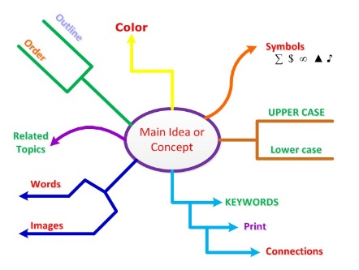
Year 8 Autumn 1 Term Knowledge Organiser 2021
Read, Cover, Write Step 1: Read the part of the section you want to remember. Step 2: Read it again. Step 3: Read it aloud. Step 4: Cover the part you are remembering with your book. Step 5: Write as much as you can remember in your exercise book. Step 6: Check your answers with a tick for correct answers or a cross for incorrect. Step 7: Correct your mistakes with the information from that section. | Mind Mapping Step 1: Read the part of the section you want to remember. Step 2: Draw a mind map with the key information. Step 3: Add and extra information that provides more detail about the topic Step 4: Check your answers using the information in all three sections of the Knowledge Organiser. Step 5: Correct any mistakes | Explaining a Diagram Step 1: Read, cover and recreate the diagram Step 2: Write a paragraph explaining what is happening in the diagram and give specific examples. Step 3: Check your answers using your class notes or ask your teacher to check in your next lesson. Step 5: Correct any mistakes | Putting new words into sentences There was a sense of foreboding through the reference to the ‘shadows that followed’ Step 1: Read, cover, write the new words and their definitions Step 2: Write a sentence that includes the new word into a real context, just as you would use it in a lesson/exam question. Step 3: Check your answer with a friend or ask your teacher to check you have used them correctly. Step 5: Correct any mistakes
You will find tasks to complete on each subject page, but use this page to help with additional tasks!
Foreboding | A feeling that something bad will happen.

Slide 5


Slide 7
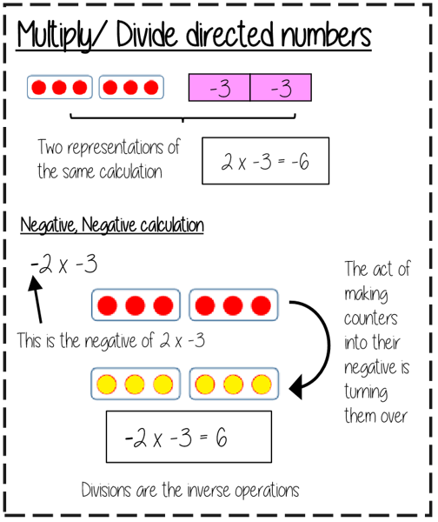
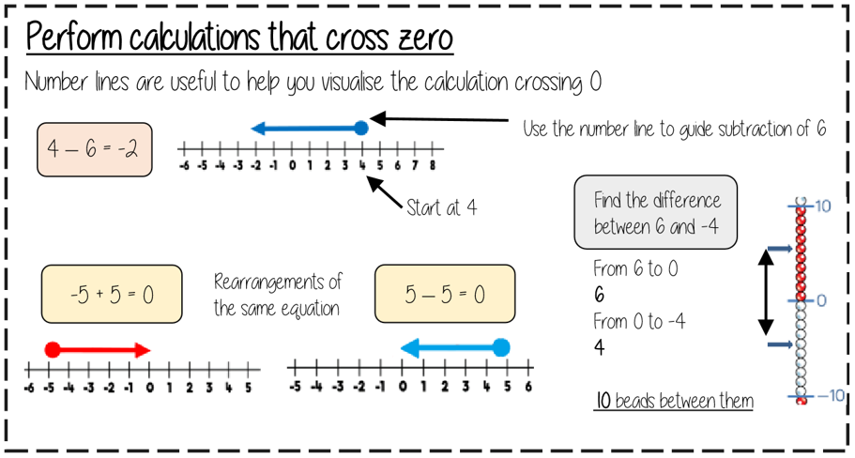
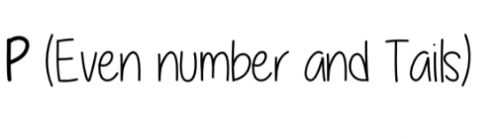
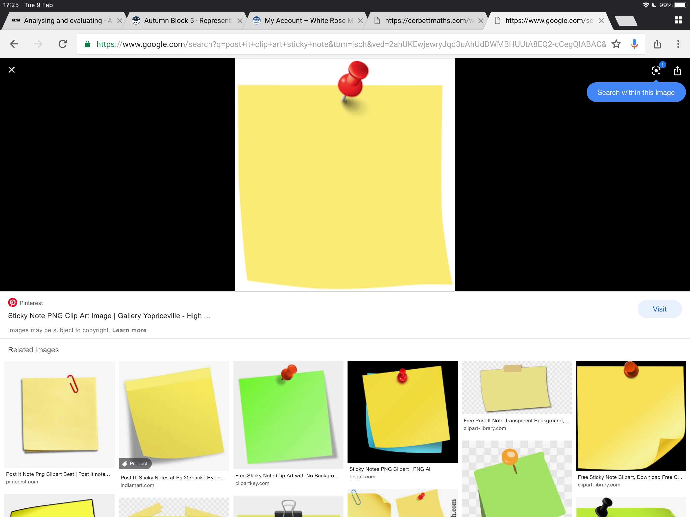
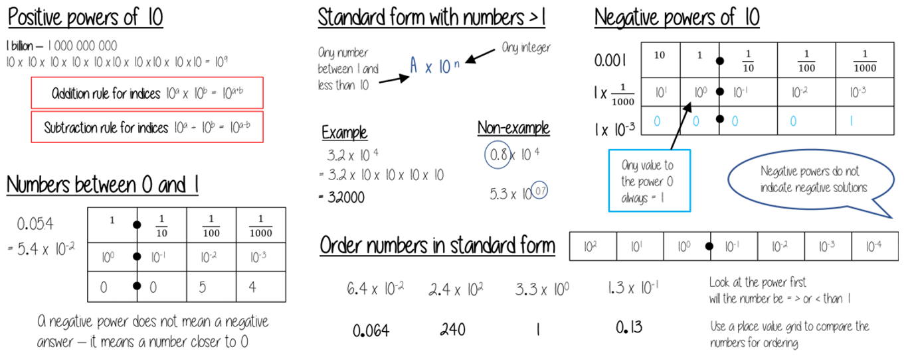
Y8 Mathematics: Numbers, The Number System & Calculating
Keywords
Multiple – a number found in the multiplication tables
Factor – a number that can divide into another number with no remainder
HCF – Highest Common Factor – the largest number that divides into 2 or more numbers with no remainder
LCM – Lowest Common Multiple – the smallest number found in the multiplication tables of 2 or more numbers
Prime Number – a number with exactly 2 factors: 1 and itself
Standard Index Form – a method of expressing very big or very small numbers in a way that is easier to understand
Task 1 Create Keyword Flashcards
Task 3. Draw some directed number arrays showing why multiplying 2 negatives has a positive result
Task 2 Using number lines show some addition and subtraction examples using negative numbers
Task 5 – Try rewriting an explanation of how to express a number in standard form.
Task 5/6
Make sure that you fully understand the work from this term. Prepare for an assessment
Task 4 – Write a list of large and small numbers in standard form.
Convert FDP
By the end of this unit you should be able to:
Find common factors and multiples
Recognise problems involving HCF and LCM
Be able to use formal methods of addition, subtraction, multiplication and division
Understand the difference between proper and improper fractions
By the end of this term, you should be able to:
Find prime factors of any number
Add and subtract using negative numbers
Multiply and divide using negative numbers
Express very large numbers using standard form
Express very small numbers using standard form

Slide 8

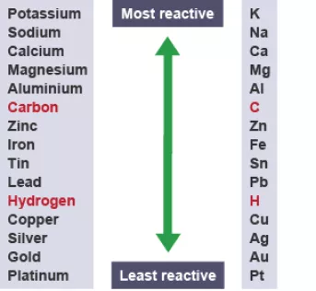
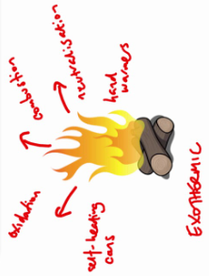
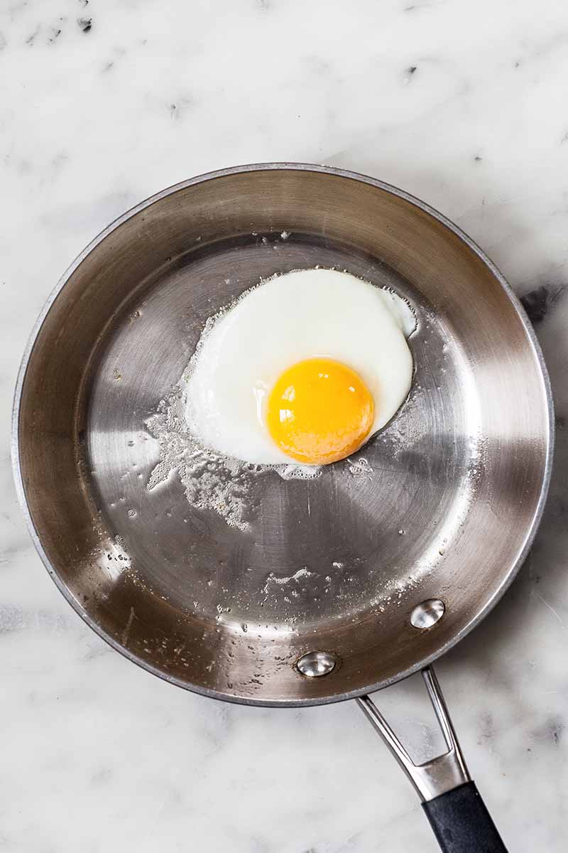
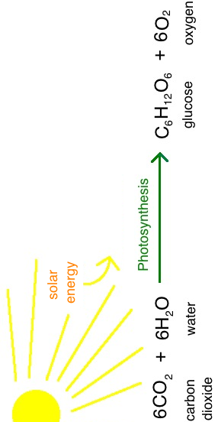
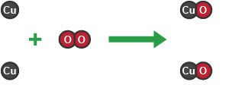
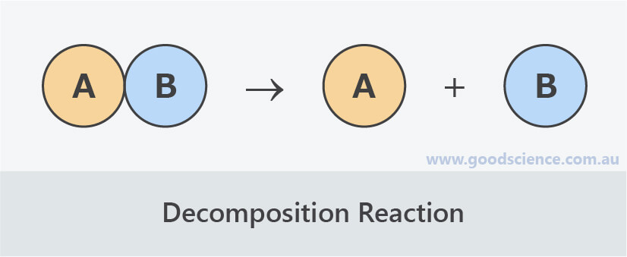
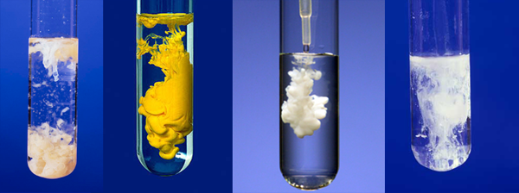
Example
Definition | A process in which one or more substances, the reactants, are converted to one or more different substances, the products. | No atoms are created or destroyed in a chemical reaction; there are the same number of atoms in reactants as there are in products. | A substance that is burnt to release energy. | A reaction in which heat energy is released to the surroundings. | A reaction in which heat energy is taken in from the surroundings. | A reaction where a substance breaks down into two or more simpler substances. | A reaction in which substances in solution are mixed and an insoluble product is made. | The reactivity series lists metals from the most reactive to the least reactive.
Word | Chemical reaction Write the word equations for respiration and photosynthesis, labelling the reactants and products in each case. | Conservation of mass Look, cover, write. Look, cover, draw. | Fuel Make a list of as many fuels as you can think of. | Exothermic reaction Cue cards! | Endothermic reaction Cue cards! | Decomposition reaction Write a word equation for the decomposition of calcium carbonate into calcium oxide and carbon dioxide. | Precipitation reaction Look, cover, write. | Reactivity series Write a mnemonic/song/ rhyme/rap to remember the order of metals in the reactivity series!

Slide 9
Site | Location | Religion | Importance of site
Kab’ah | Makkah (Saudi Arabia) | Islam | House of God, believed to be built by Abraham and Ismail Going on Hajj to Makkah is one of the 5 pillars of Islam
Golden Temple | Amritsar (India) | Sikhism | Built by Guru Ram Das Holiest pilgrimage site of Sikhism
Grotto of Massabielle | Lourdes (France) | Christianity | Saint Bernadette had a vision of the Virgin Mary If you bathe in the waters from the spring, pilgrims believe they can be healed
Western Wall | Jerusalem (Israel) | Judaism | Only remaining part of the wall of the Temple which was built by King Solomon
Church of the Holy Sepulcher | Jerusalem (Israel) | Christianity | Built on the site of Jesus’ crucifixion
Year 8 Religious Education
Task 4:
‘Its important to understand what other people believe in.’
Discuss this statement showing a balanced opinion & use examples
HOT TIP – Why is it important to understand people’s beliefs? What can it tell us about people and the world around us? Does everyone have to believe the same thing? Should differences be celebrated?
Task 1:
Using the information in the table as a starting point, choose 3 sites of Pilgrimage and create a poster for each detailing why its important and why people go
Extension:
Where would you go on a pilgrimage and why?
Task 2:
Create a diamond 9 on what you consider to be the most/least important reasons for people to go on pilgrimage
To strengthen their faith
To become closer to God
To show commitment to their faith
In the hope that they will be healed
To make up for something they they have done wrong
It is part of their duty to their religion
So that some of the holiness of the place will rub off on them
To be inspired by their faith
For a holiday
Extension:
Do you think using a computer/phone/tablet to visit a holy site counts as going on pilgrimage nowadays?
Pilgrimage | Pilgrim | Prayer | Shrine
A special journey made by a believer to a holy site made for religious reasons | Someone who goes on religious journey | The raising of the heart and mind to God | A place which is special because it connected with a sacred person or object
Task 3:
Extension: Create a picture for each Key Word

Slide 10
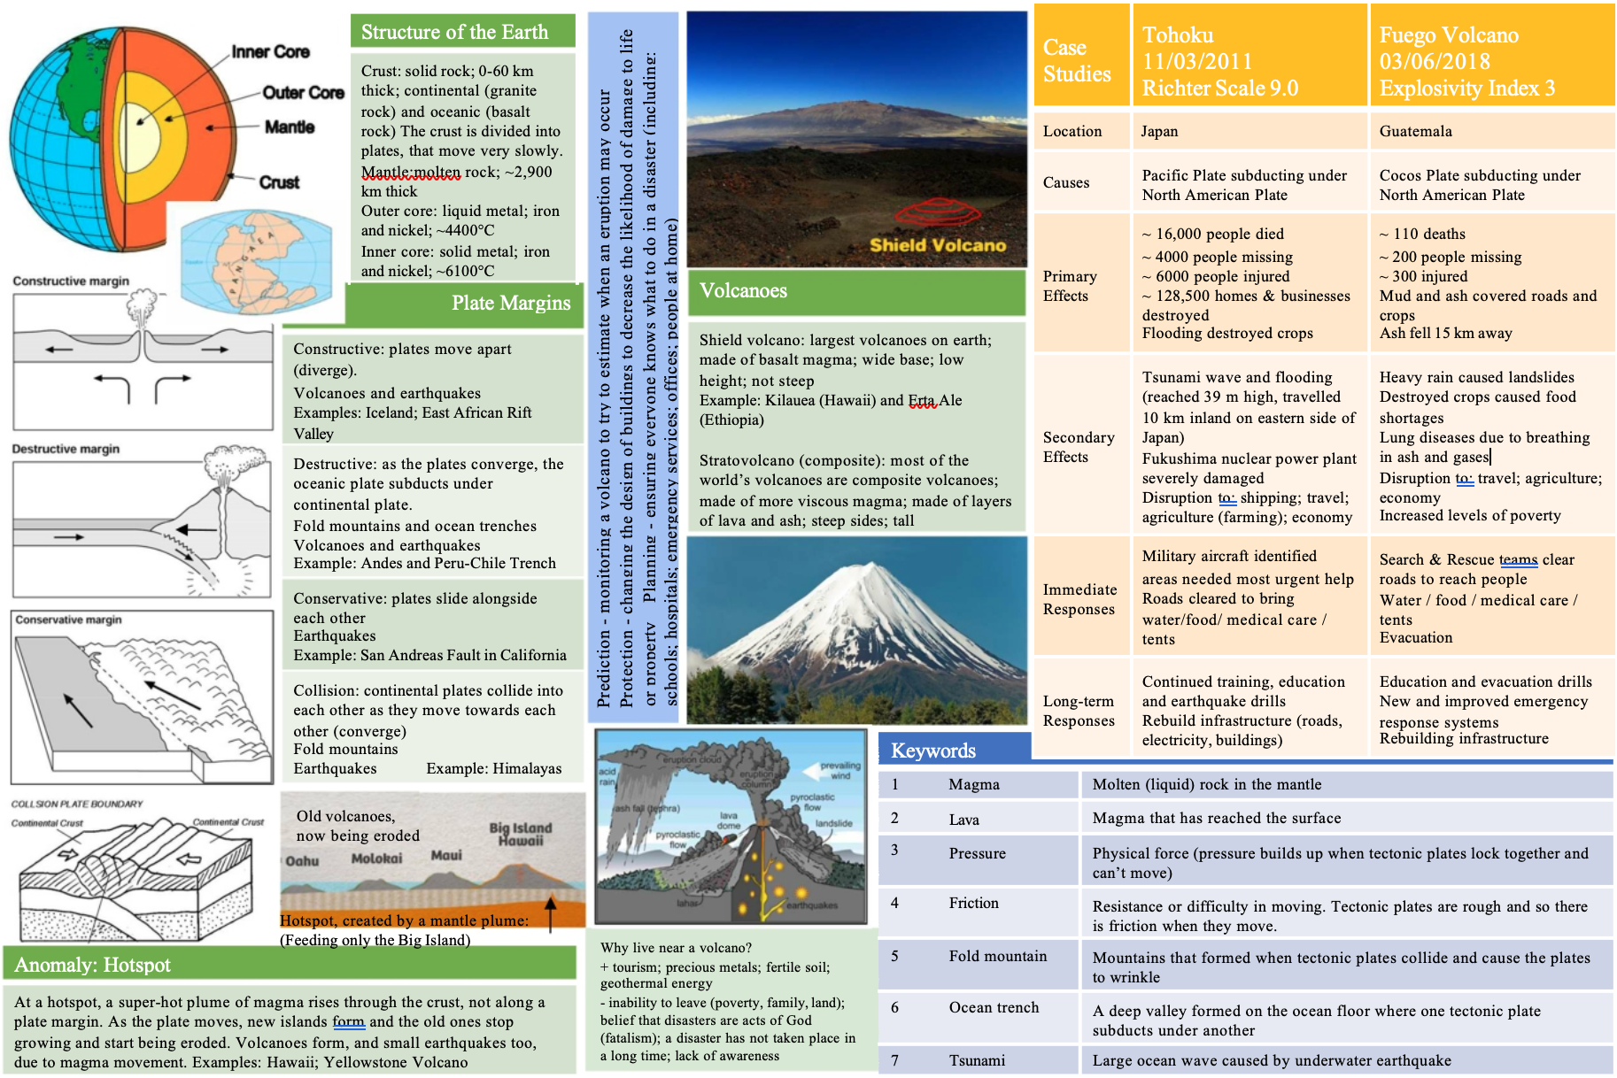
WHAT ARE THE LAYERS OF THE EARTH CALLED?
WHAT ARE THEY MADE OF?
WHICH ONE IS THE HOTTEST?
GEOGRAPHY Year 8: Plate Tectonic
THERE ARE 2 TYPES OF VOLCANO, WHAT ARE THEY? WHICH IS THE MOST COMMON?
COMPARE THESE 2 EARTHQUAKE
WHERE DID THESE HAPPEN?
WHEN?
WHICH WAS STRONGER?
WHICH DID MOST DAMAGE?
WHAT OTHER EFFECTS DID THEY CAUSE?
DRAW THE 4 TYPES OF PLATE BOUNDARY/ MARGIN. WHAT DIRECTIONS DO THEY MOVE IN?
WHAT HAPPENS AT THESE MARGINS?
MAKE FLASHCARDS TO HELP YOU REMEMBER THE IMPORTANT KEY WORDS

Slide 11
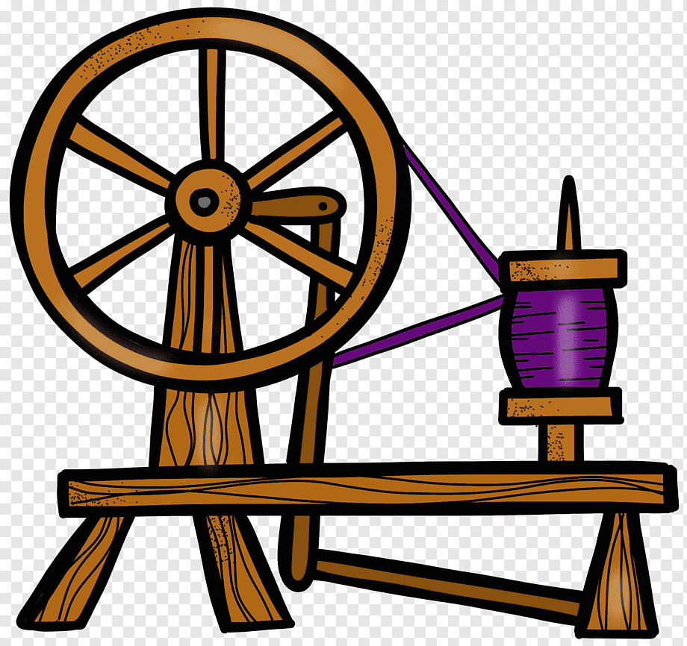
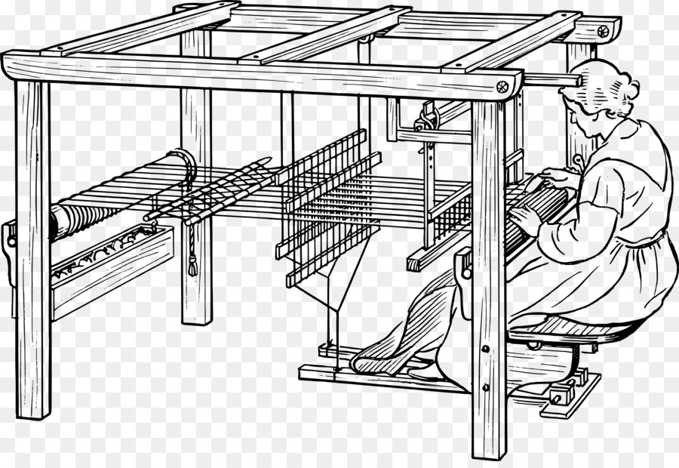
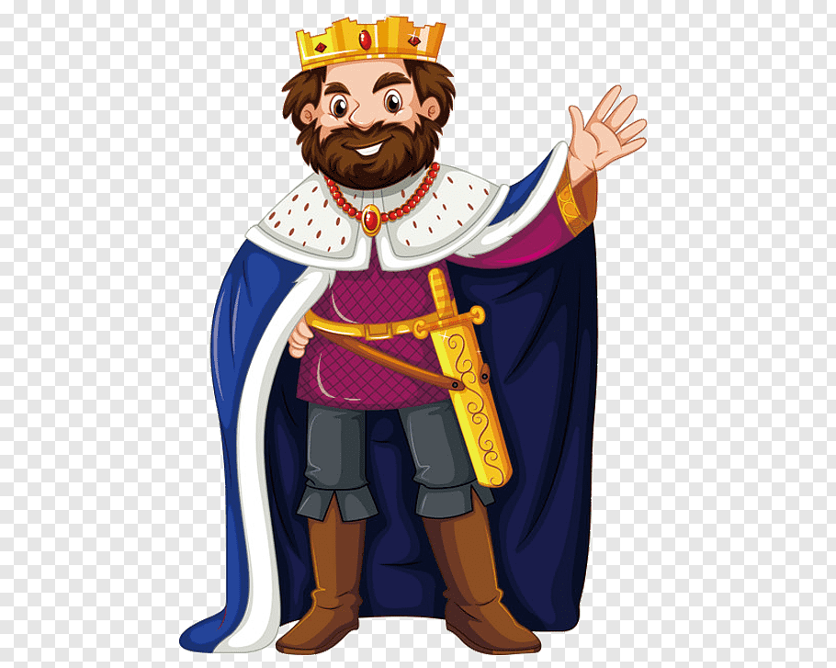
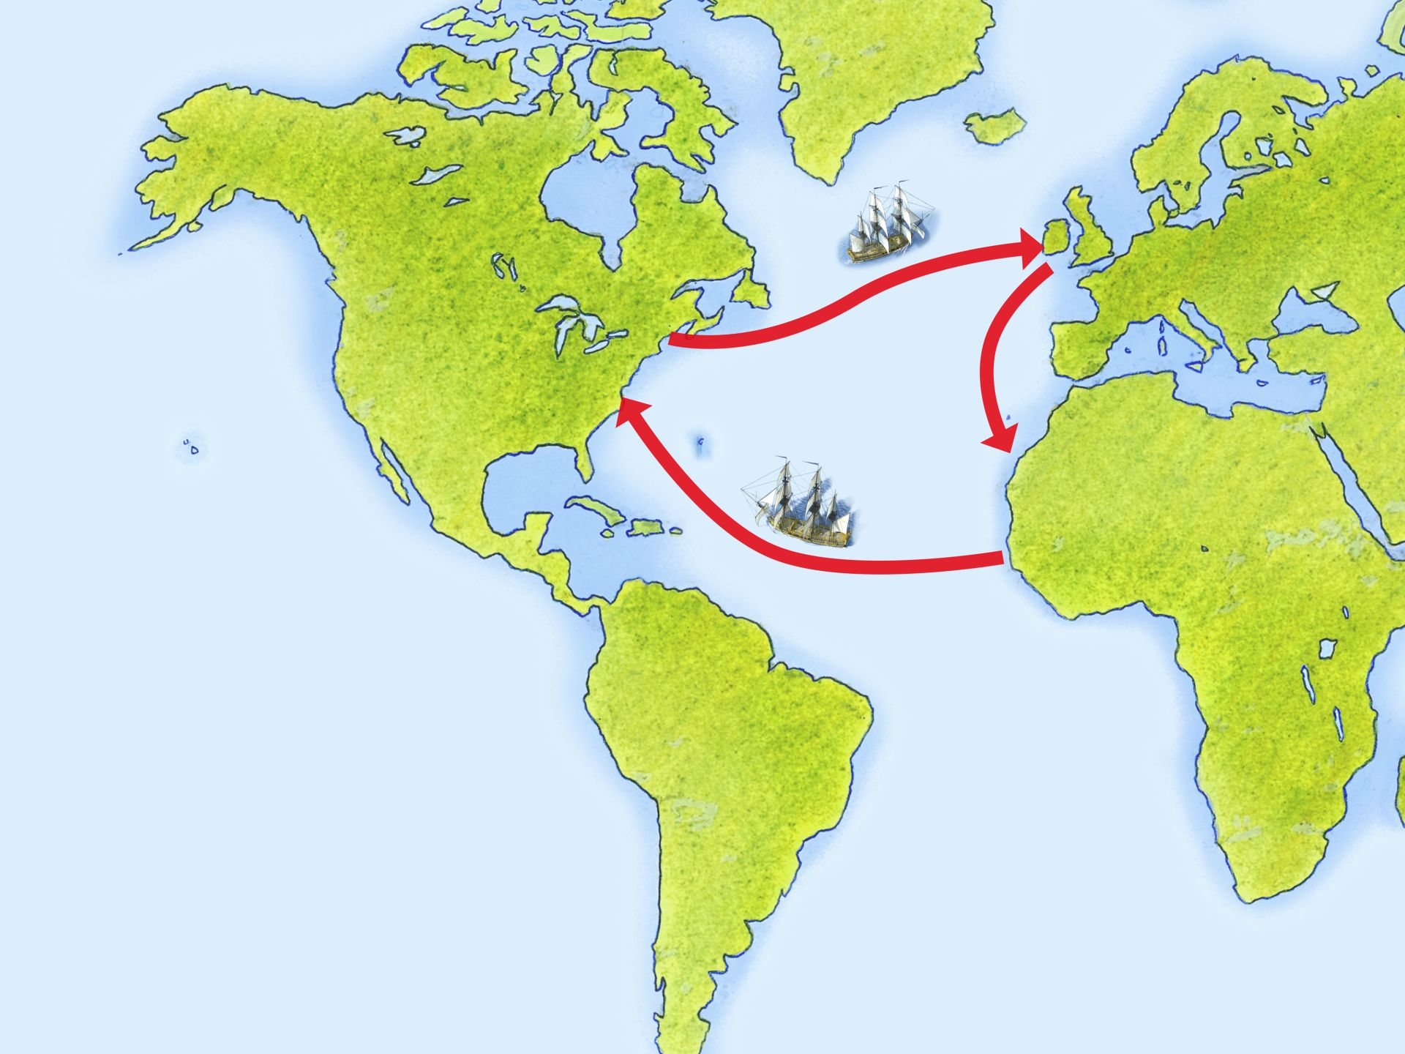


History:
Industrial Britain
Key Terms – Task 1 – LOOK, COVER, WRITE, CHECK
Key Terms | Definition | Image
Spinning Jenny | An early machine that would spin cotton on more than one spindle
Power Loom | A machine, designed in 1784, able to weave fabric using mechanical power
Monarch | A king or queen of a country
Triangular Trade | Trade between three different countries or regions
Factory | A building, or group of buildings, where goods are manufactured or assembled chiefly by machine
Abolition | The act of officially ending or stopping something, such as slavery
Key Events – Task 4 – Create a timeline for ‘The British Empire and Slavery’
1787 – The first shipment of transported prisoners to Australia in the British Empire
1789 – Olaudah Equiano published his autobiography
1807 – First Abolition of the Slave Trade Act. This banned the trading of slaves across the Atlantic
1833 – This Act gave all slaves in the British Empire their freedom
1871 – The ‘Scramble for Africa’ begins as European countries aim to take over African countries for their empires
Key Dates – Task 2 – Create a timeline for ‘Industrial Britain’
1750 – Considered to be the starting point of the Industrial Revolution
1765 – Hargreaves invents the Spinning Jenny for spinning thread
1785 – Cartwright invents the power loom
1801 – The first census is taken
1832 – Cholera outbreaks occur in British cities
1833 – The Factory Act prevents the use of children at work until they’re 9
1849 – 10,000 people died in 3 months in London from a cholera epidemic
1875 – The Public Health Act ensures public health is adequate
1901 – Education Act makes school compulsory for children up to 10 years
Key Inventions – Task 5 – Create Flashcards
Create flashcards for inventions and the dates they were invented – on the other side, write the inventor’s name:
Spinning Jenny (1765) = James Hargreaves
Steam Engine (1712) = Thomas Newcomen
Power Loom (1785) = Edmund Cartwright
Photograph (1826) = Joseph Nicéphore Niépce
Typewriter (1829) = William Burt
Key Countries – Task 3 – Create a mindmap
Create a mindmap for ‘Countries of the British Empire’ and use the following examples:
Canada
Egypt
India
Australia
New Zealand
South Africa
Jamaica

Slide 12
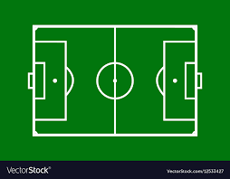
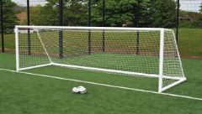
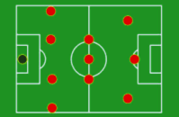
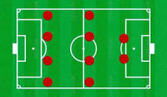

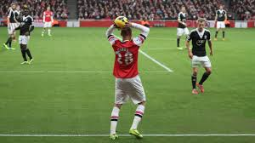
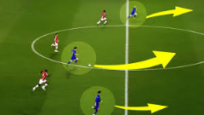
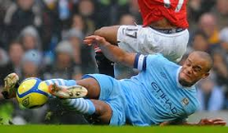
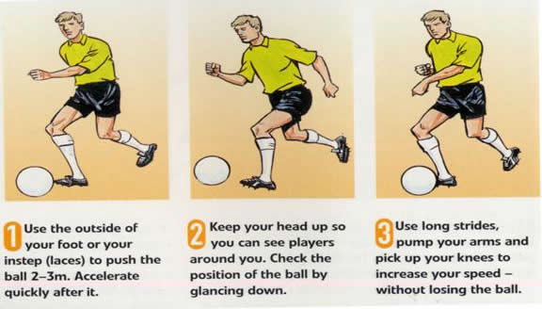
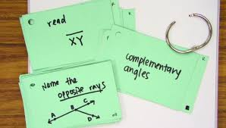
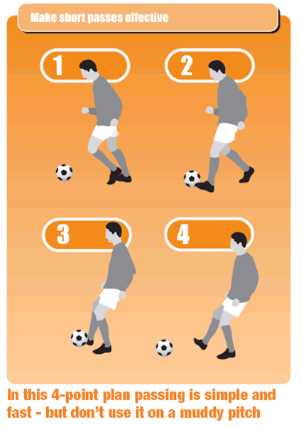
Physical Education Year 8 Term 1 Football
Section 1: Key Words: Look, Cover, Write, Check
Pitch | This is what the game is played on.
Goal posts | These are at either end of the pitch and are the target to score in.
Football | The game is played with a ball, the size will depend on the age group playing.
Throw in | This is awarded when the ball goes off the side of the pitch. The ball must be in two hands behind your head with both feet on the floor
Attack | When you have possession of the ball you are in attack and must try and score a goal.
Defense | When your team do not have the ball, you will be on the defense trying to get it back
Section 6: Knowledge recall: Create flashcards for each question.
Question
1. How is a game of football started?
2. How many players should be on the pitch at one time?
3. How do teams score?
4.What would the referee give if the defending team kicks it out of play behind their own goal?
5. How big is the goal keepers area?
6. If your team was losing with 15 minutes left, which formation would you use and why?
7. What are the different sizes of football for each age group?
8. What happens at the end of the game if it’s a draw? Explain when this differs and how.
Section 3: Formations: Below are two common formations used in football. Can you create your own formations? How many can you think of, explain each one.
Section 4: Dribbling Key Points: Look, Cover, Write, Check
You can use all parts of your foot Relaxed body Keep the ball close to your boot Maintain good balance Head up
Section 2: Basic Rules: Create a Mind Map to help you remember the rules of Football. If you know more, add them. I want to see who knows the most.
The game is started by a kick off in the centre of the pitch. A full sided game is made up of two teams of 11 players. If the ball goes off the side of the pitch, it is a throw in to the team that didn’t touch the ball last. If the ball goes of the pitch at the ends behind the goal, it is either a corner or goal kick, depending on who touched the ball last. The goalkeeper is the only player that is allowed to use their hands and must do so in the 18 yard box. A goal is scored when the ball crosses the oppositions goal line. The team with the most goals at the end of the game is the winner.
Section 5: Passing Key Points: Look, Cover, Write, Check
Non-kicking foot next to the ball Use this foot to aim at your target Body over the ball upon contact Strike the ball with the inside of foot Smooth follow through will add power

Slide 13
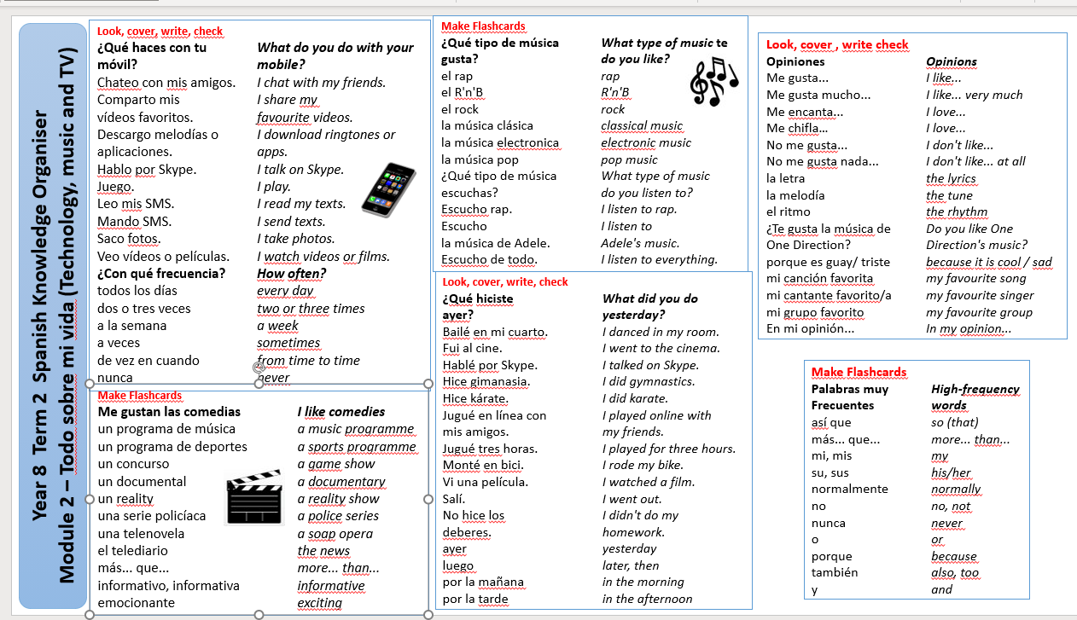

Slide 14
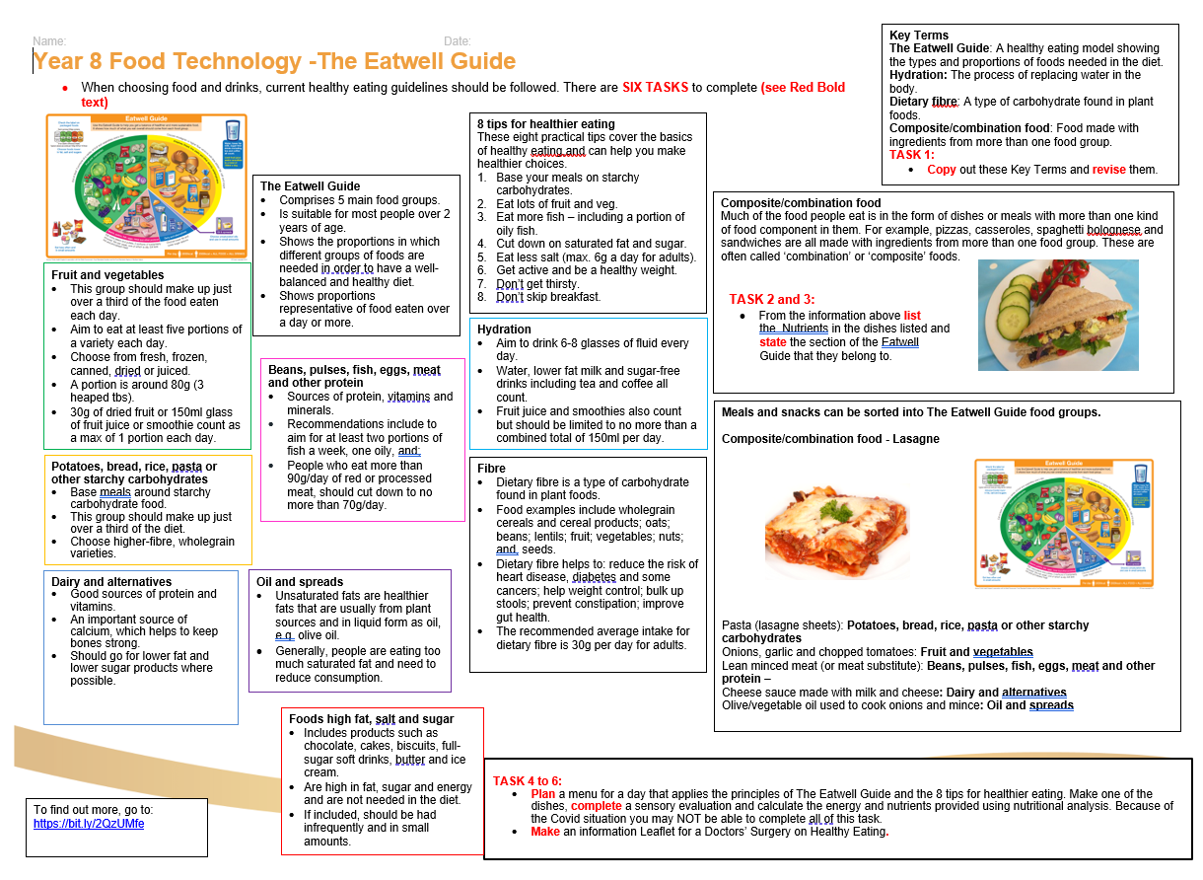

Slide 15


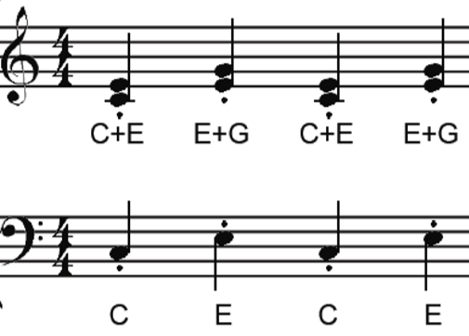
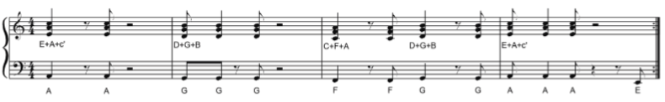


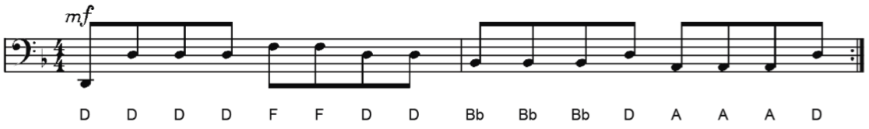
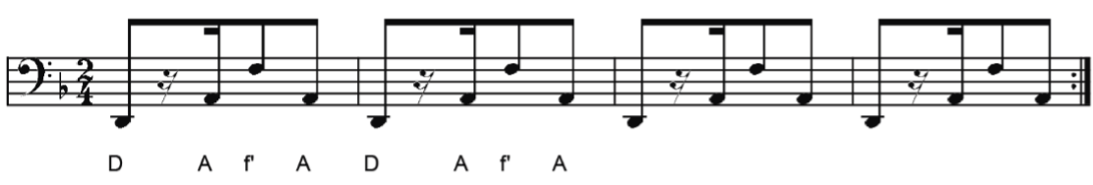
Hooks and Riffs | Exploring Repeated Musical Patterns
A. Key Words | B. Famous Hooks, Riffs and Ostinatos | C. Music Theory
HOOK – A ‘musical hook’ is usually the ‘catchy bit’ of the song that you will remember. It is often short and used and repeated in different places throughout the piece. HOOKS can either be a: MELODIC HOOK – a HOOK based on the instruments and the singers RHYTHMIC HOOK – a HOOK based on the patterns in the drums and bass parts or a VERBAL/LYRICAL HOOK – a HOOK based on the rhyming and/or repeated words of the chorus. RIFF – A repeated musical pattern often used in the introduction and instrumental breaks in a song or piece of music. RIFFS can be rhythmic, melodic or lyrical, short and repeated. OSTINATO – A repeated musical pattern. The same meaning as the word RIFF but used when describing repeated musical patterns in “classical” and some “World” music. BASS LINE – The lowest pitched part of the music often played on bass instruments such as the bass guitar or double bass. RIFFS are often used in BASS LINES. MELODY – The main “tune” of a song or piece of music, played higher in pitch that the BASS LINE and it may also contain RIFFS or HOOKS. In “Classical Music”, the melody line is often performed “with” an OSTINATO pattern below. |  | REPEAT SYMBOL – A musical symbol used in staff notation consisting of two vertical dots followed by double bar lines showing the performer should go back to either the start of the piece or to the corresponding sign facing the other way and repeat that section of music. TREBLE CLEF – A musical symbol showing that notes are to be performed at a higher pitch. Also called the G clef since it indicates that the second line up is the note G. BASS CLEF – A musical symbol showing that notes are to be performed at a lower pitch. The BASS LINE part is often written using the BASS CLEF. Also called the F clef since it indicates that the fourth line up is the note F.
 | Bass Line Riff from “Sweet Dreams” – The Eurythmics Riff from “Word Up” – Cameo Rhythmic Riff from “We Will Rock You” – Queen Vocal and Melodic Hook from “We Will Rock You” – Queen Rhythmic Ostinato from “Bolero” - Ravel Bass Line Ostinato from “Habanera” from ‘Carmen’ - Bizet Ostinato from 2nd Movement of Symphony No.101 (The Clock) – Haydn
Tasks
Look cover write, and check for all the keywords (these are in bold) Listen to a favourite song and describe it using the A: Keywords Listen to the songs mentioned in B: Famous Hooks, Riffs and Ostinatos and see if you can hear them.

Slide 16
Year 8 Computing /IT
Intro to Python programming
First steps | In this introductory lesson, you will write and execute your first programs in Python. You will go through the basics of displaying messages, assigning values to variables, and receiving input from the keyboard. For this unit, you will need a Repl.it account. You should ask your parent or carer for permission to set one of these up
Crunching numbers | In this lesson, you will gain a deeper understanding of assignment. You will also explore arithmetic expressions.
At a crossroads | In this lesson you will learn about randomness and using selection in your Python programs.
More branches | In this lesson you will learn about multi-branch selection and while loops.
Round and round | In this lesson you will learn how to use a variable as a counter within a loop.
Putting it all together | In this lesson you will extend and improve a guess the number game. This will consolidate the learning that has taken place in this unit of work.
Task 1
Think of a game you might be able to create using Python. Write down the rules and plan how it will work.
Task 3
write a script for a blog about how coding has been developed and used over the last 60 years
Useful links
https://www.bbc.co.uk/bitesize/guides/z2p9kqt/revision/1
https://www.codecademy.com/learn/learn-python-3
https://www.programiz.com/python-programming/examples
Task 2
Write a magazine article about AI , the effects it will have on ours lives in the next 20 years.
Task 4
visit BBC Bitesize and complete at least one program on python on there.
Task 5 : sign up for code academy , complete as many Python coding excises as you can .
Name | Computing Claim
Donald Knuth | Donald Ervin Knuth born January 10, 1938) is an American computer scientist, mathematician, and professor emeritus at Stanford University. He is the 1974 recipient of the ACM Turing Award, informally considered the Nobel Prize of computer science.[4] Knuth has been called the "father of the analysis of algorithms“. He is the author of the multi-volume work The Art of Computer Programming. He contributed to the development of the rigorous analysis of the computational complexity of algorithms and systematized formal mathematical techniques for it. In the process he also popularized the asymptotic notation. In addition to fundamental contributions in several branches of theoretical computer science, Knuth is the creator of the TeX computer typesetting system, the related METAFONT font definition language and rendering system, and the Computer Modern family of typeface
Grace Hopper | Grace Brewster Murray Hopper (née Murray December 9, 1906 – January 1, 1992) was an American computer scientist and United States Navy rear admiral. One of the first programmers of the Harvard Mark I computer, she was a pioneer of computer programming who invented one of the first linkers. Hopper was the first to devise the theory of machine-independent programming languages, and the FLOW-MATIC programming language she created using this theory was later extended to create COBOL, an early high-level programming language still in use today.
John McCarthy | John McCarthy (September 4, 1927 – October 24, 2011) was an American computer scientist and cognitive scientist. McCarthy was one of the founders of the discipline of artificial intelligence.He co-authored the document that coined the term "artificial intelligence" (AI), developed the Lisp programming language family, significantly influenced the design of the ALGOL programming language, popularized time-sharing, invented garbage collection, and was very influential in the early development of AI. McCarthy spent most of his career at Stanford University. He received many accolades and honors, such as the 1971 Turing Award for his contributions to the topic of AI,[3] the United States National Medal of Science, and the Kyoto Prize.

Slide 17



Task 1:
Practice using characterisation at home using characters from Harry Potter
Task 4:
Write a paragraph using PEEL
Year 8 Drama
Harry Potter
Physical Theatre
Physical theatre is a style of theatre that puts emphasis on movement rather than dialogue (speaking). It often used techniques such as movement, mime and dance.
PEEL
Point-Make a clear point of what you need to achieve
Evidence-State how this would
Explain-Why? How?
Link-back to the original point
Characterisation
Characterisation is the way an actor plays a role. This can be done through facial expressions, body language and voice.
Task 3:
Give examples of when you
could use Physical Theatre in a performance
1.) Characterisation
2.) Voice
3.) Physical
4.) Theatre
5.) Movement
6.) Pace
7.) Body Language
8.) Dramatic Pause
9.) Posture
10.) Gesture
Task 2:
Learn the Performance terminology below
Pace | Pace refers to how quickly or slowly your character speaks or moves
Body Language | Body language is the term used to describe the collective skills you use to communicate meaning about your character to the audience. This could include posture, gait and gesture.
Dramatic Pause | A dramatic pause can be taken before a line of dialogue or in the middle. This can communicate a range of different things to the audience. Perhaps the character is nervous to speak or worried what the are about to say might upset another character.
Posture | Posture refers to how your character stands and the meaning communicated to the audience through this. For example, do they stand tall or round their shoulders?
Gesture | Gesture is a word to describe a movement from a body part to communicate meaning to the audience for example, a movement of your hands or head.
Task 5:
Implement the Tier 2 vocabulary in your PEEL paragraphs
Notes:
Harry Potter image: https://www.clipartmax.com/so/harry-potter-clip-art/
Drama clipart: http://clipart-library.com/drama-cliparts.html
Book clipart: publickdomainvectors.com

Slide 18
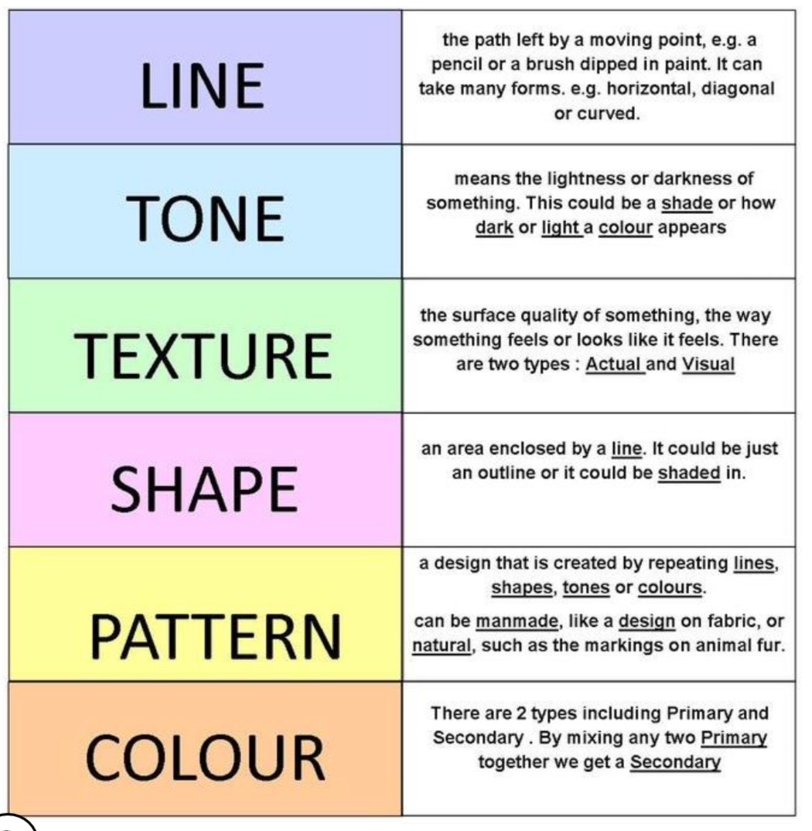
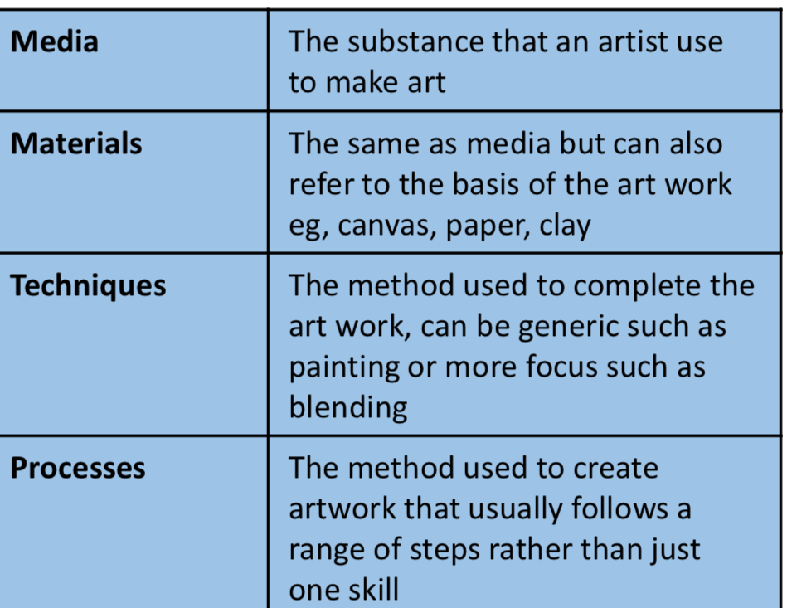
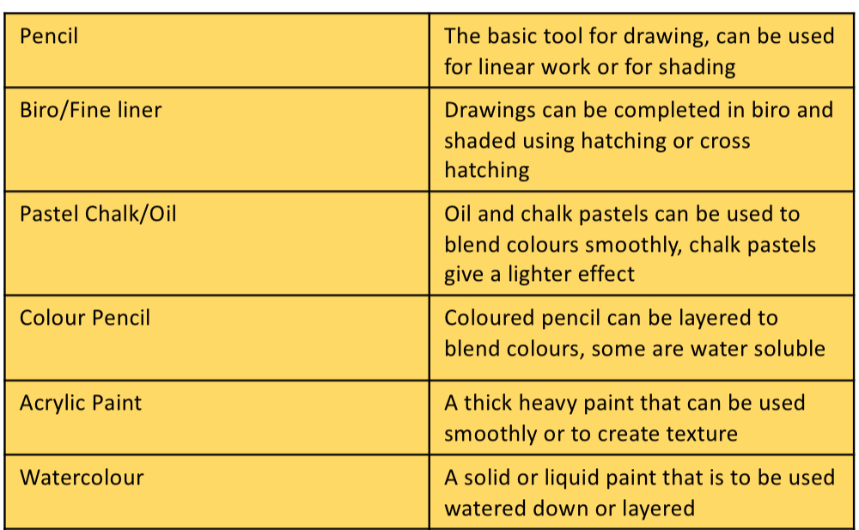
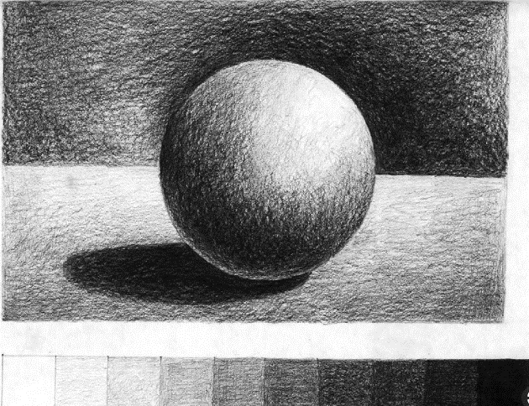
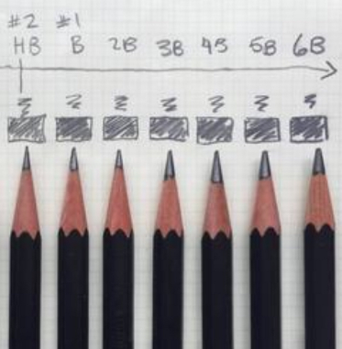
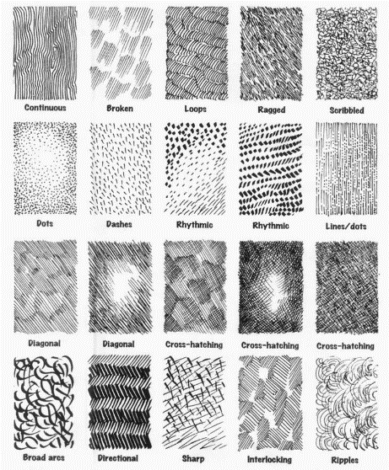
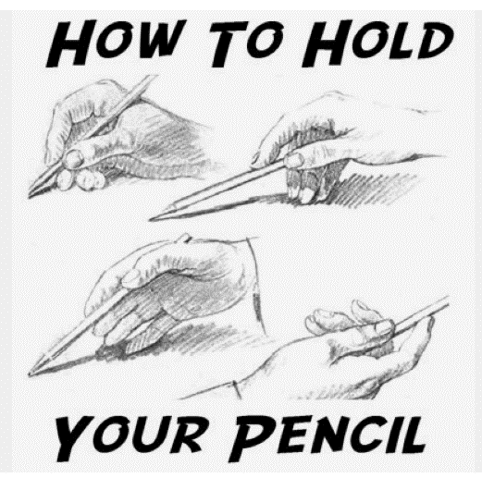

Week 1 Create Flash Cards- with your own definitions Week 4 read, cover, write the definitions of media
Week 5 Create flash cards
Week 6 Describe the illustration of Lewis Carroll’s Alice in Wonderland book cover as if the person you are talking to cannot see the image, use your art keywords to describe, line, tone, colour, shape, texture. Is it detailed, simple, realistic or abstract?
Week 7 Draw your own Alice in Wonderland book cover
Week 2 Create a series of tonal bars and draw from the 3D tonal sphere
Week 3 Create a 3x3 grid exploring mark making
Yr 8 Term 1 Alice in Wonderland painting

