Slide 1

WEST GRANTHAM UPDATE
ISSUE #6
Friday 16 January, 2025
Bagels, Brews and Bright Beginnings | Bagels, Brews and Bright Beginnings
Happy New Year from all of us at WGSA! We’re back for a brand-new term, and while the January chill has certainly made its presence felt, the energy and enthusiasm around school are keeping things bright. The start of the year is always a time for fresh goals and new opportunities, and our students have hit the ground running. Year 10 have kicked off the term with their mock exams, an important milestone that helps them prepare for next year’s GCSEs. These assessments are a chance to see what’s going well and where improvements can be made, and we’ve been impressed by the focus and resilience shown so far. Year 11 are also deep into exam season, with vocational assessments taking place in Construction, Enterprise, Sport, and Health and Social Care. These practical and written exams are a key part of their qualifications, and students have been working hard to demonstrate their knowledge and skills. To support both year groups, our popular Exam Top Tips sessions have been running each morning before mocks and exams. Students have been coming in early for a half-hour of last-minute guidance from teachers, plus a cup of tea or coffee and a bagel to start the day right, because success is always better served with breakfast! These sessions have been a great way to calm nerves, boost confidence, and make sure everyone feels prepared when | they walk into the exam hall. Beyond exams, enrichment is back in full swing, and we’re excited to introduce some brand-new options this term. Fancy threading your way into something creative? Try Cross Stitch Club, it’s sew much fun! Want to learn how to read between the lines? Body Language Club will help you decode the unspoken. If saving the planet is more your style, join Eco-Warriors Recycling and turn trash into triumph. For those who love to sing, Choir is ready to hit the high notes, and our arts and crafts sessions will let you paint, glue, and create to your heart’s content. There’s something for everyone. Whether you want to stitch up some creativity, strike the right pose, hit the high notes, or help make the planet greener, these clubs are a fantastic way to start the new year with a new skill. Existing favourites are continuing too, so there’s no shortage of opportunities to get involved and make the most of school life beyond the classroom. It’s shaping up to be a busy and exciting start to 2026, and we can’t wait to see what our students achieve in the weeks ahead. From the frosty mornings to the warm buzz of classrooms, WGSA is full of energy and ambition. Stay warm, stay focused, and let’s make this term a great one together, because January might be cold, but the future here is looking bright!
A word from...
Aaliyah, Y10
This fortnight has been all about mocks for us in Year 10, and it’s definitely been a challenge! Sitting exams in all our subjects has helped me see what I need to work on before next year, and it’s given me a taste of what the real GCSEs will feel like. They’re starting to worry me a little. One of the most interesting parts for me was the Engineering mock. Instead of a written paper, we had to complete a piece of coursework for a craft roller project. We have to think about the design process, measurements, and how to solve problems when things don’t go to plan. I enjoyed seeing how the theory we’ve learned in class connects to making something real. It’s been stressful at times, but I feel like these mocks have shown me where I’m strong and where I need to improve, and that’s what they’re for! Hopefully they continue to go well, as I think I’ve gotten off to a really good start.
WEEK A - JANUARY 19
Library Club
Football Clubs, Fitness Gym, Gardening Club, Library Club
Library Club
Basketball (Positive Futures)
Christian Union
Fitness Gym
Library Club
STEM Club
Dodgeball
Sewcial Club
Homework Club
Fitness Gym
Debate Club
Mon
Tue
Wed
Thu
Fri
WEEK B - JANUARY 26
Football Clubs, Fitness Gym, Gardening Club, Library Club
Library Club
Basketball (Positive Futures)
Christian Union
Y8 Parents’ Evening
Fitness Gym
Library Club
STEM Club
Dodgeball
Sewcial Club
Homework Club
Fitness Gym
Debate Club
Library Club
Mon
Tue
Wed
Thu
Fri

Slide 2
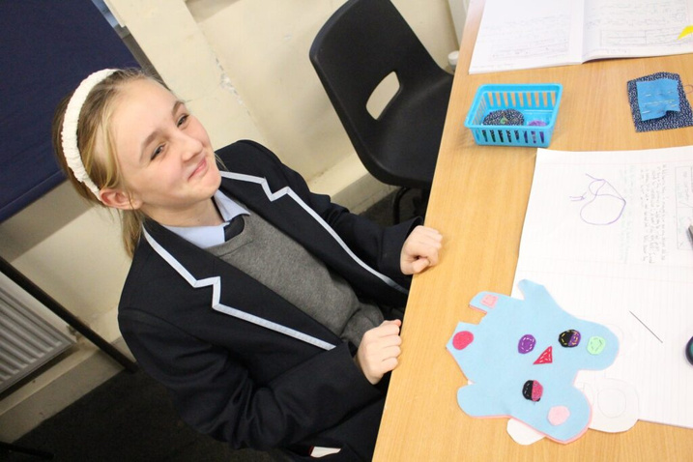
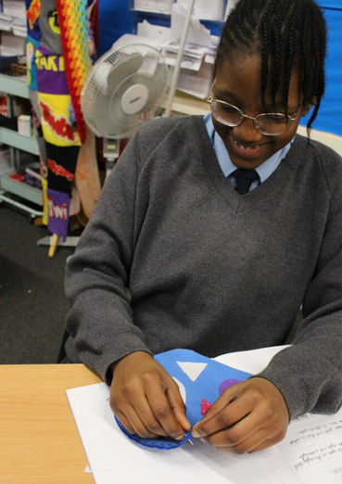
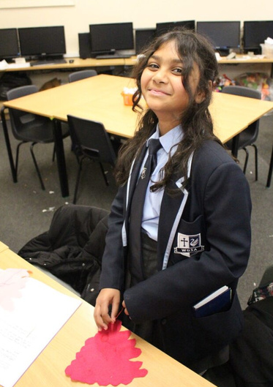
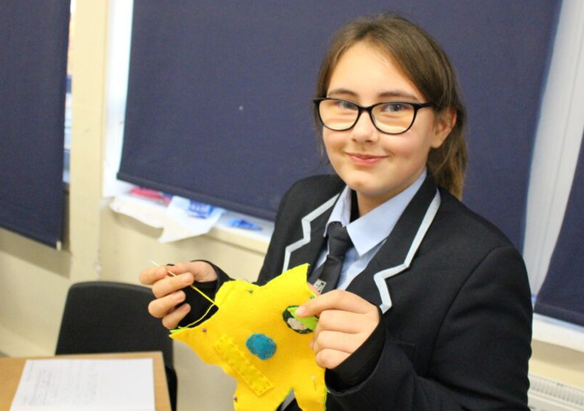
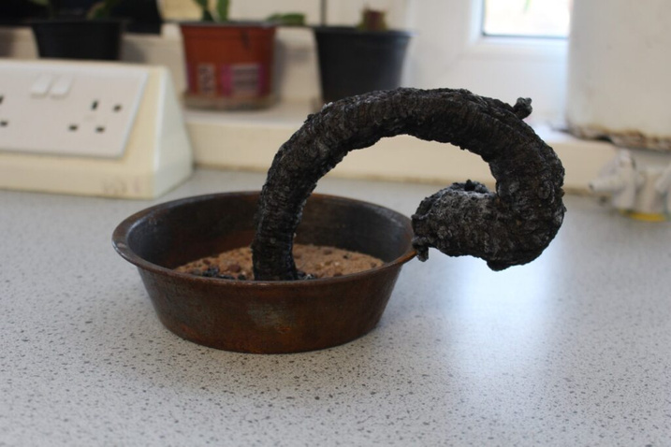
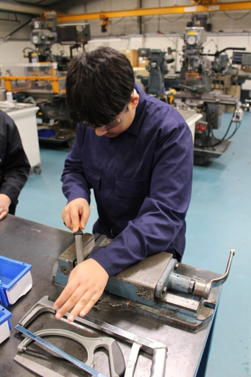
2

Slide 3
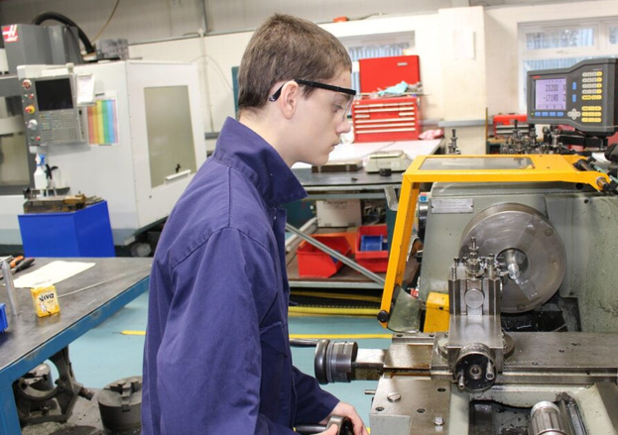
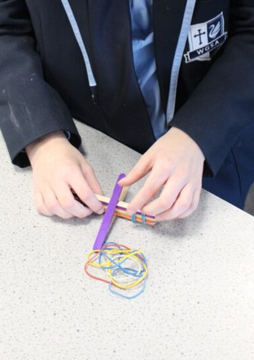
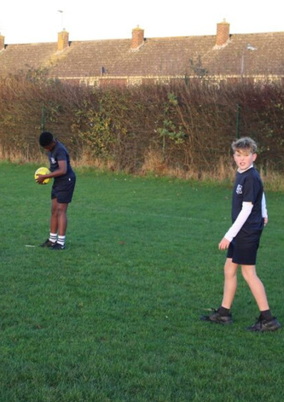
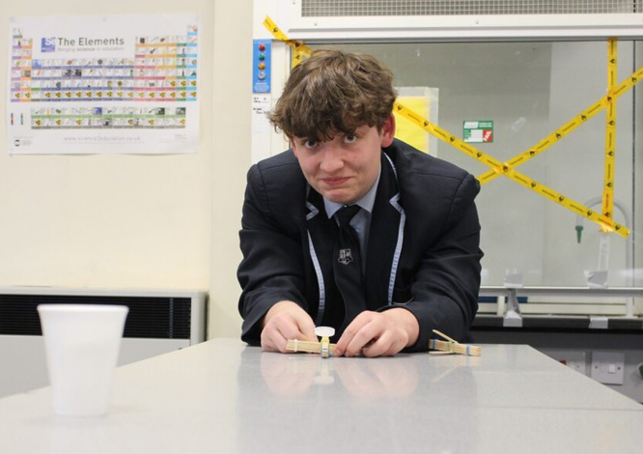
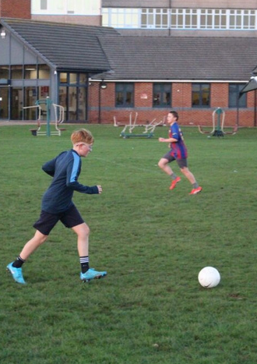
3

Slide 4


